Slide 1

The Technical perspective

Slide 2






Overview
Problem & Task
Data Overview
Business Problem: Enhancing item discovery and relevance to drive conversion and engagement.
Source: MovieLens Latest Small (ml-latest-small)
Task: Top-N Recommendation and Ranking of products for active users.
100,836
9,742
RATINGS
MOVIES
Proxy Justification:
MovieLens maps Users to Customers and Ratings to Explicit preference signals.
3,683
8
TAGS
MISSING IDS

Slide 3


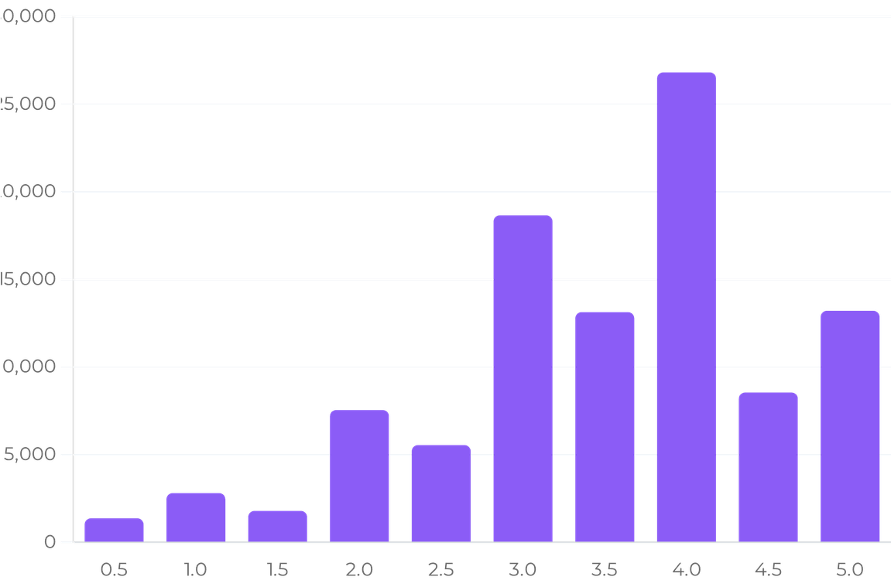


2. EDA Key Findings
Rating Distribution
Highly positive skew: most ratings cluster between 3.0 and 5.0, with 4.0 being the modal value. Indicates general user satisfaction but potential ceiling effects.
Catalog Sparsity
Extreme matrix sparsity (98%+). Most users interact with a tiny fraction of the 9,742 movies, emphasizing the need for robust collaborative filtering.
Long-Tail Behavior
RATING FREQUENCY DISTRIBUTION
Popularity-head items dominate interaction counts. The long tail contains thousands of niche items with very low visibility.

Slide 4





3. Feature Engineering Approach
User Features
Item Features
Interaction Features
Interaction counts & engagement frequency
Popularity metrics (log-scaled counts)
User-Item genre overlap scores
Deviation from user & item means
Historical mean rating & variance
Metadata: One-hot encoded genres
Collaborative preference proxies
Multi-dimensional genre affinity vectors
Item quality: Mean rating & global rank
Popularity-adjusted preference scores
Recency-weighted interaction signals
Temporal: Release year & aging
Dimensionality Reduction (PCA)
Engineered features are projected into a lower-dimensional space using PCA. This identifies latent structures, reduces redundancy, and optimizes the feature space for the reranking layer while maintaining 90%+ of explained variance.

Slide 5






4. Model Selection & Methodology
Experimental Design: Chronological Validation
To simulate a production environment and prevent temporal leakage, an 80/20 chronological split is applied per user. Models are trained on past interactions to predict future behavior, ensuring the evaluation reflects real-world predictive utility.
Popularity Baseline
Item-Item KNN
Truncated SVD
Content-Based
Hybrid Ensemble
Non-personalized global ranking. Serves as the primary sanity check and cold-start default.
Neighborhood-based CF using cosine similarity on sparse interaction vectors.
Matrix factorization capturing latent user-item preference dimensions.
TF-IDF and genre similarity mapping for metadata-driven discovery.
Weighted combination of CF and Content signals for optimal ranking.
BASELINE
COLLABORATIVE
LATENT FACTOR
METADATA
PRODUCTION CANDIDATE

Slide 6



5. Results & Model Comparison
MODEL ARCHITECTURE
PRECISION@10
RECALL@10
MAP@10
NDCG@10
COVERAGE
Hybrid Ensemble
0.085980
0.075342
0.050763
0.105408
0.4643
Item-Item KNN
0.076014
0.069900
0.045680
0.095920
0.3227
Truncated SVD
0.074155
0.071690
0.040874
0.090231
0.7808
Popularity Baseline
0.060642
0.049130
0.038090
0.078417
0.1047
Content-Based
0.010811
0.016664
0.008210
0.017321
0.4606
Decision Rule & Interpretation
The Hybrid Ensemble is selected as the production candidate, achieving the highest ranking quality (NDCG@10). While Truncated SVD offers superior catalog coverage (78%), the ensemble provides the best balance of relevance and exposure. Content-based signals are retained primarily for cold-start mitigation.

Slide 7


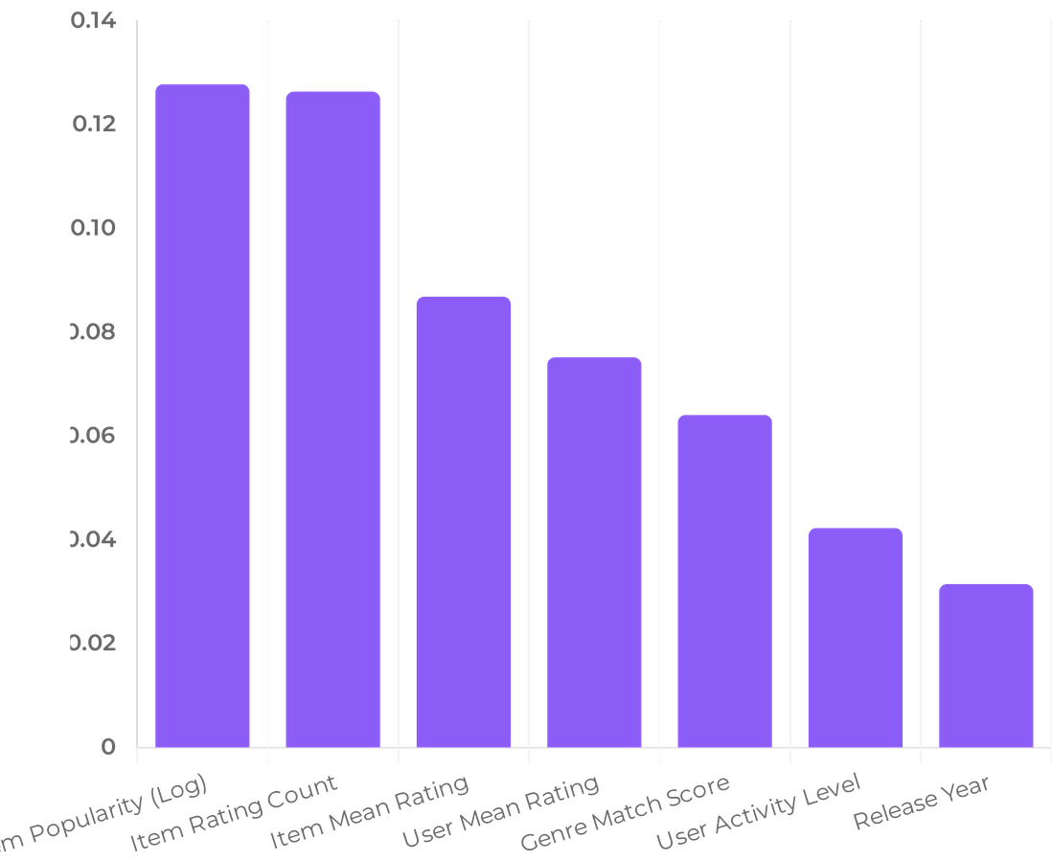


6. Feature Importance & Explainability
Top Predictors (Permutation Importance)
Neighborhood CF (KNN)
Directly explainable via item similarity: "Users who liked Movie A also liked Movie B." Uses cosine similarity in interaction space.
Latent Factors (SVD)
Captures abstract dimensions of user taste and item characteristics. Explainable through cluster analysis of latent vectors.
Hybrid Reranker
Uses Permutation Importance to quantify the contribution of engineered features, ensuring transparency in the final ensemble decision.

Slide 8










7. Limitations & Future Work
Current Limitations
Future Enhancements
Cold Start: Persistent challenge for new users and items with zero interaction history.
Session Signals: Integrate real-time intent and sequence modeling (e.g., GRU4Rec).
Proxy Gap: MovieLens lacks eCommerce signals like "add-to-cart" or price sensitivity.
Bias Mitigation: Implement popularity-aware reranking to improve long-tail exposure.
Offline Metrics: Ranking scores are proxies; true business value requires online A/B testing.
Deep Learning: Explore Neural Collaborative Filtering for non-linear interaction modeling.
TOWARDS A PRODUCTION-READY RECOMMENDATION ENGINE

