Slide 1



The Business Problem: Addressing the "Discovery Gap"
Customer Friction
Users are overwhelmed by choices but fail to find relevant products, leading to "decision fatigue" and cart abandonment.
Strategic Opportunity
Revenue Loss
Transition from a static catalog to a dynamic, personalized experience to increase Average Order Value (AOV) and Customer Lifetime Value (CLV).
Digital platforms lose significant potential revenue due to poor product discovery and low engagement.
Bottom-Line Impact
Industry estimates suggest up to 30% of revenue is lost due to inadequate personalization and discovery mechanisms.

Slide 2






Our Strategic Approach: Data-Driven Personalization
Collaborative Insights
Content Matching
Balanced Exposure
Learning from "customers like you" to predict future interests based on historical behavior patterns.
Surfacing products based on unique attributes, ensuring new and niche items are discovered.
Optimizing the mix of popular best-sellers and "hidden gems" to maximize total catalog discovery.
Strategy: We deploy a "Hybrid Intelligence" engine that bridges customer behavior with product DNA for a superior shopping experience.

Slide 3



Key Findings: Understanding Customer Behavior
40%
Powerful Feedback Loops
40% of users provide high-quality explicit feedback, which serves as a critical predictor for future purchasing behavior and preference mapping.
ENGAGEMENT
97%
The Popularity Bias Risk
97% of organic discovery is currently concentrated on just the top 10% of products, leaving a massive volume of "dead stock" in the long-tail catalog.
CONCENTRATION
2x
Personalization Multiplier
High-activity users are twice as likely to convert when presented with personalized rankings compared to static "Top Sellers" or generic lists.
CONVERSION

Slide 4

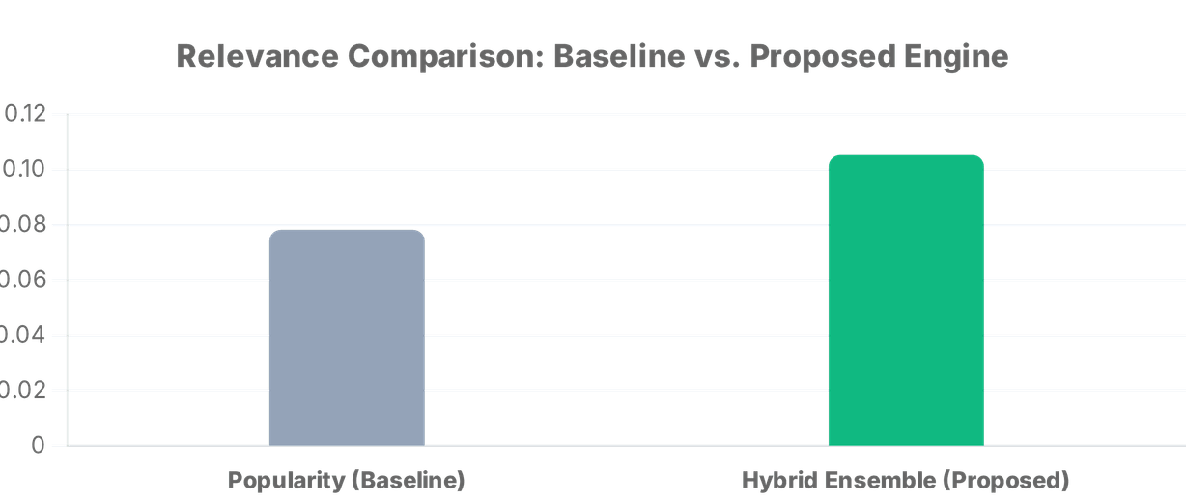
Results: Translating Accuracy to Business Value
+41%
46%
High
RELEVANCE LIFT
CATALOG DISCOVERY
CONVERSION POTENTIAL
The Value of Hybrid Intelligence
Our Hybrid Ensemble significantly outperforms standard "Top Seller" lists by balancing individual customer preferences with broader market trends, ensuring a 41% improvement in recommendation quality.

Slide 5


Strategic Recommendations: Implementation Roadmap
PHASE 1
PHASE 2
PHASE 3
Hybrid Rollout
Long-Tail Promotion
Real-Time Adaptation
Deploy the Hybrid Ensemble as the primary engine for logged-in users to maximize immediate relevance and engagement.
Implement popularity-aware reranking to actively surface high-margin niche products and reduce catalog concentration.
Integrate session-based signals to react to "in-the-moment" customer intent and browsing behavior.
Success Monitoring: Key Performance Indicators
Recommendation Click-Through Rate (CTR)
Add-to-Cart from Recommendations

Slide 6







Risks & Strategic Considerations
The Cold-Start Challenge
Data Quality & Feedback
New users with no history require "Popularity-Based" or "Trending" fallbacks until enough data is collected to personalize their experience.
Continuous monitoring of user feedback loops is essential to prevent "filter bubbles" and ensure the system adapts to changing preferences.
Strategy: Implement robust fallback logic
Strategy: Active feedback loop monitoring
Infrastructure Scaling
Privacy & Ethics
Real-time personalization requires scalable cloud architecture to maintain low latency and high availability during peak traffic periods.
Ensure all recommendation logic complies with data protection regulations (GDPR/CCPA) and maintains transparency with customers.
Strategy: Cloud-native scalable architecture
Strategy: Privacy-by-design implementation
PROACTIVE RISK MANAGEMENT ENSURES LONG-TERM SYSTEM RELIABILITY

Slide 7

Next Steps & ROI Projection
1
Immediate A/B Pilot
Launch a 4-week controlled test comparing the Hybrid Engine against the current baseline to validate performance.
PROJECTED BUSINESS VALUE
+5-10%
2
Full Production Rollout
Conversion Rate Uplift
Following pilot success, deploy the engine across all high-traffic categories to capture immediate revenue uplift.
+15%
Cross-Sell Revenue Increase
3
Omnichannel Scaling
Expand personalization to email marketing and push notifications to drive repeat-session likelihood.
THE BOTTOM LINE: Core revenue driver for modern eCommerce.

