Slide 1

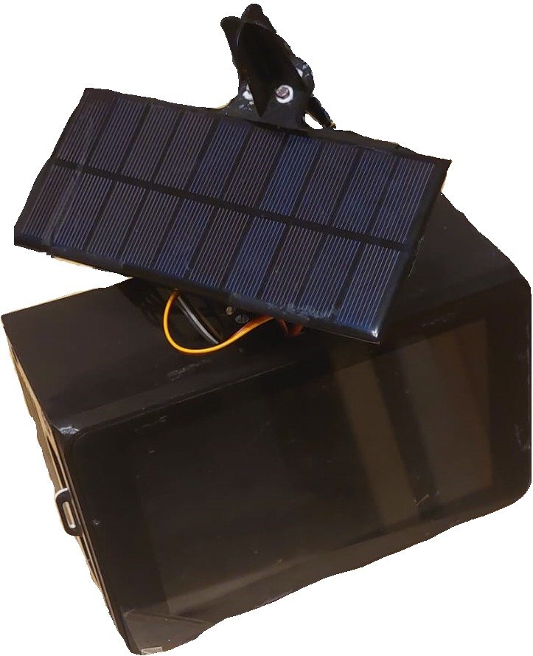
SunTracker System
Universitatea Politehnica Timisoara​
Calculatoare si Tehnologia Informatiei, 2023​
Baciu Bogdan​
SunTracker System
Optimized Energy Harnessing Through Sun Movement Tracking
Candidate: Baciu Bogdan
Coordinator: Prof. dr. ing. habil. Mihai V. Micea

Slide 2
Summary
1. Introduction​
2. Solar Energy Collection Systems​
3. SunTracker: General Description​
4. Data Acquisition Process ​
5. Data Presenting Process​
6. System Performance​
7. Conclusion

Slide 3
1. Introduction​
Areas of Development
Computer Engineering
Packaging
Motivation
Development Context
Project proposed by DSPLabs
Acknowledgements
Mihai V. Micea
Răzvan Cioargă
Stângaciu Valentin

Slide 4
2. Solar Energy Collection Systems
Technologies used during development
Linux
C++
Flask Web Framework
JavaScript
HTML & CSS
jQuery & AJAX
Python
Main application
Secondary application

Slide 5
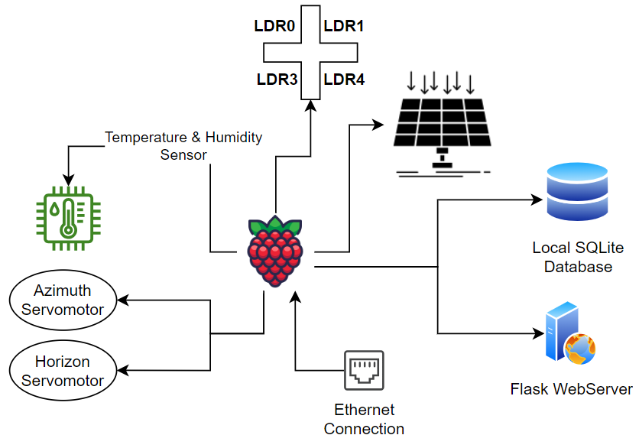
3. SunTracker: General Description
Primary
Interacting with environment
Secondary
Displaying the gathered information

Slide 6
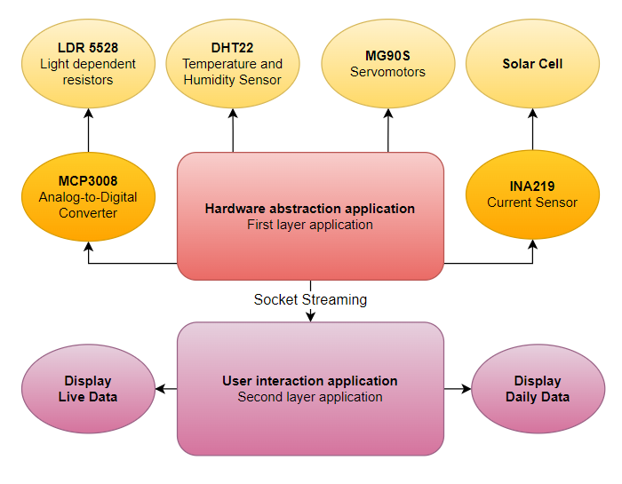
3. SunTracker: General Description
Hardware
Hardware abstraction
Dedicated application
Connection medium
Web application

Slide 7
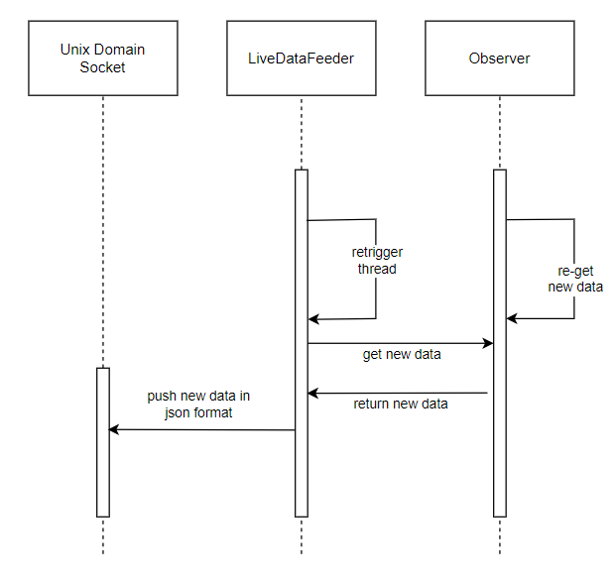
4. Data Acquisition Process
What is an Observer?
How does LiveDataFeeder work?

Slide 8
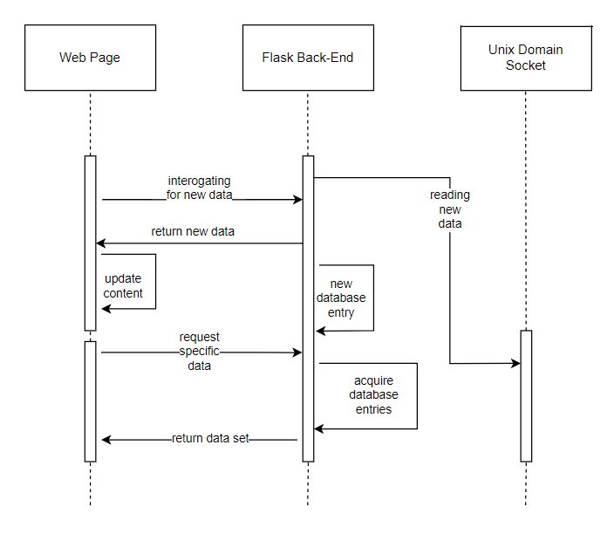
5. Data Presenting Process
What happens in the Back-End?
How does data arrive in the web page?

Slide 9

6. System Performance
Maturity
Demo Project
Limitations
Servomotors are sudden and fast
Data update rate: 1 sample / second
Current sensor calibration
User Interface
Has dependencies

Slide 10

7. Conclusions
Possible Improvements
Enable DC motor handling
Sensor calibration
Project Upgrades
Larger solar panel
Add tracking methods
Improve scalability
Personal Assessment

Slide 11
Synthesis of Contributions
Hardware platform development
Design
Implementation
Software platform development
Design
Architecture
Implementation
Package development
Design
Assembly
Soldering
Thank you!

