Slide 1
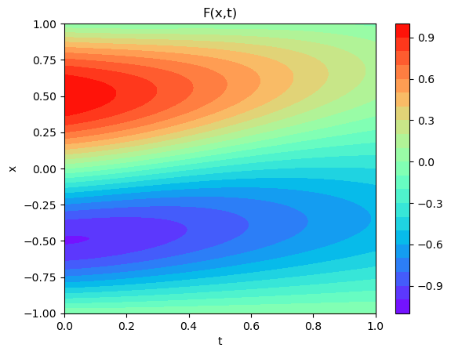


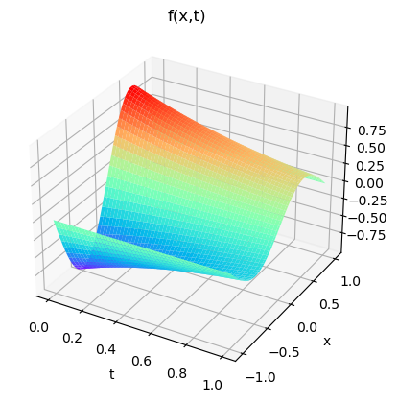
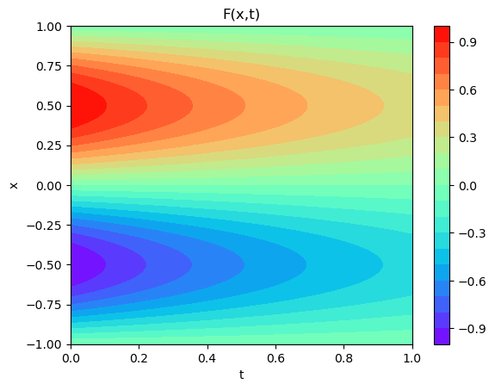
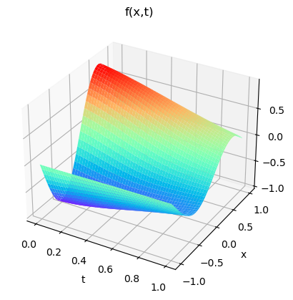
Diffusion Equation :
Initial:
Boundary: u(1,t) = u(0.5,t)=u(0,t)=u(-0.5,t)= 0
L = 1, n =2, alpha = 0.1

Slide 2

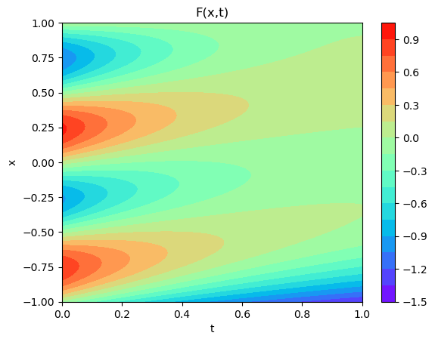

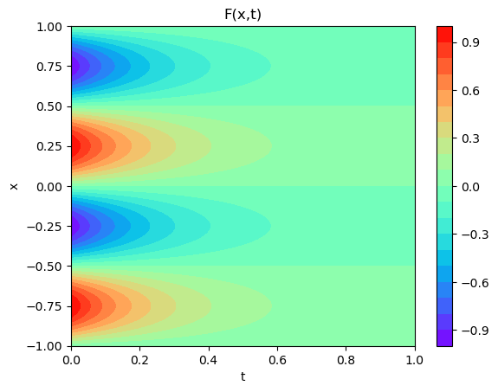
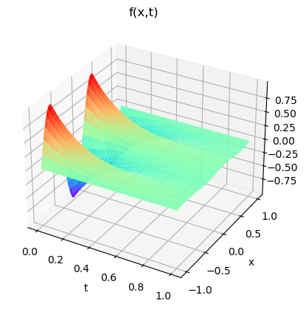
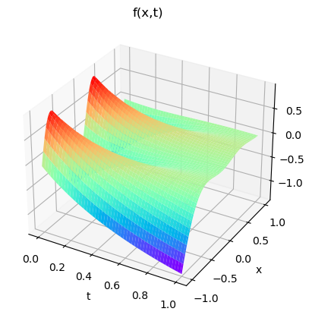
Heat’s Equation :
Initial:
Boundary: u(1,t) = u(0.5,t)=u(0,t)=u(-0.5,t)= 0
L = 1, n =2, alpha = 0.1

Slide 3

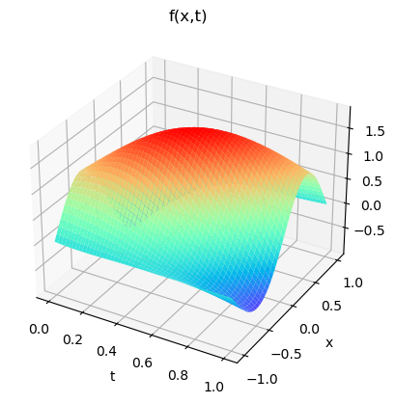
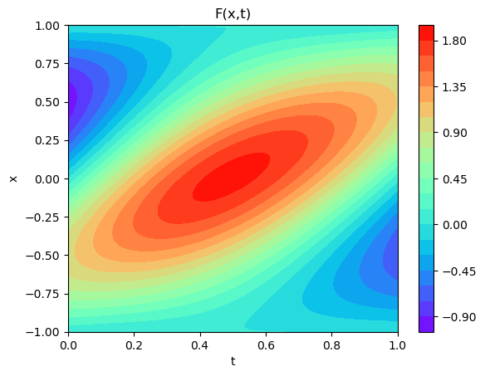
Burger’s Equation :
Initial: -sin(ⲡx)
v = 10

Slide 4
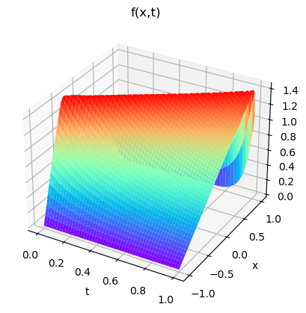
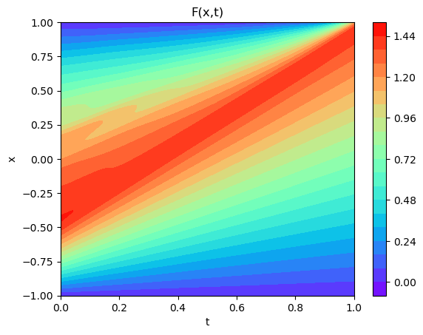
Burger’s Equation :
Initial: 2cos((ⲡ/2)x)
v = 1*1e-5

Slide 5
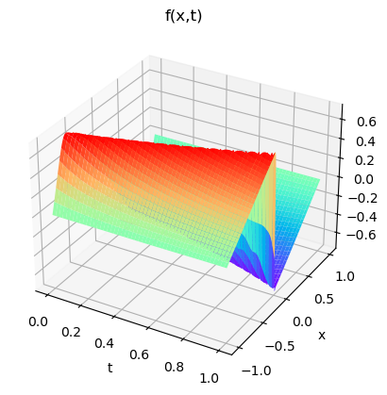
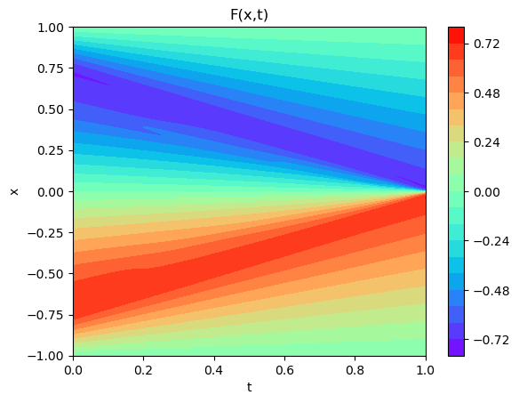
Burger’s Equation :
Initial: -sin(ⲡx)
v = 0

Slide 6
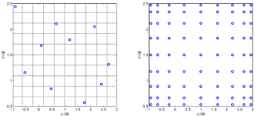
What I know I did.
Latin Hypercube sampling
Sensitivity to learning rate.
No as sensitive to structure.

