Slide 1
Advanced React

Slide 2
Hooks

Slide 3
React Hooks
Hooks are the new feature introduced in the React 16.8 version.
It allows you to use state and other React features without writing a class.
Hooks are the functions which "hook into" React state and lifecycle features from function components.
It does not work inside classes.
When to use a Hooks
If you write a function component, and then you want to add some state to it, previously you do this by converting it to a class.
But, now you can do it by using a Hook inside the existing function component.

Slide 4
With Hooks, you can extract stateful logic from a component so it can be tested independently and reused.
Hooks allow you to reuse stateful logic without changing your component hierarchy.
This makes it easy to share Hooks among many components or with the community.
Hooks let you split one component into smaller functions based on what pieces are related.
Hooks let you use more of React’s features without classes.

Slide 5
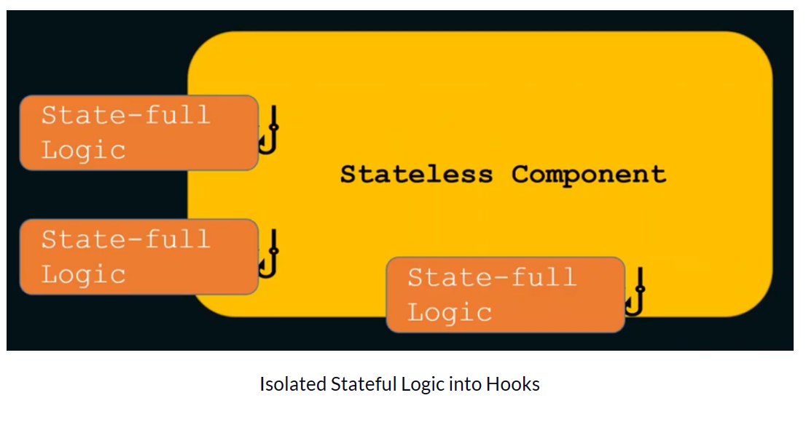
With React Hooks, we can isolate stateful logic and side-effects from a functional component. Hooks are JavaScript functions that manage the state's behaviour and side effects by isolating them from a component.

Slide 6
React provides a bunch of standard in-built hooks:
useState: To manage states. Returns a stateful value and an updater function to update it.
useEffect: To manage side-effects like API calls, subscriptions, timers, mutations, and more.
useContext: To return the current value for a context.
useReducer: A useState alternative to help with complex state management.
useCallback: It returns a memorized version of a callback to help a child component not re-render unnecessarily.
useMemo: It returns a memoized value that helps in performance optimizations.
useRef: It returns a ref object with a .current property. The ref object is mutable. It is mainly used to access a child component imperatively.
useLayoutEffect: It fires at the end of all DOM mutations. It's best to use useEffect as much as possible over this one as the useLayoutEffect fires synchronously.
useDebugValue: Helps to display a label in React DevTools for custom hooks.

Slide 7
Five Important Rules for Hooks
Never call Hooks from inside a loop, condition or nested function
Hooks should sit at the top-level of your component
Only call Hooks from React functional components
Never call a Hook from a regular function
Hooks can call other Hooks

Slide 8
import React, { useState } from 'react';
function Example() {
// Declare a new state variable, which we'll call "count"
const [count, setCount] = useState(0);
return (
<div>
<p>You clicked {count} times</p>
<button onClick={() => setCount(count + 1)}>
Click me
</button>
</div>
);
}
This new function useState is the first “Hook”
const [count, setCount] = useState(0) defines the component state. count is the state variable containing the current state value, while setCount() is the state updater function.

Slide 9
import React, { useState } from 'react';
function CountApp() {
// Declare a new state variable, which we'll call "count"
const [count, setCount] = useState(0);
return (
<div>
<p>You clicked {count} times</p>
<button onClick={() => setCount(count + 1)}>
Click me
</button>
</div>
);
}
export default CountApp;

Slide 10
class Example extends React.Component {
constructor(props) {
super(props);
this.state = {
count: 0
};
}
render() {
return (
<div>
<p>You clicked {this.state.count} times</p>
<button onClick={() => this.setState({ count: this.state.count + 1 })}>
Click me
</button>
</div>
);
}
}

Slide 11
useState accepts an initial state and returns two values:
The current state.
A function that updates the state.
The useState Hook can be used to keep track of strings, numbers, booleans, arrays, objects, and any combination of these!
Hooks in react:
React useEffect
React useRef Hook etc
React useCallback

Slide 12
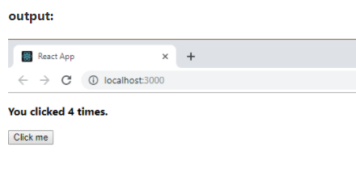
In the above example, useState is the Hook which needs to call inside a function component to add some local state to it.
The useState returns a pair where the first element is the current state value/initial value, and the second one is a function which allows us to update it.
After that, we will call this function from an event handler or somewhere else.
The useState is similar to this.setState in class.

Slide 13
import { useState } from "react";
import ReactDOM from "react-dom/client";
function FavoriteColor() {
const [color, setColor] = useState("red");
return <h1>My favorite color is {color}!</h1>
}
const root = ReactDOM.createRoot(document.getElementById('root'));
root.render(<FavoriteColor />);

Slide 14
The useEffect Hook allows you to perform side effects in your components.
Some examples of side effects are: fetching data, directly updating the DOM, and timers.
useEffect accepts two arguments. The second argument is optional.
useEffect(<function>, <dependency>)

Slide 15
import { useState, useEffect } from "react";
import ReactDOM from "react-dom/client";
function Timer() {
const [count, setCount] = useState(0);
useEffect(() => {
setTimeout(() => {
setCount((count) => count + 1);
}, 1000);
});
return <h1>I've rendered {count} times!</h1>;
}
const root = ReactDOM.createRoot(document.getElementById('root'));
root.render(<Timer />);

Slide 16
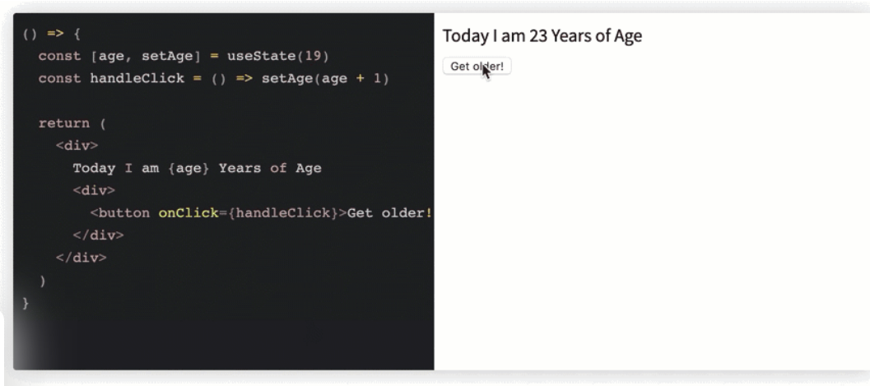

Slide 17
import React, { useState, useEffect } from 'react';
function Example() {
const [count, setCount] = useState(0);
// Similar to componentDidMount and componentDidUpdate:
useEffect(() => {
// Update the document title using the browser API
document.title = `You clicked ${count} times`;
});
return (
<div>
<p>You clicked {count} times</p>
<button onClick={() => setCount(count + 1)}>
Click me
</button>
</div>
);
}

Slide 18
const CounterFnSetState = () => {
const [count, setCount] = useState(0);
return (
<>
<p>Count value is: {count}</p>
<button onClick={() => setCount(0)}>Reset</button>
<button
onClick={() => setCount(prevCount => prevCount + 1)}>
Plus (+)
</button>
<button
onClick={() => setCount(prevCount => prevCount - 1)}>
Minus (-)
</button>
</>
);
}

Slide 19
import React, { useState, useEffect } from 'react';
function Example() {
const [count, setCount] = useState(0);
useEffect(() => {
document.title = `You clicked ${count} times`;
});
return (
<div>
<p>You clicked {count} times</p>
<button onClick={() => setCount(count + 1)}>
Click me
</button>
</div>
);
}

Slide 20
What does useEffect do? By using this Hook, you tell React that your component needs to do something after render.
React will remember the function you passed (we’ll refer to it as our “effect”), and call it later after performing the DOM updates. I
n this effect, we set the document title, but we could also perform data fetching or call some other imperative API.
function Example() {
const [count, setCount] = useState(0);
useEffect(() => {
document.title = `You clicked ${count} times`;
});
}

Slide 21
What are React refs and DOM?
React provides a feature known as refs that allow for DOM access from components.
You simply attach a ref to an element in your application to provide access to the element’s DOM from anywhere within your component.
Refs can also be used to provide direct access to React elements and not just DOM nodes.
Refs provide a way to access DOM nodes or React elements created in the render method.
Generally, the use of refs should be considered only when the required interaction cannot be achieved using the mechanisms of state and props.

Slide 22
Refs are a function provided by React to access the DOM element and the React element that you might have created on your own.
They are used in cases where we want to change the value of a child component, without making use of props and all.
They also provide us with good functionality as we can use callbacks with them.

Slide 23
class App extends React.Component {
constructor(){
super();
this.state = { sayings: ""};
}
update(e){
this.setState({ sayings: e.target.value});
}
render(){
return (
<div>
Mukul Says <input type="text" onChange = {this.update.bind(this)}/>
<br/>
<em>{this.state.sayings}</em>
</div>
);
}
}
ReactDOM.render(< App />, document.getElementById('root'));

Slide 24
React Refs
Refs is the shorthand used for references in React.
It is similar to keys in React.
It is an attribute which makes it possible to store a reference to particular DOM nodes or React elements.
It provides a way to access React DOM nodes or React elements and how to interact with it.
It is used when we want to change the value of a child component, without making the use of props.

Slide 25
When to Use Refs
Refs can be used in the following cases:
When we need DOM measurements such as managing focus, text selection, or media playback.
It is used in triggering imperative animations.
When integrating with third-party DOM libraries.
It can also use as in callbacks.

Slide 26
When to not use Refs
Its use should be avoided for anything that can be done declaratively.
For example, instead of using open() and close() methods on a Dialog component, you need to pass an is Open prop to it.
You should have to avoid overuse of the Refs.

Slide 27
How to create Refs
In React, Refs can be created by using React.createRef().
It can be assigned to React elements via the ref attribute.
It is commonly assigned to an instance property when a component is created, and then can be referenced throughout the component.
class MyComponent extends React.Component {
constructor(props) {
super(props);
this.callRef = React.createRef();
}
render() {
return <div ref={this.callRef} />;
}
}

Slide 28
Creating Refs
Refs are created using React.createRef() and attached to React elements via the ref attribute. Refs are commonly assigned to an instance property when a component is constructed so they can be referenced throughout the component.
class MyComponent extends React.Component {
constructor(props) {
super(props);
this.myRef = React.createRef();
}
render() {
return <div ref={this.myRef} />;
}
}

Slide 29
Accessing Refs
When a ref is passed to an element in render, a reference to the node becomes accessible at the current attribute of the ref.
const node = this.myRef.current;
The value of the ref differs depending on the type of the node:
When the ref attribute is used on an HTML element, the ref created in the constructor with React.createRef() receives the underlying DOM element as its current property.
When the ref attribute is used on a custom class component, the ref object receives the mounted instance of the component as its current.
You may not use the ref attribute on function components because they don’t have instances.

Slide 30
Adding a Ref to a DOM Element
This code uses a ref to store a reference to a DOM node:
class CustomTextInput extends React.Component {
constructor(props) {
super(props);
// create a ref to store the textInput DOM element
this.textInput = React.createRef();
this.focusTextInput = this.focusTextInput.bind(this);
}

Slide 31
focusTextInput() {
// Explicitly focus the text input using the raw DOM API
// Note: we're accessing "current" to get the DOM node
this.textInput.current.focus();
}
render() {
// tell React that we want to associate the <input> ref
// with the `textInput` that we created in the constructor
< return (div>
<input
type="text"
ref={this.textInput} />
<input
type="button"
value="Focus the text input"
onClick={this.focusTextInput}
/></div>);}}

Slide 32
Adding a Ref to a Class Component
If we wanted to wrap the CustomTextInput above to simulate it being clicked immediately after mounting, we could use a ref to get access to the custom input and call its focusTextInput method manually:
class AutoFocusTextInput extends React.Component {
constructor(props) {
super(props);
this.textInput = React.createRef();
}

Slide 33
componentDidMount() {
this.textInput.current.focusTextInput();
}
render() {
return (
<CustomTextInput ref={this.textInput} />
);
}}

Slide 34
Note that this only works if CustomTextInput is declared as a class:
class CustomTextInput extends React.Component {
// ...
}

Slide 35
Refs and Function Components
By default, you may not use the ref attribute on function components because they don’t have instances:
function MyFunctionComponent() {
return <input />;
}
class Parent extends React.Component {
constructor(props) {
super(props);
this.textInput = React.createRef();
}
render() {
// This will *not* work!
return (
<MyFunctionComponent ref={this.textInput} />
);
}
}

Slide 36
If you want to allow people to take a ref to your function component, you can use forwardRef (possibly in conjunction with useImperativeHandle), or you can convert the component to a class.
You can, however, use the ref attribute inside a function component as long as you refer to a DOM element or a class component:

Slide 37
function CustomTextInput(props) {
// textInput must be declared here so the ref can refer to it
const textInput = useRef(null);
function handleClick() {
textInput.current.focus();
}
return (
<div>
<input
type="text"
ref={textInput} />
<input
type="button"
value="Focus the text input"
onClick={handleClick}
/>
</div>
);
}

Slide 38
Exposing DOM Refs to Parent Components
In rare cases, you might want to have access to a child’s DOM node from a parent component.
This is generally not recommended because it breaks component encapsulation, but it can occasionally be useful for triggering focus or measuring the size or position of a child DOM node.
While you could add a ref to the child component, this is not an ideal solution, as you would only get a component instance rather than a DOM node.
Additionally, this wouldn’t work with function components.

Slide 39
Callback Refs
React also supports another way to set refs called “callback refs”, which gives more fine-grain control over when refs are set and unset.
Instead of passing a ref attribute created by createRef(), you pass a function.
The function receives the React component instance or HTML DOM element as its argument, which can be stored and accessed elsewhere.
The example below implements a common pattern: using the ref callback to store a reference to a DOM node in an instance property.
class CustomTextInput extends React.Component {
constructor(props) {
super(props);

Slide 40
class CustomTextInput extends React.Component {
constructor(props) {
super(props);
this.textInput = null;
this.setTextInputRef = element => {
this.textInput = element;
};
this.focusTextInput = () => {
// Focus the text input using the raw DOM API
if (this.textInput) this.textInput.focus();
};
}

Slide 41
MVC
MVC stands for Model View Controller.
It is an architectural pattern used for developing the user interface.
It divides the application into three different logical components: the Model, the View, and the Controller.
It is first introduced in 1976 in the Smalltalk programming language.
In MVC, each component is built to handle specific development aspect of an application.
It is one of the most used web development frameworks to create scalable projects.
The Model-View-Controller (MVC) framework is an architectural/design pattern that separates an application into three main logical components Model, View, and Controller.
Each architectural component is built to handle specific development aspects of an application.
It isolates the business logic and presentation layer from each other.
It was traditionally used for desktop graphical user interfaces (GUIs).

Slide 42
Features of MVC :
It provides a clear separation of business logic, Ul logic, and input logic.
It offers full control over your HTML and URLs which makes it easy to design web application architecture.
It is a powerful URL-mapping component using which we can build applications that have comprehensible and searchable URLs.

Slide 43
Model-View-Controller architecture
It constitutes three interconnected components. These components are:
Model
View
Controller

Slide 44
1. Model
The model is the layer that keeps data for the application. The layer is responsible for storing and retrieving data from the database, and it is also responsible for validating the data.
For example, if you want to create a new user, you will have to create a new user model and save it to the database.
2. View
It is the layer used to present the application. It is used to display the data to the end-user.
For instance, if you want to create a user view, you will have to create UI components that the user interacts with, such as a login form in an easy-to-understand format.
3. Controller
The controller is the logic layer of the application. It is responsible for processing the user’s request and generating the response. It links the view and the model.
For example, the controller will be responsible for validating the user’s input, and then it will pass the user’s input to the model to save the user.

Slide 45
How MVC architecture works:
The controller receives the request for the application and passes it to the model to send and receive data.
The view then uses the data from the controller to generate presentable information to the end-user.
The view is only concerned with how the information is presented, not with the end presentation.
Thus, it is the Html file that renders the information from the controller.
The view then sends its final presentation to the controller, and the controller then sends the response to the browser, which then displays the response to the end-user.

Slide 46
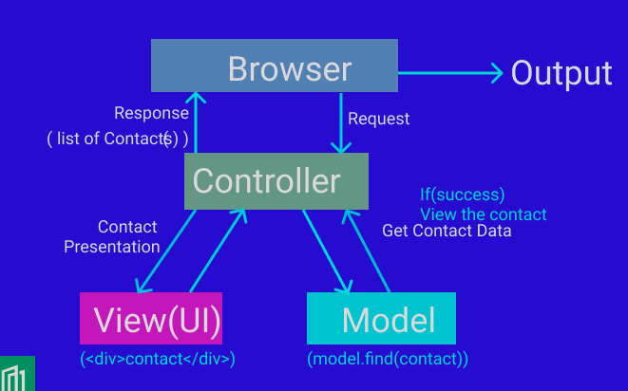

Slide 47
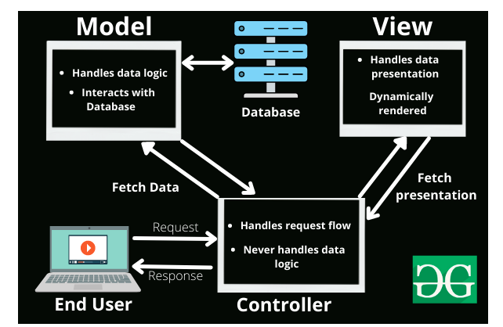
The MVC framework includes the following 3 components:
Controller
Model
View

Slide 48
View:
The View component is used for all the UI logic of the application.
It generates a user interface for the user.
Views are created by the data which is collected by the model component but these data aren’t taken directly but through the controller.
It only interacts with the compiler.
Model:
The Model component corresponds to all the data-related logic that the user works with.
This can represent either the data that is being transferred between the View and Controller components or any other business logic-related data.
It can add or retrieve data from the database.
It responds to the controller’s request because the controller can’t interact with the database by itself.
The model interacts with the database and gives the required data back to the controller.

Slide 49
Controller:
The controller is the component that enables the interconnection between the views and the model so it acts as an intermediary.
The controller doesn’t have to worry about handling data logic, it just tells the model what to do.
It process all the business logic and incoming requests, manipulate data using the Model component and interact with the View to render the final output.

Slide 50
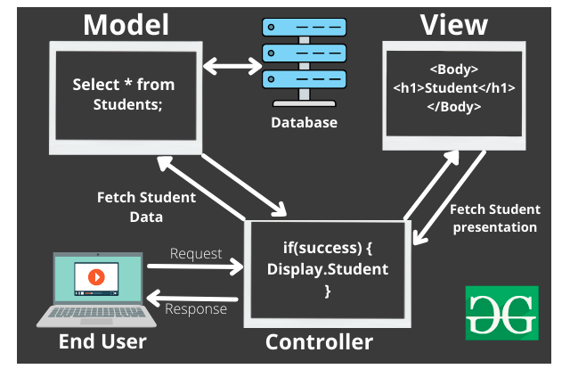

Slide 51
Advantages of MVC:
Ease of Debugging: Since the application is divided into components, it is easier to debug one component without interfering with the other components.
Ease of Use: The user can focus on the task at hand and not think about how to use the application.
Ease of Extensibility: Since the application is divided into components, it is easier to add new components without interfering with the other components.
Codes are easy to maintain and they can be extended easily.
The MVC model component can be tested separately.
The components of MVC can be developed simultaneously.
It reduces complexity by dividing an application into three units. Model, view, and controller.
This architecture helps to test components independently as all classes and objects are independent of each other

Slide 52
Popular MVC Frameworks:
Some of the most popular and extensively used MVC frameworks are listed below.
Ruby on Rails
Django
CherryPy
Spring MVC
Catalyst
Rails
Zend Framework

Slide 53
Flux
Flux is the application architecture that Facebook uses for building client-side web applications.
It is an alternative to MVC architecture and other software design patterns for managing how data flows in the react application.
It is the backbone of all React application.
It is not a library nor a framework.
It complements React as view and follows the concept of Unidirectional Data Flow model.
Flux is the application architecture that Facebook uses for building client-side web applications.
It complements React's composable view components by utilizing a unidirectional data flow.

Slide 54
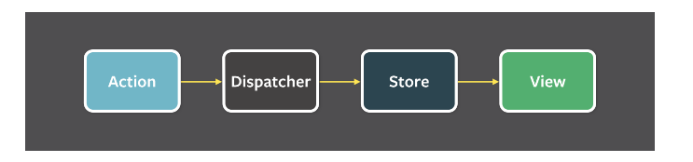
Flux applications have three major parts: the dispatcher, the stores, and the views (React components).
Structure and Data Flow​
Data in a Flux application flows in a single direction:

Slide 55
A unidirectional data flow is central to the Flux pattern.
The dispatcher, stores and views are independent nodes with distinct inputs and outputs.
The actions are simple objects containing the new data and an identifying type property.

Slide 56
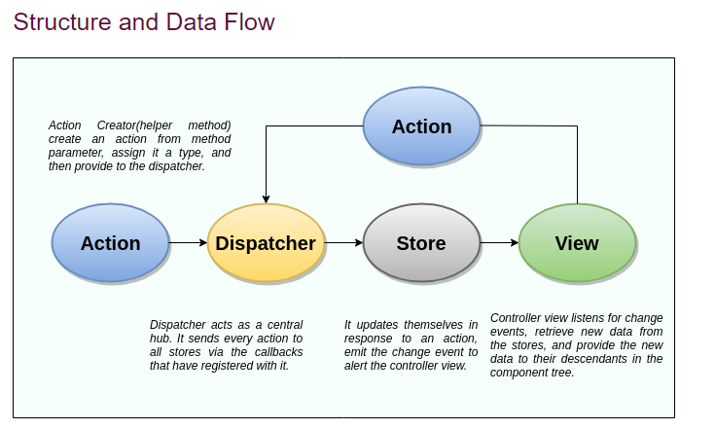
Flux applications have three major roles in dealing with data:
Dispatcher
Stores
Views (React components)

Slide 57
In Flux application, data flows in a single direction(unidirectional).
This data flow is central to the flux pattern.
The dispatcher, stores, and views are independent nodes with inputs and outputs.
The actions are simple objects that contain new data and type property.
Now, let us look at the various components of flux architecture one by one.

Slide 58
Dispatcher
It is a central hub for the React Flux application and manages all data flow of your Flux application.
It is a registry of callbacks into the stores.
It has no real intelligence of its own, and simply acts as a mechanism for distributing the actions to the stores.
All stores register itself and provide a callback.
It is a place which handled all events that modify the store.
When an action creator provides a new action to the dispatcher, all stores receive that action via the callbacks in the registry.

Slide 59
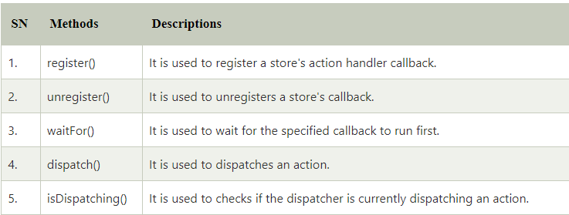
The dispatcher's API has five methods. These are:

Slide 60
Stores
It primarily contains the application state and logic.
It is similar to the model in a traditional MVC.
It is used for maintaining a particular state within the application, updates themselves in response to an action, and emit the change event to alert the controller view.
Views
It is also called as controller-views.
It is located at the top of the chain to store the logic to generate actions and receive new data from the store.
It is a React component listen to change events and receives the data from the stores and re-render the application.

Slide 61
Actions
The dispatcher method allows us to trigger a dispatch to the store and include a payload of data, which we call an action.
It is an action creator or helper methods that pass the data to the dispatcher.

Slide 62
Advantage of Flux
It is a unidirectional data flow model which is easy to understand.
It is open source and more of a design pattern than a formal framework like MVC architecture.
The flux application is easier to maintain.
The flux application parts are decoupled.

Slide 63
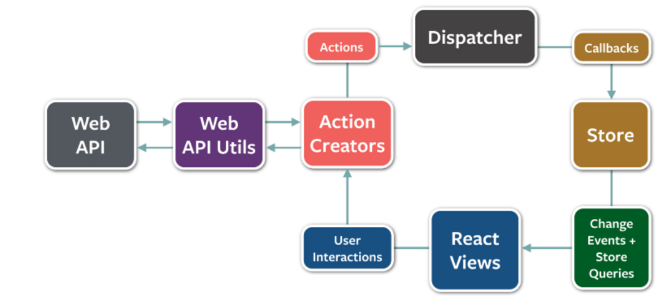

Slide 64
