Slide 1
What is Software?
The product that software professionals build and then support over the long term.
Software encompasses: (1) instructions (computer programs) that when executed provide desired features, function, and performance; (2) data structures that enable the programs to adequately store and manipulate information and (3) documentation that describes the operation and use of the programs.
‹#›
Notes:
‹#›

Slide 2
Software products
Generic products
Stand-alone systems that are marketed and sold to any customer who wishes to buy them.
Examples – PC software such as editing, graphics programs, project management tools; CAD software; software for specific markets such as appointments systems for dentists.
Customized products
Software that is commissioned by a specific customer to meet their own needs.
Examples – embedded control systems, air traffic control software, traffic monitoring systems.
‹#›

Slide 3
Challenges in large project
Effort intensive
High cost
Changing requirement
Long development time
High Risk of failure, user acceptance, performance maintainability
‹#›

Slide 4
Reason for failure of software
No planning for development
Deliverable to user not identified
Poor understanding of user requirements
No control or review
Technical incompetence of developer
Poor understanding of cost and efforts by both developer and user
‹#›

Slide 5
Engineering approach
Attempt and estimate cost/efforts
Plan and schedule work
Involve user in defining requirement
Identify stages in development
Define clear milestone so that progress can be measured
Schedule review for control and quality
Identify deliverable
Plan for testing
‹#›

Slide 6
Job of software developer
Dealing with users
Dealing technical people
Dealing with management
‹#›

Slide 7
Software costs
Software costs often dominate computer system costs. The costs of software on a PC are often greater than the hardware cost.
Software costs more to maintain than it does to develop. For systems with a long life, maintenance costs may be several times development costs.
Software engineering is concerned with cost-effective software development.
‹#›

Slide 8
Features of Software?
Its characteristics that make it different from other things human being build.
Features of such logical system:
Software is developed or engineered, it is not manufactured in the classical sense which has quality problem.
Software doesn't "wear out.” but it deteriorates (due to change). Hardware has bathtub curve of failure rate ( high failure rate in the beginning, then drop to steady state, then cumulative effects of dust, vibration, abuse occurs).
‹#›

Slide 9
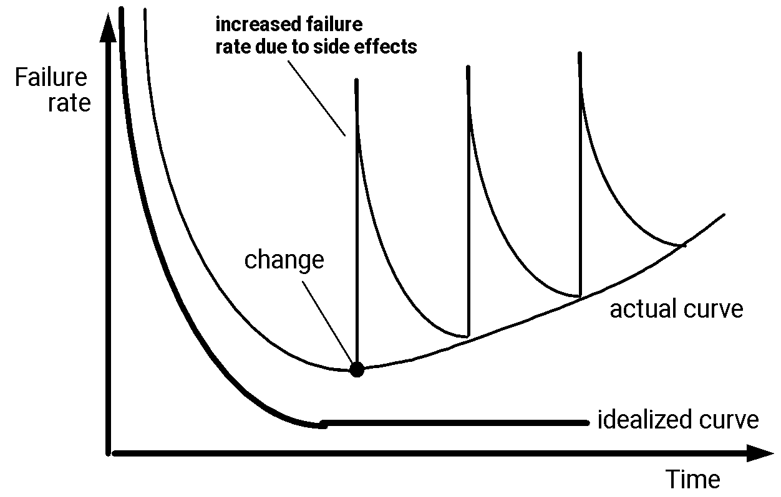
Wear vs. Deterioration
‹#›
Notes:
‹#›

Slide 10
Software Engineering Definition
The seminal definition:
[Software engineering is] the establishment and use of sound engineering principles in order to obtain economically software that is reliable and works efficiently on real machines.
The IEEE definition:
Software Engineering: (1) The application of a systematic, disciplined, quantifiable approach to the development, operation, and maintenance of software; that is, the application of engineering to software. (2) The study of approaches as in (1).
‹#›

Slide 11
Importance of Software Engineering
More and more, individuals and society rely on advanced software systems. We need to be able to produce reliable and trustworthy systems economically and quickly.
It is usually cheaper, in the long run, to use software engineering methods and techniques for software systems rather than just write the programs as if it was a personal programming project. For most types of system, the majority of costs are the costs of changing the software after it has gone into use.
‹#›

Slide 12
What is the difference between software engineering and computer science?
Computer science is concerned with theory and fundamentals;
software engineering is concerned with the practicalities of developing and delivering useful software
‹#›

Slide 13
What is the difference between software engineering and system engineering
System engineering is concerned with all aspects of computer-based systems development including hardware, software and process engineering.
Software engineering is part of this process concerned with developing the software infrastructure, control, applications and databases in the system.
‹#›

Slide 14
What are Software Paradigms?
Paradigm - refer to a category of entities that share a common characteristic.
Three kinds of Software Paradigms:
Programming Paradigm – model of how programmers communicate to computers
Software Design Paradigm – model for implementing a group of applications sharing common properties.
Software Development Paradigm – SE, management model for implementing big projects using engg. principles.
‹#›

Slide 15
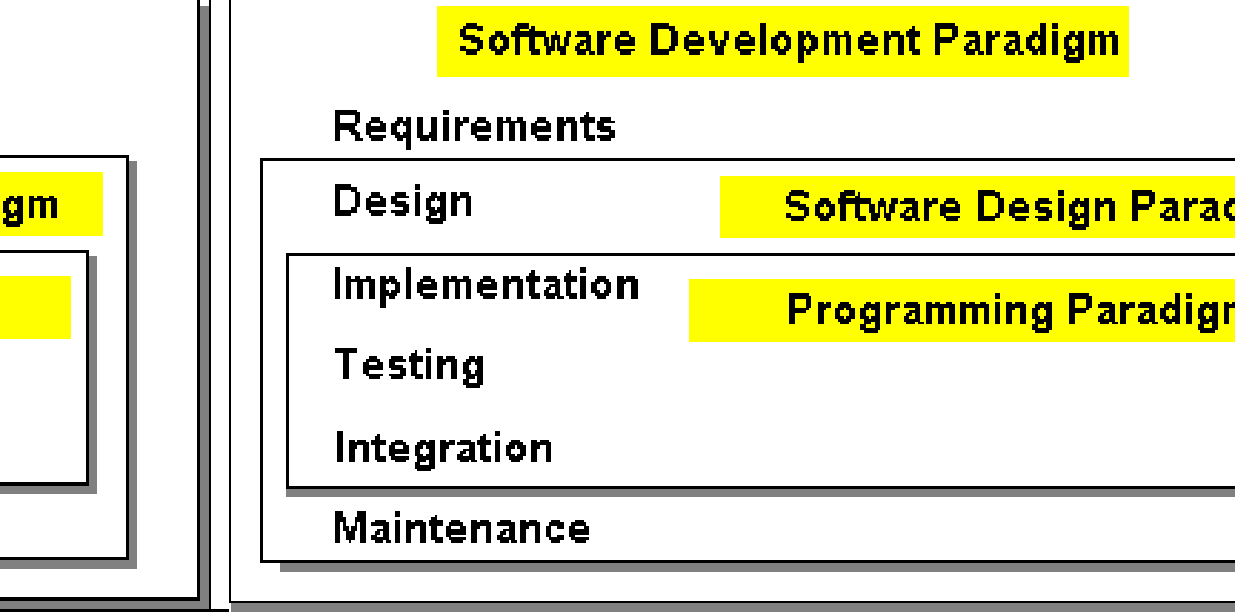
What are Software Paradigms?
‹#›

Slide 16
Software Applications
1. System software: such as compilers, editors, file management utilities
2. Application software: stand-alone programs for specific needs.
3. Engineering/scientific software: Characterized by “number crunching”algorithms. such as automotive stress analysis, molecular biology, orbital dynamics etc
4. Embedded software resides within a product or system. (key pad control of a microwave oven, digital function of dashboard display in a car)
5. Product-line software focus on a limited marketplace to address mass consumer market. (word processing, graphics, database management)
6. WebApps (Web applications) network centric software. As web 2.0 emerges, more sophisticated computing environments is supported integrated with remote database and business applications.
7. AI software uses non-numerical algorithm to solve complex problem. Robotics, expert system, pattern recognition game playing
‹#›
Notes:
‹#›

Slide 17
FAQ about software engineering
Question | Answer
What is software? | Computer programs, data structures and associated documentation. Software products may be developed for a particular customer or may be developed for a general market.
What are the attributes of good software? | Good software should deliver the required functionality and performance to the user and should be maintainable, dependable and usable.
What is software engineering? | Software engineering is an engineering discipline that is concerned with all aspects of software production.
What is the difference between software engineering and computer science? | Computer science focuses on theory and fundamentals; software engineering is concerned with the practicalities of developing and delivering useful software.
What is the difference between software engineering and system engineering? | System engineering is concerned with all aspects of computer-based systems development including hardware, software and process engineering. Software engineering is part of this more general process.
‹#›

Slide 18
Essential attributes of good software
Product characteristic | Description
Maintainability | Software should be written in such a way so that it can evolve to meet the changing needs of customers. This is a critical attribute because software change is an inevitable requirement of a changing business environment.
Dependability and security | Software dependability includes a range of characteristics including reliability, security and safety. Dependable software should not cause physical or economic damage in the event of system failure. Malicious users should not be able to access or damage the system.
Efficiency | Software should not make wasteful use of system resources such as memory and processor cycles. Efficiency therefore includes responsiveness, processing time, memory utilisation, etc.
Acceptability | Software must be acceptable to the type of users for which it is designed. This means that it must be understandable, usable and compatible with other systems that they use.
‹#›

Slide 19
A Layered Technology
Software Engineering
tools
methods
process model
a “quality” focus
‹#›

Slide 20
Software Process
Activities in software projects
Characterized by a common process framework
Framework activities - task sets
Umbrella activities
“Process maturity” enables development of quality software products
‹#›

Slide 21
Software Process
Purpose of process is to deliver software in a timely manner and with sufficient quality to satisfy those who have sponsored its creation and those who will use it.
A process is a collection of activities, actions and tasks that are performed when some work product is to be created. It is not a rigid prescription for how to build computer software. Rather, it is an adaptable approach that enables the people doing the work to pick and choose the appropriate set of work actions and tasks.
‹#›
Notes:
‹#›

Slide 22
Five Activities of a Generic Process framework
Communication: communicate with customer to understand objectives and gather requirements
Planning: creates a “map” defines the work by describing the tasks, risks and resources, work products and work schedule.
Modeling: Create a “sketch”, what it looks like architecturally, how the constituent parts fit together and other characteristics.
Construction: code generation and the testing.
Deployment: Delivered to the customer who evaluates the products and provides feedback based on the evaluation.
These five framework activities can be used to all software development regardless of the application domain, size of the project, complexity of the efforts etc, though the details will be different in each case.
For many software projects, these framework activities are applied iteratively as a project progresses. Each iteration produces a software increment that provides a subset of overall software features and functionality.
‹#›

Slide 23
Umbrella Activities
Complement the five process framework activities and help team manage and control progress, quality, change, and risk.
Software project tracking and control: assess progress against the plan and take actions to maintain the schedule.
Risk management: assesses risks that may affect the outcome and quality.
Software quality assurance: defines and conduct activities to ensure quality.
Technical reviews: assesses work products to uncover and remove errors before going to the next activity.
Measurement: define and collects process, project, and product measures to ensure stakeholder’s needs are met.
Reusability management: defines criteria for work product reuse and establishes mechanism to achieve reusable components.
Work product preparation and production: create work products such as models, documents, logs, forms and lists.
‹#›

Slide 24
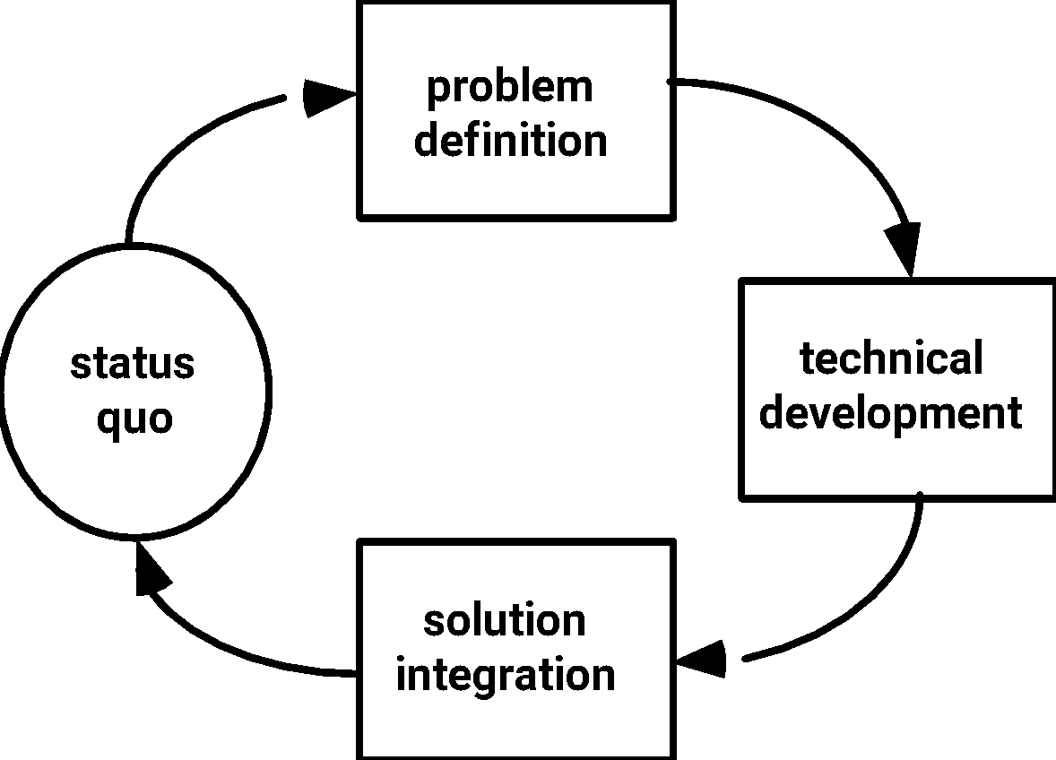
Process as Problem Solving
‹#›

Slide 25
What is a software process model?
A simplified representation of a software process, presented from a specific perspective.
Examples of process perspectives are
Workflow perspective - sequence of activities;
Data-flow perspective - information flow;
Role/action perspective - who does what.
Generic process models
Waterfall;
Iterative development;
Component-based software engineering
‹#›

Slide 26
The Process Model:Adaptability
the framework activities will always be applied on every project ... BUT
the tasks (and degree of rigor) for each activity will vary based on:
the type of project (an “entry point” to the model)
characteristics of the project
common sense judgment; concurrence of the project team
‹#›

Slide 27
The Primary Goal:High Quality
Remember:
High quality = project timeliness
Why?
Less rework!
‹#›

Slide 28
The Systematic Process
Problem
Analysis
Design
Models
Development
Solution
Testing
‹#›

Slide 29
Generic Phases
Definition Phase
Focus on ‘what’ the software is
Development Phase
Focus on ‘how’ the software works
Maintenance Phase
Focus on ‘change’ to the software
‹#›

Slide 30
Definition Phase
Identify information to be processed
Identify system behaviour - functions and performance
Determine constraints, interfaces, validation criteria
Major tasks:
Software project planning
Requirements analysis
‹#›

Slide 31
Development Phase
Define data structures, function implementation, procedural details, interfaces
Translate design to programming language
How testing is performed
Major tasks:
Software design
Code generation
Software testing
‹#›

Slide 32
Maintenance Phase
Reapplies definition and development phases to existing software
Types of changes:
Correction
Adaptation
Enhancement
‹#›

Slide 33
The Essence of Practice
How does the practice of software engineering fit in the process activities mentioned above? Namely, communication, planning, modeling, construction and deployment.
George Polya outlines the essence of problem solving, suggests:
1. Understand the problem (communication and analysis).
2. Plan a solution (modeling and software design).
3. Carry out the plan (code generation).
4. Examine the result for accuracy (testing and quality assurance).
‹#›

Slide 34
Understand the Problem
Who has a stake in the solution to the problem? That is, who are the stakeholders?
What are the unknowns? What data, functions, and features are required to properly solve the problem?
Can the problem be compartmentalized? Is it possible to represent smaller problems that may be easier to understand?
Can the problem be represented graphically? Can an analysis model be created?
‹#›

Slide 35
Plan the Solution
Have you seen similar problems before? Are there patterns that are recognizable in a potential solution? Is there existing software that implements the data, functions, and features that are required?
Has a similar problem been solved? If so, are elements of the solution reusable?
Can subproblems be defined? If so, are solutions readily apparent for the subproblems?
Can you represent a solution in a manner that leads to effective implementation? Can a design model be created?
‹#›

Slide 36
Carry Out the Plan
Does the solutions conform to the plan? Is source code traceable to the design model?
Is each component part of the solution provably correct? Has the design and code been reviewed, or better, have correctness proofs been applied to algorithm?
‹#›

Slide 37
Examine the Result
Is it possible to test each component part of the solution? Has a reasonable testing strategy been implemented?
Does the solution produce results that conform to the data, functions, and features that are required? Has the software been validated against all stakeholder requirements?
‹#›

Slide 38
Hooker’s General Principles for Software Engineering Practice: important underlying law
Help you establish mind-set for solid software engineering practice (David Hooker 96).
1: The Reason It All Exists: provide values to users
2: KISS (Keep It Simple, Stupid! As simple as possible)
3: Maintain the Vision (otherwise, incompatible design)
4: What You Produce, Others Will Consume (code with concern for those that must maintain and extend the system)
5: Be Open to the Future (never design yourself into a corner as specification and hardware changes)
6: Plan Ahead for Reuse
7: Think! Place clear complete thought before action produces better results.
‹#›

Slide 39
Software Myths Examples
Myth 1: Once we write the program and get it to work, our job is done.
Reality: the sooner you begin writing code, the longer it will take you to get done. 60% to 80% of all efforts are spent after software is delivered to the customer for the first time.
Myth 2: Until I get the program running, I have no way of assessing its quality.
Reality: technical review are a quality filter that can be used to find certain classes of software defects from the inception of a project.
Myth 3: software engineering will make us create voluminous and unnecessary documentation and will invariably slow us down.
Reality: it is not about creating documents. It is about creating a quality product. Better quality leads to a reduced rework. Reduced work results in faster delivery times.
‹#›
Notes:
‹#›

Slide 40
What are the costs of software engineering?
Roughly 60% of costs are development costs, 40% are testing costs. For custom software, evolution costs often exceed development costs.
Costs vary depending on the type of system being developed and the requirements of system attributes such as performance and system reliability.
Distribution of costs depends on the development model that is used.

Slide 41
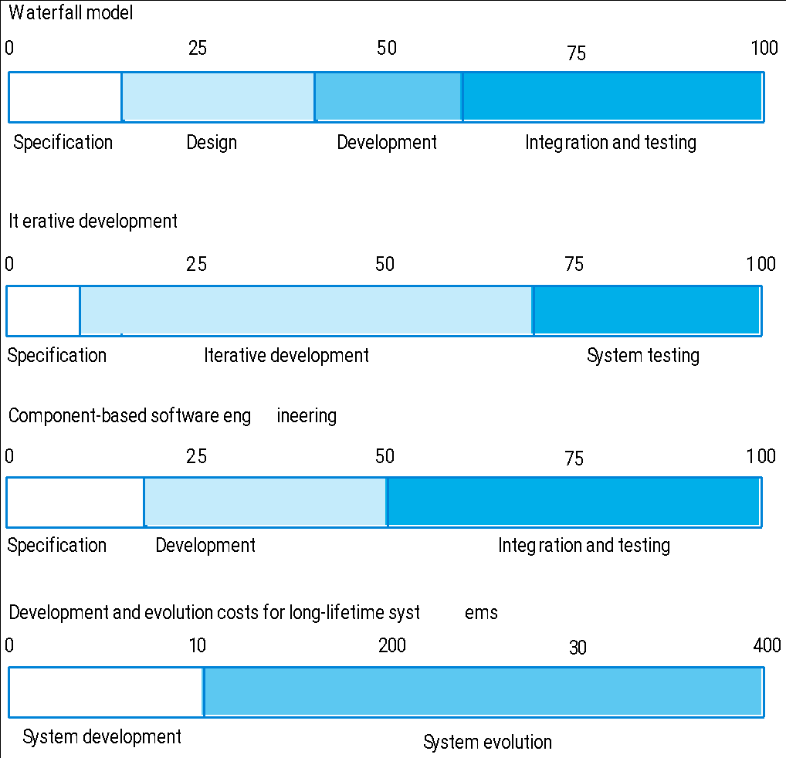
Activity cost distribution

Slide 42
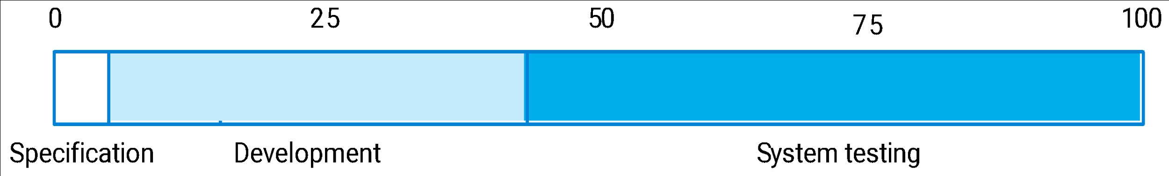
Product development costs

Slide 43
What are software engineering methods?
Structured approaches to software development which include system models, notations, rules, design advice and process guidance.
Model descriptions
Descriptions of graphical models which should be produced;
Rules
Constraints applied to system models;
Recommendations
Advice on good design practice;
Process guidance
What activities to follow.

Slide 44
What is CASE (Computer-Aided Software Engineering)
Software systems that are intended to provide automated support for software process activities.
CASE systems are often used for method support.
Upper-CASE
Tools to support the early process activities of requirements and design;
Lower-CASE
Tools to support later activities such as programming, debugging and testing.

Slide 45
What are the key challenges facing software engineering?
Heterogeneity, delivery and trust.
Heterogeneity
Developing techniques for building software that can cope with heterogeneous platforms and execution environments;
Delivery
Developing techniques that lead to faster delivery of software;
Trust
Developing techniques that demonstrate that software can be trusted by its users.

Slide 46
Issues of professional responsibility
Confidentiality
Engineers should normally respect the confidentiality of their employers or clients irrespective of whether or not a formal confidentiality agreement has been signed.
Competence
Engineers should not misrepresent their level of competence. They should not knowingly accept work which is outwith their competence.

Slide 47
Issues of professional responsibility
Intellectual property rights
Engineers should be aware of local laws governing the use of intellectual property such as patents, copyright, etc. They should be careful to ensure that the intellectual property of employers and clients is protected.
Computer misuse
Software engineers should not use their technical skills to misuse other people’s computers. Computer misuse ranges from relatively trivial (game playing on an employer’s machine, say) to extremely serious (dissemination of viruses).

Slide 48
References
“Software Engineering: A Practitioner’s Approach” 6th Ed. by Roger S. Pressman, Mc-Graw-Hill, 2005
“Software Engineering” by Ian Sommerville, Addison-Wesley, 2001
‹#›
Notes:
‹#›

