Slide 1
S&P Return Simulation
Group 8
May 12, 2022

Slide 2
Executive Summary
Project Overview
App Functionality
Project Goals
A user inputs how much money they would like to put into the S&P500 and for how long they would like to hold the investment
The app runs two Monte Carlo simulations in order to predict the Real Rate and S&P500 Earnings (variables) for a future time period
Using the predicted variables, the app also applies a confidence interval to estimate the range of each variables with 95% certainty
The app then matches the predicted variables to all the daily real rates and S&P earnings for the last 50 years and pulls the matches into a new data frame
The app takes the mean price-to-earnings ratio of the new data frame and multiplies it by the predicted S&P500 Earnings to calculate the price of the S&P500 for a future time period
An output is displayed to give the user an estimate of how much their investment will be worth for a future time period
Predict the price of the S&P500 at a given time based on historical parameters that are
correlated to the market
Achieved
Allow for users to financially plan by estimating the future value of their investment, assuming they put their money into the S&P500
Allow for a user to financial plan by estimating the future value of their investment with any equity security
Long-Term
Expand app to run multiple different types of securities (debt, cryptocurrency, etc.) and offer portfolio optimization strategies based on investor risk tolerance

Slide 3
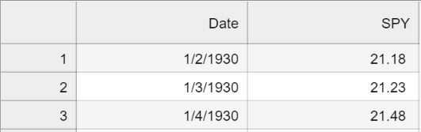
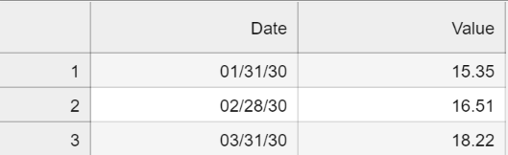
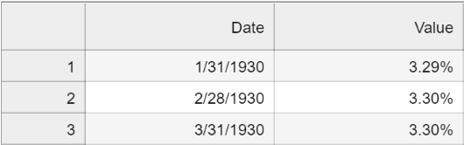
Data Collection & Sourcing
These data sets allow you to calculate to key variables: Real Rates and S&P500 Earnings
Data Collection and Sources
Data | Frequency | Source | Sample Input
SPY Price | Daily | Capital IQ
SPY Price-to-Earnings | Monthly | Capital IQ
10-Year Treasure Rate | Monthly | Capital IQ
CPI Index | Monthly | Quandl API | https://data.nasdaq.com/api/v3/datasets/{cpi_code}.json ?api_key={quandl_key}
Real Rates and S&P500 Earnings are two macroeconomic variables that are correlated to the
price of the S&P500. By estimating these two variables with a certain degree of confidence,
the app can then predict the price of the S&P500 for the same time period.

Slide 4
Data Cleanup & Exploration
Data Cleanup Process
Key Issue
Resolution / Explanation
Loading different types of datasets into Python
(APIs, CSVs, etc.)
Different types of data pulls required different types of code in order to read the data in Python
Having the index date time format in each of
the data frames
Cleaning up specific dates and making sure the column was uniform across data sets so that the inner join function pulled correctly
Having all values in each column as a float
Changing each data frame to read the data as a value
Standardizing units of measurement
Using the pct_change function where applicable to calculate daily rate changes across data frames to calculate the real rate

Slide 5
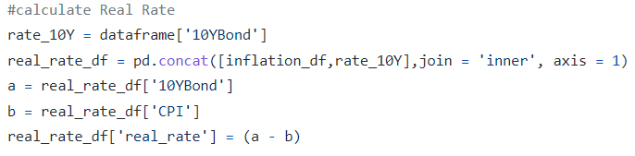
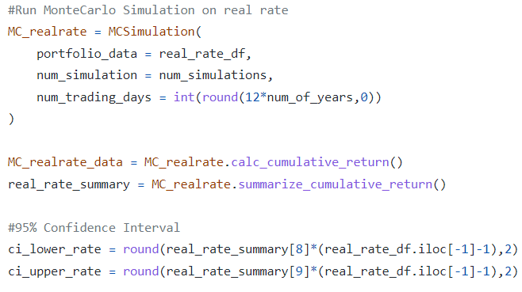
Group Approach – Financial Application / Analysis
Monte Carlo simulation on Real Rate
Real Rate Calculation
Code Snapshots
In calculating the real rate, we first needed create a data frame containing the daily percentage change for the CPI Index along with the daily change in 10-year interest rates
The real rate is calculated as the 10-year rate less the CPI rate
Real Rate Monte Carlo Simulation
The app is running a Real Rate Monte Carlo simulation to predict the probability of different rates at a future time period
The cumulative_return function sums of the daily changes from today’s date to the future time period
A confidence interval is applied on the simulation, in order to provide a range of rates that estimated Real Rate will be between with 95% certainty

Slide 6
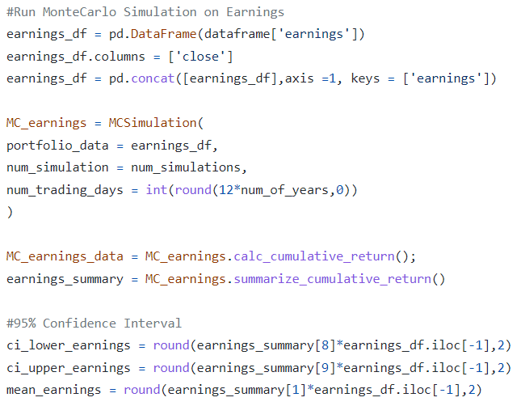
Group Approach – Financial Application / Analysis
Monte Carlo simulation on S&P500 Earnings
Real Rate Monte Carlo Simulation
Code Snapshots
The app is running a S&P500 Earnings Monte Carlo simulation to predict the probability of different rates at a future time period
The cumulative_return function sums of the daily changes from today’s date to the future time period
A confidence interval is applied on the simulation, in order to provide a range of rates that estimated S&P500 Earnings will be between with 95% certainty

Slide 7
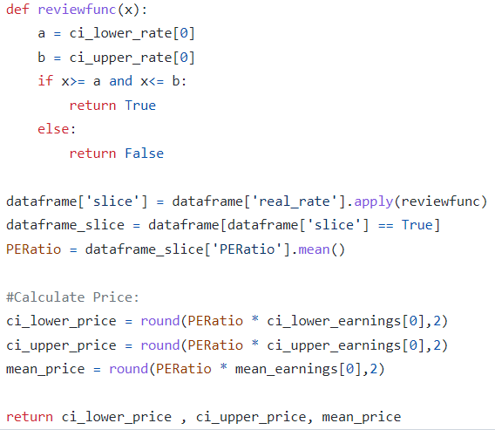
Group Approach – Financial Application / Analysis
Overview
Code Snapshots
The app runs a function that matches the confidence interval of Real Rates and Earnings to historical periods and creates a new data frame called dataframe_slice
From there, the app calculates the average of the corresponding price-to-earnings ratio of the S&P500 for the data frame
The price-to-earnings ratio is then multiplied by the high, low and average earnings of the confidence interval in order to calculate the S&P500 price range

Slide 8

Team
Member | Data Collection | App Development | Code Review | Presentation
Dynah Beerman
Drissa Compaore
Philip DeNormandie
Bennett Kramer
Tiago Lopes

Slide 9
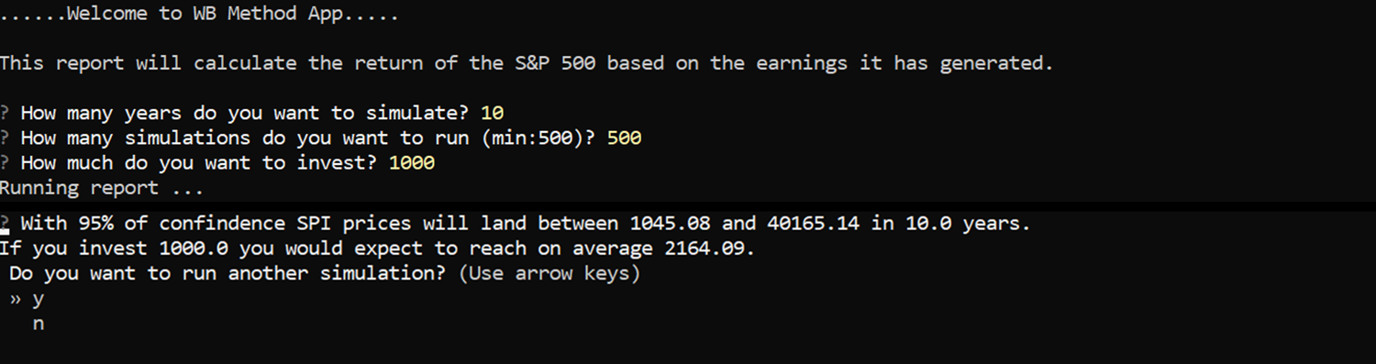
Results, Conclusions & Next Steps
Results
Next Steps
Historic outcomes don’t necessarily predict the future trajectory of the equities markets, but the financial coding and analysis through potentially hundreds of thousands of Monte Carlo simulations, provide reasonable guidance on future prices
The app will output a range of how much a user’s investment will be worth for a given time – while it will likely not be 100% correct, it will give the user enough guidance towards how to financially plan
Running the app online and using more computing power to run a higher number of Monte Carlo simulations
Building in functionality to be able to pick specific equity securities to invest in versus only the S&P500
Building in functionality to move outside of the equity markets and view returns for debt securities and/or cryptocurrencies
Application Functionality

