Slide 1
Exploring Natural Language Processing using Azure
Usha Rengaraju

Slide 2
About me
Kaggle Grandmaster
WiMLDS(Bangalore and Mysore)
TensorFlow User Group Organizer Mysuru
GDG Mysore Organizer Mysuru
Twitter : @URengaraju
Github : https://github.com/ushareng
Ambassador : Women TechMakers Mysuru , WiDS Mysuru(Women in Data Science)

Slide 3
Communities
WiMLDS Mysore :
https://www.meetup.com/Mysore-Women-in-Machine-Learning-and-Data-Science/
GDG Mysuru :
https://www.meetup.com/Google-Developers-group-Mysuru/
TensorFlow User Group Mysuru :
https://www.meetup.com/TFUG-Mysuru/

Slide 4
Natural Language Processing
Natural Language Processing (NLP) is a branch of artificial intelligence (AI) that deals with written and spoken language.
NLP is used to build solutions that extract semantic meaning from text or speech, or that formulate meaningful responses in natural language.

Slide 5
Use Cases
Analyze Survey Results
Analyze Recorded Inbound Calls
Process and categorize support incidents
Monitor your project’s social media feeds

Slide 6
Detect Language
Extract Key Phrases
Determine Sentiment
Extract Known Entities

Slide 7
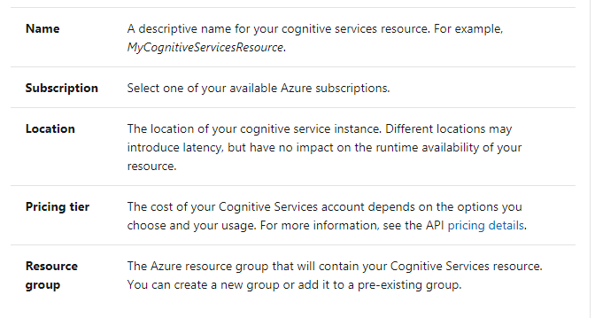
Cognitive Resource

Slide 8
Resources Links
https://github.com/ushareng/CloudCommunityConference
https://docs.microsoft.com/en-gb/azure/cognitive-services/text-analytics/overview
https://github.com/microsoft/Azure-Pyday

