Slide 1












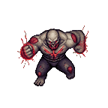


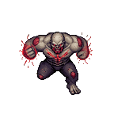
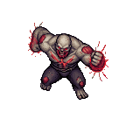
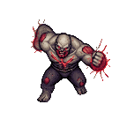
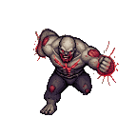









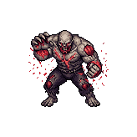
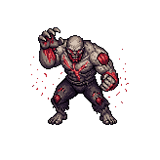


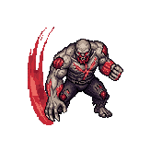
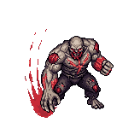
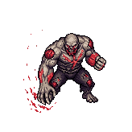
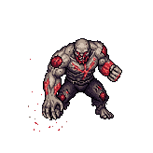

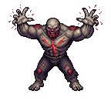

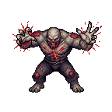



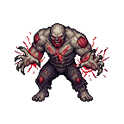
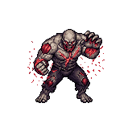
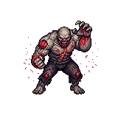


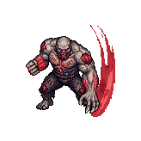
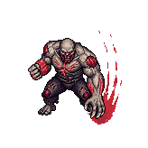
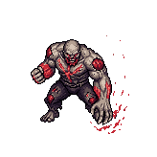
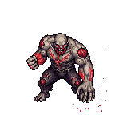
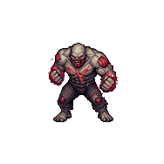
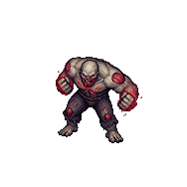
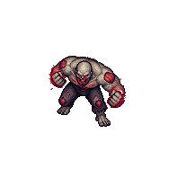
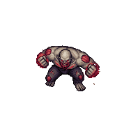


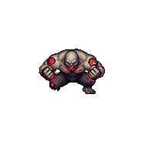
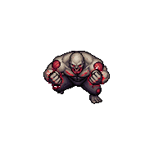

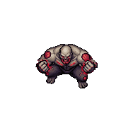

Beast_Zombie_Boss - south
0
1
2
3
4
5
6
7
8
9
10
idle
move
run
sprint
swipe
swipe-both
swipe-left
body-charge

Slide 2






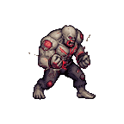
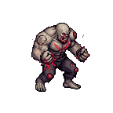




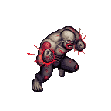
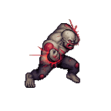
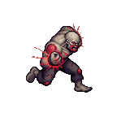
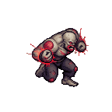
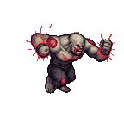
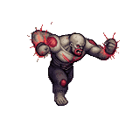

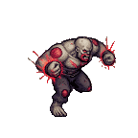





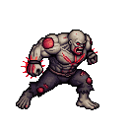

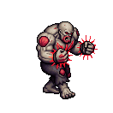
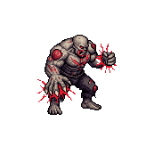
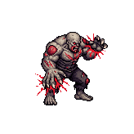
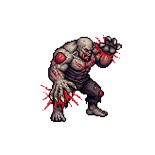


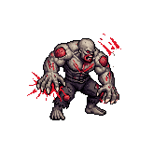
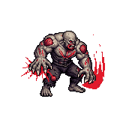
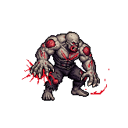


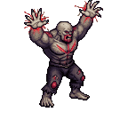
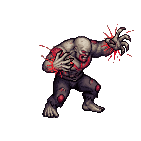
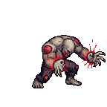
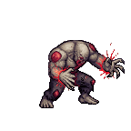
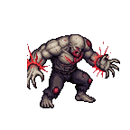
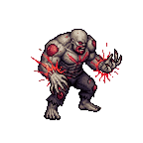



















Beast_Zombie_Boss - south-east
0
1
2
3
4
5
6
7
8
9
10
idle
move
run
sprint
swipe
swipe-both
swipe-left
body-charge

Slide 3































































Beast_Zombie_Boss - east
0
1
2
3
4
5
6
7
8
9
10
idle
move
run
sprint
swipe
swipe-both
swipe-left
body-charge

Slide 4































































Beast_Zombie_Boss - north-east
0
1
2
3
4
5
6
7
8
9
10
idle
move
run
sprint
swipe
swipe-both
swipe-left
body-charge

Slide 5































































Beast_Zombie_Boss - north
0
1
2
3
4
5
6
7
8
9
10
idle
move
run
sprint
swipe
swipe-both
swipe-left
body-charge

Slide 6































































Beast_Zombie_Boss - north-west
0
1
2
3
4
5
6
7
8
9
10
idle
move
run
sprint
swipe
swipe-both
swipe-left
body-charge

Slide 7































































Beast_Zombie_Boss - west
0
1
2
3
4
5
6
7
8
9
10
idle
move
run
sprint
swipe
swipe-both
swipe-left
body-charge

Slide 8































































Beast_Zombie_Boss - south-west
0
1
2
3
4
5
6
7
8
9
10
idle
move
run
sprint
swipe
swipe-both
swipe-left
body-charge

