Slide 1






























Beast_Zombie_Boss - idle (before / after)
south
south-east
east
north-east
north
north-west
west
south-west
before (frame 0)
after (frame 0)
before (frame 3)
after (frame 3)

Slide 2
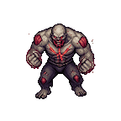
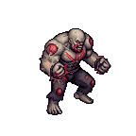
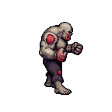
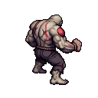
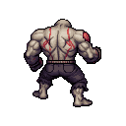
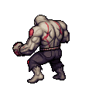
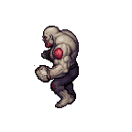
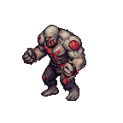
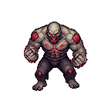




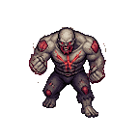
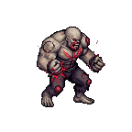
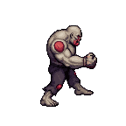
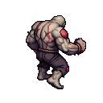
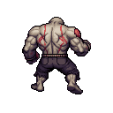
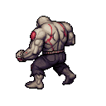
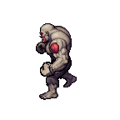
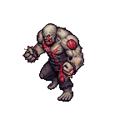

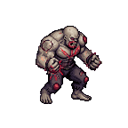

Beast_Zombie_Boss - move (before / after)
south
south-east
east
north-east
north
north-west
west
south-west
before (frame 0)
after (frame 0)
before (frame 3)
after (frame 3)

Slide 3
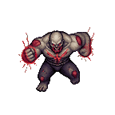
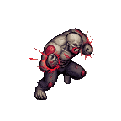
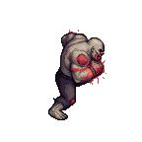
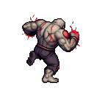
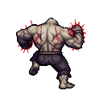
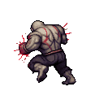
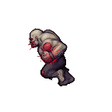
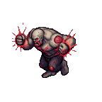
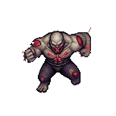
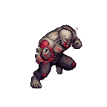
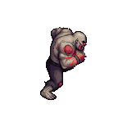
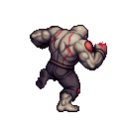
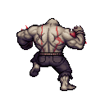
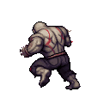
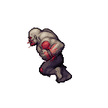
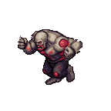
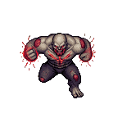
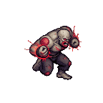
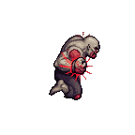
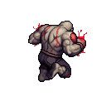
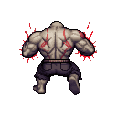
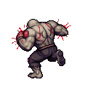
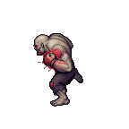
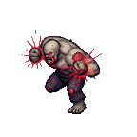
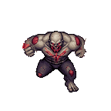
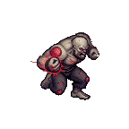


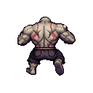
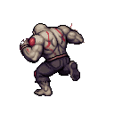
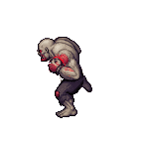
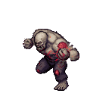
Beast_Zombie_Boss - run (before / after)
south
south-east
east
north-east
north
north-west
west
south-west
before (frame 0)
after (frame 0)
before (frame 3)
after (frame 3)

Slide 4
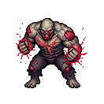
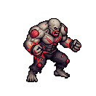




























Beast_Zombie_Boss - sprint (before / after)
south
south-east
east
north-east
north
north-west
west
south-west
before (frame 0)
after (frame 0)
before (frame 3)
after (frame 3)

Slide 5





























Beast_Zombie_Boss - swipe (before / after)
south
south-east
east
north-east
north
north-west
west
south-west
before (frame 0)
after (frame 0)
before (frame 3)
after (frame 3)

Slide 6
































Beast_Zombie_Boss - swipe-both (before / after)
south
south-east
east
north-east
north
north-west
west
south-west
before (frame 0)
after (frame 0)
before (frame 3)
after (frame 3)

Slide 7





























Beast_Zombie_Boss - swipe-left (before / after)
south
south-east
east
north-east
north
north-west
west
south-west
before (frame 0)
after (frame 0)
before (frame 3)
after (frame 3)

Slide 8
























Beast_Zombie_Boss - body-charge (before / after)
south
south-east
east
north-east
north
north-west
west
south-west
before (frame 0)
after (frame 0)
before (frame 3)
after (frame 3)

