Slide 1











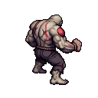

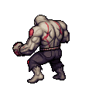


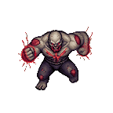
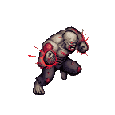
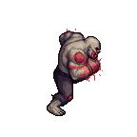
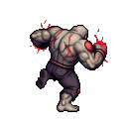

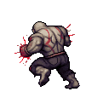

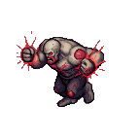


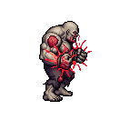


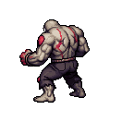


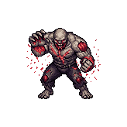
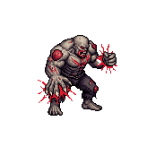
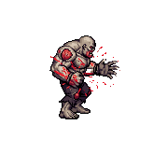
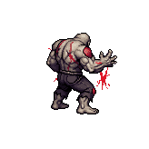
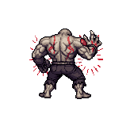
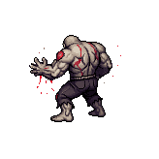
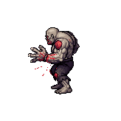



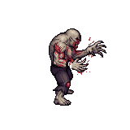
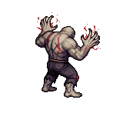

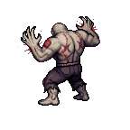
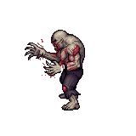
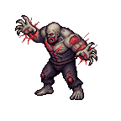
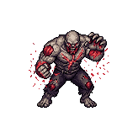
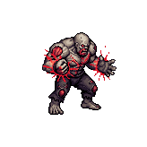
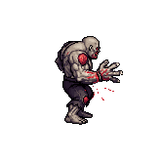
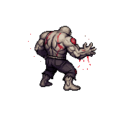
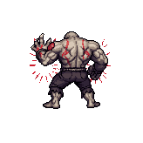
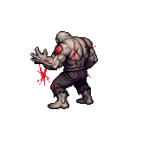
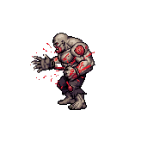
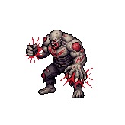
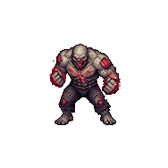

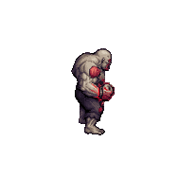
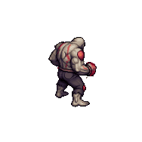


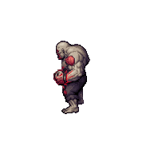
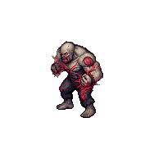
Beast_Zombie_Boss - frame 0 (0.png)
south
south-east
east
north-east
north
north-west
west
south-west
idle
move
run
sprint
swipe
swipe-both
swipe-left
body-charge

Slide 2










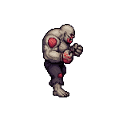


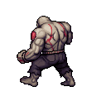



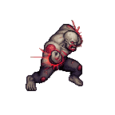
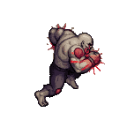
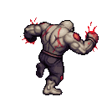

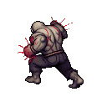
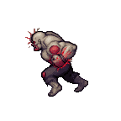



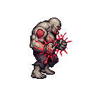


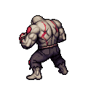


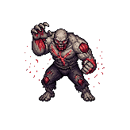
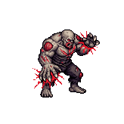
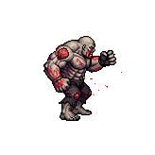
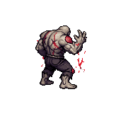
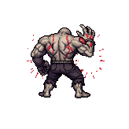
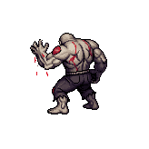


























Beast_Zombie_Boss - frame 1 (1.png)
south
south-east
east
north-east
north
north-west
west
south-west
idle
move
run
sprint
swipe
swipe-both
swipe-left
body-charge

Slide 3
































































Beast_Zombie_Boss - frame 2 (2.png)
south
south-east
east
north-east
north
north-west
west
south-west
idle
move
run
sprint
swipe
swipe-both
swipe-left
body-charge

Slide 4
































































Beast_Zombie_Boss - frame 3 (3.png)
south
south-east
east
north-east
north
north-west
west
south-west
idle
move
run
sprint
swipe
swipe-both
swipe-left
body-charge

Slide 5
























































Beast_Zombie_Boss - frame 4 (4.png)
south
south-east
east
north-east
north
north-west
west
south-west
idle
move
run
sprint
swipe
swipe-both
swipe-left
body-charge

Slide 6
























































Beast_Zombie_Boss - frame 5 (5.png)
south
south-east
east
north-east
north
north-west
west
south-west
idle
move
run
sprint
swipe
swipe-both
swipe-left
body-charge

Slide 7
























































Beast_Zombie_Boss - frame 6 (6.png)
south
south-east
east
north-east
north
north-west
west
south-west
idle
move
run
sprint
swipe
swipe-both
swipe-left
body-charge

Slide 8
























































Beast_Zombie_Boss - frame 7 (7.png)
south
south-east
east
north-east
north
north-west
west
south-west
idle
move
run
sprint
swipe
swipe-both
swipe-left
body-charge

Slide 9








Beast_Zombie_Boss - frame 8 (8.png)
south
south-east
east
north-east
north
north-west
west
south-west
idle
move
run
sprint
swipe
swipe-both
swipe-left
body-charge

Slide 10








Beast_Zombie_Boss - frame 9 (9.png)
south
south-east
east
north-east
north
north-west
west
south-west
idle
move
run
sprint
swipe
swipe-both
swipe-left
body-charge

Slide 11








Beast_Zombie_Boss - frame 10 (10.png)
south
south-east
east
north-east
north
north-west
west
south-west
idle
move
run
sprint
swipe
swipe-both
swipe-left
body-charge

