Slide 1
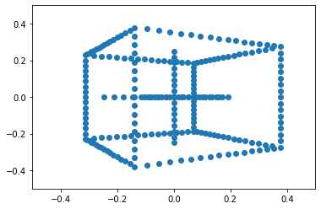
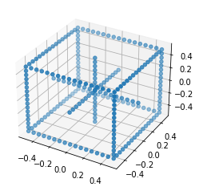
Pinhole camera model & Homogeneous coordinates q = K[R|t]Q = PQ

Slide 2
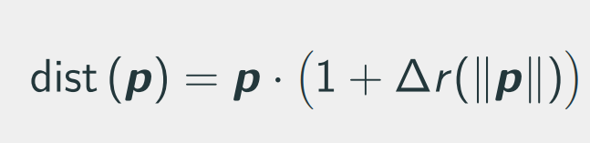
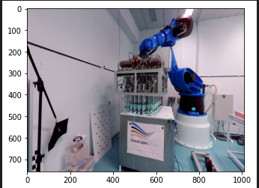
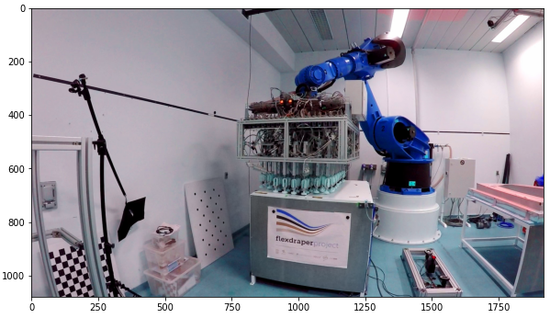
Camera model & homographies

Slide 3
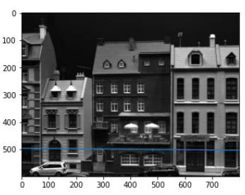
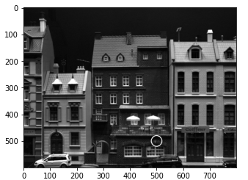
Stereo vision & triangulation. Multiview geometry. Essential & Fundamental matrices. 0 = p’Ep; 0 = q’Fq;

Slide 4
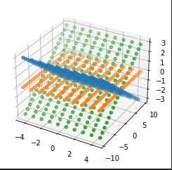
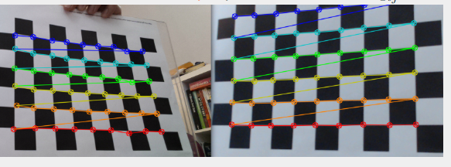
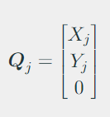
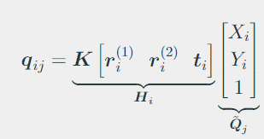
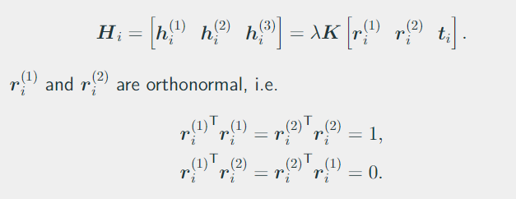
Camera calibration

Slide 5
Non-linear triangulation & calibration
Don’t really know what to put here : ) take some equations from the slides….

Slide 6
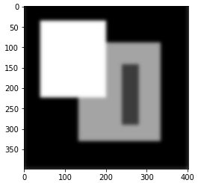
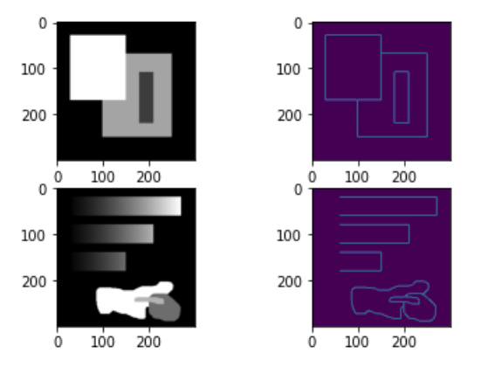
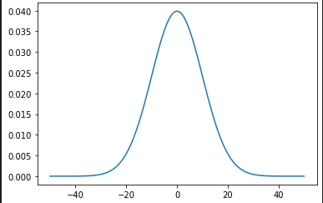
Simple features. Canny. Harris

Slide 7
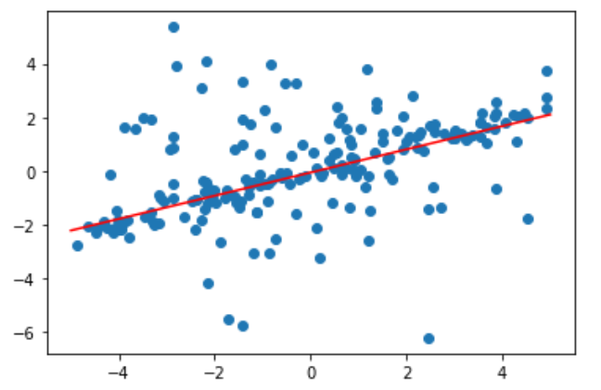
Robust model fitting. RANSAC

Slide 8
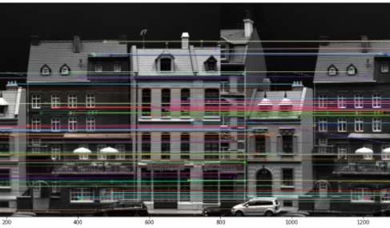
Constrained geometry feature matching
Eight-point algorithm
Fundamental matrix
RANSAC

Slide 9
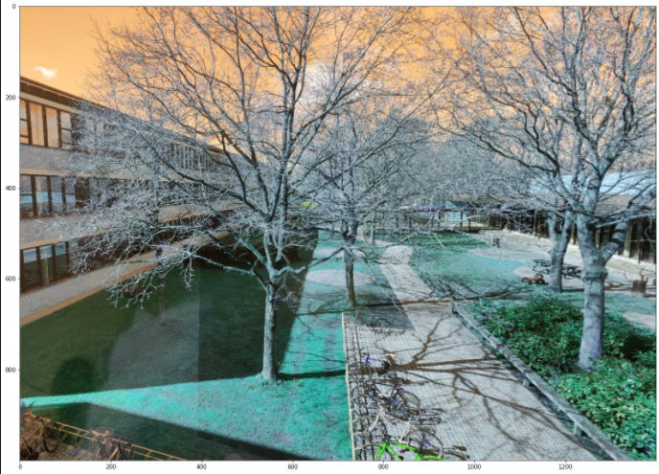
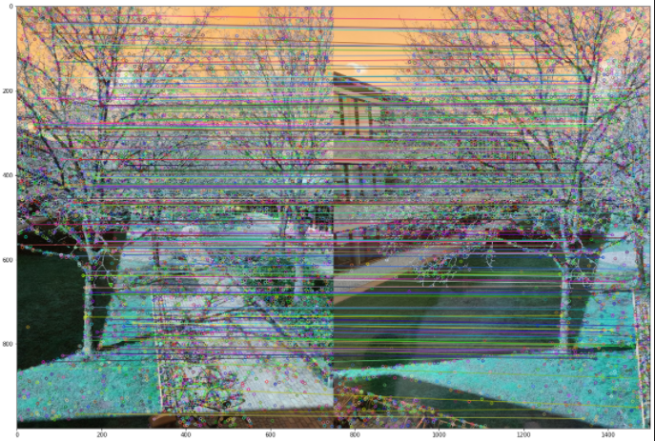
Image stitching
RANSAC for fitting Homographies
Warping
Finally stiching

Slide 10
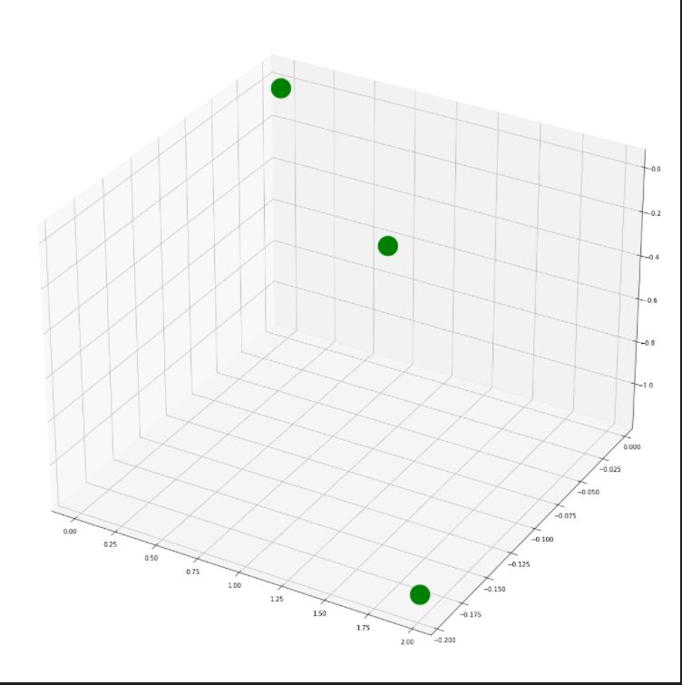
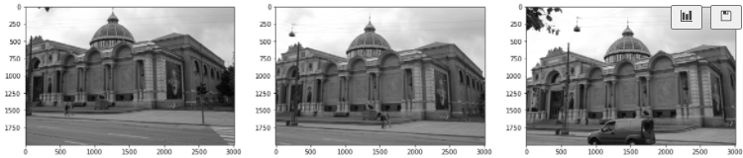
Visual odometry
SIFT
Essential matrix, decomposition (R,t)
Triangulation from first pair
PnP to estimate pose of camera in third

Slide 11
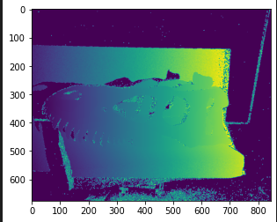
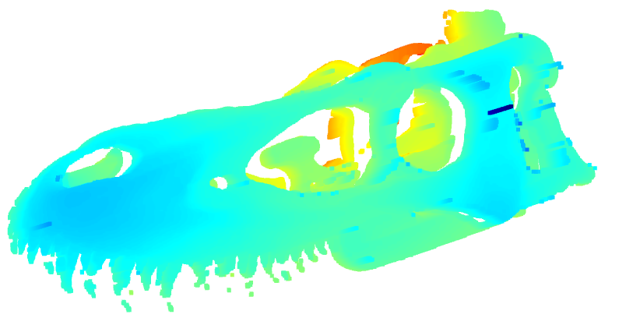
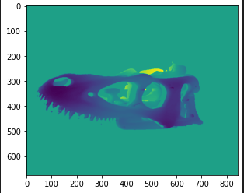
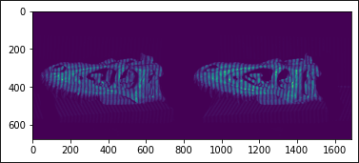
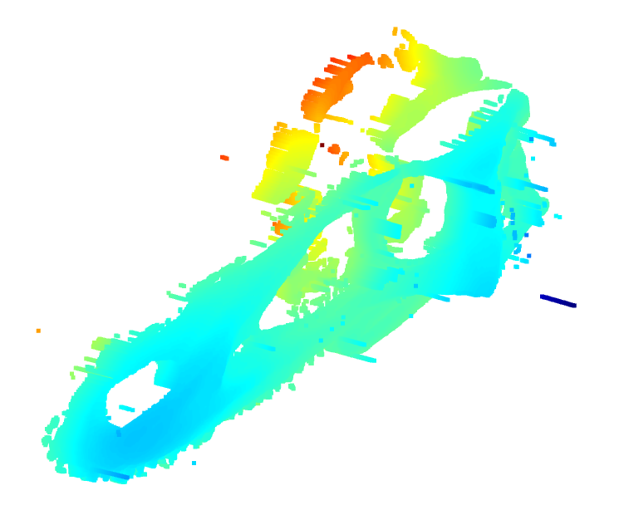
Structured light
Rectification
Unwrapping, pattern
Matching pixels
Disparity map
Triangulate matches

