Slide 1
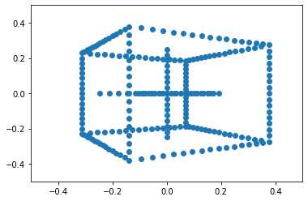
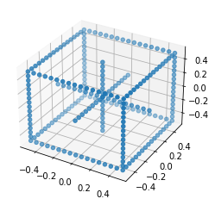
Homogeneous coordinates & pinhole camera model (p = K[R t]Q)

