Slide 1
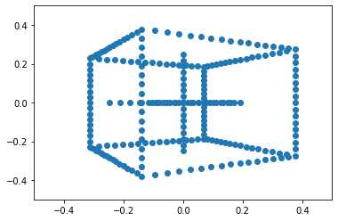
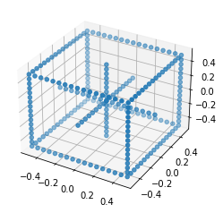
Pinhole camera model & Homogeneous coordinates q = K[R|t]Q = PQ

Slide 2
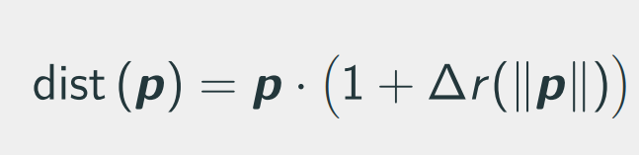
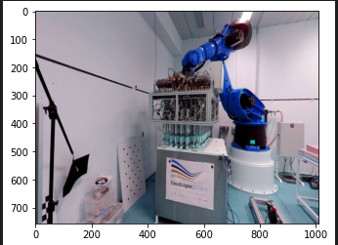
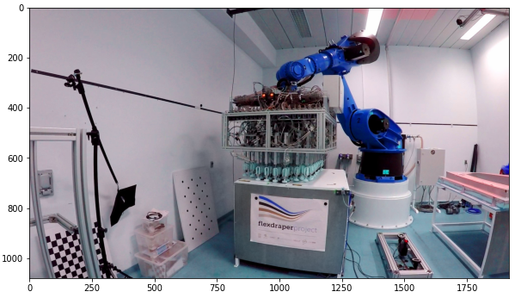
Camera model & homographies

Slide 3
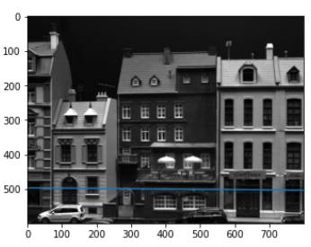
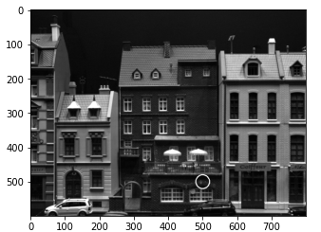
Stereo vision & triangulation. Multiview geometry. Essential & Fundamental matrices. 0 = p’Ep; 0 = q’Fq;

Slide 4
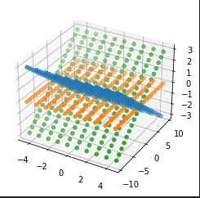
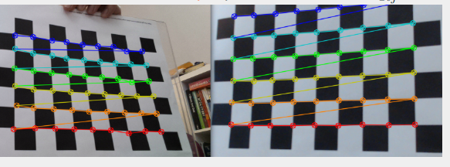
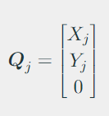
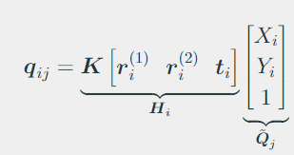
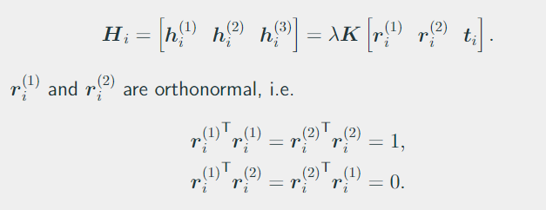
Camera calibration

Slide 5
Non-linear triangulation & calibration
Don’t really know what to put here : ) take some equations from the slides….

Slide 6
Non-linear triangulation & calibration

Slide 7
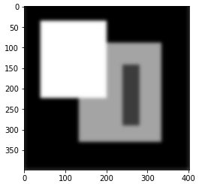
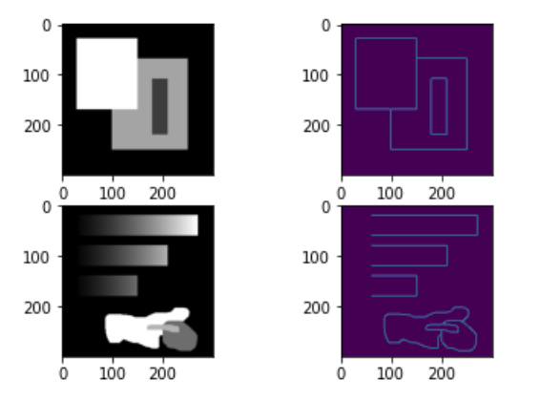
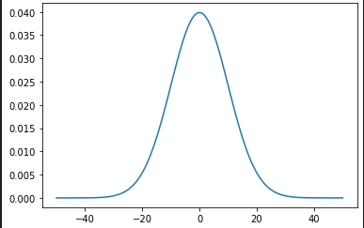
Simple features. Canny. Harris

Slide 8
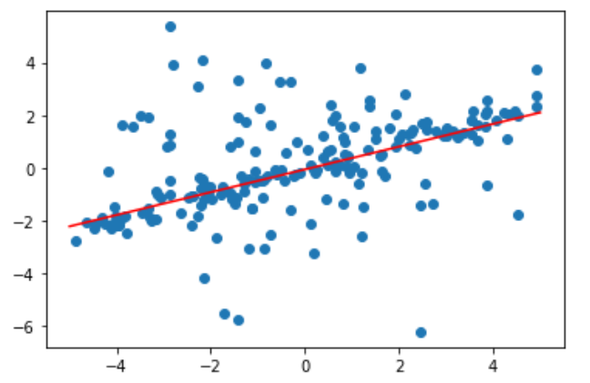
Robust model fitting. RANSAC

Slide 9
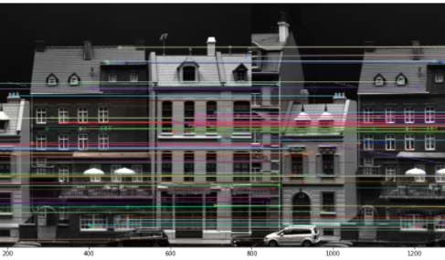
Constrained geometry feature matching
Eight-point algorithm
Fundamental matrix
RANSAC

Slide 10
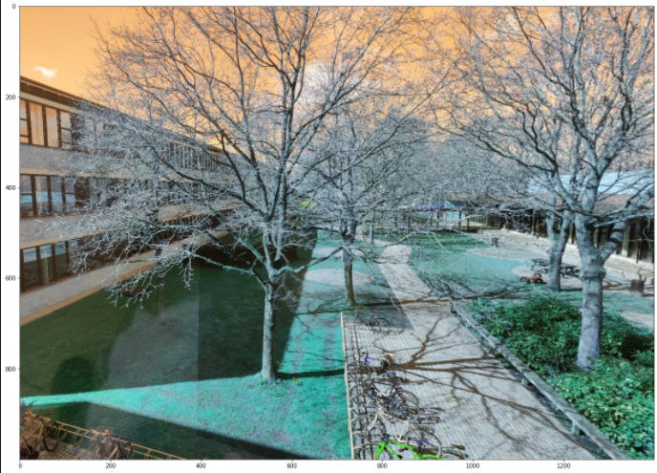
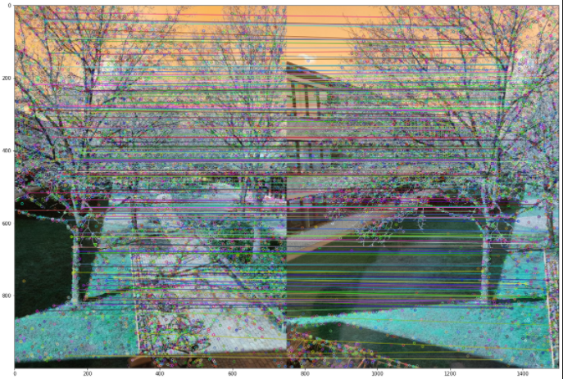
Image stitching
RANSAC for fitting Homographies
Warping
Finally stiching

