Slide 1
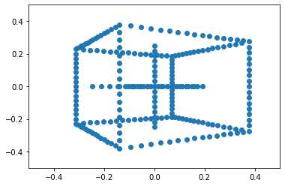
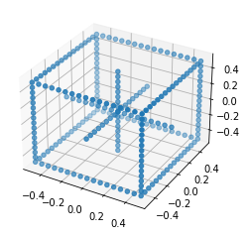
Homogeneous coordinates & pinhole camera model (q = K[R t]Q = PQ)

