Slide 1


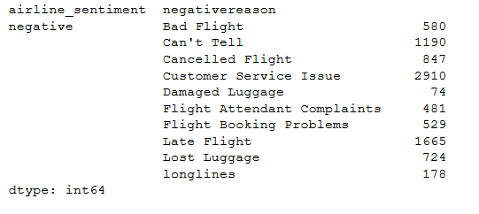
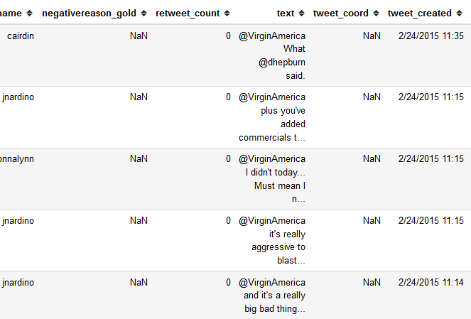
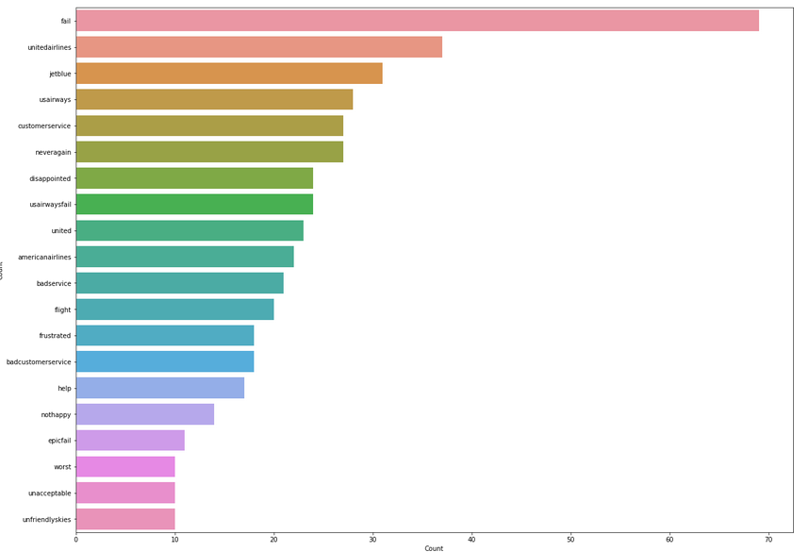
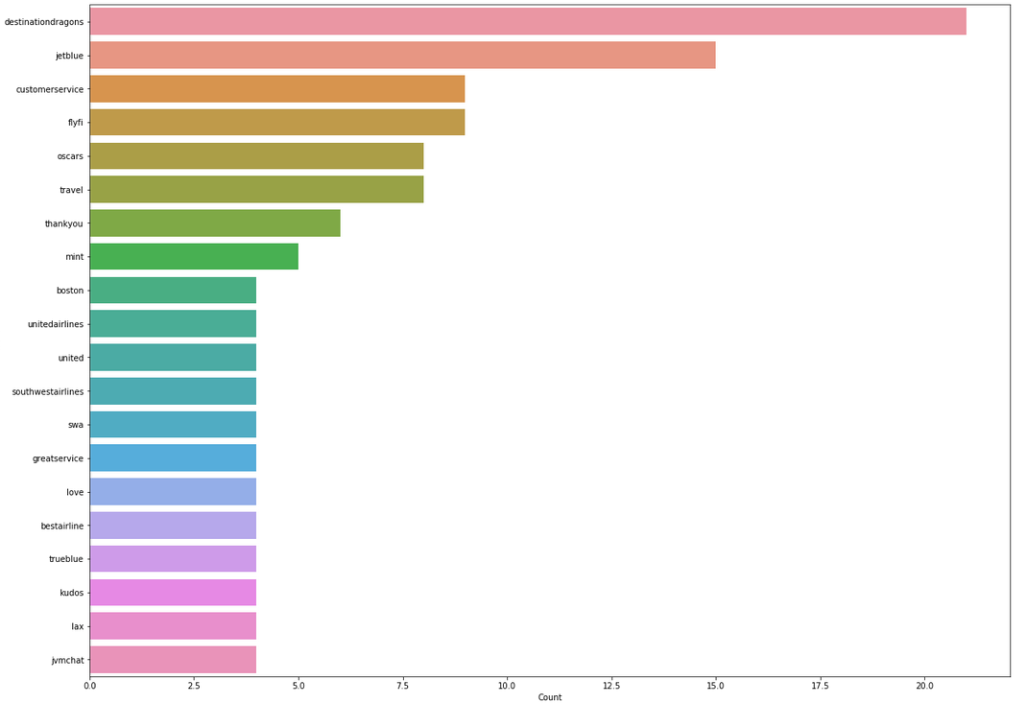
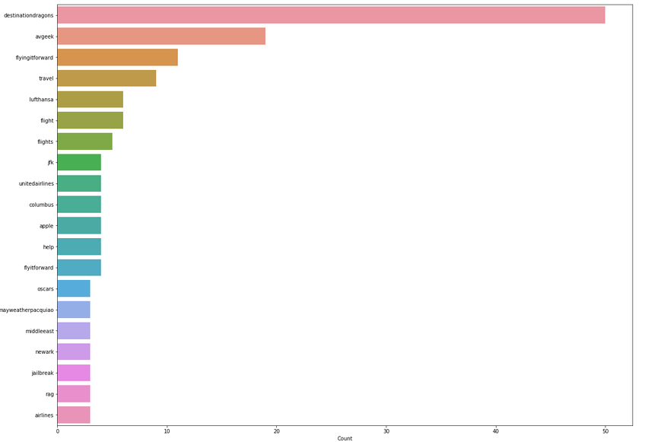
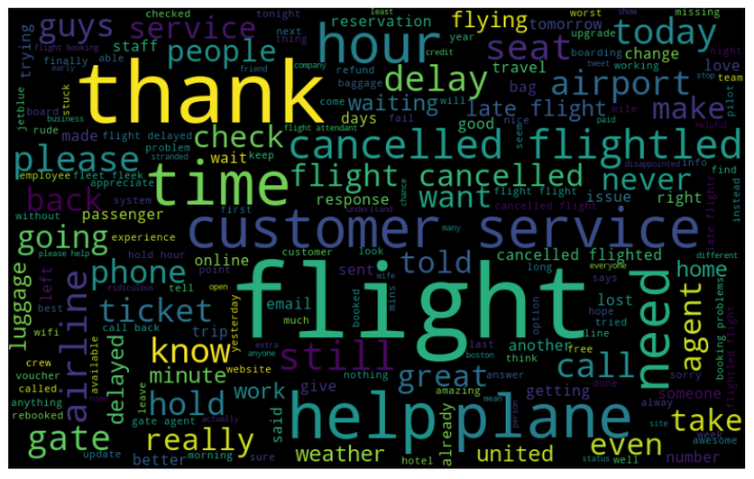
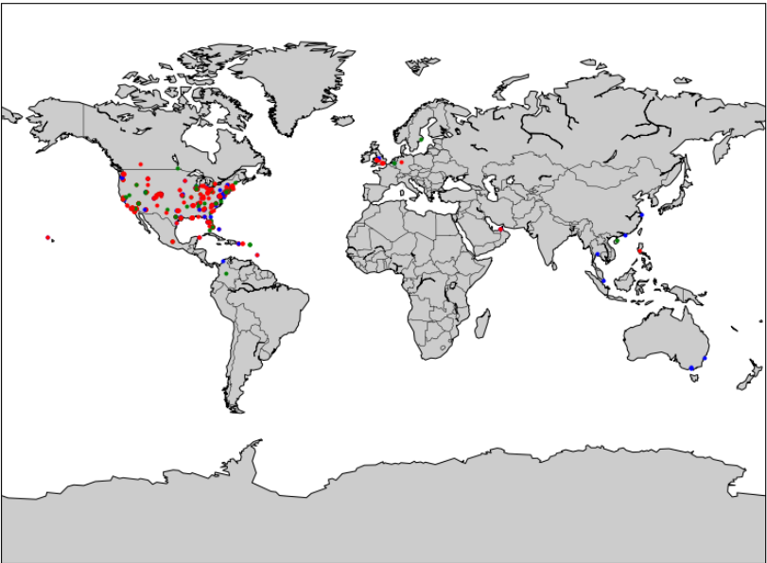
Sentiment analysis and predictions on airline Twitter reviews
Sevasti Yfanti, Vasileios Zaridis and Panagiotis Grigoriadis
Department of Electrical and Computer Engineering, University of Thessaly, Greece
Summary: Our task was to perform sentiment analysis and predictions on a dataset with tweets and other information on airline sentiments. We applied several ML algorithms and preprocessing techniques ,compared our results and extracted some conclusions.
Motivation
Learn NLP (natural language processing), which is a common and powerful practice applied today.
Learn how to extract sentiment from texts.
Learn how we could apply ML algorithms to improve a company’s efficiency.
Practice our skills on python and especially ML.
Observe and understand how Twitter data is used by today’s industries to extract useful information.
Even more specifically, delve into Neural Networks, which is an extremely popular technique in 2019.
Introduction
Sentiment analysis and prediction is a pretty common business problem nowadays
Tech giants like Google, Amazon, Facebook tackle with this last years.
It is almost always confronted with ML.
Airline companies are especially interested in it, because they want to have a clear image of how satisfier their customers are and what the need to improve.
Goal: Predict how bad/good/neutral the tweets regarding the companies were.
Method
NLP and data preprocessing, in general
Implementation of supervised learning algorithms
Classic ML algorithms, like Logistic Regression and SVM
More advanced techniques, like Random Forests and Neural Networks
Data
Extracted from a Kaggle competition [1] , although live data from twitter can also be used (did a similar homework in the past)
‘Airline twitter sentiment’ is an all set dataset, which includes the text itself, along with some extra information.
That extra information is why we chose this dataset, as it was really helpful.
# of attributes : 15
# of instances : 14640
Requires a lot of preprocessing (handling NAN values, handling categorical values with one-hot encoding)
Plotted many different graphs, to enhance our understanding of the data.
Experimental Results
NLP is very crucial
Especially word embedding must be done very carefully
Classic Machine learning algorithms seem to have accuracy in the range of [37~89]%
Best predictions: Gradient Boosting with textBlob sentiment preprocessing
Neural Networks seem to have accuracy in the range of [80~90]%
Best predictions: Simple Keras classifier with 1 layer and 8 hidden layer neurons
Conclusions
One must understand the data before proceeding
Preprocessing of the data can be more difficult than applying the algorithms themselves, and equally important
All algorithms seem quite successful
Neural Networks seem the most accurate, but they rely a lot on trial and error, and can be quite time consuming
Going forward: Of course, you can always apply and test more techniques, especially Neural Networks and experiment. That’s what we will do.
References:
[1] https://www.kaggle.com/crowdflower/twitter-airline-sentiment
Spring 2019, ECE 417 Poster Session

