Slide 1
ProActive
Adaptive Diagnostic Probe Sets with minimal test-time compute for Multimodal Reliability
Target - ICLR 2027
Presented By: Aman Prakash

Slide 2
Question:
How much evidence should we collect before deciding why an MLLM failed?

Slide 3
Question:
How much evidence should we collect before deciding why an MLLM failed?
Doctor’s Analogy It is similar to asking how much evidence a doctor needs before diagnosing a disease. e.g. Common Cold

Slide 4
Diagnosing MLLM failures is like diagnosing a medical patient
A doctor can diagnose a patient’s disease in the following ways:
Case I: Full Body Test
Patient → Symptoms → Full body test → Stop → Return diagnosis
Pros: 100% effective Cons: Costly

Slide 5
Diagnosing MLLM failures is like diagnosing a medical patient
A doctor can diagnose a patient’s disease in the following ways:
Case I: Full Body Test
Patient → Symptoms → Full body test → Stop → Return diagnosis
Pros: 100% effective Cons: Costly
Case II: Adaptive Testing
Patient → Symptoms → Order tests→ Analyze & collect evidence →Order more tests → Analyze & collect evidence → Stop → Return diagnosis
Pros: Cheap Cons: Less effective than a full-body test

Slide 6
Diagnosing MLLM failures is like diagnosing a medical patient
A doctor can diagnose a patient’s disease in the following ways:
Case I: Full Body Test
Patient → Symptoms → Full body test → Stop → Return diagnosis
Pros: 100% effective Cons: Costly
Case II: Adaptive Testing
Patient → Symptoms → Order tests→ Analyze & collect evidence →Order more tests → Analyze & collect evidence → Stop → Return diagnosis
Pros: Cheap Cons: Less effective than a full-body test
Case III: No Testing
Patient → Symptoms → No need of test; doctor analyze→ Return diagnosis
Pros: No cost Cons: Very few similar cases exist

Slide 7
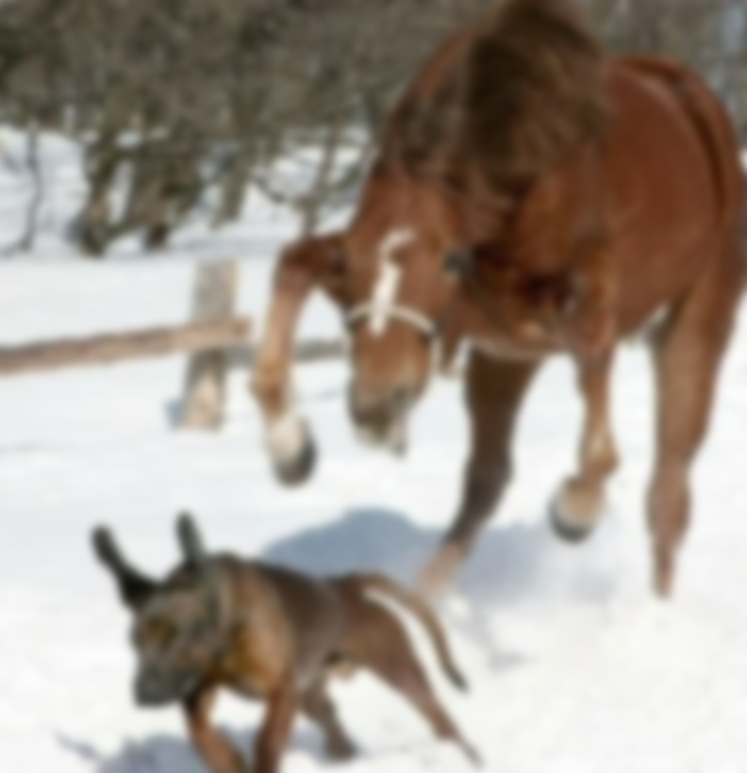
Relation of 3 cases with MLLM failure diagnosis using e.g.
Image: blurry image of a dog near a horse
Question: “What animal is jumping?”
Model: “Dog”
Ground Truth: “Horse”
Failure: Multiple reasons 1. Visual issue (image unclear) 2. Language prior (“dog” more common in the training dataset )
Source: Reddit

Slide 8
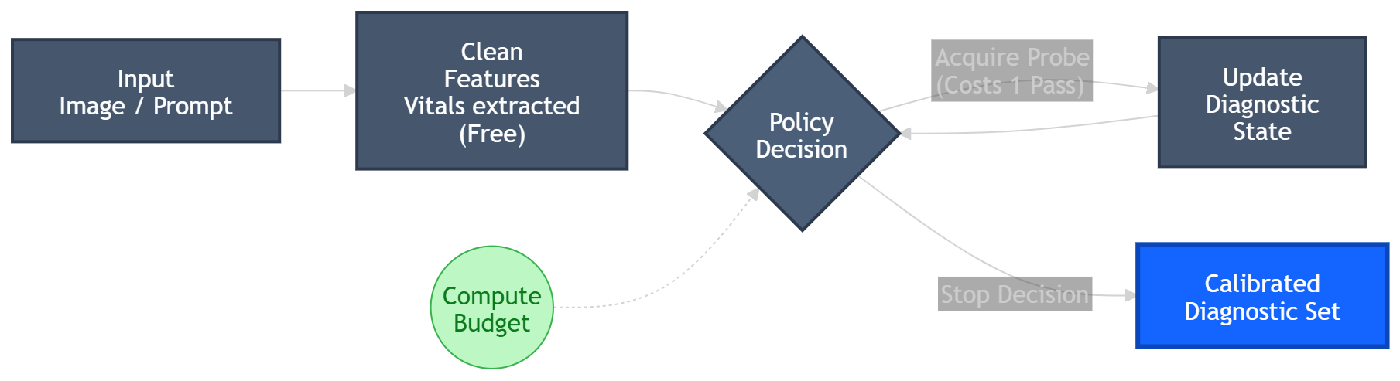
Case I: Full Probe test (analogy “Full Body Test”)
We blindly do all possible probe actions (visual probe, relation probe, etc)
Case II: Adaptive Testing
Probe 1 → remove image, then next probe Probe 2 → relation test, then next probe Probe 3 → grounding re-check & STOP
Case III: No Testing
Not applicable in this case

Slide 9
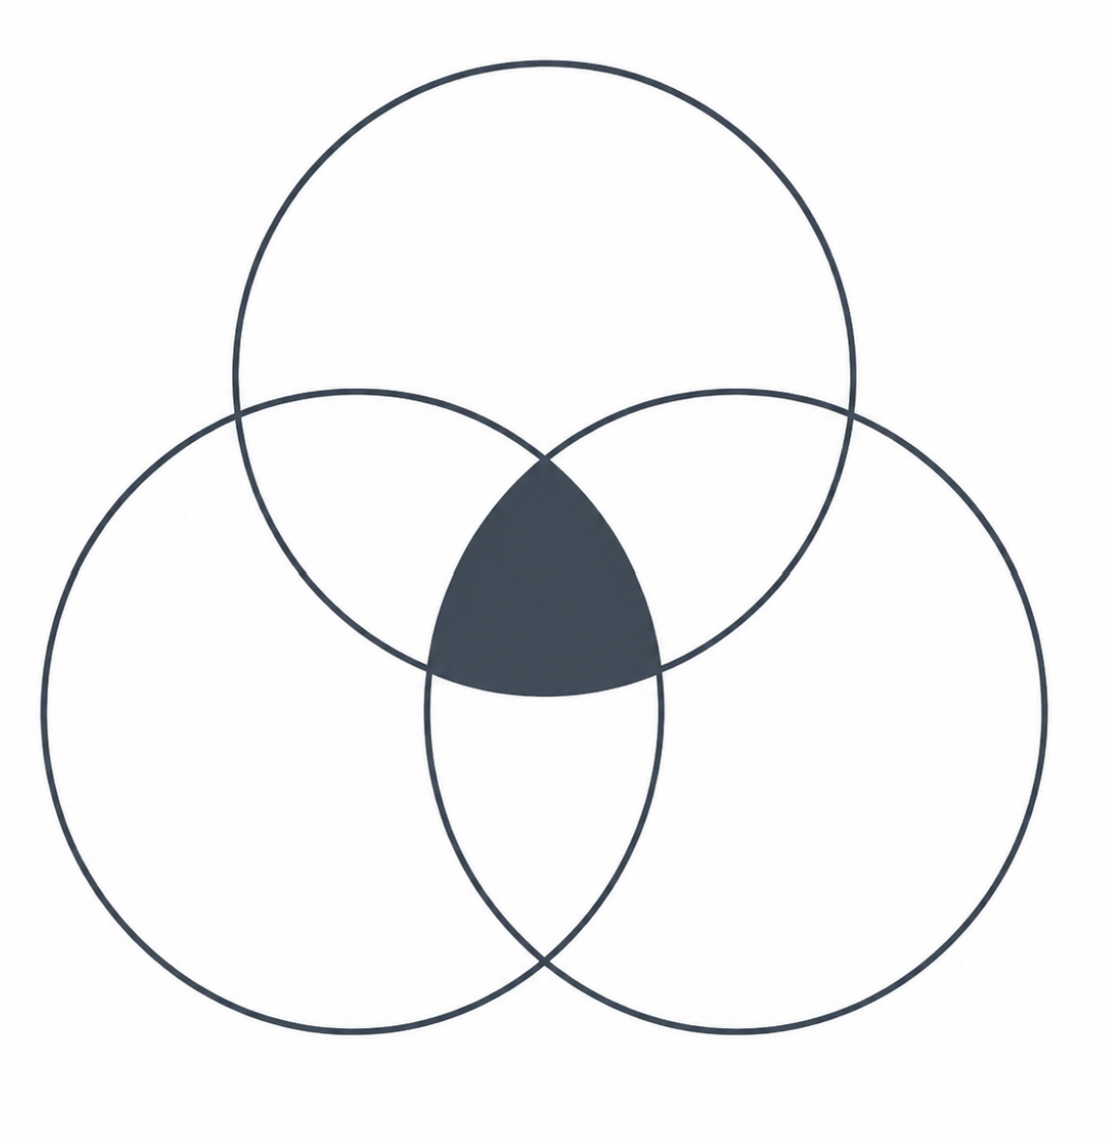
Problems with existing diagnosis in MLLMs
Entangled Symptoms
Visual Fragility
e.g. A visual illusion triggering a language bias
Language Prior
Alignment Relation

Slide 10
RQ 1: Probe Efficiency
Can we recover most diagnostic quality using only a few probes at a fraction of the cost?

Slide 11
RQ 2: Probe Adaptivity
Can adaptive probe selection outperform fixed probe schedules?

Slide 12
RQ 3: Generalization
Does the learned policy (decision rule to selectively run probe) on one model/dataset generalize to unseen MLLMs and datasets?

Slide 13
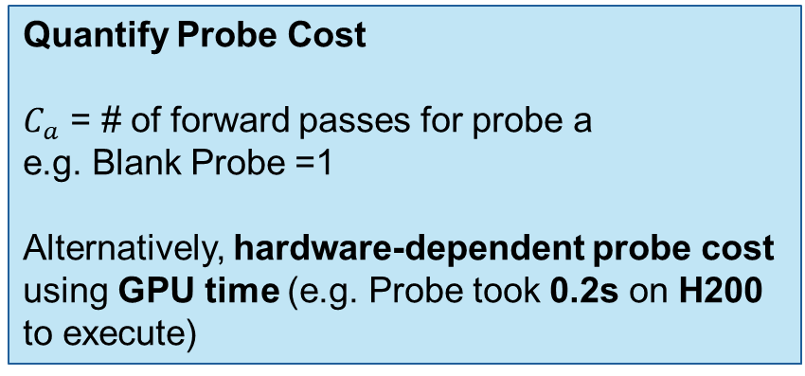
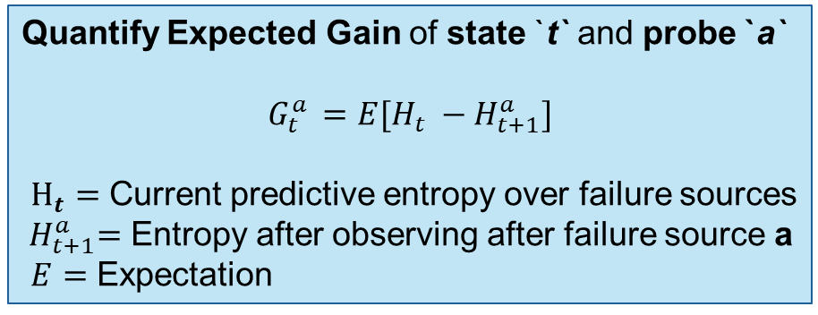
Core ML contribution of ProActive for ICLR
We aim to build a policy for the active selection of probes in order to predict the failure source.
Value of Information (${VOI}_{t}$ ) = Expected Gain ($G_{t}^{a })$– Probe Cost ($C_{a}$)
Our Policy: ProActive
Decision Rule: If ${VOI}_{t}$ > 0 then acquire probe, else STOP
Quantify Expected Gain of state `t` and probe `a`
$$G_{t}^{a }=E[H_{t} −H_{t+1}^{a}]$$
$H_{t}=$ Current predictive entropy over failure sources
${ H}_{t+1}^{a}=$ Entropy after observing after failure source a
$E=$ Expectation
Quantify Probe Cost
$C_{a}$ = # of forward passes for probe a
e.g. Blank Probe =1
Alternatively, hardware-dependent probe cost using GPU time (e.g. Probe took 0.2s on H200 to execute)

Slide 14
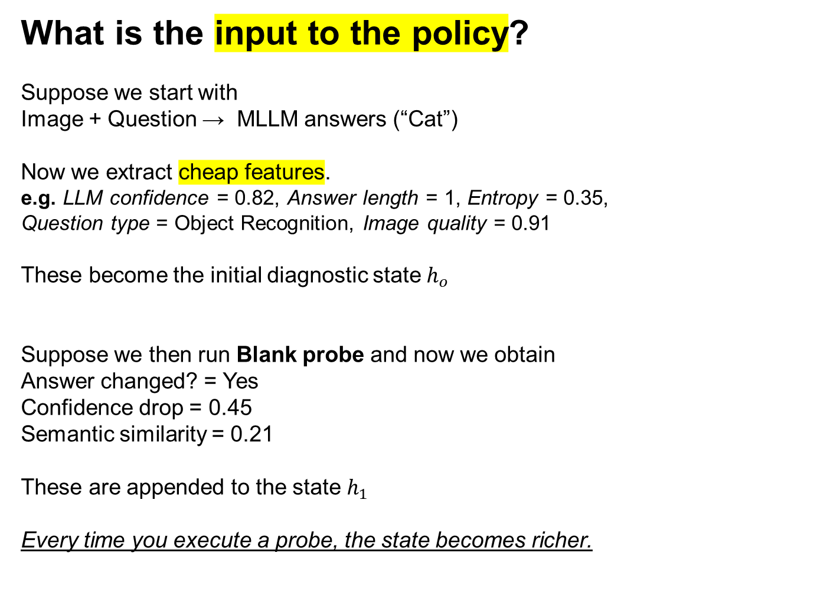
What is the input to the policy?
Suppose we start with
Image + Question → MLLM answers (“Cat”)
Now we extract cheap features.
e.g. LLM confidence = 0.82, Answer length = 1, Entropy = 0.35, Question type = Object Recognition, Image quality = 0.91
These become the initial diagnostic state $h_{o}$
​
Suppose we then run Blank probe and now we obtain
Answer changed? = Yes
Confidence drop = 0.45
Semantic similarity = 0.21
These are appended to the state $h_{1}$
​
Every time you execute a probe, the state becomes richer.

Slide 15
What does the policy output?
The policy simply predicts
Blank Probe (i.e. replacing image with blank image during inference): 0.72
Grounding Probe (Asking MLLM again “Check again carefully”): 0.18
Relation Probe (“Replacing terms like left and right): 0.05
STOP: 0.05
Repeat Probe or Stop
Policy network can be: 1. MLP (similar to AlphaGo)
2. Small Transformer

Slide 16
Key Pillars of this study
Multimodal hallucination diagnosis
Active feature acquisition
Adaptive test-time compute, and
4. Conformal/risk-controlled prediction Risk control = “explicitly limiting how often the model is allowed to be wrong.”

