Slide 1
Hello World!
This video was made to help people understand FFT, specifically for Georgia Tech Course CS-6515. This is hopefully achieved by giving a solid example and trying to attach that to notation used in the lecture videos and re-ordering a few things.
Pre-req:
DC4 FFT Part 1 videos 13 – 21: The complex number and root notation stuff. You need to know how to calculate roots.
Disclaimers:
I am not a TA
This video is not endorsed by the Georgia Institute of Technology in any way
Stuff in this video might be wrong, I am not liable for any damages this video may cause

Slide 2
In my opinion…Ideal order to watch lectures
Personally, for DC4 and DC5, I would watch lectures in the following order:
DC4 FFT Part 1 videos 13 – 21: The complex number and root notation stuff
This presentation: The matrix version of the FFT process in action
DC5 FFT Part 2 videos 6 – 18: Why the O(n²) FFT works proof
DC4 FFT Part 1 videos 5 – 12: How to do FFT in O(nlogn)
DC5 FFT Part 2 videos 1 – 5: How to do FFT in O(nlogn) continued
Alternatively, you can switch 2 and 3.
DC4 FFT Part 1 videos 1 - 4 I don’t think you need to watch. All you need to know from those videos is the the naïve approach to calculating C(x) is O(n²).
*** The above are all personal opinions though, everyone learns different.

Slide 3
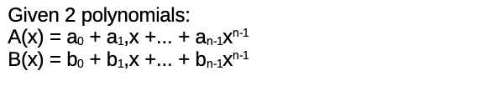
The Problem
Want to find out the co-efficients of C(x):
C(x) = A(x) * B(x) = c₀x⁰ + c₁x¹ + c₂x² + … + c_{2n-2}x^{2n-2}

Slide 4
Let’s work on a solid example and we’ll explain the FFT process along the way:
A(x) = 1 + 2x
B(x) = 5 + 5x
C(x) = ?

Slide 5
Steps:
1. Figure out what “n” is
2. FFT(a, W_{2n}) = (r₀, r₁, ... ,r_{2n-1})
3. FFT(b, W_{2n} ) = (s₀, s₁, ... ,s_{2n-1})
4. t = (r₀ * s₀, r₁ * s₁ , ... , r_{2n-1} * s_{2n-1})
5. FFT(t, W^{2n-1}) / 2n = (c₀, c₁ , ... , c_{2n-1})
Reference:
A(x) = 1 + 2x
B(x) = 5 + 5x
Take biggest exponent x terms from A(x) and B(x), in our case 2x and 5x. Multiply them together and find the exponent, in our case 2x * 5x = 10x² . So the exponent is 2 and let’s call that u for the general case.
In the general case n is such that {min g : 2u <= 2^{g}} and n = 2^{g} / 2.
In our example u = 2, so 2 * 2 <= 2^{g} . This implies g =2 and n=2. Technically g could be larger powers of 2 but ignore that.

Slide 6

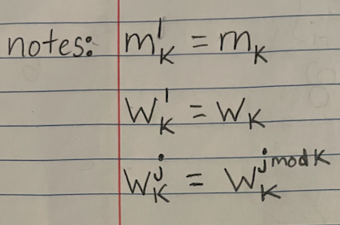
Steps:
1. Figure out what “n” is
2. FFT(a, W_{2n}) = (r₀, r₁, ... ,r_{2n-1})
3. FFT(b, W_{2n} ) = (s₀, s₁, ... ,s_{2n-1})
4. t = (r₀ * s₀, r₁ * s₁ , ... , r_{2n-1} * s_{2n-1})
5. FFT(t, W^{2n-1}) / 2n = (c₀, c₁ , ... , c_{2n-1})
Reference:
A(x) = 1 + 2x
B(x) = 5 + 5x
Step1: n=2
FFT(a, W_{2n}) is defined to be:
Vector a is just the coefficients of A(x) but what is the matrix m_{2n}?

Slide 7
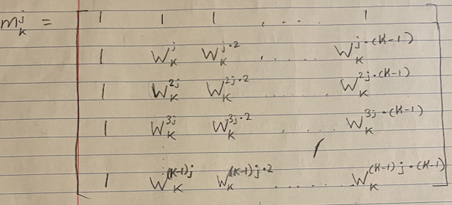
Steps:
1. Figure out what “n” is
2. FFT(a, W_{2n}) = (r₀, r₁, ... ,r_{2n-1})
3. FFT(b, W_{2n} ) = (s₀, s₁, ... ,s_{2n-1})
4. t = (r₀ * s₀, r₁ * s₁ , ... , r_{2n-1} * s_{2n-1})
5. FFT(t, W^{2n-1}) / 2n = (c₀, c₁ , ... , c_{2n-1})
Reference:
A(x) = 1 + 2x
B(x) = 5 + 5x
Step1: n=2
In general, a matrix

Slide 8


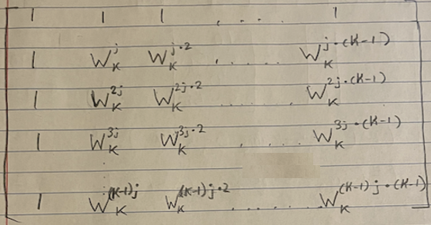
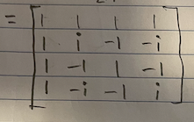
Steps:
1. Figure out what “n” is
2. FFT(a, W_{2n}) = (r₀, r₁, ... ,r_{2n-1})
3. FFT(b, W_{2n} ) = (s₀, s₁, ... ,s_{2n-1})
4. t = (r₀ * s₀, r₁ * s₁ , ... , r_{2n-1} * s_{2n-1})
5. FFT(t, W^{2n-1}) / 2n = (c₀, c₁ , ... , c_{2n-1})
Reference:
A(x) = 1 + 2x
B(x) = 5 + 5x
Step1: n=2
In our example that we are working on, j = 1 and k = 2n = 4 so:
=

Slide 9
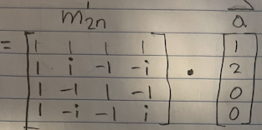
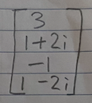

Steps:
1. Figure out what “n” is
2. FFT(a, W_{2n}) = (r₀, r₁, ... ,r_{2n-1})
3. FFT(b, W_{2n} ) = (s₀, s₁, ... ,s_{2n-1})
4. t = (r₀ * s₀, r₁ * s₁ , ... , r_{2n-1} * s_{2n-1})
5. FFT(t, W^{2n-1}) / 2n = (c₀, c₁ , ... , c_{2n-1})
Reference:
A(x) = 1 + 2x
B(x) = 5 + 5x
Step1: n=2
So FFT(a, W_{2n}):
=
So r = (r₀, r₁, ... ,r_{2n-1}) = (3, 1 + 2i , -1, 1 - 2i)

Slide 10

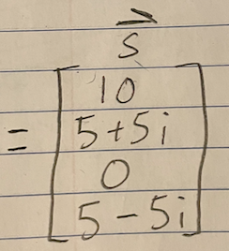
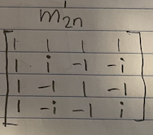
Steps:
1. Figure out what “n” is
2. FFT(a, W_{2n}) = (r₀, r₁, ... ,r_{2n-1})
3. FFT(b, W_{2n} ) = (s₀, s₁, ... ,s_{2n-1})
4. t = (r₀ * s₀, r₁ * s₁ , ... , r_{2n-1} * s_{2n-1})
5. FFT(t, W^{2n-1}) / 2n = (c₀, c₁ , ... , c_{2n-1})
Reference:
A(x) = 1 + 2x
B(x) = 5 + 5x
Step1: n=2
Step2: r=(3,1+2i,-1,1-2i)
Similarly, FFT(b, W_{2n}):
So s = (s₀, s₁, ... ,s_{2n-1}) = (10, 5 + 5i , 0, 5 - 5i)

Slide 11
Steps:
1. Figure out what “n” is
2. FFT(a, W_{2n}) = (r₀, r₁, ... ,r_{2n-1})
3. FFT(b, W_{2n} ) = (s₀, s₁, ... ,s_{2n-1})
4. t = (r₀ * s₀, r₁ * s₁ , ... , r_{2n-1} * s_{2n-1})
5. FFT(t, W^{2n-1}) / 2n = (c₀, c₁ , ... , c_{2n-1})
Reference:
A(x) = 1 + 2x
B(x) = 5 + 5x
Step1: n=2
Step2: r=(3,1+2i,-1,1-2i)
Step3: s=(10,5+5i,0,5-5i)
Calculate vector t, which is very straightforward:
t = (r₀ * s₀, r₁ * s₁ , ... , r_{2n-1} * s_{2n-1})
= [3 * 10, (1+2i) * (5 + 5i) , -1*0, (1-2i)*(5 - 5i)]
=[30, -5 + 15i, 0, -5-15i]

Slide 12
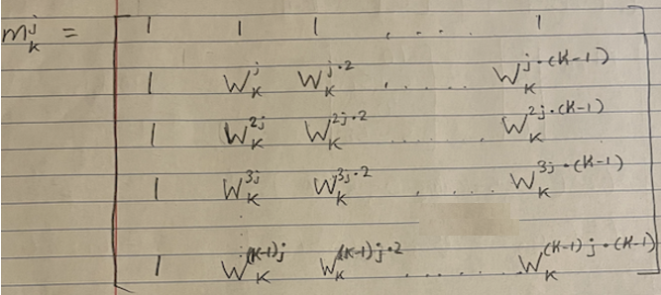
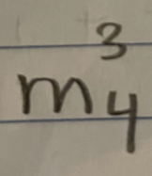
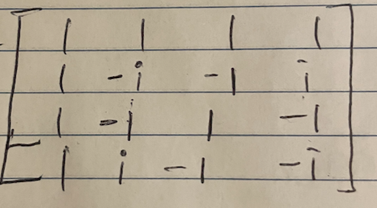
Steps:
1. Figure out what “n” is
2. FFT(a, W_{2n}) = (r₀, r₁, ... ,r_{2n-1})
3. FFT(b, W_{2n} ) = (s₀, s₁, ... ,s_{2n-1})
4. t = (r₀ * s₀, r₁ * s₁ , ... , r_{2n-1} * s_{2n-1})
5. FFT(t, W^{2n-1}) / 2n = (c₀, c₁ , ... , c_{2n-1})
Reference:
A(x) = 1 + 2x
B(x) = 5 + 5x
Step1: n=2
Step2: r=(3,1+2i,-1,1-2i)
Step3: s=(10,5+5i,0,5-5i)
Step4: t=(30,-5+15i,0,-5-15i)
We need a new matrix for the 3rd FFT, one where j = 2n -1 = 3 and k = 2n = 4
SO
=

Slide 13
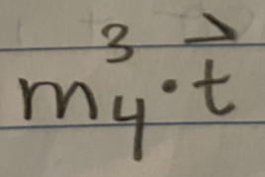
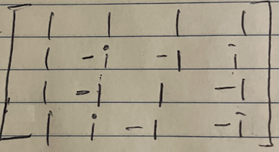
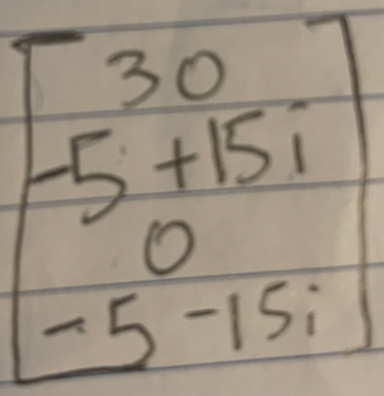
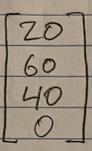
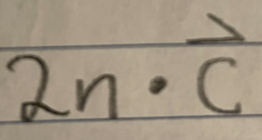
Steps:
1. Figure out what “n” is
2. FFT(a, W_{2n}) = (r₀, r₁, ... ,r_{2n-1})
3. FFT(b, W_{2n} ) = (s₀, s₁, ... ,s_{2n-1})
4. t = (r₀ * s₀, r₁ * s₁ , ... , r_{2n-1} * s_{2n-1})
5. FFT(t, W^{2n-1}) / 2n = (c₀, c₁ , ... , c_{2n-1})
Reference:
A(x) = 1 + 2x
B(x) = 5 + 5x
Step1: n=2
Step2: r=(3,1+2i,-1,1-2i)
Step3: s=(10,5+5i,0,5-5i)
Step4: t=(30,-5+15i,0,-5-15i)
Now we do the FFT:
=
=
=

Slide 14
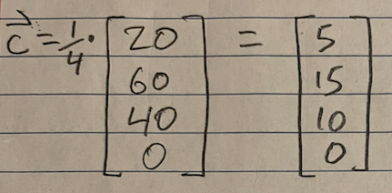
Steps:
1. Figure out what “n” is
2. FFT(a, W_{2n}) = (r₀, r₁, ... ,r_{2n-1})
3. FFT(b, W_{2n} ) = (s₀, s₁, ... ,s_{2n-1})
4. t = (r₀ * s₀, r₁ * s₁ , ... , r_{2n-1} * s_{2n-1})
5. FFT(t, W^{2n-1}) / 2n = (c₀, c₁ , ... , c_{2n-1})
Reference:
A(x) = 1 + 2x
B(x) = 5 + 5x
Step1: n=2
Step2: r=(3,1+2i,-1,1-2i)
Step3: s=(10,5+5i,0,5-5i)
Step4: t=(30,-5+15i,0,-5-15i)
Finally, we just divide everything we got from the Step 5 FFT by 2n=4:
Therefore c = (5, 15, 10, 0)

Slide 15
Verification
If c = (5, 15, 10, 0), then our final polynomial via fast fourier transform is:
C(x) = c₀x⁰ + c₁x¹ + c₂x² + c₃x³
C(x) = 5*1 + 15x + 10x² + 0x³
C(x) = 5 + 15x + 10x²
If we manually multiply A(x) * B(x) this is what we get… so we good.

