Slide 1

UECS3294 ADVANCED WEB APPLICATION DEVELOPMENT ASSIGNMENT: Blog Management System January 2021 Trimester
ID | Student Name | Email
1703648 | Tan Ying Yao | yyaoutar@1utar.my
1701231 | Lim Thien Chung | thienchung@1utar.my
1704368 | Wong Yin Khye | stevenwong0121@1utar.my

Slide 2
Blog Management System
All three roles are able to access the backend dashboard, however each role has their own specific functions available:
Users can only search and view blog posts without any permission to edit or delete them
Writers can search, view and even add new blog posts along with editing or deleting their own blogs
Admins have full functions of users and writers and the ability to create new categories and publish or draft blog posts.
Gates is the main authorization of this application. Each time a user is trying to access
CRUD functions, gates will be called to verify the current role of the user using ‘isAdmin’, ‘isUser’ or ‘isWriter’. The gates will check the database for the role of the current user. Each role has their own function as stated above.

Slide 3
Database Information
The application uses MySQL database system.
The database consist of the following tables:
i) Users: This table is used for maintaining user records for authentication and authorization purposes.
ii) Categories: This table is used to display the title of categories that is related to Blogs. Categories can belong to many blog posts.
iii) Blogs: This table is used to display and store title, description, body and image of blog posts. Each blog post has one category,

Slide 4
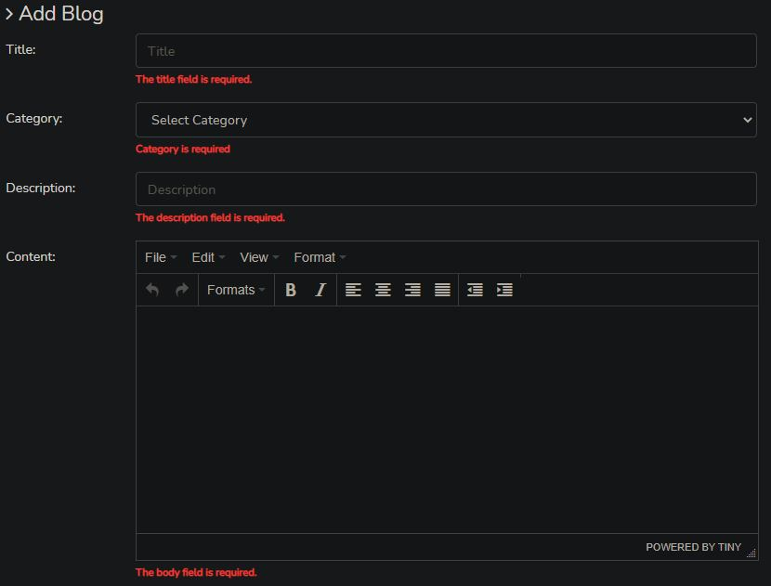
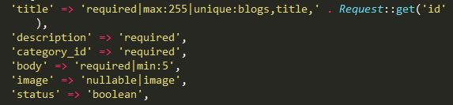
Data Validation
All CRUD Operations has data validation for inputs as demonstrated when adding a new blog post below:
Field validation has been added
to all relevant categories

Slide 5
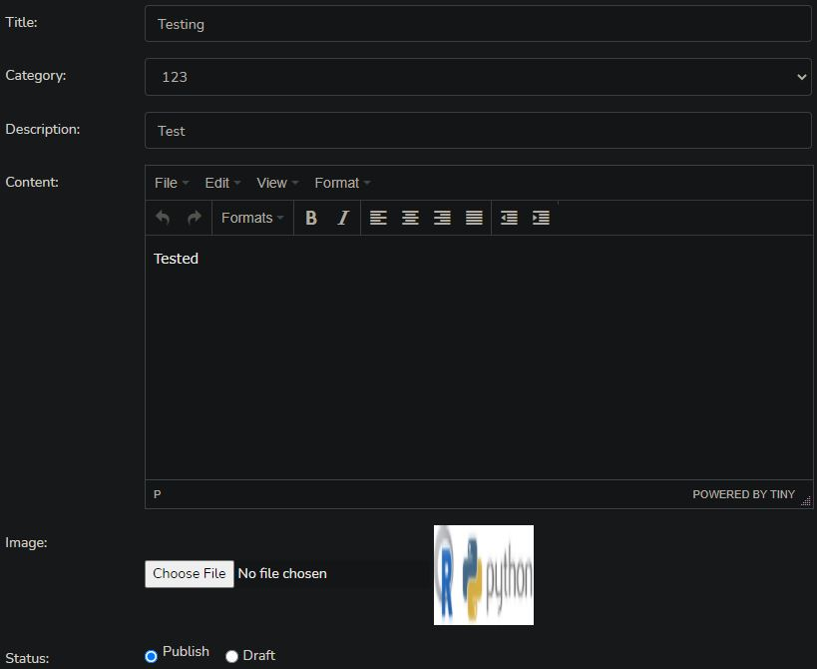
CRUD Function: Add Blog
Blog post can only be added by Admin
Or writers in the dashboard:

Slide 6
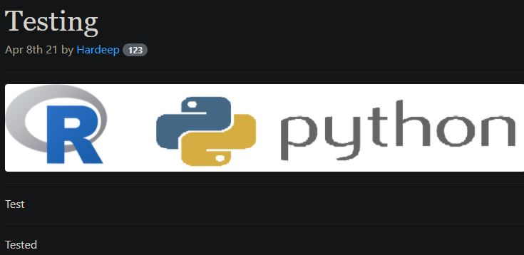
CRUD Function: View Blog
Blog post is added and shown in main page of the system

Slide 7
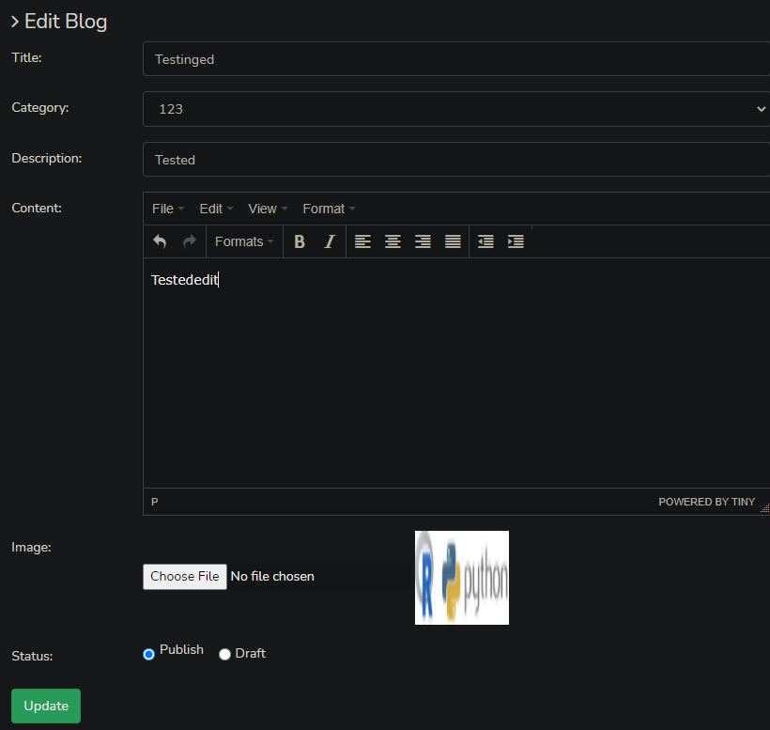
CRUD: Edit Blogs
Blog post can be edited and updated
by Admin and Writers

Slide 8
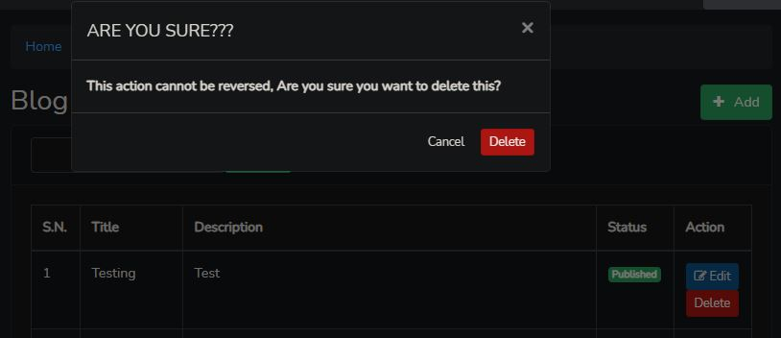
CRUD Function: Delete Blogs
Blog post can be deleted
by Admin and Writers

Slide 9
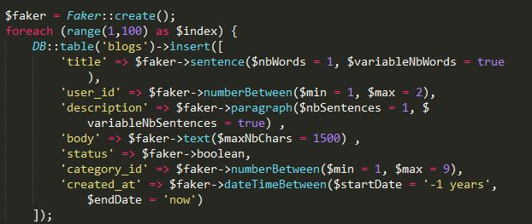
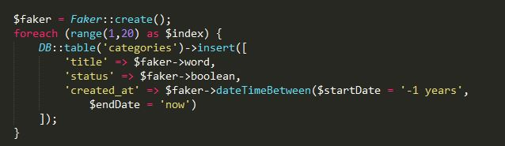
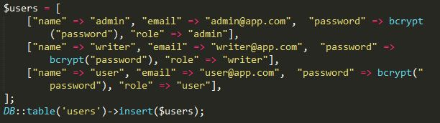
Database Relational Queries
Database seeders has been created for all three tables:
Using Faker function to seed fake data in database

Slide 10
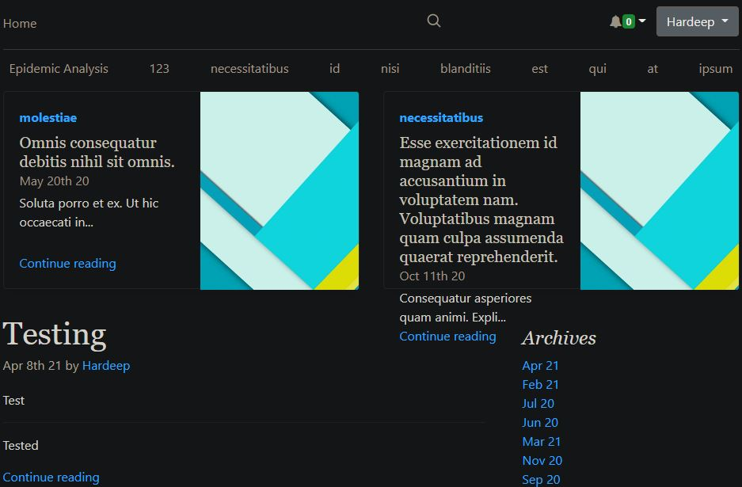
Database Seeded
Blog Management System is seeded by non-sensical data

Slide 11
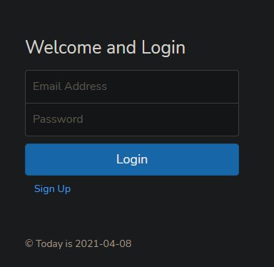
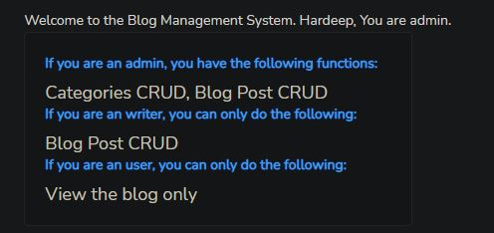
User Authentication
Users will be greeted in the login page when chosen, and will be prompted to sign up if they have not done so.
The role of the user is shown in the dashboard:

Slide 12
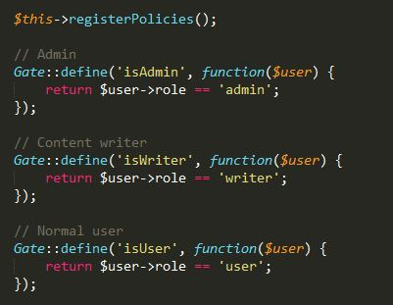
Usage of Gates
Gates is the main authorization of this application. Each time a user is trying to access
CRUD functions, gates will be called to verify the current role of the user using ‘isAdmin’, ‘isUser’ or ‘isWriter’.

Slide 13
Gates: isUser
User is navigated to the main page and cannot access the backend dashboard

Slide 14
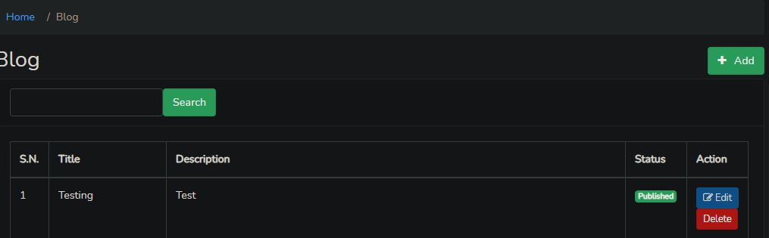
Gates:isWriter
Writer can add, edit and even delete blog posts

Slide 15
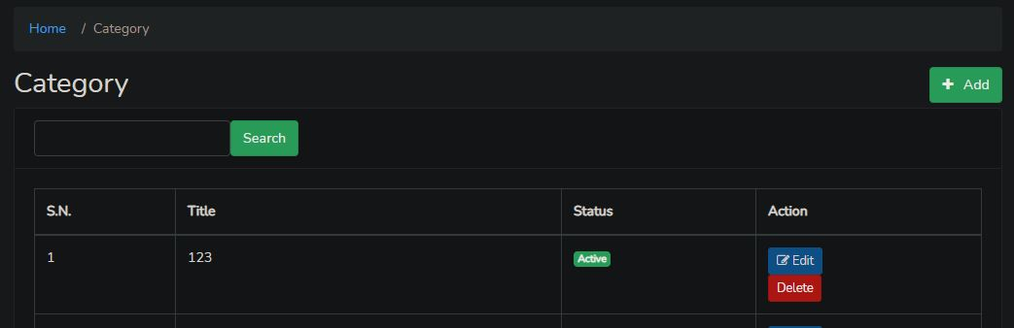
Gates:isAdmin
Admin has full functions of the system including: add, edit and delete blog posts and categories

Slide 16
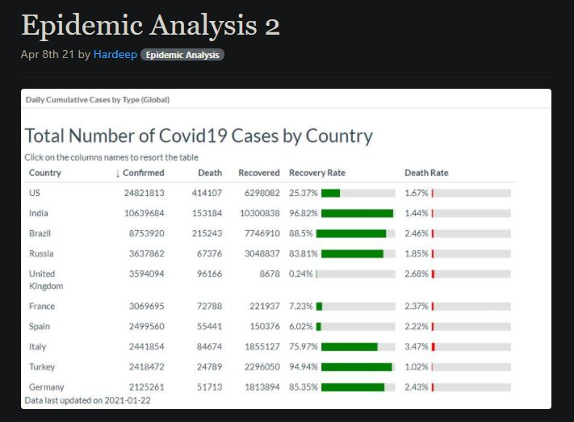
Photo Gallery
The blog post also features photo gallery function, allowing uploads of photos to blog posts

Slide 17
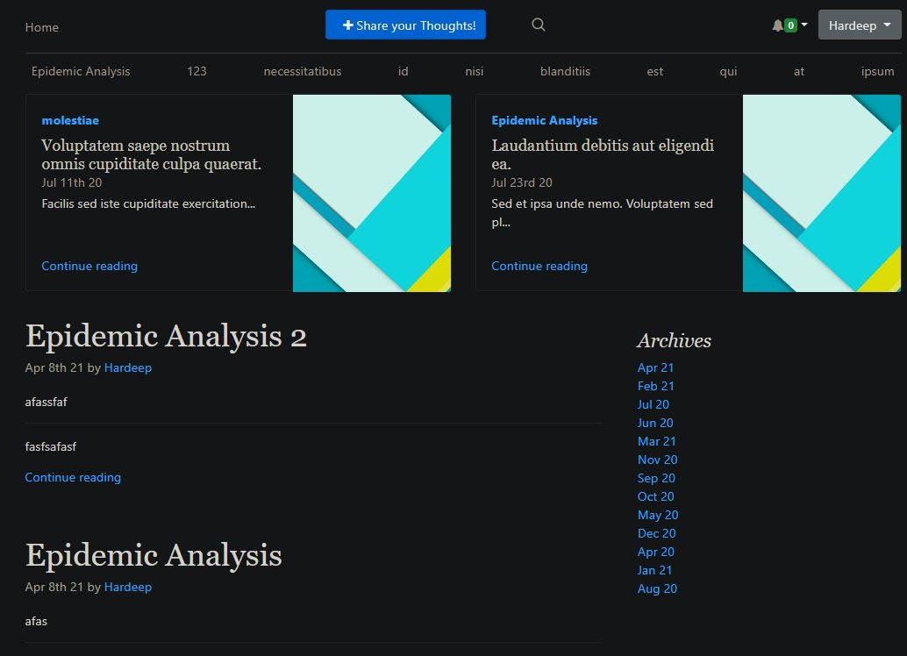
Thank You for taking your time reading this!

