Slide 1
CLAUDE SKILLS
Claude Skills
3
A Practitioner's Guide — What skills are · When to use them · How they're built
Core Sections
∞
Reusable Workflows
1
SKILL.md to Rule Them All
SKILLS
CLAUDE CODE
SKILL.md
AGENTIC AI

Slide 2
AGENDA
Three sections take you from zero to skill-creator.
Skills encode expert workflows — write once, trigger automatically, reproduce perfectly every time.
01
02
03
What is a Skill?
When to Use Skills
Anatomy of a Skill
Definition, purpose, and the recipe analogy — understand what a skill is before you build one.
Triggers, use-cases, and the decision criteria for choosing a skill over a prompt or CLAUDE.md.
File structure, YAML frontmatter, progressive disclosure, and bundled resources — dissected.
CONFIDENTIAL — Claude Skills | The Forge — Intelligence Engineered
The Forge

Slide 3
01
What is a Skill?
Definition · Purpose · The Recipe Analogy
SKILL.md
YAML FRONTMATTER
PROGRESSIVE DISCLOSURE

Slide 4
WHAT IS A SKILL?
A skill is a directory of instructions Claude loads automatically when needed.
📁 A Folder
🧠 Context on Demand
⚡ Repeatable Excellence
›
A skill is simply a directory containing a required SKILL.md file.
›
Skills are listed in Claude's context at all times (name + description only).
›
Once written, a skill encodes a best-practice workflow permanently.
›
Optional sub-folders hold scripts, reference docs, and assets.
›
The full SKILL.md body loads only when the skill triggers.
›
Any Claude invocation gets the same expert-level result.
›
No code required for basic skills — Markdown is enough.
›
Bundled resources (scripts, refs) load only when referenced.
›
Skills can be versioned, shared across teams, and org-deployed.
›
Install via Claude.ai Settings › Skills, or place in .claude/skills/
›
This keeps the main context window lean and focused.
›
They work identically across Claude.ai, Claude Code, and the API.
CONFIDENTIAL — Claude Skills | The Forge — Intelligence Engineered
The Forge

Slide 5
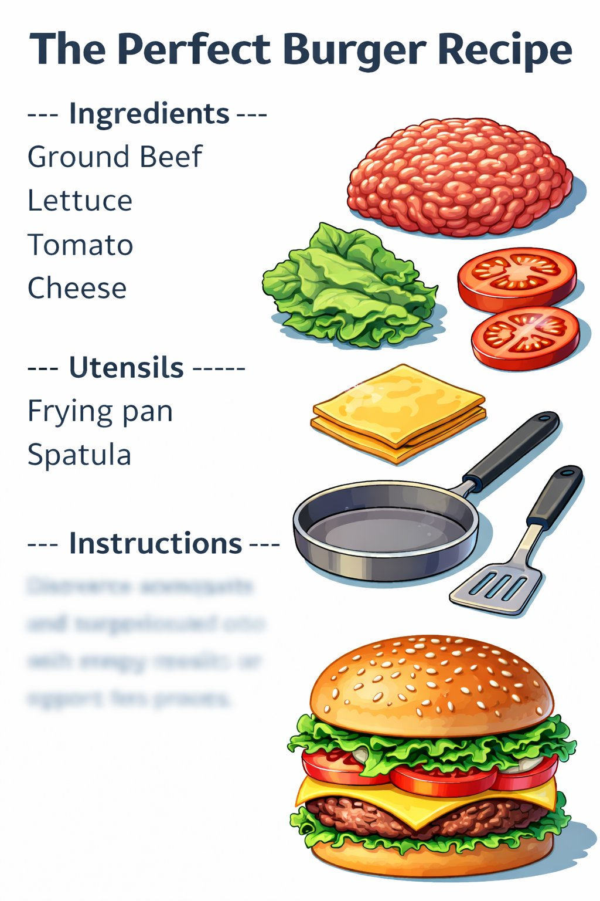

THE RECIPE ANALOGY
A well-crafted skill works exactly like a great food recipe.
🍔 A Food Recipe
🤖 A Claude Skill
›
YAML frontmatter
Name, description, trigger
›
Bundled scripts
Tools Claude can execute
≡
›
SKILL.md body
Step-by-step instructions
›
Ingredient list
Specific inputs required
›
Consistent output
Same quality, every invocation
›
Utensils
Tools needed to execute
Oct 2025
›
Instructions
Step-by-step procedure
Skills Released
›
Yields
Predictable, repeatable output
500 lines
Max SKILL.md Target
"Anyone who reads the recipe can reproduce the dish perfectly — every single time."
"Anyone who deploys the skill gets Claude performing the task at expert level — every time."
CONFIDENTIAL — Claude Skills | The Forge — Intelligence Engineered
The Forge

Slide 6
02
When to Use Skills
Triggers · Use-Cases · Decision Criteria
ACTIVATION
DESCRIPTION QUALITY
TRIGGER PATTERNS

Slide 7
WHEN TO USE SKILLS
Skills outperform prompts when workflows are complex, repetitive, or need to be shared.
🔁 Repetitive
Complex Tasks
🔧 Specialized
Tool Chains
📐 Consistency
& Standards
🚀 Onboarding
& Sharing
Multi-step workflows you run regularly — generating PowerPoints, validating EDI files, creating Word reports.
Skills remove the need to re-explain the process each time. Write it once; Claude applies it always.
When Claude needs specific scripts, exact library versions, or a precise CLI sequence — bundle it in a skill so the process never drifts.
Scripts in skills/ are executable without loading.
Brand guidelines, design tokens, naming conventions, data masking rules. Skills encode standards so every output matches org expectations without manual review.
Package expertise so teammates get expert-level results without deep knowledge. Org admins can deploy skills workspace-wide (shipped Dec 2025).
CONFIDENTIAL — Claude Skills | The Forge — Intelligence Engineered
The Forge

Slide 8
TRIGGERING
Claude's description-matching is the gatekeeper — write it well and skills activate reliably.
How Triggering Works
Description Quality Matters
›
All skill names + descriptions are always in Claude's context
✗ Weak — undertriggers
"How to build a dashboard to display internal data."
›
When a request matches a skill description, Claude reads the full SKILL.md body
›
Simple one-step queries may not trigger — substantive tasks work best
✓ Strong — activates reliably
"Build dashboards to display internal data. Use when user mentions dashboards, data visualization, internal metrics, or wants to display company data — even if they don't say 'dashboard.'"
›
Testing: real-world data shows optimized descriptions improve activation from 20% to 90%
›
Keep descriptions front-loaded with key use-cases — each entry is capped at 1,536 characters
CONFIDENTIAL — Claude Skills | The Forge — Intelligence Engineered
The Forge

Slide 9
03
Anatomy of a Skill
File Structure · Frontmatter · Bundled Resources
SKILL-CREATOR
DIRECTORY LAYOUT
3-LEVEL LOADING

Slide 10
ANATOMY — FILE STRUCTURE
The skill-creator skill illustrates the full directory layout and 3-level progressive disclosure.
skill-creator/
Progressive Disclosure — 3 Levels
├── SKILL.md ← required
1
Metadata
│ ├── YAML frontmatter
name + description
Always in context (~100 words)
Powers the triggering decision
Capped at 1,536 chars per skill
│ └── Markdown body
├── agents/
│ ├── grader.md
2
SKILL.md Body
│ ├── comparator.md
Full instructions loaded on trigger
Target: under 500 lines
Reference bundled files with clear pointers
Split to continuation slides if needed
│ └── analyzer.md
├── references/
3
Bundled Resources
│ └── schemas.md
scripts/, references/, assets/
Loaded only when referenced
Can be unlimited in size
Scripts execute without loading content
└── scripts/
└── run_loop.py
CONFIDENTIAL — Claude Skills | The Forge — Intelligence Engineered
The Forge

Slide 11
ANATOMY — SKILL.MD
The frontmatter is the brain; the body is the blueprint. Both must be precise.
SKILL.md — frontmatter + body
Key Frontmatter Fields
---
name
name: skill-creator
description: >
Skill identifier used in file naming and packaging. Keep it short and unique.
Create new skills, modify existing.
Use when users want a skill,
description
even if they don't say 'skill'.
Primary trigger signal. Be specific and 'pushy' — include exact phrases users might say. Front-load key use-cases. Cap: 1,536 chars.
---
# Skill Creator
compatibility
A skill for creating and improving
Optional. List required tools or dependencies (e.g., Node.js, Python, LibreOffice).
other skills iteratively.
## Creating a Skill
# Body
### Capture Intent
Markdown instructions Claude follows. Reference bundled files with explicit 'read when' guidance. Stay under 500 lines.
Start by understanding the user...
CONFIDENTIAL — Claude Skills | The Forge — Intelligence Engineered
The Forge

Slide 12
KEY TAKEAWAYS
Five things to remember when building and deploying Claude Skills.
01
02
03
Skills = Folders
Recipes for Claude
Trigger via Description
A skill is a directory with SKILL.md plus optional scripts, references, and assets. No server, no API, no complex setup.
Like a food recipe, a well-crafted skill encodes expertise once — any Claude invocation reproduces the same expert-level result.
The YAML description is the gatekeeper. Be specific and pushy — include the phrases users will actually type.
04
05
Load Progressively
Open Standard
Metadata always → SKILL.md on trigger → bundled resources on demand. Keep context lean; only load what's needed.
Agent Skills is an open standard (Dec 2025). The same SKILL.md works across Claude.ai, Claude Code, and other AI platforms.
CONFIDENTIAL — Claude Skills | The Forge — Intelligence Engineered
The Forge

Slide 13
RESOURCES & FURTHER LEARNING
Official docs, video tutorials, and community deep-dives to build your skills practice.
📄 Official Docs
▶ Video & Tutorials
🔬 Deep Dives
›
Skills How-To Guide
›
Full Claude Skills Tutorial for Beginners in 2026!
›
Complete Guide to Building Skills (PDF)
claude.ai/docs/skills/how-to
youtube.com — search title
resources.anthropic.com (Anthropic, Jan 2026)
Core reference — structure, frontmatter, bundled resources
Beginner-to-pro: SKILL.md, triggering, bundled resources
Official patterns: org deployment, open standard, distribution
›
Claude Code: Extend with Skills
›
Otto from Anthropic — Agent Skills in 4 min
›
Claude Skills Comprehensive Guide 2026
code.claude.com/docs/en/skills
websearchapi.ai/blog/claude-code-skills
anandbg.com/blog/claude-skills-guide-2026
Activation, hot-reload (Jan 2026), env variable tuning
Skills vs CLAUDE.md vs MCP — the clearest comparison
Hot-reload, invocation control flags, enterprise patterns
›
Agent Skills Overview (API)
›
Codecademy: Build a Lesson Plan Generator
›
10 Must-Have Skills for Claude in 2026
platform.claude.com/docs/agents-and-tools
codecademy.com/article/how-to-build-claude-skills
medium.com/@unicodeveloper (Mar 2026)
Pre-built skills (pptx, xlsx, docx, pdf) + custom via API
Hands-on beginner tutorial — YAML, body, testing (<1 hr)
Community top-skills: frontend-design (277k installs), gws
›
Skills Cookbook (Jupyter)
›
AI & ML Human Training: Getting Started
›
Skills Activation Best Practices (GitHub)
platform.claude.com/cookbook/skills
medium.com — AI ML Human Training
gist.github.com/mellanon/50816550e
Hands-on notebooks: xlsx, pptx, pdf via the API
6-step quick-skill tutorial with official GitHub examples
Research: optimized descriptions = 20%→90% activation
CONFIDENTIAL — Claude Skills | The Forge — Intelligence Engineered
The Forge

Slide 14
Skills turn Claude into
a specialist.
Write the skill once. Let Claude apply it everywhere.
SKILL.md
YAML FRONTMATTER
PROGRESSIVE DISCLOSURE
THE FORGE

