Slide 1
MOVIES Victor Githinji
Understanding the current Movie Trends

Slide 2
Objectives
Getting to know movie genres
Which are the most common genres
To see which genres have been most common in the recent years

Slide 3
Background
Movies continue to become a major source of entertainment for many people
The development of streaming services has made distribution of movies much easier, and increased movie consumption
This has created increased demand for movies, leading to the need for creation of new movie studios

Slide 4
Genres
1. Action,Crime,Drama
2. Biography,Drama
3. Drama
4. Comedy,Drama,Fantasy
5. Comedy
6. Adventure,Animation,Comedy
7. Biography
8. History

Slide 5
9. Documentary
10. Animation,Drama,History
11. Drama,Mystery
12. Action,Animation,Comedy
13. Biography,Comedy,Drama
14. Action,Drama
15. Documentary,History
16. Sci-Fi

Slide 6
Problem
Exploring movies doing best in the Box Office
Provide insight to the Head of Microsoft new Movie Studio, on what type of films to focus more on creating
Need to improve on resource mobilization to produce the right movies for their consumers

Slide 7
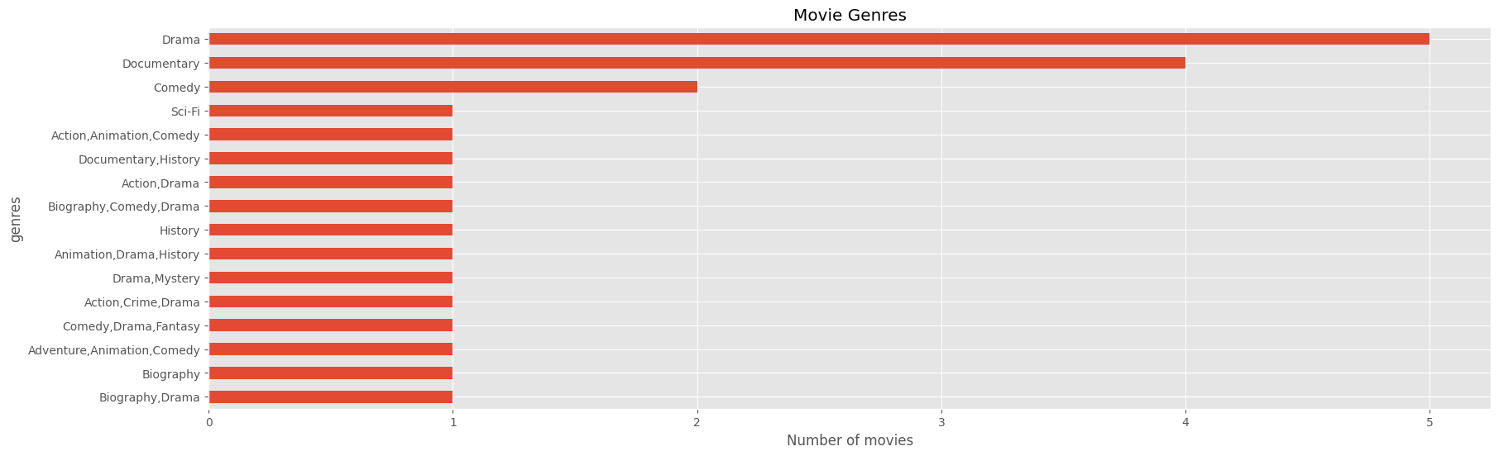

Slide 8

Most common genres that have been in production are Drama, Documentary and Comedy.

Slide 9
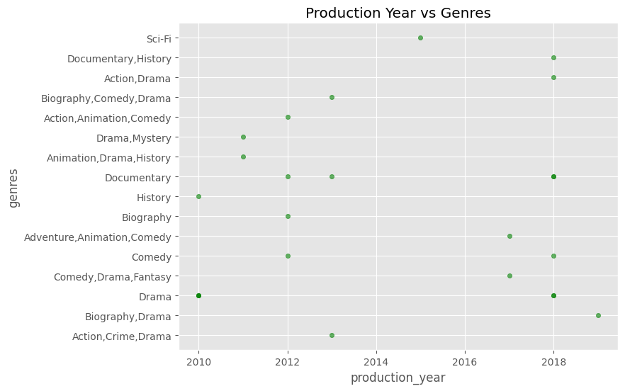

Slide 10
Below is a scatter plot representing genres of movies produced verses their production years. from the scatter plot, we can also see the various common genres being common in the most recent years being Documentary History, Action and Drama, Comedy, Documentary and Drama

Slide 11
Summary
1. Three movies genres stand out
*Drama
*Documentary
*Comedy
2. These three genres are common in the recent years, so currently relevant
3. 2018 had the most movies

Slide 12
Recommendations
1They should be prepared to produce more movies
2. More focus should be put in production of Drama movies
3. Production should be continuous
4. Movie categories to focus on(Drama, Comedy, and Documentary)

Slide 13
THANK YOU

