Slide 1



Consumer Goods
Ad_Hoc Insights

Slide 2
INTRODUCTION:
Atlic Hardware is leading computer hardware producer in India and its expanded world wide.The company has a head office in Delhli and regional offices throughout India.
BACKGROUND:
The management wants to get insights on their company products and sales too.
The insights will help the management to make data driven decisions.
GOALS:
Atliq Hardware wants to do ad-hoc analysis therefore analytical team assigned us a task to generate a report by running 10 ad_hoc requests.
We ran 10 ad_hoc requests using SQL to present meaningful insights to our Stakeholders when will help our Company to make data -driven decisions for their business growth.

Slide 3
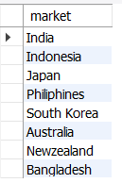
1.Provide the list of markets in which customer "Atliq Exclusive" operates its business in the APAC region.
Output:
Atliq store has established its presence in 8 major markets in the APAC region
Among this 8 countries, India is the most active market.

Slide 4

2. What is the percentage of unique product increase in 2021 vs. 2020? The final output contains these fields,
unique_products_2020 unique_products_2021 percentage_chg
Output:
36.33 % increase in the unique Product count from 2020 to 2021 indicates that the business has grown significantly in the past year

Slide 5
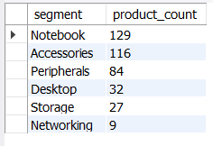
3. Provide a report with all the unique product counts for each segment and sort them in descending order of product counts. The final output contains 2 fields,
segment
product_count
Output:
Notebooks and accounts have the highest number of unique products ,129 and 116 respectively which reveals they have a good performance
Networks Segment has only 9 unique Products suggesting poor performance.

Slide 6
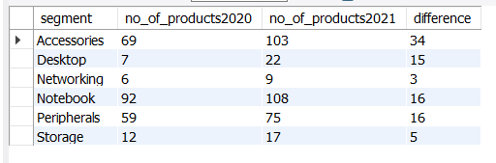
4. Follow-up: Which segment had the most increase in unique products in 2021 vs 2020? The final output contains these fields,
segment product_count_2020 product_count_2021 difference
Accessories segment has the largest increase in the unique products 2020 to 2021 while the Desktop segment has the largest percentage increase
Output:

Slide 7





Accessories segment has seen the largest increase in the product count with value 34 which means they selling more unique products in 2021 than 2020
Network segment has seen that the smallest increase in the product count,which indicates their sales performance is very less

Slide 8



5. Get the products that have the highest and lowest manufacturing costs. The final output should contain these fields,
product_code product
manufacturing_cost
0.892
240.5364
Output:
AQ Master wired x1 Ms
AQ HOME Allin1
Gen 2
AQ HOME Allin1 Gen 2 has the highest manufacturing cost
AQ Master wired x1 Ms has the lowest manufacturing cost

Slide 9
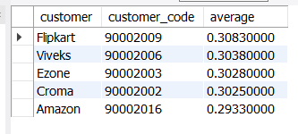
6. Generate a report which contains the top 5 customers who received an average high pre_invoice_discount_pct for the fiscal year 2021 and in the Indian market. The final output contains these fields,
customer_code customer
average_discount_percentage
In 2021,the top 5 customers were offered similar pre invoice discount percentages
With Flipkart being the most heavily discounted customer in the Indian market at 0.3083
Output:

Slide 10
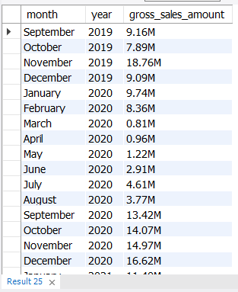
7.Get the complete report of the Gross sales amount for the customer “Atliq Exclusive” for each month. This analysis helps to get an idea of low and high-performing months and take strategic decisions.The final report contains these columns:
Month Year
Gross sales Amount
Output:
The sales amount was stable from September 2019 to 2020,but then dropped Significantly in March & April 2020,which may be due to the COVID-19 pandemic
The sales amount in Nov 2020 was much higher than in previous months at 32 M dollars

Slide 11

8. In which quarter of 2020, got the maximum total_sold_quantity? The final output contains these fields sorted by the total_sold_quantity,
Quarter
total_sold_quantity
Output:
During the 3rd Quarter of FY2020, COVID-19 was at its peak the sold quantity is dropped to 2.08 M which months are March,April and May.
First Quarter has the most amount of quantities sold as we know that the first quarter comes with September,October and November

Slide 12

9. Which channel helped to bring more gross sales in the fiscal year 2021 and the percentage of contribution? The final output contains these fields,
Channel
gross_sales_mln
percentage
Output:
The Retailer channel has high percentage of contribution towards sales FY2021
The sales contribution of other channels, Direct and Ditributer is Comparatively very low

Slide 13
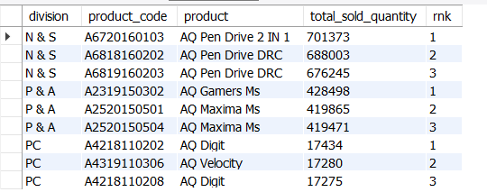
10. Get the Top 3 products in each division that have a high total_sold_quantity in the fiscal_year 2021? The final output contains these fields,
Division
product_code
product
total_sold_quantity
rank_order
The largest amount of products got sold in the division N & S ,whereas their products are cheaper than the products in the division P & A and PC
Division PC is the lowest amount of products sold
Output:

Slide 14
THANK YOU

