Slide 1
Computer Architecture

Slide 2
What is micro-operation?
  The operations executed on data stored in registers are called “micro-operations”
    e.g increment,load,shift etc
    Types
    i)Register Transfer Micro-operations
    ii)Arithmetic ------
    iii)Logical ------
    iv)Shift -------

Slide 3
Register Transfer Logic (RTL)
  The symbolic notation used to describe the micro-operation transfers among registers is called a ‘register transfer language’
  Every statement written in RTL notation implies a hardware construction for implementing the transfer

Slide 4
Basic Symbols for RTL
Symbol | Description | Examples
Letters & denotes a numerals Register MAR , R2
Parentheses ( ) denotes a part of R2(0-7) a register R2(L)
Arrows ← denotes a transf- R2 ← R1 er of information
Comma separate two R2←R1, micro operations R1←R2

Slide 5
If we want the transfer to occur only under a predetermined control condition,it is represented as ,
  P : R2 ← R1 (If P =1 then R2←R1)
  Control condition may have only value ‘1’ or ‘0’
  It is terminated with a colon.

Slide 6
Arithmetic Micro operations
Arithmetic micro operations perform arithmetic operations on numeric data stored in registers.
  e.g addition,subtraction,increment,decrement
  Addition R3 ← R1 + R2
  Subtraction R3 ← R1- R2 R2 ← R2’
  R2 ← R2’ + 1
  R3 ← R1 + R2’+1
  -Increment R1 ← R1 + 1
  -Decrement R1 ← R1 - 1

Slide 7
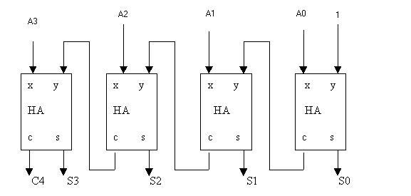
4-bit binary incrementer

Slide 8
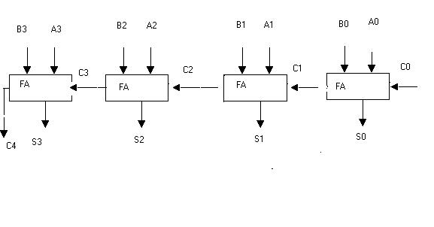
4-bit binary adder

Slide 9
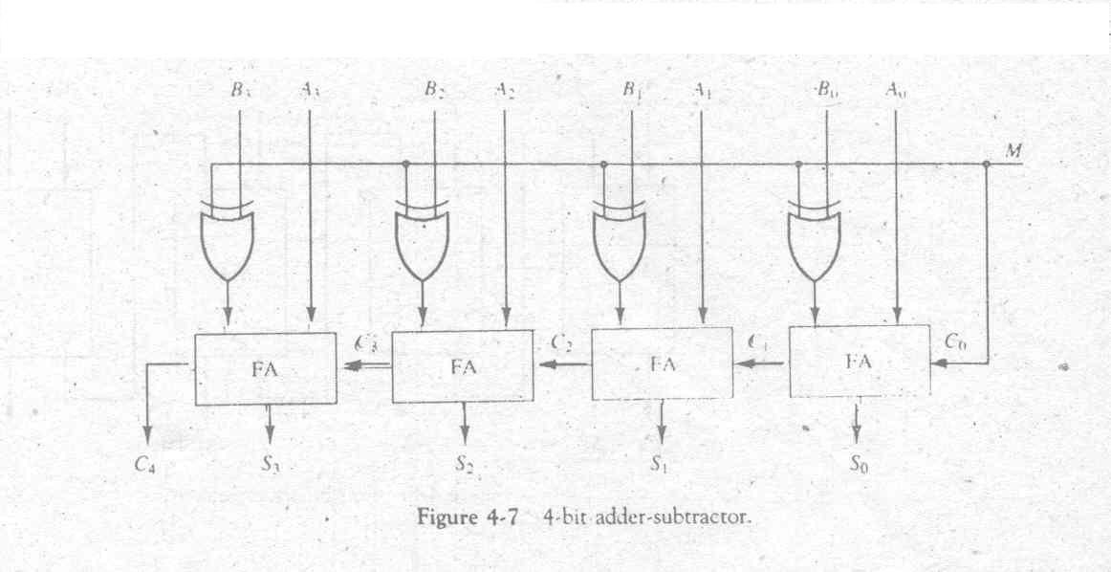
4-bit adder-subtractor

Slide 10
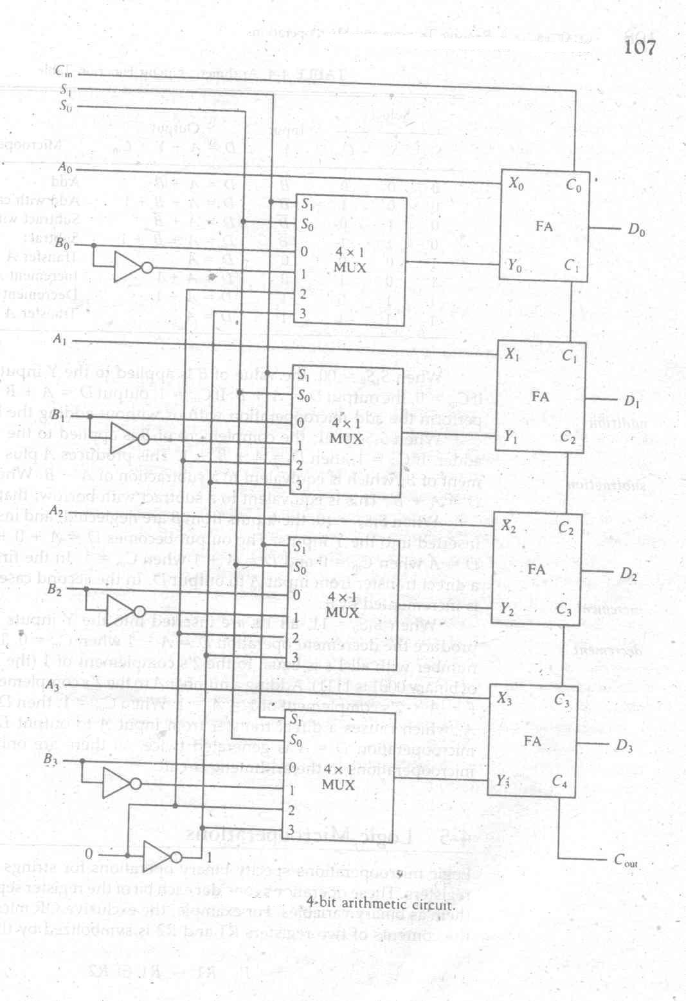
4- bit Arithmetic Circuit

Slide 11
Arithmetic Circuit Function Table
S1 | S0 | C_{in} | Input Y | Output D=A+Y+C_{in} | Microperation
0 | 0 | 0 | B | D = A + B | Add
0 | 0 | 1 | B | D = A + B +1 | Add with Carry
0 | 1 | 0 | B’ | D = A + B’ | Subtract with Borrow
0 | 1 | 1 | B’ | D = A + B’+1 | Subtract
1 | 0 | 0 | 0 | D = A | Transfer A
1 | 0 | 1 | 0 | D = A + 1 | Increment A
1 | 1 | 0 | 1 | D = A – 1 | Decrement A
1 | 1 | 1 | 1 | D = A | Transfer A

Slide 12




Logic Micro operations
MUX
(4 x 1)

Slide 13
Logic operations Function Table
S1 S0 |  | Output | Operation
0 | 0 | E = A ∧ B | AND
0 | 1 | E = A ∨ B | OR
1 | 0 | E = A ⊕ B | XOR
1 | 1 | E = ‾A | NOT

Slide 14
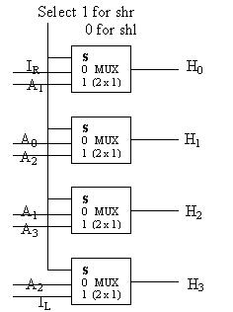
Shift Micro operations
Select | Output
S | H₃ H₂ H₁ H₀
0 | A₂ | A₁ | A₀ | I_{R}
1 | I_{L} | A₃ | A₂ | A₁

Slide 15
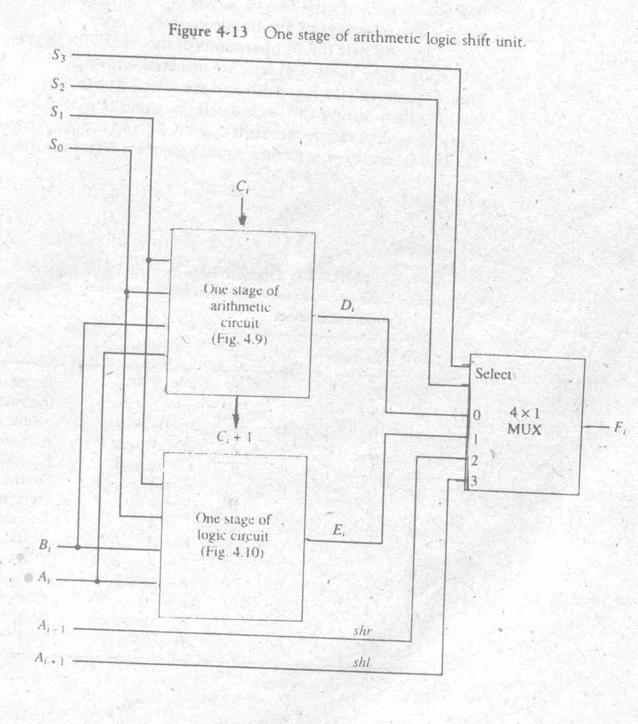

Slide 16
Operation select S3 S2 S1 S0 Cin |  |  |  |  | Operation | Function
0 | 0 | 0 | 0 | 0 | F = A | Transfer A
0 | 0 | 0 | 0 | 1 | F = A + 1 | Increment A
0 | 0 | 0 | 1 | 0 | F = A + B | Addition
0 | 0 | 0 | 1 | 1 | F = A + B + 1 | Add with Carry
0 | 0 | 1 | 0 | 0 | F = A + B’ | Subtract with Borrow
0 | 0 | 1 | 0 | 1 | F = A + B’ + 1 | Subtraction
0 | 0 | 1 | 1 | 0 | F = A –1 | Decrement A
0 | 0 | 1 | 1 | 1 | F = A | Transfer A
0 | 1 | 0 | 0 | X | F = A ∧ B | AND
0 | 1 | 0 | 1 | X | F = A ∨ B | OR
0 | 1 | 1 | 0 | X | F = A ⊕ B | XOR
0 | 1 | 1 | 1 | X | F = A’ | NOT
1 | 0 | X | X | X | F = SHR A | Shift Rirht A into F
1 | 1 | X | X | X | F = SHL A | Shift Left A into F

Slide 17
Operation select S3 S2 S1 S0 Cin |  |  |  |  | Operation | Function
0 | 0 | 0 | 0 | 0 | F = A | Transfer A
0 | 0 | 0 | 0 | 1 | F = A + 1 | Increment A
0 | 0 | 0 | 1 | 0 | F = A + B | Addition
0 | 0 | 0 | 1 | 1 | F = A + B + 1 | Add with Carry
0 | 0 | 1 | 0 | 0 | F = A + B’ | Subtract with Borrow
0 | 0 | 1 | 0 | 1 | F = A + B’ + 1 | Subtraction
0 | 0 | 1 | 1 | 0 | F = A –1 | Decrement A
0 | 0 | 1 | 1 | 1 | F = A | Transfer A
0 | 1 | 0 | 0 | X | F = A ∧ B | AND
0 | 1 | 0 | 1 | X | F = A ∨ B | OR
0 | 1 | 1 | 0 | X | F = A ⊕ B | XOR
0 | 1 | 1 | 1 | X | F = A’ | NOT
1 | 0 | X | X | X | F = SHR A | Shift Rirht A into F
1 | 1 | X | X | X | F = SHL A | Shift Left A into F

