Slide 1
Computer Architecture
  Abdul Khaliq
  (PUCIT, Punjab University Lahore)

Slide 3
Basic Computer Organization and Design
CH # 5

Slide 4
CPU Organization
The organization of the CPU is defined by its internal registers ,the timing and control structure and the set of instructions that it uses.
  What is a program?
    A program is a set of instructions that specify the operations, operands and the sequence by which processing has to occur.

Slide 5
Instruction Format
  An instruction code is a group of bits that instruct the processor to perform a specific operation
  It consist of different parts,i.e
    Operation Part (op-code)
    Operand part

Slide 6
Op-code
    There may be 2^{n} operations against n bits of op-code
    An operation is sometimes called as “macro-operation” because it specifies a set of micro-operations.
    After the interpretation of op-code ,control unit issues a sequence of control signals to initiate micro-operations in internal registers.

Slide 7
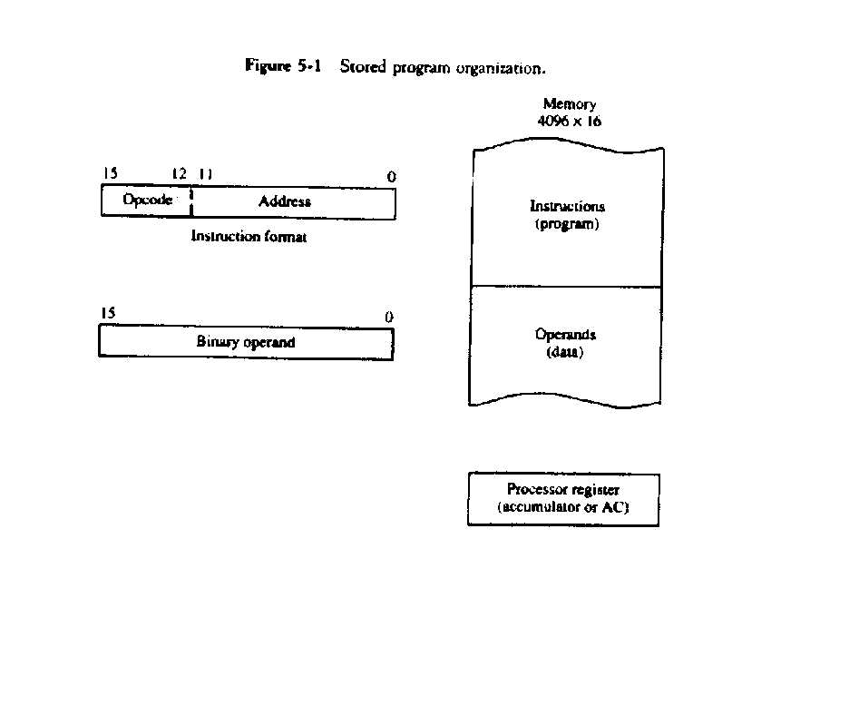
Instruction

Slide 8
.
    -Operand part may contain the address of a memory word or of a register.
    CPU having a single processor-register (accumulator , AC) perform operations with the memory operand and the content of AC.

Slide 9
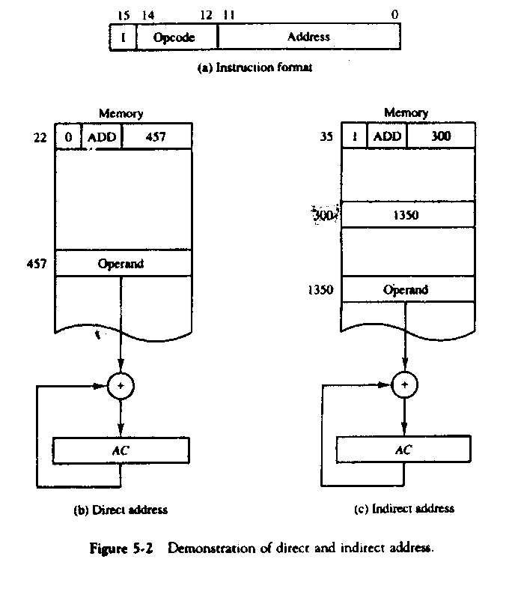
Addressing Modes
1- Immediate: Address bits specify the operand itself instead of its address.
2- Direct Addressing: Address bits points to location of the operand
3- Indirect Addressing:
Address bits points to address of the operand.

Slide 10
Problem
Design a microprocessor with the following specifications:
Total address space = 4K
  Word size = 16 bits
  Instruction size = 16 bits
  Single Accumulator register
    Maximum 7 other registers.
  Can send/receive 8 bit data to I/O devices.
  Addressing modes:
    Direct Memory reference
    Indirect memory reference
    Register reference

Slide 11
Solution
Total Address Space = 4K = 4096 = 2¹²
  Therefore, the address bus must be 12 bits wide.
Word size = 16 bits
  The microprocessor reads from memory 16 bits at a time.
  The data bus must be 16 bits wide
  Internal data registers must be 16 bits wide.
Direct and Indirect addressing
  Need 1 bit in the instruction to specify direct vs. indirect mode.

Slide 12
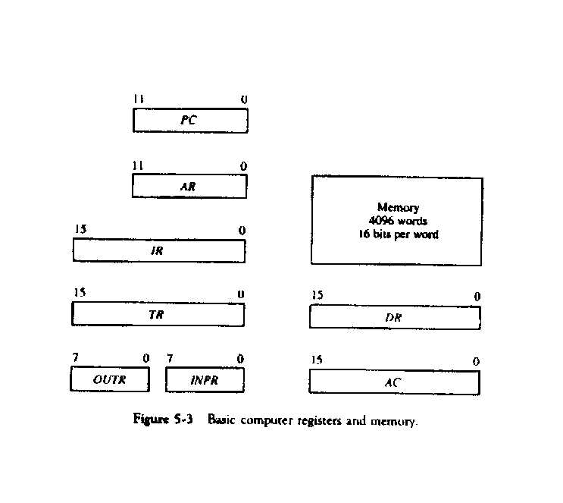
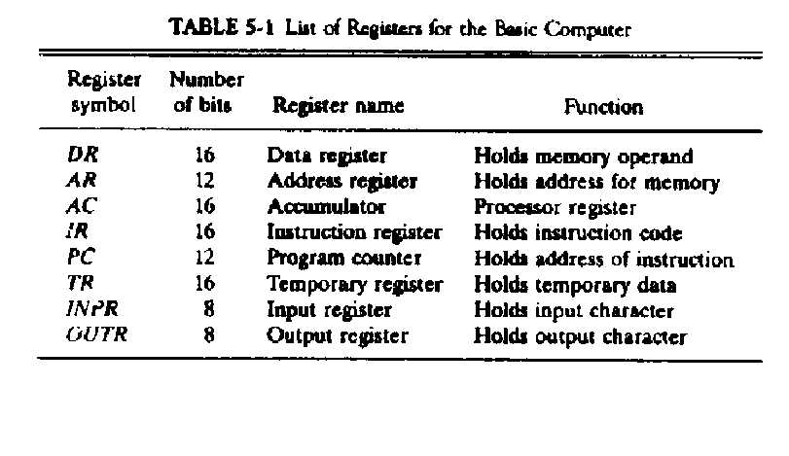
List of Registers

Slide 13
Machine Organization Design
Now we are in this position to draw the bus interface of these registers and Memory.
  We already learnt how to interface registers with the bus.
  We have decided registers sizes.
  We have decided size of data and address bus.
Now we need:
  Clock generator to synchronize the microoperations.
  Control unit to generate signals e.g., Load, Increment and Clear inputs to registers. Read, Write signals to memory and Select which entity will use the common bus at a particular moment.
  ALU to perform the arithmetic and Logic operations.

Slide 14
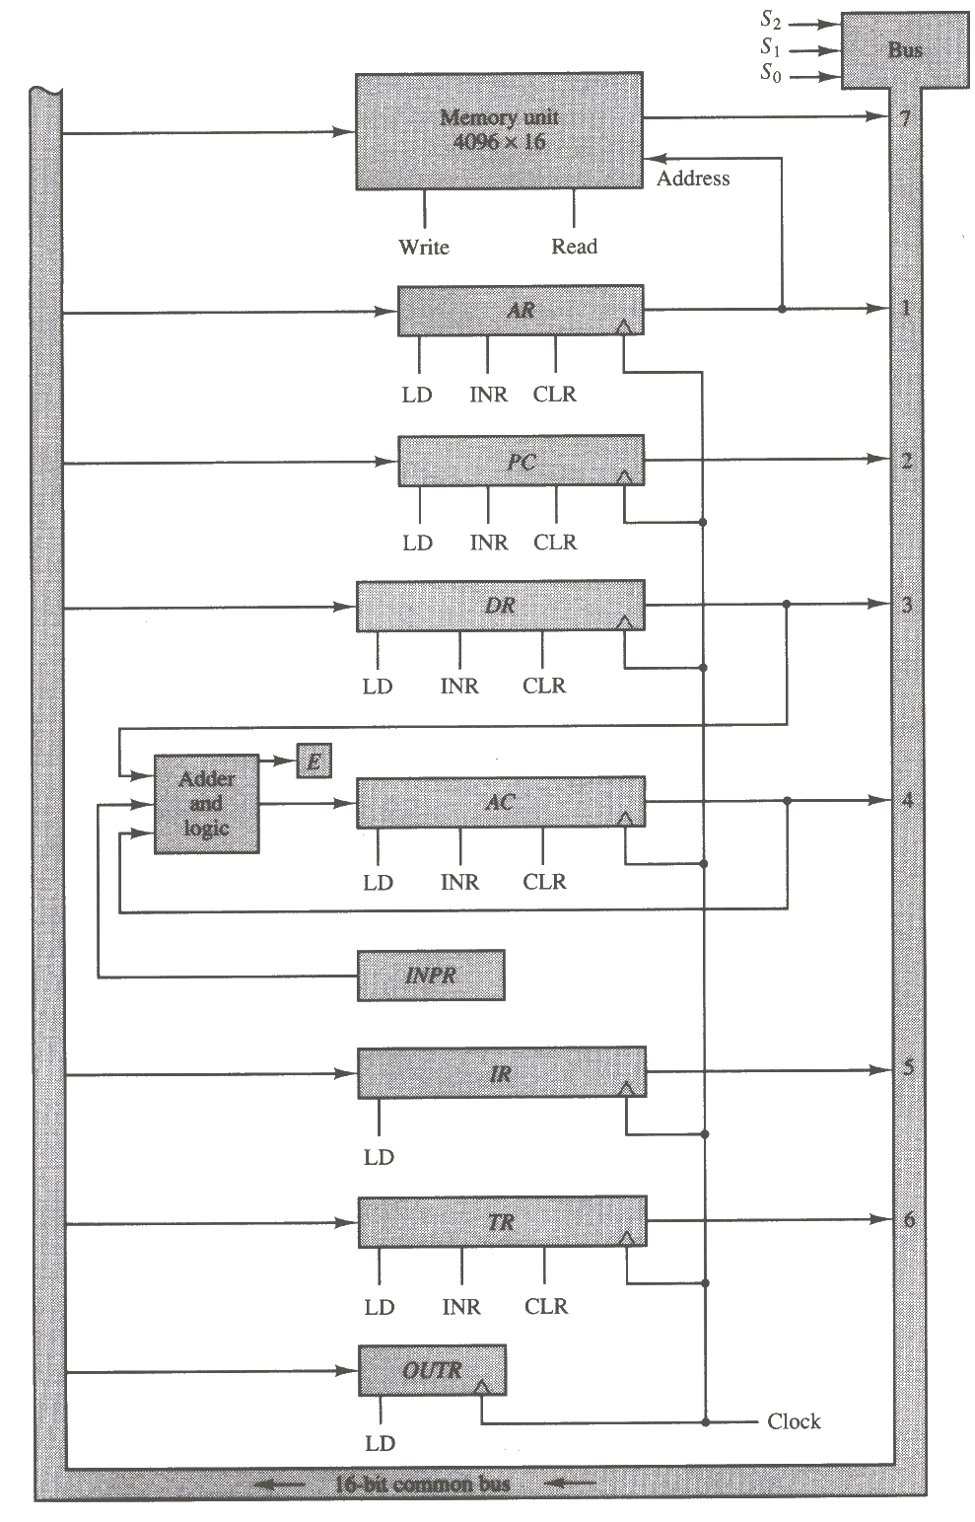
Machine Organization
For Simplicity we have not shown the Multiplexers or tri-state buffers.
The decimal number shown on the right represent which module to have access to the bus e.g., when
S0 S1 S2 = 100
Accumulator is selected on to send data to the bus.
Data is stored in the destination register by activating LD input..
INPR is not connected to the common bus as it is not designed to receive data from the bus.
You can see that following operation is possible in single clock Pulse.
  DR ← AC, AC ← DR

Slide 16
Von Neumann Architecture
The Stored Program concept
  John von Neumann (~1950)
  Key Architectural Concept
    Paved the way for modern processors
Program and data are stored in the memory.
Program counter (PC) points to the current instruction in memory
  PC is updated on every instruction
  Program words are fetched from sequential memory locations

