Slide 1
Procedures

Slide 2
The Stack
A stack is a memory in which data is added and removed from a location called the top of Stack..
Stack is known as last-In-First-Out (LIFO) memory, as data stored last can be removed first.
PUSH and POP instructions are used for stack operation.

Slide 3
The Stack
The stack resides in the stack segment (in main memory) who’s segment number is in the processor’s SS register.
The SP register holds the offset address of the last element added to the stack i.e., top of stack.
If the stack was allocated with the directive:
.stack 100h
  Then SP should, initially, contain 100h (pointing to the top of the empty stack)

Slide 4
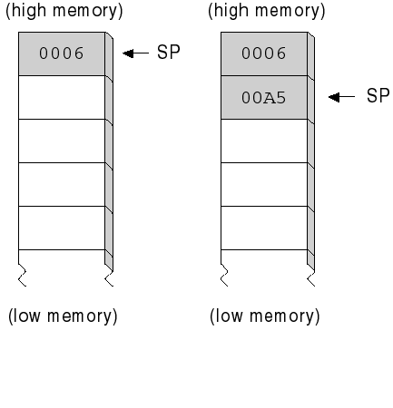
PUSH (16-bit case)
PUSH source
  will decrement SP by 2
  and copy the content of source into word at SS:SP
  little endian: low order byte at lower offset
Ex: (see figure)
  mov ax,0006
  push ax
  mov ax,00A5h
  push ax
This is for a source of type word (reg16 or mem16).
imm16 are allowed only on 286 and later processors

Slide 5
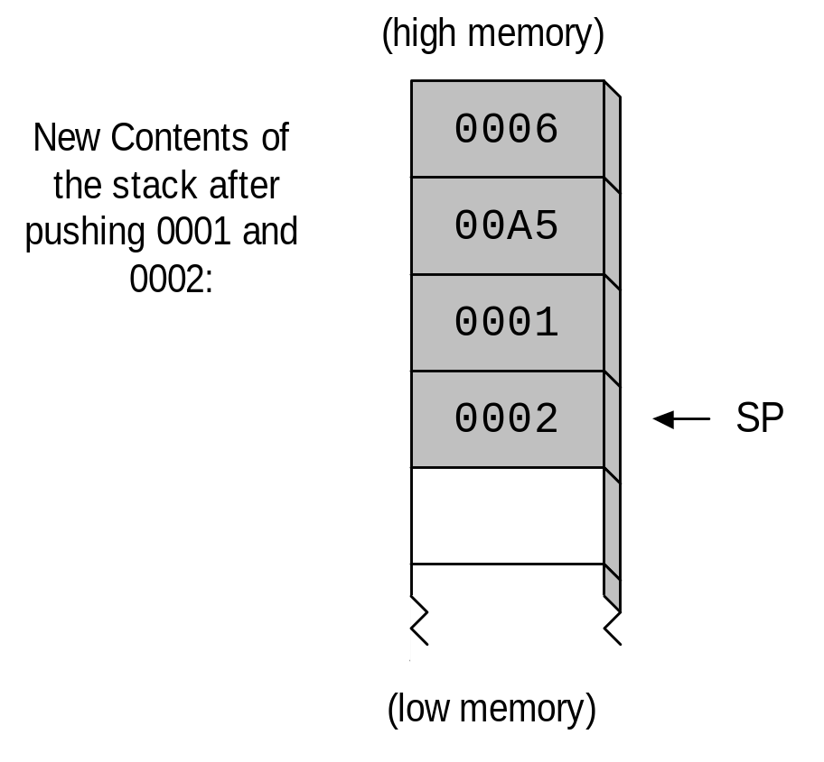
After pushing 0001 and 0002
Top of Stack

Slide 6
POP
The POP instruction undoes the action of PUSH
  POP destination
For a 16-bit destination operand:
  the word at SS:SP is transfered into destination
  SP is incremented by 2

Slide 7
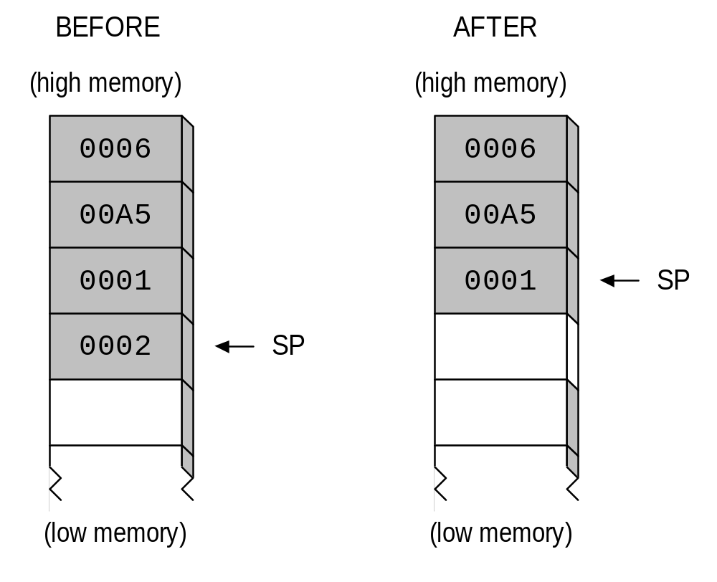
Before and After Popping from the Stack
pop AX
; now, AX=0002
Top of Stack
Top of Stack

Slide 8
Push / POP Example
.data
message db “message!”,"$"
.code
push ax
push dx
mov ah,9
mov dx,offset message
int 21h
pop dx
pop ax

Slide 9
Uses of the Stack
Can be used to save the contents of CPU registers temporarily.The registers may then be used for some other purpose. We can restore the register contents from stack when desired.
Save the return address when a CALL instruction is executed
Push parameters on the stack before calling a subroutine

Slide 10
More Saving and Restoring
PUSHA (.286) pushes AX, CX, DX, BX, SP, BP, SI, DI on stack and POPA pops the same registers in reverse order
PUSHAD (.386) pushes EAX, ECX, EDX, EBX, ESP, EBP, ESI, EDI on stack and POPAD pops the same registers in reverse order
PUSHF and POPF pushes and pops the FLAGS register onto and from the stack
PUSHFD and POPFD (.386) pushes and pops the EFLAGS register onto and from the stack

Slide 11
Procedures
As programs become larger and sophisticated, they have to be subdivided into procedures.
A procedure is a block of logically related instructions that can be called by another program or procedure.
In a well designed program , each procedure has a single purpose and does its job independently of the rest of program.
A procedure can be called many times in a single program.
Use of procedures make program easier to write, understand, and debug

Slide 12
Procedures
Procedures are defined like this:
  name PROC [type]
  ... set of instructions...
  RET
  name ENDP
The “type” is either NEAR or FAR
To transfer control to the procedure “name” we do:
  CALL [type] name
RET transfers control to the instruction following CALL
The default for “type” is:
  NEAR: for memory models: tiny, small, compact
  FAR: for memory models: medium, large, huge

Slide 13
Example: Calling a Procedure
  main proc
  mov ax,@data
  mov ds,ax
  call MySub
  mov ax,4c00h ; returns to here
  int 21h
  main endp
  MySub proc
  . ; control transfers here
  .
  ret
  MySub endp

Slide 14
Nested Procedure Calls (1)
  main proc
  000A call sub1
  000C mov ax,...
  .
  main endp
  sub1 proc
  .
  call sub2
  0050 ret
  sub1 endp
  sub2 proc
  .
  call sub3
  0060 ret
  sub2 endp
  sub3 proc
  .
  .
  ret
  sub3 endp

Slide 15
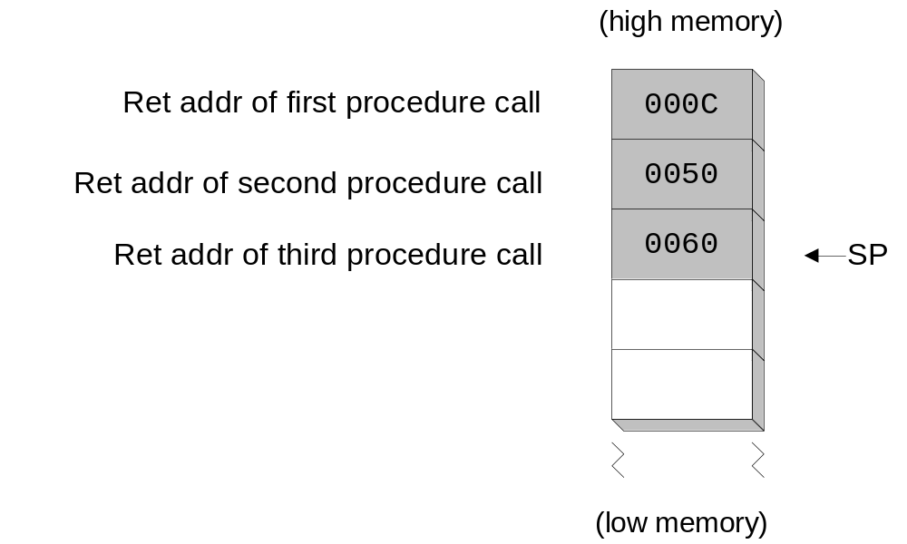
Nested Procedure Calls (2)

Slide 16
Avoid Overlapping Procedures!
  main proc
  .
  call subroutine1
  .
  subroutine1 proc
  .
  main endp
  .
  .
  ret
  subroutine1 endp

Slide 17
Procedure Calls (1)
title Procedure Demonstration (SUBS.ASM)
  ; This program calls two procedures: one for
  ; keyboard input, another to add the elements
  ; in an array of integers.
  .model small
  .stack 100h
  .data
  char db ?
  sum dw ?
  array dw 100h,200h,300h,400h,500h
  array_size = ($−array)/(TYPE array)
  ; more...

Slide 18
Procedure Calls (2)
.code
main proc
mov ax,@data ; set up the DS register
mov ds,ax
call inputChar ; input char into AL
mov char,AL ; store in a variable
; Prepare to call the calcSum procedure.
mov bx,offset array ; BX points to array
mov cx,array_size ; CX = array count
call calcSum ; calculate sum
mov sum,ax ; store in a variable
mov ax,4C00h ; return to DOS
int 21h
main endp

Slide 19
Procedure Calls (3)
; input character from keyboard
inputChar proc
mov ah,1 ; DOS function #1: char input
int 21h ; call DOS to do the work
ret
inputChar endp
; more...

Slide 20
Procedure Calls (4)
; Calculate the sum of an array of integers.
; Input: BX points to the array and CX contains
; the array size. Returns the SUM in AX.
calcSum proc
push bx ; save BX, CX
push cx
mov ax,0
CS1: add ax,[bx]
add bx,2 ; point to next integer
loop CS1 ; repeat for array size
pop cx ; restore BX, CX
pop bx
ret ; sum stored in AX
calcSum endp

Slide 21
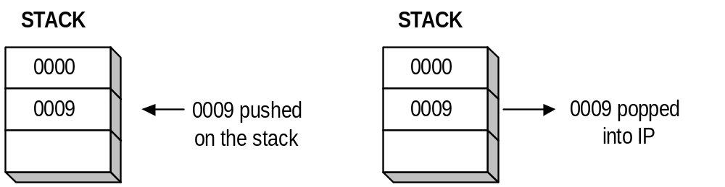
Calling a NEAR Procedure
main proc
0006: call sub1
0009: inc ax
.
main endp
sub1 proc
0080: mov ax,1
.
ret
sub1 endp

Slide 22
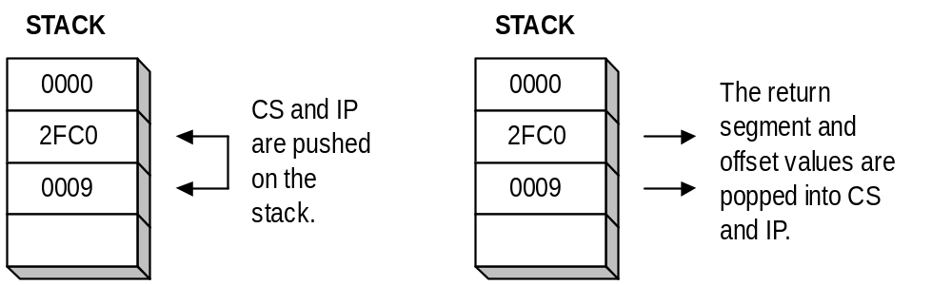
Calling a FAR Procedure
main proc
2FC0:0006: call far Ptr sub1
2FC0:0009: inc ax
.
.
main endp
sub1 proc
3AB6:0080: mov ax,1
.
ret
sub1 endp
sub1 endp

Slide 23
Preserving Local Registers
It is common practice to save and restore any registers that a procedure plans to modify.
Writeint proc
push cx ; save registers that will change
push bx
push si
.
.
pop si ; restore the same registers
pop bx ; (in reverse order)
pop cx
ret
Writeint endp

Slide 24
Using Procedures
When a procedure returns to the caller it should preserve the content of the registers (except those used to return a value)
  should save first the content of the registers that it will modify and restore them just before returning to the caller
Caution on stack usage:
  SP points to the return address when entering the procedure. Make sure that this is the case just before executing RET !!

Slide 25
Interrupts

Slide 26
Interrupts
Hardware interrupts
  occur as a response to a hardware device
  routed through the Intel 8259 Interrupt Controller
Software interrupts
  calls to operating system functions, located in BIOS and DOS
  activated by the INT instruction

Slide 27
Interrupt Vectoring Process
Calling program
Interrupt Handler
mov...
F000:F065
sti
int 10h
F066
cld
add...
1
2
F067
push es
3
F068
.
.
.
.
.
IRET
3069
F000:F065
F000:AB62
(entry for INT 10)
Interrupt Vector Table
return to calling
4
program

Slide 28
INT Instruction
The INT instruction is always followed by a number that identifies its type
Common examples:
  INT 10h - video BIOS
  INT 14h - Serial I/O
  INT 16h - keyboard BIOS
  INT 17h - printer services
  INT 1Ah - Time of day
  INT 1Ch - User timer
  INT 21h - DOS services

Slide 29
DOS Function Calls (INT 21h)
The INT 21h instruction activates a DOS function call
The function number (0-FF) is placed in the AH register before invoking INT 21h
Some functions require that you assign values to certain registers before invoking INT 21h
Some functions return values in registers

Slide 30
Simple Console I/O
mov ah,1 ; single character input
int 21h
mov ah,2 ; single character output
mov dl,'A'
int 21h
mov ah,9 ; string output
mov dx,offset message
int 21h

