Slide 1



Slide 2
Software Project Planning
By Amina Mustansir

Slide 3


Cost estimation is one of the issues addressed in Project Plan
Cost estimation is made for
  Cost benefit analysis by customer & developer
  For bidding purposes
  For project control once development begins

Slide 4

Break-down of project cost
Requirements of software, hardware & human resources.
  Hardware resource : Computer, terminal time, memory required etc.
  Software resource: Tools, Compilers etc.
  Human Resources:
    Bulk of the cost is due to human resource needed. Cost models focus on that & calculate effort in Person-months.

Slide 5
Uncertainties of Cost Estimation
Cost estimation can be provided at any stage of development life cycle.
Later is more accurate, as we have more information about the final product.
At the beginning a lot of uncertainty exists about the actual specification of the system.
At the beginning stage cost estimates can’t be accurate and can be off by as much as the factor of 4.

Slide 6
Parameters affecting cost
Cost for a project is a function of many parameters
  Size of the project
  Programmers ability
  Experience in the area
  Complexity of the project
  Reliability Requirements

Slide 7

Software Project Estimation
Purpose
To achieve reliable cost and effort estimates
  Delay estimation until late in the project
  Base estimates on similar projects that have already been completed.
  Use relatively simple decomposition techniques to generate project cost and effort estimates.
  Use one or more empirical models for software cost and effort estimation.

Slide 8
Decomposition Techniques
  “divide and conquer” approach
  Cost and effort estimation done step wise
Empirical estimation models
  Complement decomposition techniques
  A model based on experience

Slide 9
Decomposition Techniques
Software sizing

Slide 10
Software Sizing
The accuracy of a software project estimate is predicated on
  Degree to which the planner has properly estimated the size of the product to be built
  Ability to translate the size estimate into human effort, calendar time, and dollars
  Degree to which the project plan reflects the abilities of the software team
  Stability of product requirements and the environment that supports the software engineering effort.

Slide 11
Cost Model
Cost model requires some knowledge or estimate of some of the parameters, which are then used to predict the cost.
COCOMO gives estimates within 20% of actual cost 68% of time.

Slide 12
COCOMO
Boehm derived a cost model called COCOMO (Constructive Cost Model) using data from a large set of projects at TRW, a consulting firm based in California (Fenton, 1997).
COCOMO is a relatively straightforward model based on inputs relating to the size of the system and a number of cost drivers that affect productivity.
The original COCOMO model was first published in 1981 (Boehm, 1981).
Boehm and his colleagues have since defined an updated COCOMO, called COCOMO II, that accounts for recent changes in software engineering technology (Fenton, 1997).

Slide 13
Constructive Cost Model (Pfleeger P. 105 ff)
  Still uses “arbitrary” factors
Estimates duration as well as effort
Applies to three different circumstances:
  organic, semi-detached, embedded

Slide 14

Three different models:
  Basic (Application composition model)
    similar structure to other models
    Used during the early stages of software engineering
    When prototyping of user interfaces, consideration of software and system interaction, assessment of performance, and evaluation of technology maturity are paramount
  Intermediate (Early design stage model)
    multiplies by “effort adjustment factor” to cover special circumstances (0.9 -> 1.4)
    Used once requirements have been stabilized and basic software architecture has been established
  Advanced (Post-architecture-stage model)
    partitions estimation across the life cycle (see Process based Decomposition)
    Used during the construction of the software

Slide 15
COCOMO II
COCOMO is reasonably well matched to custom, build-to-specification software projects, COCOMO II is useful for a much wider collection of techniques and technologies.

Slide 16
COCOMO Model
It is a multivariable model
  Obtain an initial estimate of effort from the estimate of KDL
  Determine a set of 15 multiplying factors from different attributes of a project (cost drivers)
  Adjust the effort estimate by multiplying the initial estimate with all the multiplying factors.
    Initial estimate of effort in person-month is determined by : Ei= a*( KDL)^b

Slide 17

Values of the constants ‘a’ and ‘b’ depend on the project type.
  Organic - In Organic type relatively small software teams develop familiar types of software in an in-house environment. Most of the personals has previous experience in working with related or similar systems
    Examples – simple business systems, simple inventory mgmt. Systems, and data processing systems
  Embedded Type - The project may require new technology, unfamiliar algorithms, or an innovative new method for solving a problem. Organization has little experience.
    Examples – embedded avionics systems and real-time command systems
  Semi-detached - Is an intermediate stage between organic and embedded type. It has a mixture of organic and intermediate characteristics
    Examples – developing a new os, a dbms and complex inventory mgmt. system

Slide 18
Type Effort
Organic Ei = 3.2(KDSI)^{1.05} ,
Semi-Detached Ei = 3.0(KDSI)^{1.12}
Embedded Ei= 2.8(KDSI)^{1.20}
KDSI = Delivered source instruction in thousands

Slide 19
Cost Drivers
The cost drivers are grouped into four categories
  Software Product Attributes
  Computer Attributes
  Personnel Attributes
  Project Attributes
Software Product Attributes
  RELY - Required software reliability
  DATA - Data Base Size
  CPLX - Software Complexity
Computer Attributes
  TIME - Execution time constraint

Slide 20
  STOR - Main storage constraints
  VIRT - Virtual Machine Volatility
  TURN - Computer Turnaround Time
Personnel Attributes
  ACAP - Analysts Capability
  AEXP - Applications Experience
  PCAP - Programmer Capability
  VEXP - Virtual Machine Experience
  LEXP - Programming Language Experience
Project Attributes
  MODP - Modern programming practices
  TOOL - Use of software tools
  SCED - Required Development Schedule

Slide 21
Four categories of cost driver attributes
a. required software reliability
Product attributes
b. size of application database
c. complexity of the product
a. run-time performance constraints
b. memory constraints
Hardware attributes
c. volatility of the virtual machine environment
d. required turnaround time
a. analyst capability
b. programmer capability
Personnel attributes
c. applications experience
d. virtual machine experience
e. programming language experience
a. use of software tools
Project attributes
b. application of software engineering methods
c. required development schedule

Slide 22
Cost ratings and multipliers for the attributes, e.g. the ratings and multipliers of software reliability
Rating
Multiplier
very low (effect: slight inconvenience)
0.75
low (low, easily recoverable losses)
0.88
nominal (moderate, recoverable losses)
1.00
high (high financial loss)
1.15
very high (risk to human life)
1.40

Slide 23
Effort Adjustment Factor (EAF) is calculated by multiplying the appropriate values for 15 cost drivers
The final effort estimate E is obtained as:
  E = EAF * Ei

Slide 24
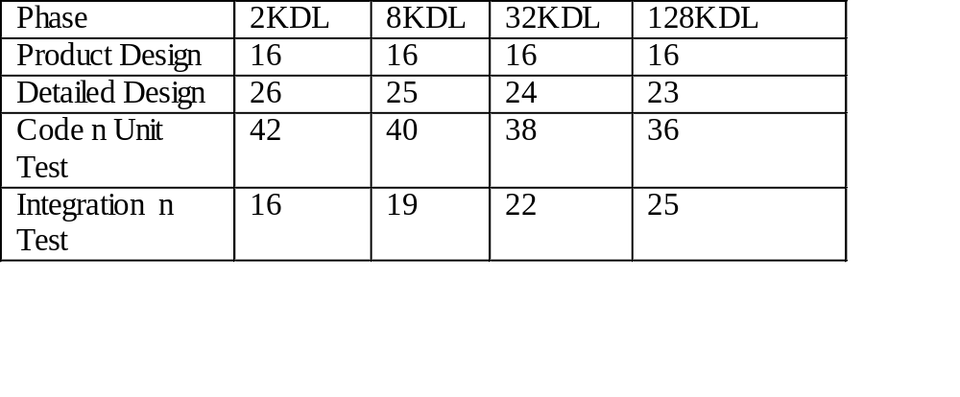
Phase Distribution on Effort
For planning and monitoring purposes we need to have estimates of efforts for different phases.
Percentage effort for a phase varies for different types of projects.

Slide 25
Role of Size Estimation
Key input to the cost model is the estimate of the size of the software.
Actual size depends on many factors like programming habits of the programmer etc.
There is a general tendency to underestimate the size. Optimistic attitude.
Estimating the size of smaller units is easier than estimating the size of large system

Slide 26
Example

Slide 27
Project duration & Staffing
Duration (calender time) can’t be calculated by dividing total effort by the average staff size….???
Brooks says, “person and months (time) are not interchangeable.
Communication time increases with the square of the number of staff.
For ‘n’ persons, there are n^2 –1 communication paths.

Slide 28
Cont’d
Each project will require some time to finish and this time can’t be reduce by putting in more people.
Obviously there is some relation b/w project duration and Person-months….but that is NOT linear.
    Organic, Duration (in months) = 2.5 (E)^0.38
    Semidetached, Duration = 2.5(E)^0.35
    Embedded , Duration = 2.5 (E)^0.32
    Example: D= 2.5* 16.34^0.38 = 7.23 Months

Slide 29
Staffing
Avg Staff size = Total Effort (p-m)/duration
Does’nt give good staff estimation as there is a variation across the different phases.

