Slide 1
Introduction to Software Engineering-Lecture 1
By
Amina Mustansir
Lecturer, PUCIT

Slide 2
Learning Outcomes
  Appreciate the problems associated with developing software
  Understand the need for a managed approach to Software Development
  Be able to define the term ‘Software Engineering’

Slide 3

Introduction
Teacher
Class
Subject
  Name
  Course outline
  Books
  Project
  Assignments

Slide 4
Software
Definition
  Computer software is the product that software engineers design and build

Slide 5
Components of Software
Sets of instructions
Programs
System documentation
User documentation
Combination of numbers and text
Documents
Data/
Content

Slide 6
Types of software
Generic software
  Stand-alone systems produced by a development organization and sold on the open market to any customer
  for example word processors, spreadsheets and games
Customized software
  Systems commissioned by a particular customer.
  for example web sites, air-traffic control systems and software for managing the finances of large organizations

Slide 7
Engineering
Definition
  Implementation of a solution to a practical problem
    Comprises any kind of activity which aims at either solving a problem or completing a task related to the definition, design, and specification of a product.
  Analysis, design, construction, verification, and management of technical (or social) entities.

Slide 8
Software Engineering
Definition
  Establishment and use of sound engineering principles in order to obtain economically software that is reliable and works efficiently on real machines.
  The application and study of a systematic, disciplined, quantifiable approach to the development, operation and maintenance of software; that is the application of engineering to software

Slide 9

Importance of Software Engineering
Software crisis
Software quality
  Over budget
  Out of schedule-OS360
  Property damage-explosion of European Ariane rocket
  Life and death-radiotherapy

Slide 10
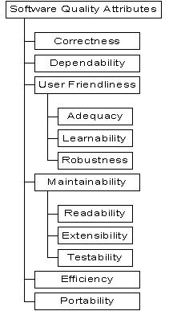

Slide 11
Difference
Software Engineering
  Concerned with the practicalities of developing and delivering useful software
  A field of study deals with practicalities of software development
Computer science
  Concerned with theory and fundamentals
  A field of study deals with theories and practices of computation, communication, automation, coordination and data manipulation.

Slide 12

Difference
System engineering
  Concerned with all aspects of computer-based systems development, including hardware, software, and process engineering
Software engineering
  Part of system engineering
  Deals with software only

Slide 13
Comparing software engineering and related fields
For further information, check this link
  http://en.wikipedia.org/wiki/Comparing_software_engineering_and_related_fields

Slide 14
References
Roger S. Pressman
  ^{7th} edition
Software Engineering
  Ian Sommerville 6th edition

