Slide 1


Slide 2
Project Management Concepts
By: Amina Mustansir
Lecturer ,PUCIT

Slide 3
Quick Look
What is it?
  Project management involves the planning, monitoring, and control of the people, process, and events that occur as software evolves from a preliminary concept to an operational implementation.
Who does it?
  Everyone “manages” to some extent, but the scope of management activities varies among people involved in a software project.
  A software engineer manages her day-to-day activities, planning, monitoring, and controlling technical tasks.
  Project managers plan, monitor, and control the work of a team of software engineers.

Slide 4

Quick Look (contd.)
Why is it important?
  Building computer software is a complex undertaking, particularly if it involves many people working over a relatively long time. That’s why software projects need to be managed.
What are the steps?
  Understanding the four P’s– people, product, process, and project.
What is the work product?
  A project plan is produced as management activities commence.

Slide 5


Introduction
Activities and products of each phase of the life cycle must be managed, reviewed and controlled
For the project to be delivered
  on time,
  within budget and
  to the required quality

Slide 6
Project Management
Definition:
  Project management involves the planning, monitoring and control of the people, process, and events that occur as software evolves from a preliminary concept to an operational implementation.

Slide 7
Purpose:
  To plan and document the management and technical functions and activities of the project
The plans must be reviewed, refined and updated as the project progresses

Slide 8
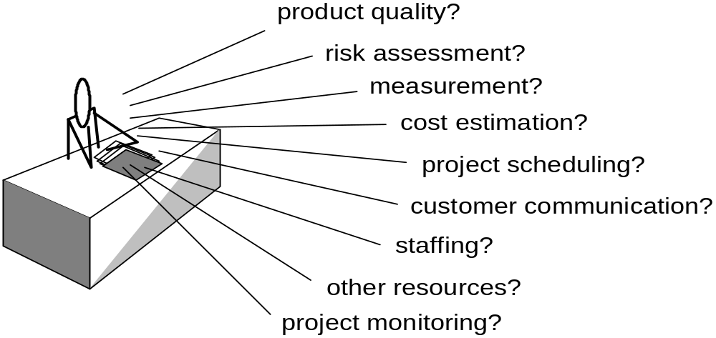
Project Management Concerns

Slide 9
Major processes in Project Management
Identify a need for a product or service
Define the goals of the project and their relative importance
Select appropriate performance measures
Develop a schedule
Develop a budget
Develop the technological (process) concept
Integrate into a project plan
Implement the plan
Monitor and control the project
Evaluate project success

Slide 10
Project life cycle
Conceptual design
Advanced development
Detailed design
Production
Termination

Slide 11
Phases of a Project
Conceptual design phase
  The organization realizes that a project may be needed, or receives a request from a customer to propose a plan to perform a project
Advanced development
  Project manager plans the project to a level of detail sufficient for initial scheduling and budgeting

Slide 12
Detailed design phase
  If project approved, it will enter this phase to define responsibility, team,organizational structure, detailed plan, Kickoff
Production phase
  The project is monitored and controlled during this phase
Termination phase
  The project is closed out and properly disclosed

Slide 13
Conceptual design\ Opening\ Initiation
Goals
Scope
Baseline
Requirements
Feasibility
Desirability

Slide 14
Major Activities in the conceptual design phase
Start
Identification of a need
Need is important?
Stop
Technical evaluation
Project is feasible?
Development of alternatives
Benefit-cost analysis
Selection of best alternative
Definition of project

Slide 15
Advanced development\ Planning
Plan
Budget
Schedule
Bid proposal
Management commitment

Slide 16
Detailed design\Executing
Responsibility definition
Team
Organizational structure
Detailed plan
Kickoff

Slide 17
Major activities in the detailed design phase
Conceptual design approved?
No
Back to conceptual design phase
Yes
Detailed design is acceptable?
Yes
Go to production phase
No
Prepare technological baseline
Prepare detailed schedule
Conduct resource requirements analysis
Prepare budget

Slide 18
Production\ Controlling
Manage
Measure
Control
Update and replan
Problem solving

Slide 19
Termination\Closing
Closeout
Document
Suggest improvements
Transit
Reassign
Dissolve team

Slide 20
The Management Spectrum
4
P’s
People
Product
Process
Project

Slide 21
4 P’s
People — the most important element of a successful project
Product — the software to be built
Process — the set of framework activities and software engineering tasks to get the job done
Project — all work required to make the product a reality

Slide 22

People
SEI has developed a People Management Capability Maturity Model
Following are some of the KPA’s in PM-CMM
    Recruiting
    Selection
    Performance Management
    Training
    Compensation
    Career development
    Organization and work design
    Team/Culture development

Slide 23

Players
Senior managers
  Define business issues
Project (technical) managers
  Plan, motivate, organize, and control the practitioners
Practitioners
  Deliver technical skills to engineer a product
Customers
  Specify requirements
End-users
  Interact with software once released for production

Slide 24
MOI Model of Leadership
Motivation: Ability to Encourage
Organization: Ability to mold or invent new processes
Innovation: Ability to encourage people to create

Slide 25
Characteristics of an Effective Project Manager
Problem solving
  Diagnose technical and organizational issues
Managerial identity
  Take charge
Achievement
  Initiative, accomplishment
Influence and team building
  Understand and react; Remain under control

Slide 26
Mantei Classification of Organizations
Democratic Decentralized (DD)
  no permanent leader.
  Task coordinator are for shorter duration and are based on task orientation.
  Decisions on the basis of group consensus
  Communication is horizontal
Controlled Decentralized (CD)
  Software Engineering Team has defined permanent and secondary leaders.
  Problem solving a group activity with horizontal communication.
  Vertical communication along control line also occurs
Control Centralized (CC)
  Top Level problem solving.
  Communication vertical between team members and team leader.

Slide 27
Software Teams
The following factors must be considered when selecting a software project team structure…
The difficulty of the problem to be solved
The size of the resultant program(s) in lines of code or function points
The time that the team will stay together (team lifetime)
The degree to which the problem can be modularized
The required quality and reliability of the system to be built
The rigidity of delivery date
The degree of sociability (communication) required for the project.

Slide 28
Mantei 7 Project Factors
Problem Complexity
Size of program
Team Duration
Degree of modularity of the problem
Required Quality and Reliability
Rigidity of Delivery Date
Degree of Sociability Communication required

Slide 29
Constantine 4 Organizational Paradigms
Closed Paradigm :
Random Paradigm :
Open Paradigm :
Synchronous Paradigm :
Traditional Hierarchy
Loosely structured team
Combination of Closed And Random Paradigm
Natural Compartmentalization

Slide 30
Toxic Factors for Team Environment
Frenzied work atmosphere
High Frustration
Fragmented Procedures
Vague definition of roles
Continuous exposure to failures

Slide 31
The Product
Software Scope
  Context
  Information Objectives
  Function and Performance
Problem Decomposition

Slide 32
The Process
Generic phases characterize the software process
Selection of Model – a wide array exists e.g. the linear sequential model to the formal methods model
Decision should be appropriate for
  Customers
  People who will do the work
  Characteristics of the product
  Project environment

Slide 33
The Process (contd.)
A preliminary project plan developed based on the set of common process framework activities.
Common Process Framework
Framework Activities
Task Sets
Tasks
Milestones deliverables
SQA points
Umbrella Activities

Slide 34
Project
A project is an undertaking of limited duration in time with a defined outcome.
Characteristics of a Project
  One goal
  Specified time / finite life
  Within Budget
  According to Specification
  Risk

Slide 35
The Project : Reasons of Jeopardy
Lack of customer’s need or understanding
Product scope poorly defined
Changes managed poorly
Change in technology
Business needs change
Unrealistic deadlines
Resistant Users
Lost sponsorship
Lack of appropriate skills
Lessons not learned

Slide 36
The Project : Jeopardy Avoidance
Reel 5 Points
Start on right foot
Maintain momentum
Track progress
Make smart decisions: Keep it simple and straight
Conduct postmortem analysis

Slide 37
Conclusion
Software project management is an umbrella activity
Four P’s have a substantial influence on software project management-PEOPLE, PROCESS, PROJECT, PRODUCT.
The pivotal element is people

