Slide 1

imagine • program • share
Scratch!

Slide 2
What is Scratch?
Scratch is a programming language that makes it easy to create your own interactive stories, animations, games, music, and art and share your creations on the web.
To download Scratch on your PC just visit http://scratch.mit.edu/ . .
Download the setup and install it.

Slide 3
Significance:
As we create Scratch projects, we learn important mathematical and computational ideas, while also learning to think creatively, reason systematically, and work collaboratively.

Slide 4
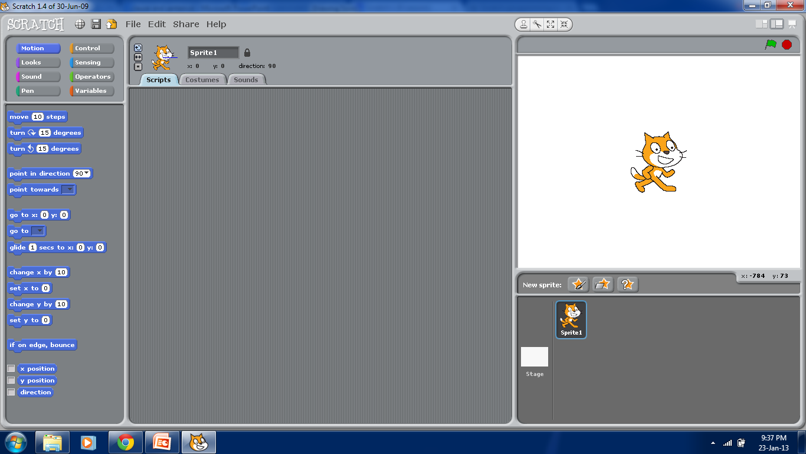
User interface:

Slide 5
Areas overview:
Sprite(any character) handling:
  Scripts area => All commands are dragged to this area.
  Costumes area => Select or paint costumes for your character.
  Sounds area => Select or import sounds for your character.
Stage(background) handling:
  Scripts area => All commands are dragged to this area.
  Costumes area => Select or paint costumes for background.
  Sounds area => Select or import sounds for background.
Commands handling.
  Motion => Contain command blocks related to motion.
  Control => Contain command blocks related to control.
  Looks => Contain command blocks related to looks.
  Sensing => Contain command blocks related to sensing.
  Sounds => Contain command blocks related to sounds.
  Operators => Contain command blocks related to operators.
  Variables => Contain command blocks related to variables.

Slide 6
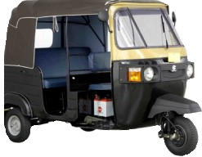
My project theme:
Rickshaw maze game:
The rickshaw(sprite) can move by arrow keys in a maze.
It has to pick the passengers and get them to their destiny before fuel and time ends.
It can’t touch maze lines otherwise game will be over.
It can grab the fuel tanks(CNG) that randomly appears on screen to refill it’s fuel.
Make score by dropping the passengers to their destinies till you become “GAME MASTER”.

Slide 7
Subordinate Clause:
It is dependent to the Main clause.
It can’t stand alone as a sentence to give a complete sense.
Example:
  I saw a book that was pretty valuable.
  Main clause Subordinate clause
  We arrived home when it was late.

Slide 8
What is Sentence?
A sentence is a group of words that gives a complete sense.
A complete sentence has at least a subject and a main verb to give a complete thought.
  Sentence == Subject + Verb + Object(conditional) + Complete thought
Example
  The students attended the class.
  Subject Verb Object

Slide 9
Subclasses of Sentences:
Simple Sentence
  One Main idea(Main Clause)
Compound Sentence
  Main Clause + Coordinate Clause
Complex Sentence
  Main Clause + Subordinate Clause
Mixed Sentence
  Main Clause + Coordinate Clause + Subordinate Clause

Slide 10
Simple sentence:
It has one main idea and has one clause.
It has one subject and one predicate.
Examples:
  He plays hockey daily.
  I will meet you tomorrow.
  Grammar is very interesting.

Slide 11
Compound sentence:
It has two or more main ideas.
It has two or more independent clauses or coordinate clauses.
Example:
  I crossed a kangaroo and got a woolly jumper.
  Main idea/clause Coordinate clause

Slide 12
Complex sentence:
It has one main idea and one or more dependent ideas(subordinate clauses).
Example:
  She has sent a book which I can’t understand.
  Main idea/clause Subordinate clause

Slide 13
Mixed sentence:
It is a mixture of compound and complex sentences.
It has two main ideas/clauses and one or more dependent ideas/clauses.
Example:
  The students play happily as the teachers sit around which is a pleasant sight.

Slide 14
Difference:
Generally Clause can be a complete sentence or a sentence within a sentence.
  Simple Sentence
  Compound Sentence
But in some cases clause might not be a sentence to give a complete thought.
  Complex Sentence
  Mixed Sentence

Slide 15
Clauses in Compound Sentence:
Consists of Independent nature clauses
  Main Clause
  Coordinate Clause
‘They are happy while we are sad.’
Main clause Coordinate clause

Slide 16
Clauses in Complex Sentence:
Consists of dependent nature clauses
  Subordinate clause
‘We arrived home when it was late’.
Main Clause Subordinate clause
Here the Subordinate clause can’t exist as a complete sentence to give a sense.

Slide 17
Our Conclusions:
Subordinate clause does not give a complete thought and sense.
It cannot stand alone as a sentence and that is what where the difference lies between a clause and a sentence.

Slide 18
Any difference left?
Think class!!!

