Slide 1
ENVIRONMENT POLLUTION AND CONTROL

Slide 2
Prepared By :-
Bsef12m014 :- Hassan Anwar
Bsef12m054 :- M.Muzamil Ejaz
Bsef12m025 :- Hisham Zahid
Bsef12m061:- Raza Ahmed
Bsef12m032:- Abdul Maroof

Slide 3
Environmental Pollution
Environmental Pollution can be defined as any undesirable change in physical, chemical, or biological characteristics of any component of the environment i.e. air, water, soil which can cause harmful effects on various forms of life or property.
Pollution: The term pollution can be defined as influence of any substance causing nuisance, harmful effects, and uneasiness to the organisms
Pollutant:- Any substance causing Nuisance or harmful effects or uneasiness to the organisms, then that particular substance may be called as the pollutant.

Slide 4
Types of Pollution
WATER POLLUTION
AIR POLLUTION
LAND POLLUTION
NOISE POLLUTION

Slide 5
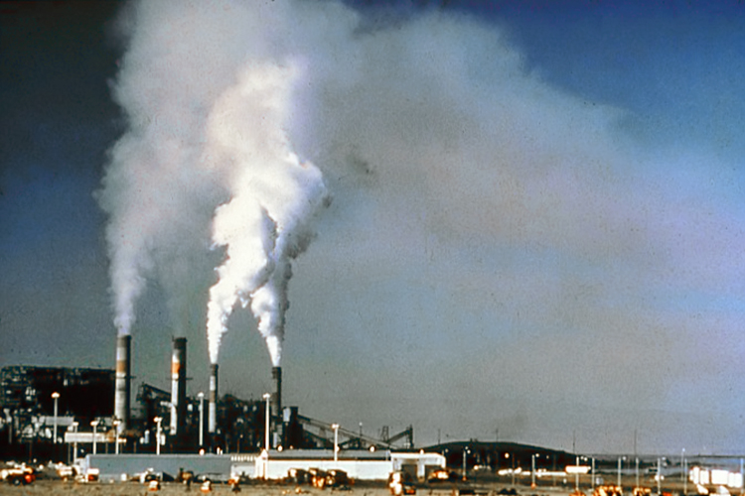
Air Pollution

Slide 6
Air pollution is the introduction of chemicals, particulate matter, or biological materials that cause harm or discomfort to humans or other living organisms, or cause damage to the natural environment or built environment, into the atmosphere.
A substance in the air that can cause harm to humans and the environment is known as an air pollutant.

Slide 7
Causes of Air Pollution
Carbon dioxide-this happens because of Deforestation and fossil fuel burning.
Sulfur dioxide –Due to the burning of sulfur containing compounds of fossil fuels.
Sulfur oxides- very dangerous to humans at a high concentration. Sulfur in the atmosphere is responsible for acid rain.

Slide 8
Consequences of Air Pollution
CO2 is a good transmitter of sunlight, but it also
partially restricts infrared radiation going back
from the earth into space, which produces the so-
called greenhouse effect that prevents a drastic
cooling of the Earth during the night.
CO2 in atmosphere --> GLOBAL WARMING

Slide 9
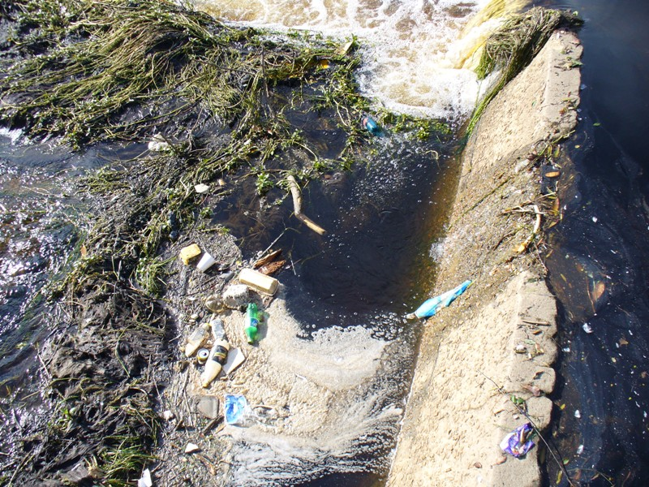
WATER POLLUTION

Slide 10
Water Pollution can be defined as alteration in physical, chemical, or biological characteristics of water through natural or human activities and making it unsuitable for its designated use.
Fresh Water present on the earth surface is put to many uses. It is used for drinking, domestic and municipal uses, agricultural, irrigation, industries, navigation, recreation. The used water becomes contaminated and is called waste water.

Slide 11
Sources of Water Pollution
Most of Water Pollution is man made It may also occur naturally by addition of soil particles through erosion animal wastes and leaching of minerals from rocks
The sources of water pollution can be classified as
Municipal Waste Water
Industrial Waste
Inorganic Pollutants
Organic Pollutants
Agricultural Wastes
Marine Pollution
Thermal pollution

Slide 12
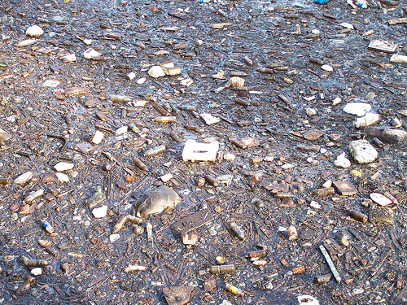
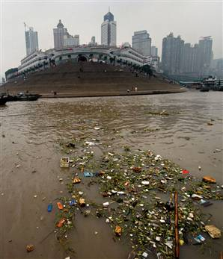
Municipal Waste Water

Slide 13
Industrial Waste
The major source of water pollution is the waste water discharged from industries and commercial bodies, these industries are chemical, metallurgical, food processing industries, textile, paper industries. They discharge several organic and inorganic pollutants. That prove highly toxic to living beings.

Slide 14
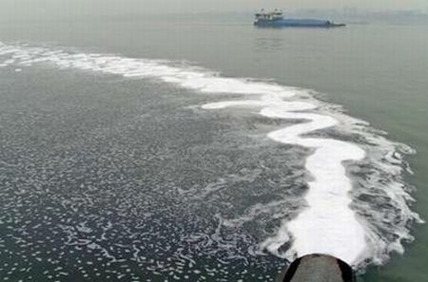
Industrial Waste

Slide 15
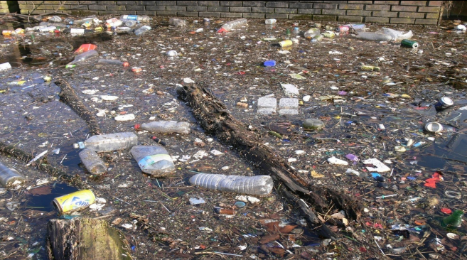
Inorganic Pollutants
They include fine particles of different metals, chlorides, sulphates, oxides of iron, cadmium, acids and alkalies.

Slide 16
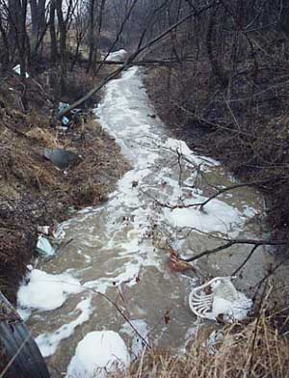
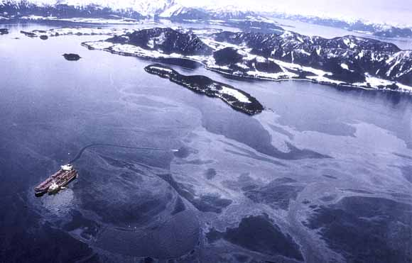
Organic Pollutants
They Include oils, fats, phenols, organic acids grease and several other organic compounds

Slide 17
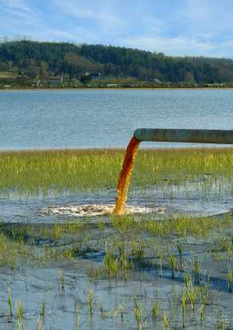
Agricultural Wastes
Chemical fertilizers and pesticides have become essential for present day high yielding crops.
Consequently , they have become a potential source of water pollution. These fertilizers contain major plants nutrients mainly nitrogen, phosphorous, and potassium.
Excess fertilizers may reach the ground water by leaching or may be mixed with surface water of rivers, lakes and ponds by runoff and drainage.

Slide 18
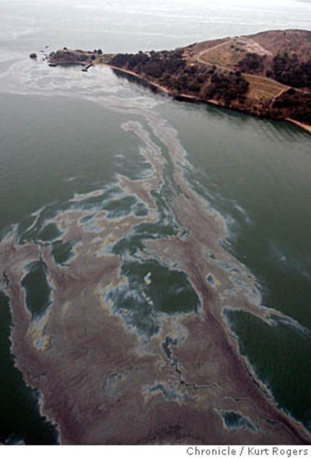
Marine Pollution
Ocean are the final sink of all natural and manmade pollutants. Rivers discharge their pollutants into the sea. The sewage and garbage of costal cities are also dumped into the sea. The other sources include, discharge of oils, grease, detergents, and radioactive wastes from ships.

Slide 19
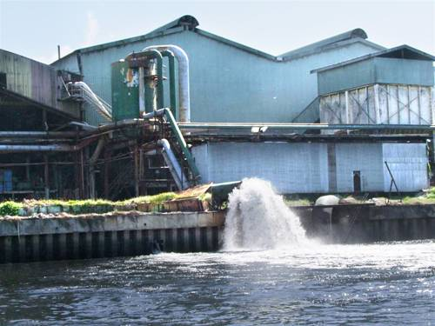
Thermal Pollution
Thermal Pollution of water is caused by the rise in temperature of water. The main source of thermal pollution are the thermal and nuclear power plants. The power generating plants use water as coolants and release hot water into the original source. Sudden rise in temperature kills fish and other aquatic animals.

Slide 20
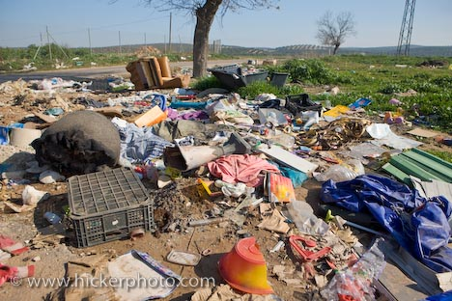
Land Pollution

Slide 21
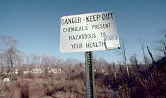
Land pollution is the demolition of Earth's land surfaces often caused by human activities and their misuse of land resources. It occurs when waste is not disposed properly.
Urbanization and industrialization are major causes of land pollution.

Slide 22
Causes of Land Pollution
Four Main causes of land pollution:
Construction
Agriculture
Domestic waste
Industrial Waste

Slide 23
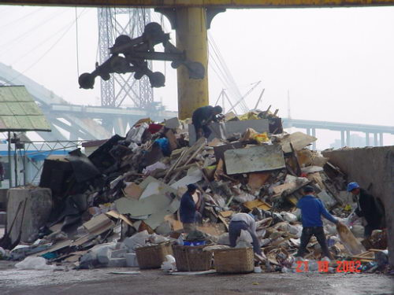
Construction
Buildings take up resources and land, the trees are chopped down and used to make buildings.
Takes away the places for animals and other organisms to live.

Slide 24
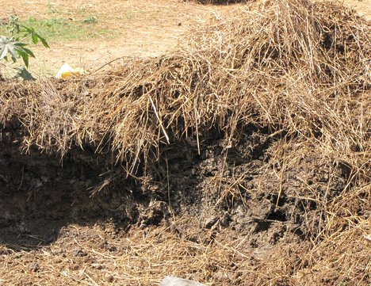
Agriculture
As there are more and more people inhabiting the earth, food is in higher demand and so forests are chopped down and turned into farmland
In addition, herbicides, pesticides, artificial fertilizers, animal manure are washed into the soil and pollute it.

Slide 25
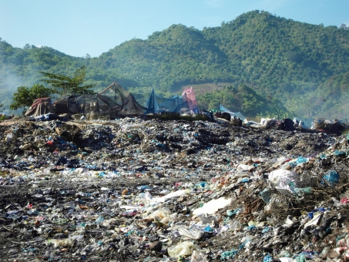
Domestic Waste
Tons of domestic waste is dumped every day. Some waste
from homes, offices and industries can be recycled or
burnt in incinerators .
There is still a lot of garbage, such as refrigerators and
washing machines that are dumped in landfills simply
because they cannot be reused in anyway, nor recycled .

Slide 26
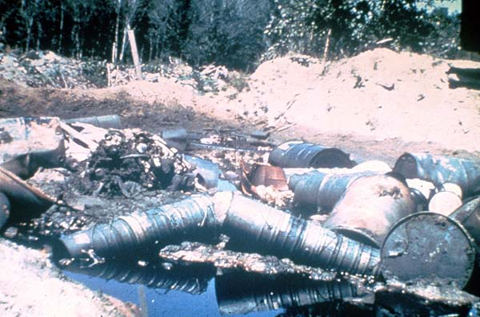
Industrial Waste
Plastics factories, chemical plants, oil refineries, nuclear waste disposal activity, large animal farms, coal-fired power plants, metals production factories and other heavy industry all contribute to land pollution.

Slide 27
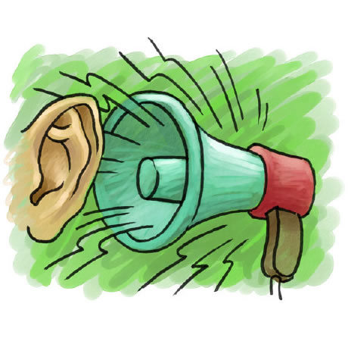
NOISE POLLUTION

Slide 28
Noise pollution is excessive, displeasing human, animal, or machine-created environmental noise that disrupts the activity or balance of human or animal life.
Sound becomes undesirable when it disturbs the normal activities such as working, sleeping, and during conversations.
World Health Organization stated that “Noise must be recognized as a major threat to human well-being”

Slide 29
Sources of Noise Pollution
Transportation systems are the main source of noise
pollution in urban areas.
Construction of buildings, highways, and streets cause a lot
of noise, due to the usage of air compressors, bulldozers,
loaders, dump trucks, and pavement breakers.
Industrial noise also adds to the already unfavorable
state of noise pollution.
Loud speakers, plumbing, boilers, generators, air
conditioners, fans, and vacuum cleaners add to the existing
noise pollution.

Slide 30
Effects OF NOISE POLLUTION
According to the USEPA, there are direct links between
noise and health. Also, noise pollution adversely affects the
lives of millions of people.
Noise pollution can damage physiological and
psychological health.
High blood pressure, stress related illness, sleep disruption,
hearing loss, and productivity loss are the problems related
to noise pollution.
It can also cause memory loss, severe depression, and panic
attacks.

Slide 31
Solutions for Noise Pollution
Planting bushes and trees in and around sound
generating sources is an effective solution for noise
pollution.
Regular servicing and tuning of automobiles can
effectively reduce the noise pollution
Social awareness programs should be taken up to educate
the public about the causes and effects of noise pollution.
Workers should be provided with equipments such as ear
plugs and earmuffs for hearing protection.

Slide 32
Similar to automobiles, lubrication of the machinery
and servicing should be done to minimize noise
generation.
Soundproof doors and windows can be installed to
block unwanted noise from outside.
Regulations should be imposed to restrict the usage
of play loudspeakers in crowded areas and public
places.
Factories and industries should be located far from
the residential areas.

Slide 33
WAYS TO STOP POLLUTION
We believe that it is the responsible thing to do to increase recycling.
It is just like doing laundry and separating blacks and colors.
The residents of the country should also try and do their part and put in at least one day of litter picking up.

Slide 34
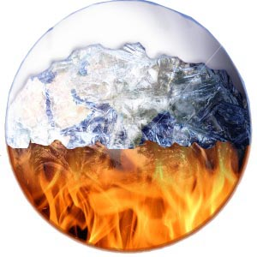
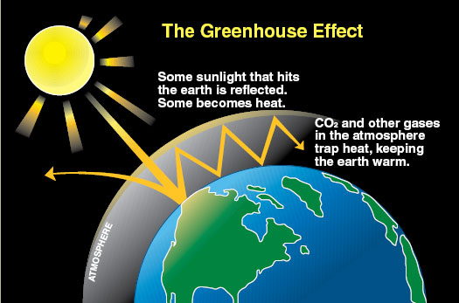
GLOBAL WARMING AND THE GREENHOUSE EFFECT
Global Warming
Greenhouse Effect

Slide 35
difference between Global Warming and the Greenhouse Effect
Global warming refers to a rise in the
temperature of the surface of the earth.
The Greenhouse Effect is a process by which
thermal radiation from a planetary surface is
absorbed by atmospheric greenhouse gases,
and is re-radiated in all directions.

Slide 36
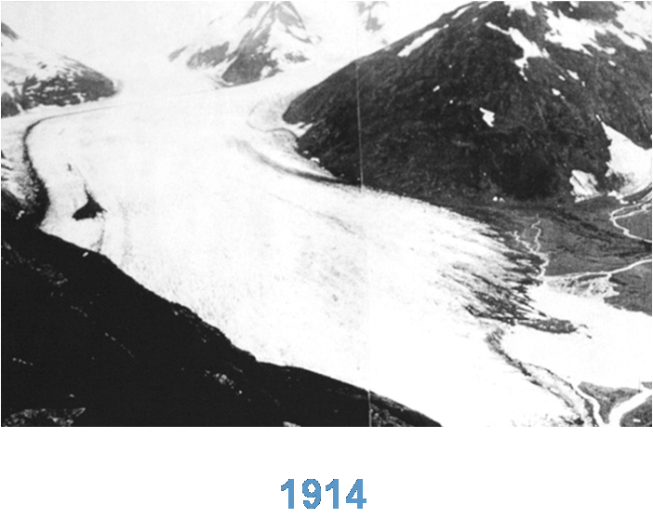
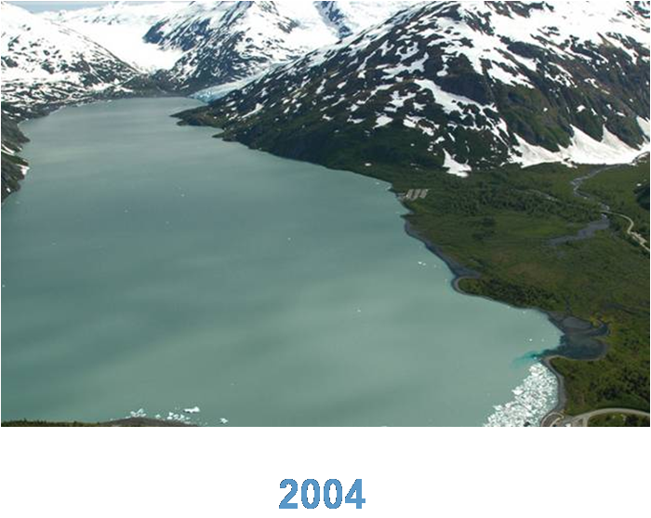
Some Proof of Global Warming
Portage Glacier Alaska now….
Portage Glacier Alaska then….

Slide 37
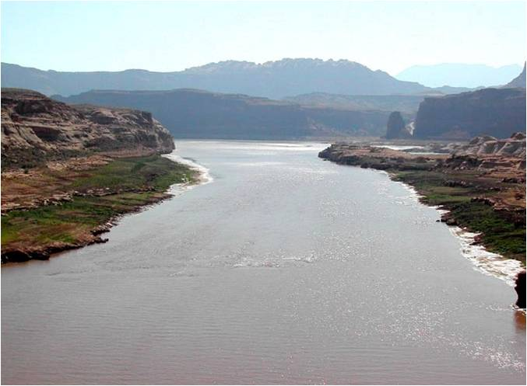
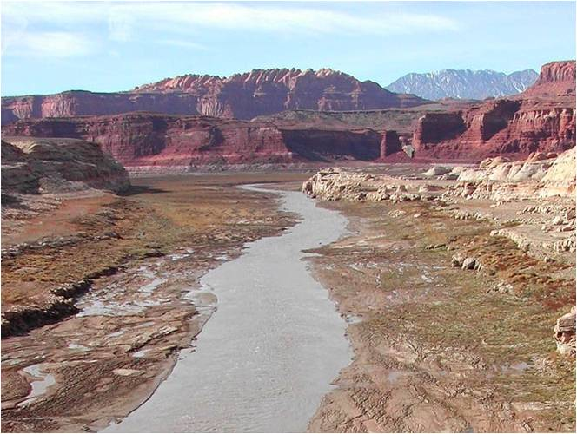
Colorado River, As of
December 2003
Colorado River, As of
June 2002

Slide 38

ANY QUESTIONS??

Slide 39
THANK YOU

