Slide 1
Design Class Diagram
(DCD)

Slide 2
Design Class Diagram (DCD)
A Design class diagram (DCD) illustrates the specifications for software classes and interfaces (for example Java interfaces) in an application.
It involves
  Classes, associations and attributes
  Interfaces with their operations
  Methods
  Navigability
  Dependencies
Design classes can be identified from interaction diagrams or from Domain Model

Slide 3
Domain Model vs Design Model Classes
Sale
Register
Domain Model
1
1
Date
isComplete: Boolean
time
captures
Register
Sale
1
Date
isComplete: Boolean
time
Design Model
1
endSale()
enterItem()
makePayment()
captures
MakeNewLineItem()

Slide 4
Methods name from interaction diagrams
Methods
Sale
Date
isComplete: Boolean
time
MakeNewLineItem(…)
2: makeLineItem(spec,qty)
:Register
:Sale
Issues related to Method names
  Interpretation of Create message
  Depiction of accessing messages (accessor / mutator methods)
  Interpretation of messages to multiobjects
  Language-dependent syntax

Slide 5
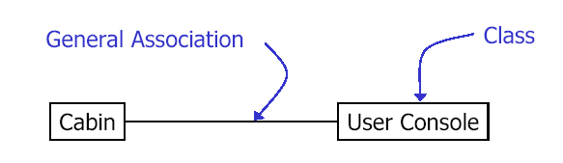
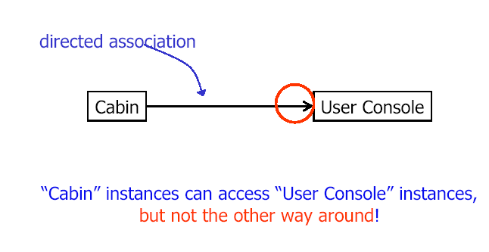
Association and Navigability of Classes
Associations describe navigation paths through the class/object model
Here: navigation in both directions possible
“Cabin” instances can access “User Console” instances, but not the other way around!

Slide 6
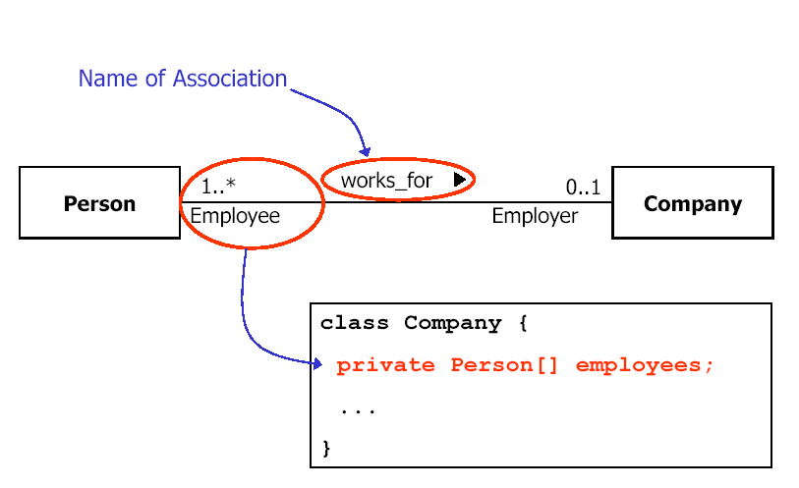

Slide 7
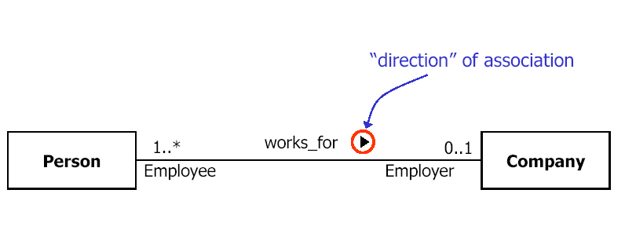

Slide 8
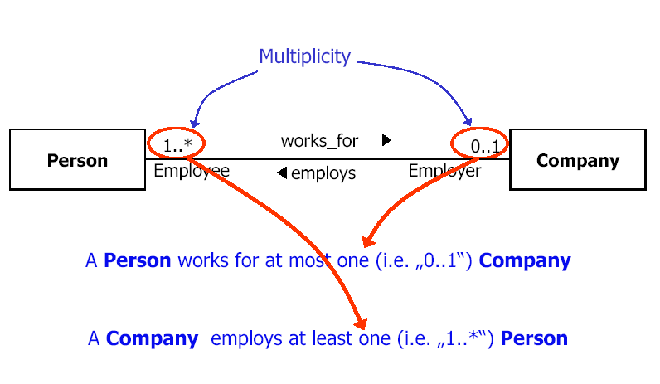

Slide 9
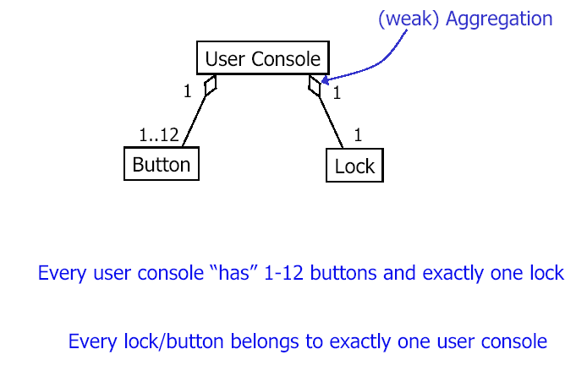
Types of Association: Aggregation
Aggregation is a kind of association used to model
Whole-Part relationship.

Slide 10
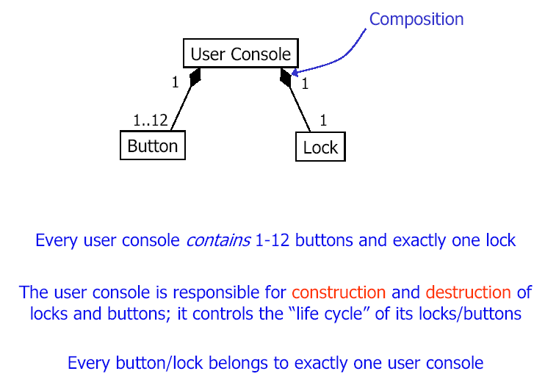
Types of Association: Composition
Composition means the part is a member of only one composite object (the whole), and it has an existence and disposition dependency on the composite

Slide 11
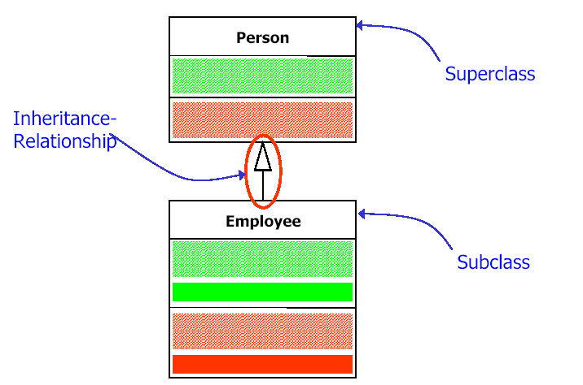
Inheritance

Slide 12
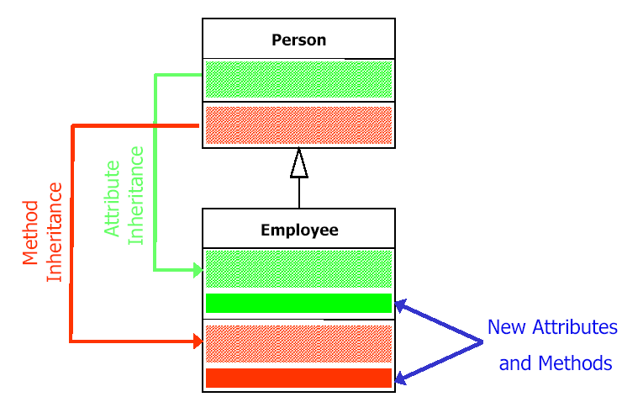

Slide 13
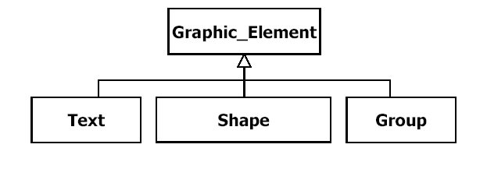
Subclasses inherit attributes, associations and operations from their Superclasses
Subclasses can overwrite inherited operations
Each instance of a subclass is also an instance of its superclass (Polymorphism)

Slide 14
Case Study: “Buyable Books ltd”
Problem Statement
“Buyable Books ltd” would like to establish an internet-based online bookstore. The customer can interactively select any book from the categories fiction, non-fiction and educational. They can then examine a short description and price of each book, select the ones they want to purchase and proceed to paying for them. To complete payment a form must be filled out with shipping and payment information.
Payment may be by credit card or postal order. The customer may write to a help desk to ask for information. When the order is confirmed, a confirmation email is sent to the customer with details of the order and a reference number. The reference number can be used to check the status of the order on line. Behind the scenes the system must verify the customer’s credentials, request the books from the warehouse, print an invoice and request a delivery to the customer.

Slide 15
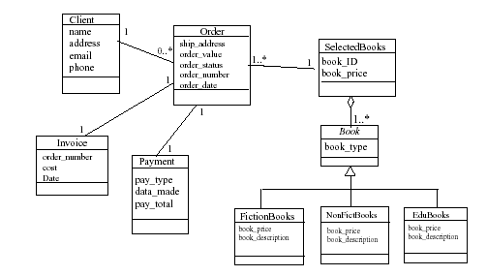
Solution: Static Class Model

Slide 16
Rational Rose
Rational Rose supports many types of classes such as
  Boundary
  Entity/Resource
  Controller

Slide 17
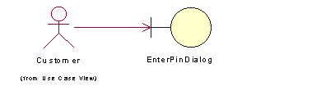
Boundary Classes
Boundary classes are used in the Analysis Model to model interactions between the system and its actors (users or external systems)
Boundary classes are often implemented in some GUI format (dialogs, widgets, beans, etc.)
Boundary classes can often be abstractions of external APIs (in the case of an external system actor)
Every boundary class must be associated with at least one actor:

Slide 18
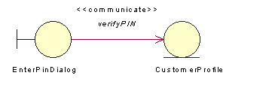
Entity Classes
Entity classes are used within the Analysis Model to model persistent information
Often, entity classes are created from objects within the business object model or domain model

Slide 19
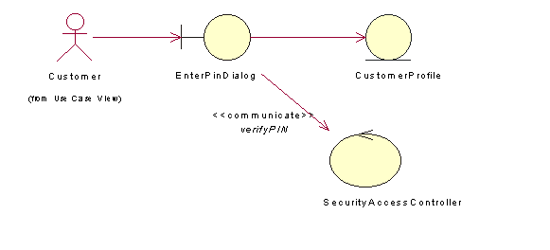
Control Classes
Control classes model abstractions that coordinate, sequence, transact, and otherwise control other objects
In Smalltalk MVC mechanism, these are controllers
Control classes are often encapsulated interactions between other objects, as they handle and coordinate actions and control flows.

Slide 20
References
Applying UML and Patterns by Craig Larman
  Chapter 19: 19.1, 19.4, 19.5, 19.6
  Chapter 26: 26.1, 26.2, 26.4, 26.6, 26.7
  Chapter 27: 27.1, 27.2 ,27.4 ,27.5, 27.6, 27.7 ,27.8 ,27.10

