Slide 1
GRASP: Designing Objects with responsibilities

Slide 2
An object-oriented system is composed of objects sending messages to other objects.
The quality of the overall design depends on which object is doing what.
That is, the quality depends on how we assign responsibilities to the objects.
“Identify requirements, create a domain model, add methods to the software classes, define messages to meet requirements…”
Too Simple!
  What methods belong where?
  How do we assign responsibilities to classes?

Slide 3
Responsibilities and Methods
Contracts or obligations of a class
There are two types of Responsibilities.
  What must a class “know”?
    Private encapsulated data
    Related objects
    Things it can derive or calculate
  What must a class “do”?
    Take action (create an object, do a calculation)
    Initiate action in other objects
    Control/coordinate actions in other objects
Responsibilities are assigned during object design

Slide 4
Examples of Responsibilities
“A Sale is responsible for creating SalesLineItems” (doing)
“A Sale is responsible for knowing its total” (knowing)
These are related to operations, attributes, associations in the domain model

Slide 5
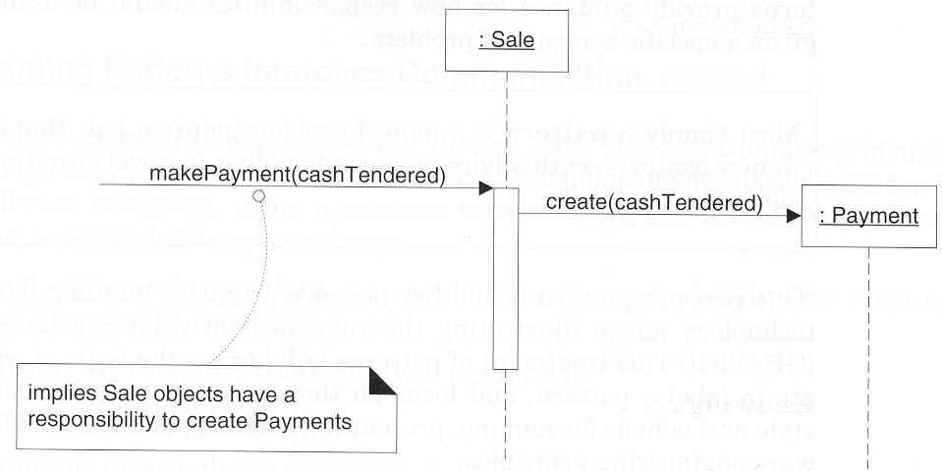
Responsibilities in Interaction Diagrams

Slide 6
Patterns
“General principles and idiomatic solutions that guide design”
Example:
Pattern Name: Information Expert
Solution: Assign a responsibility to the
class that has the information
necessary to fulfill it
Problem Solved: What is a basic principle by which
to assign responsibilities to objects?
Patterns capture fundamental, widely-used design principles

Slide 7
GRASP Patterns
General Responsibility Assignment Software Patterns
GRASP can be used when designing interaction (sequence) diagrams and class diagrams.
They do not usually contain "new" ideas. They try to codify existing knowledge and principles.
The five basic patterns:
  Information Expert
  Creator
  High Cohesion
  Low Coupling
  Controller

Slide 8
Pattern: Information Expert
Problem: How do we assign responsibilities to objects?
Solution: Assign a responsibility to an information expert – the class that has the information necessary to fulfill the responsibility

Slide 9
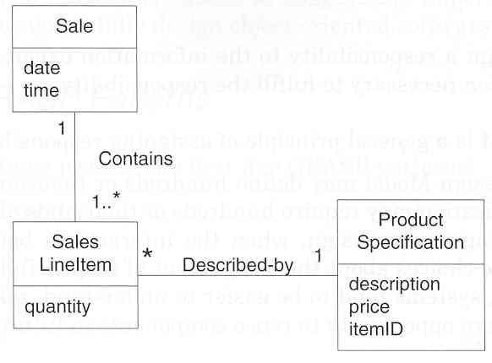
Example: NextGen
In the NextGen system, some class needs to know the
grand total of a sale. What class should be responsible?
Sale contains info about all the
SalesLineItems

Slide 10
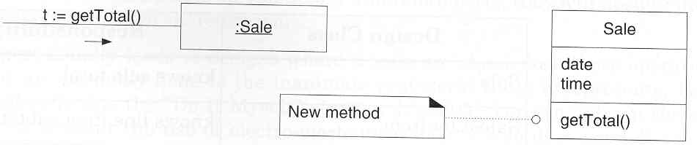
Example [2]
1. The new responsibility is conveyed by an operation in an
interaction diagram. A new method is created in the design
class to express this.
[Larman 2002]

Slide 11
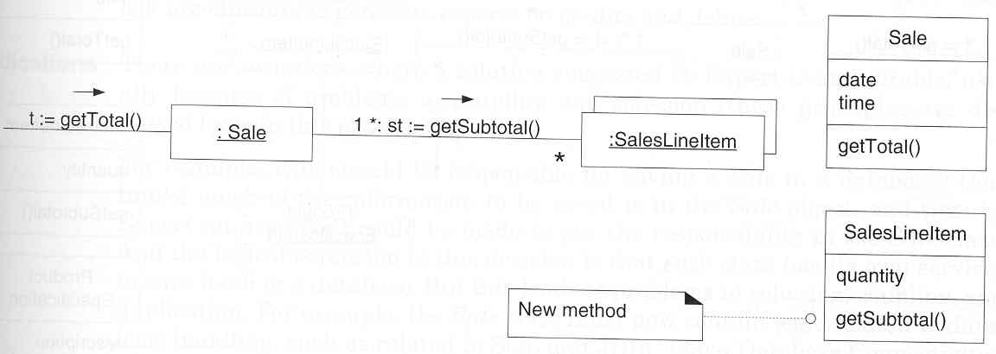
Example [3]
2. Responsibility for each subtotal is assigned to the
SalesLineItem

Slide 12
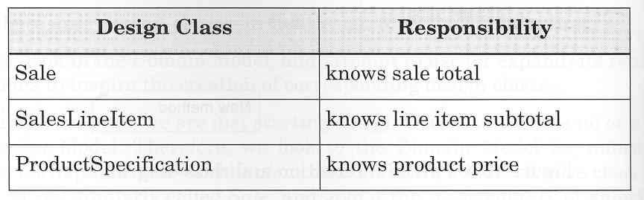
Summary

Slide 13
Exceptions
Q: Should each object be responsible for saving itself in a database?
A: No. Consider separation of concerns (application logic vs. database logic)
Related to coupling and cohesion
(we’ll learn these a little later)

Slide 14
Pattern: Creator
Problem: What class should be responsible for creating new instances of some class?
Solution: Assign B responsibility to create A if:
  B aggregates A objects
  B contains A objects
  B records instances of A objects
  B closely uses A objects
  B has initializing data that will be passed to A when it’s created

Slide 15
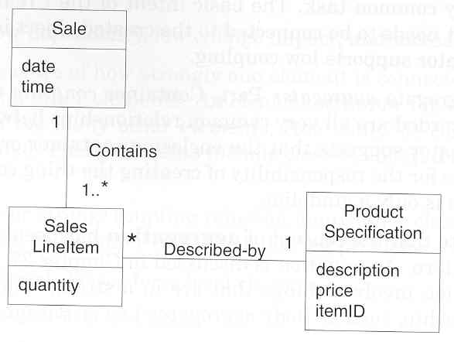
Example: NextGen
What class should be responsible for creating a
SalesLineItem instance?
Sale aggregates many
SalesLineItems
[Larman 2002]

Slide 16
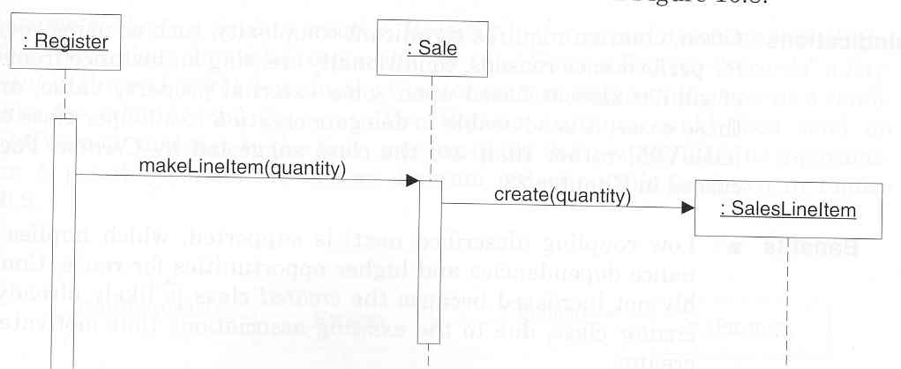
Example [2]
1. The new responsibility is conveyed by an operation in an interaction diagram. A new method is created in the design class to express this.

Slide 17
Exceptions
If object creation is a complex process, consider using a helper class called a Factory (see Ch. 23) instead

Slide 18
Pattern: Coupling
Problem: How to support low dependency, low change impact, and increased reuse?
Solution: Assign a responsibility so that coupling remains low

Slide 19
What is Coupling?
A measure of how strongly one class is connected to / has knowledge of / or relies on others
  Low coupling: not dependent
  High coupling: highly dependent
High coupling is undesirable…
  Changes in related classes force local changes
  Harder to understand class in isolation
  Harder to reuse class

Slide 20

Example: NextGen
How should we assign responsibility for creating
Payment and associating it with Sale?

Slide 21
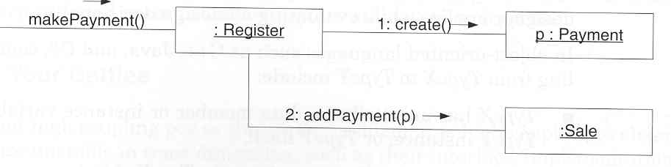
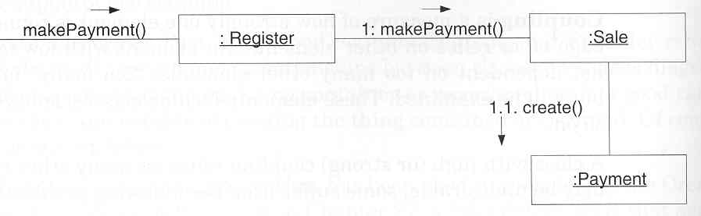
Example [2]
Option 1
Option 2
Which option supports
Low Coupling?

Slide 22
Exceptions
High coupling is okay if the classes referred to are stable
  Java libraries (java.util)
  Stable code (won’t change)
Be realistic – worry about the worst cases, not every case
  Most new code is in constant flux…

Slide 23
Pattern: High Cohesion
Problem: How to keep complexity manageable?
Solution: Assign a responsibility so that cohesion remains high

Slide 24
What is Cohesion?
A measure of how strongly related and focused the responsibilities of a class are
  Highly focused & related: high cohesion
  Not focused, unrelated: low cohesion
Low cohesion is undesirable…
  Hard to comprehend classes
  Hard to reuse classes
  Hard to maintain classes
  Brittle: classes easily broken by changes

Slide 25
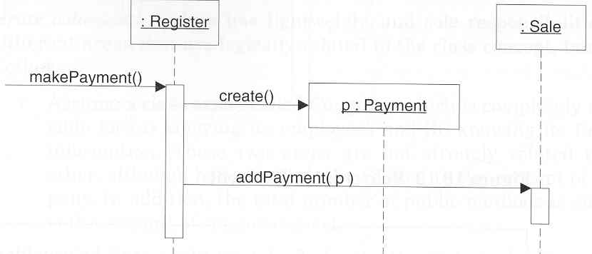
Example: NextGen
What class should be
responsible for creating a
Payment and associating it
with a Sale?

Slide 26
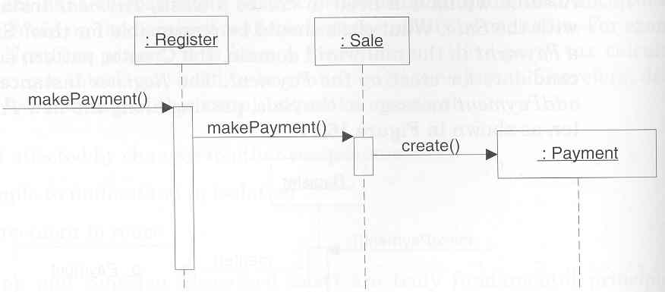
Example [2]
In this option, Register delegates
the responsibility to Sale
Higher cohesion, lower coupling

Slide 27
Exceptions
Grouping responsibilities for easier maintenance
  Example: all methods for interacting with a database kept in a single class
    PRO: easier to maintain
    CON: less cohesion, higher coupling
    (handles operations for many objects)
Method1():
Method2():
Method3():
Method4():
Method5():
……

Slide 28
Pattern: Controller
Problem: Who should be responsible for handling an input system event?
Solution: Assign responsibility for receiving or handling a system event to a class representing:
  Overall system, device, subsystem
  (façade controller)
  Use case scenario, e.g. EndSaleHandler

Slide 29
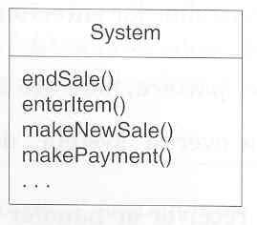
Example: NextGen
System operations
associated with system
events

Slide 30
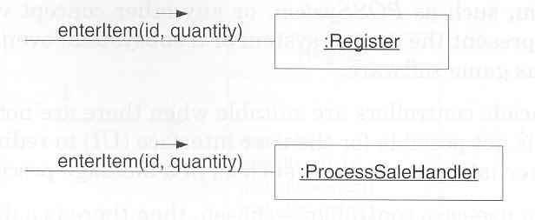
Example [3]
Represents the overall system, device or subsystem
Represents the receiver or handler of all events of a use case

Slide 31
Choosing a Controller
Façade controller
  PRO: all events handled in one place
  CON: can become too bloated
Use-case controller
  PRO: manage many different events across different processes
  CON: adds additional classes; events can’t be managed (e.g. logged) in one place

Slide 32
Bloated Controllers
A poorly designed controller class which is un focused and handling to many responsibilities
Problems Signs
  A single class receiving all system events
  Controller itself is performing many tasks that can be distributed
  Controller is overburdened by attributes and other significant information
Cure
  Add more controllers
  Design controller in a way that it assign responsibilities to other objects

Slide 33
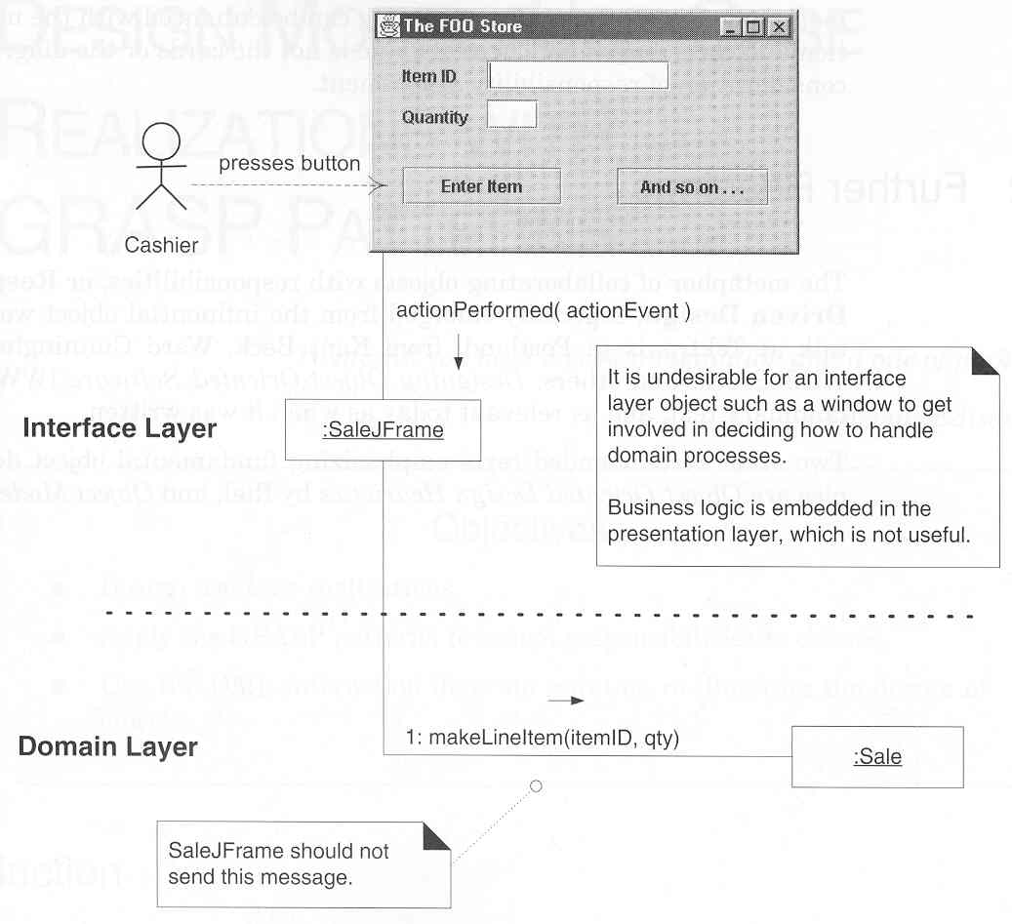
Less Desirable Coupling

Slide 34
References
Applying UML and Patterns by Craig Larman
  Chapter 16

