Slide 1
Implementation Model
Mapping Designs To Code

Slide 2
Language Mapping
Introduction
  UML artifacts created during the design work
    interaction diagrams - input to the code generation
    DCDs - process
  Implementation Model : artifacts
    source code
    database definitions
    JSP/XML/HTML pages….
  Language Sample : Java, C#, Visual Basic, C++, Smaltalk, Python, …….

Slide 3
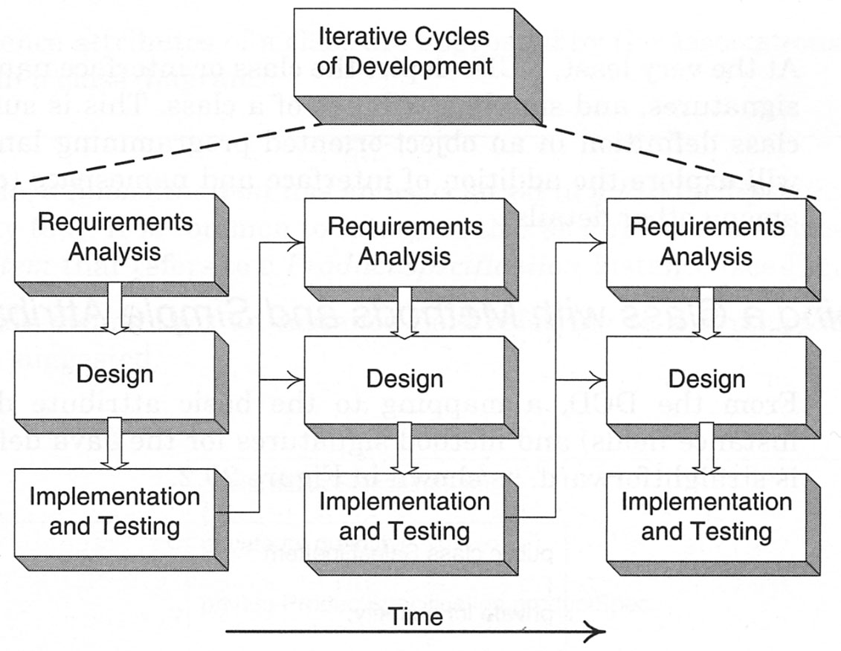
Programming and the Development Process
Creativity and Change During Implementation
  Programming work is not a final code generation stop
  During programming and testing, myriad change, detailed problem uncovering and resolving
  Expect and plan for change and deviation from the design during programming
Code Change and the Iterative process
Implementation in an iteration influences later design

Slide 4
Programming and the Development Process
Code Changes, CASE Tools, and Reverse-Engineering
  CASE Tools : automatically generating artifacts
  Reverse-Engineering : the activity of generating diagrams from source code

Slide 5
Mapping Design to Code
Writing source code for :
  class and interface definitions
  method definitions

Slide 6
Creating Class Definitions from DCDs
DCDs depict :
  class or interface name
  superclasses
  method signatures
  simple attributes of a class

Slide 7
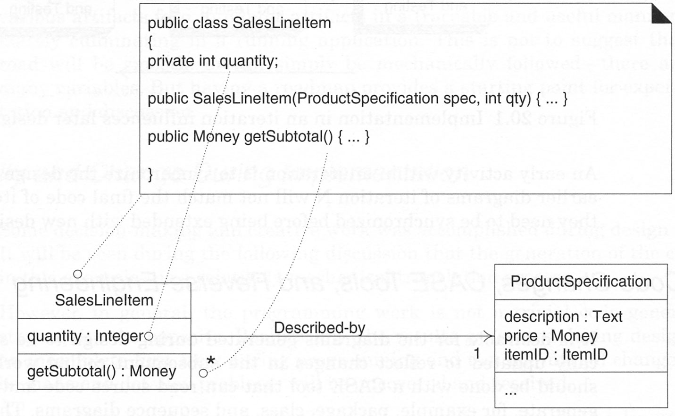
Creating Class Definitions from DCDs
Defining a class with Methods and Simple Attributes
  Note the addition in the source code of Java constructor SalesLineItem(…)
  Create method is often excluded from the class diagram
SalesLineItem in Java.

Slide 8
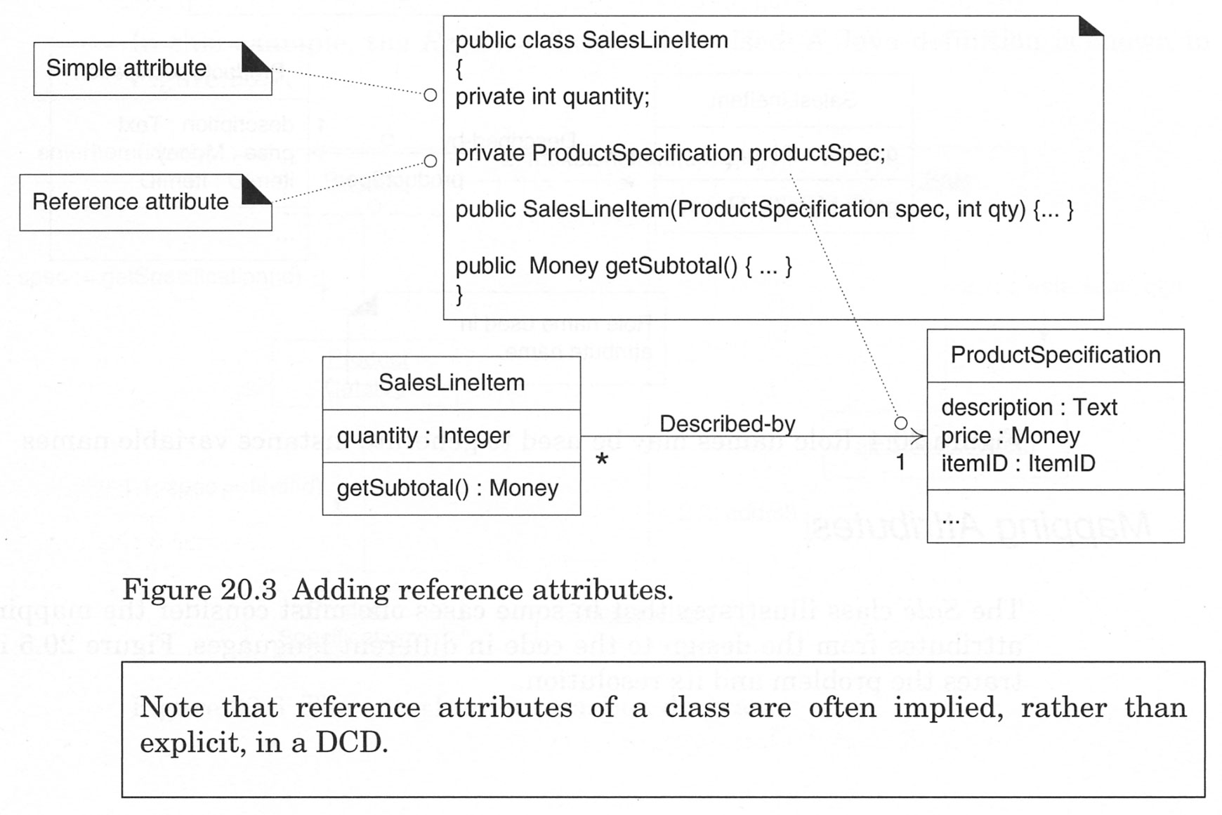
Creating Class Definitions from DCDs
Adding Reference Attributes
  Reference attribute
    an attribute that refers to another complex object, not to a primitive type
    are suggested by the associations and navigability in a class diagram
  Note that reference attributes of a class are often implied, rather than explicit, in a DCD
Adding reference attributes.

Slide 9
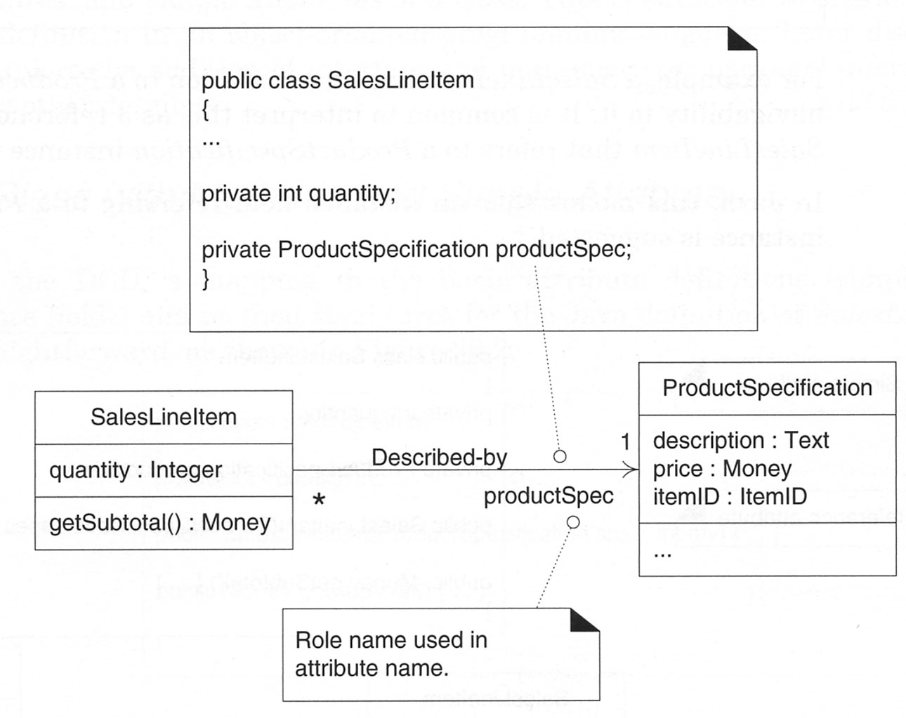
Creating Class Definitions from DCDs
Role names may be used to generate instance variable names.

Slide 10
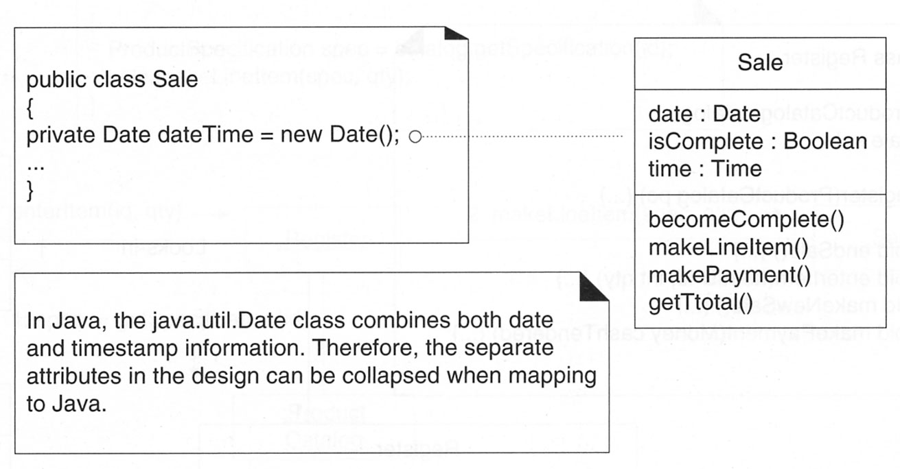
Creating Class Definitions from DCDs
Mapping Attributes
Mapping date and time to Java.

Slide 11
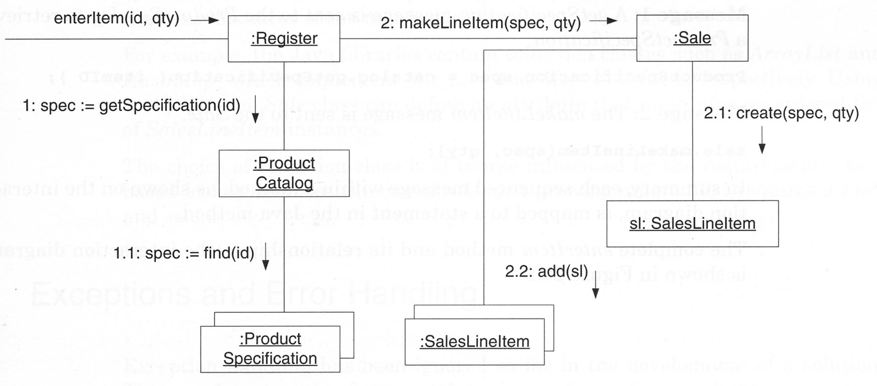
Creating Methods from Interaction Diagrams
The enterItem interaction diagram.

Slide 12
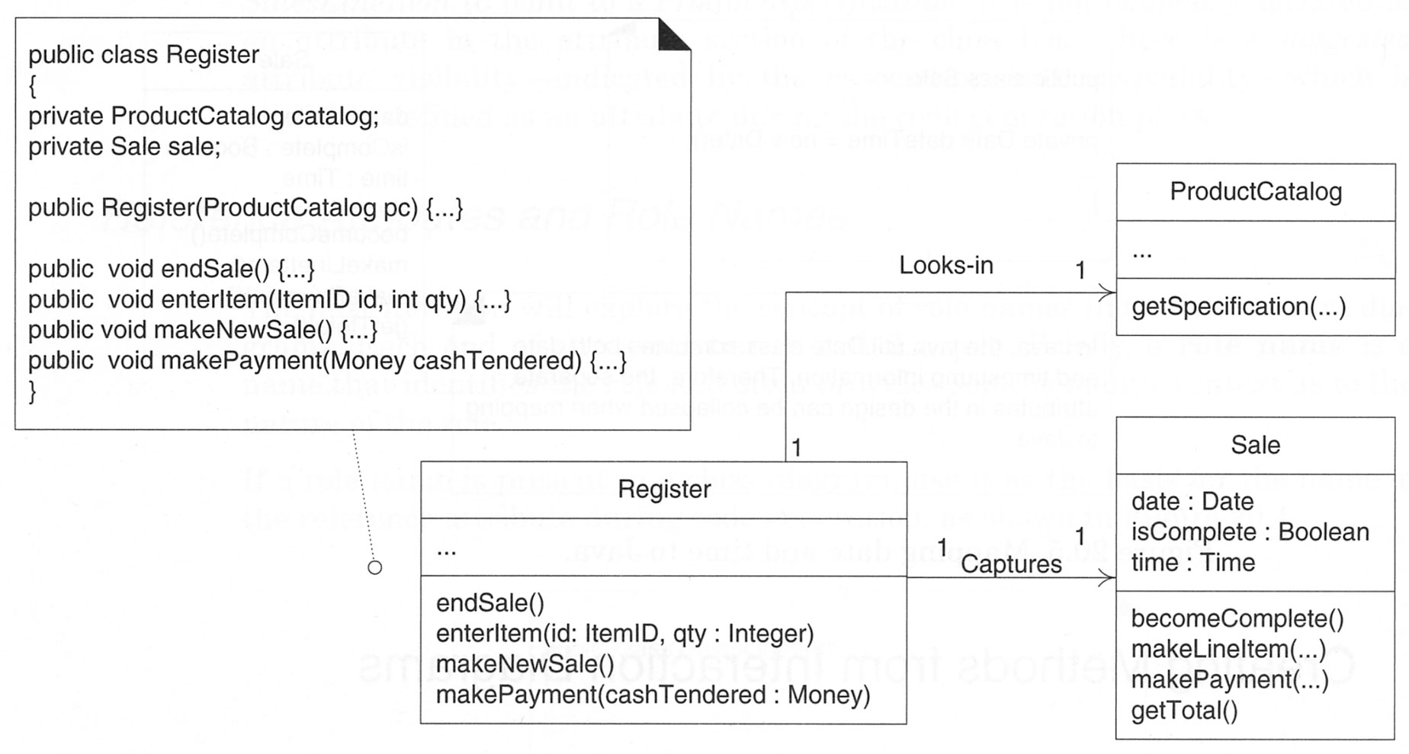
Creating Methods from Interaction Diagrams
The Register—enterItem Method
The Register class.

Slide 13
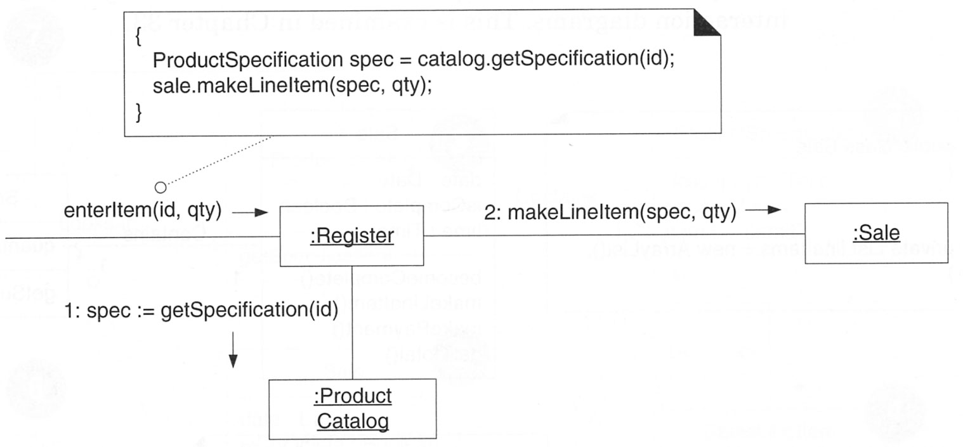
Creating Methods from Interaction Diagrams
The enterItem method.

Slide 14
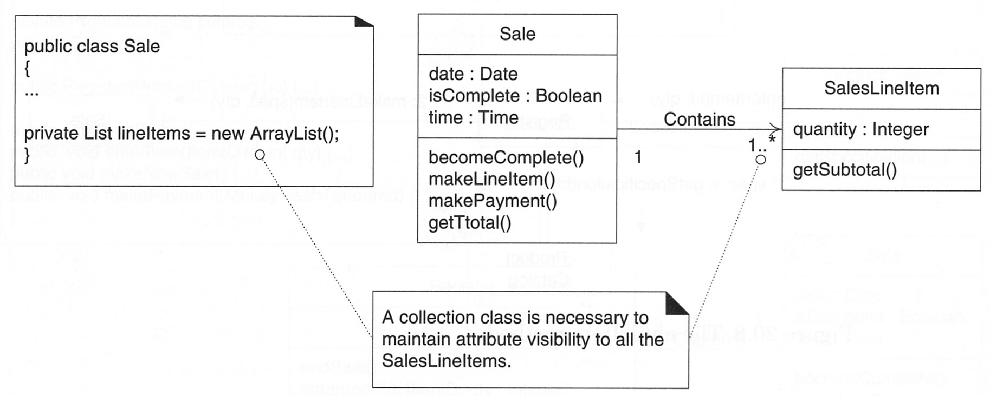
Container/Collection Classes in Code
Adding a collection.

Slide 15
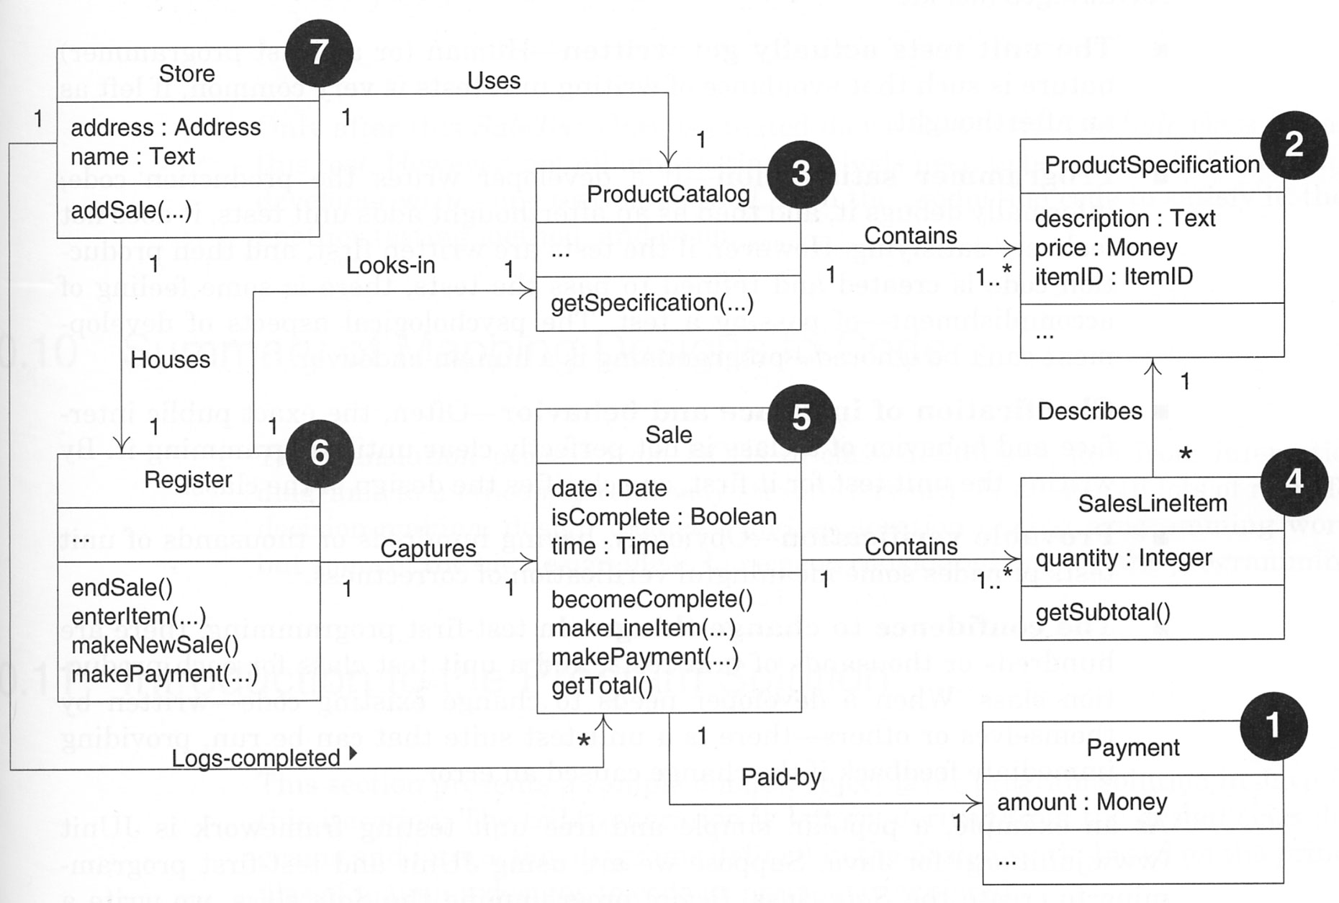
Order of Implementation
Possible order of class implementation and testing.

Slide 16
Test-First Programming
An excellent practice
Applicable to the UP
  writes unit testing code for all production code
  write a little production code
  make it pass the test, then write some more test code,
  and so forth

Slide 17
Test-First Programming
Advantages
  The unit tests actually get written
  Programmer satisfaction
  Clarification of interface and behavior
  Provable verification
  The confidence to change things

Slide 18
Summary of Mapping Designs to Code
There is still lots of room for
  decision-making
  design changes
  exploration during programming work
Some of the big design ideas have been considered prior to the programming
The main point of this listing is to show that there is a translation from design artifacts to a foundation of code. This code defines a simple case; it is not meant to illustrate a robust, fully developed Java program with synchronization, exception handling, and so on.

Slide 19
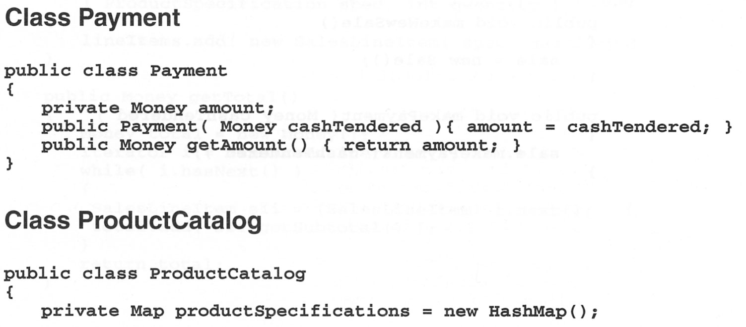
Summary of Mapping Designs to Code

Slide 20
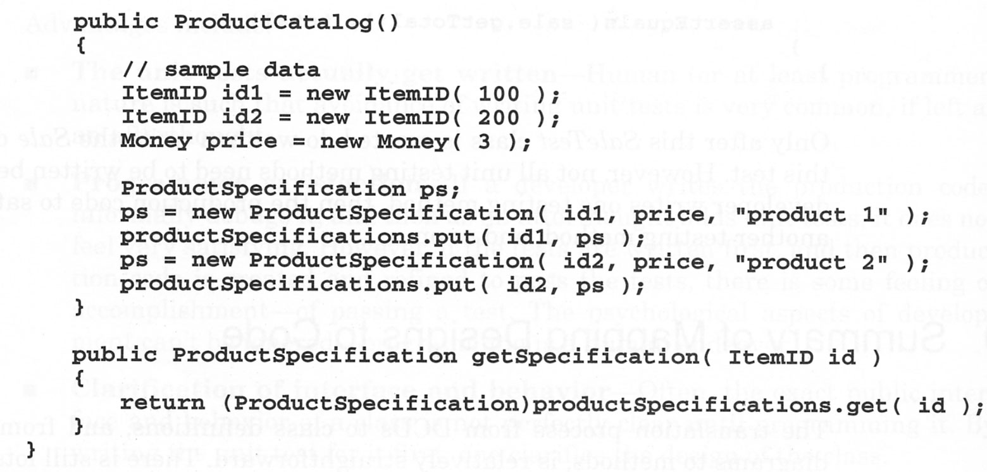
Summary of Mapping Designs to Code

Slide 21
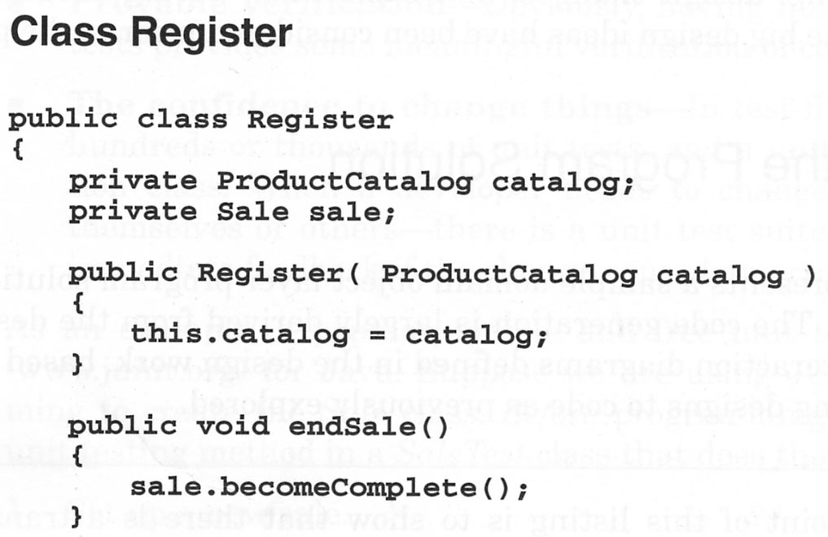
Summary of Mapping Designs to Code

Slide 22
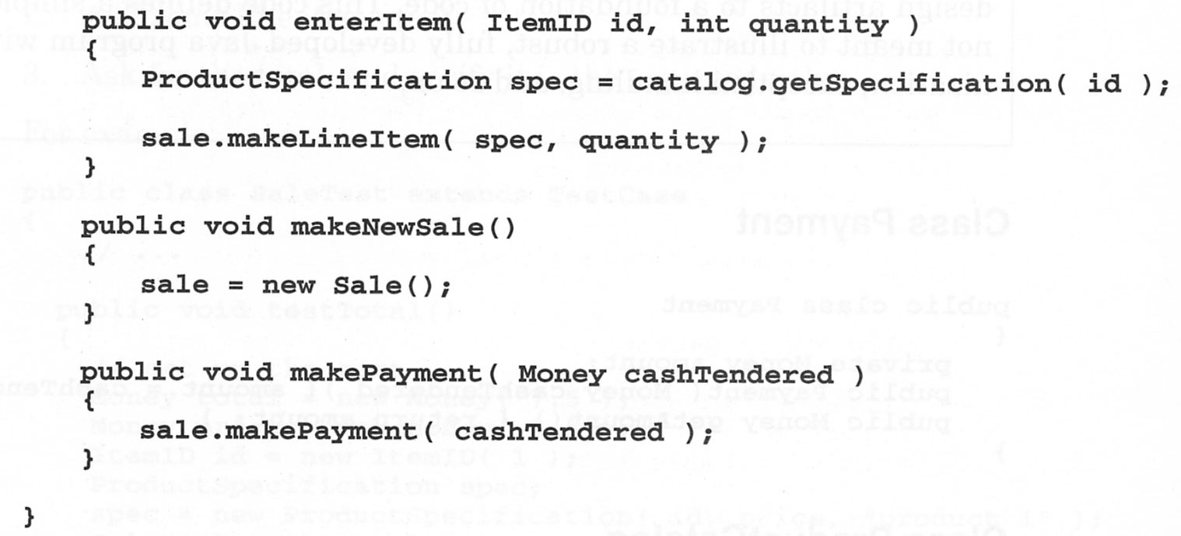
Summary of Mapping Designs to Code

Slide 23
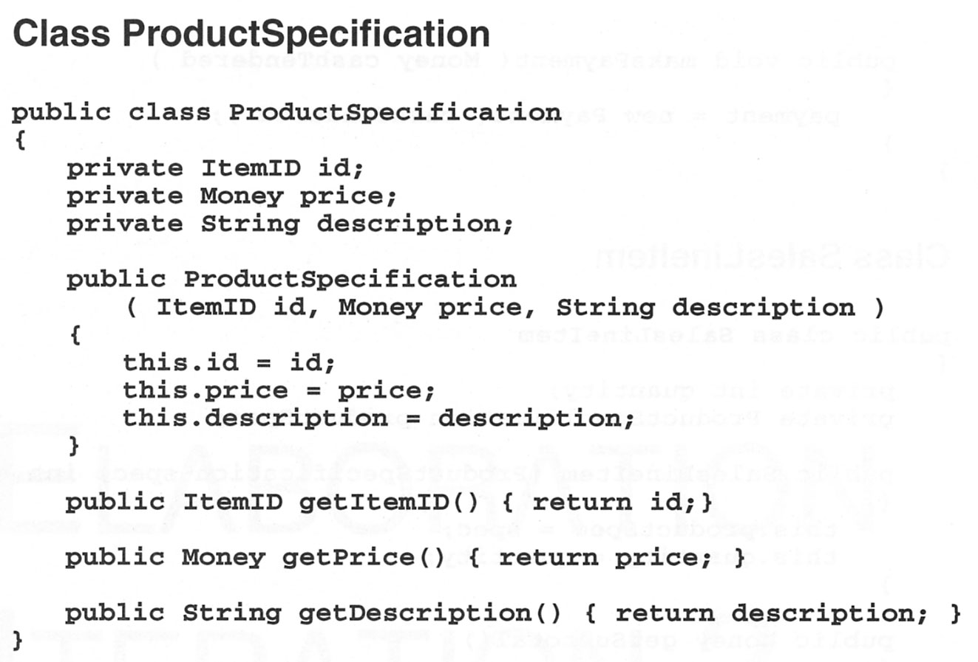
Summary of Mapping Designs to Code

Slide 24
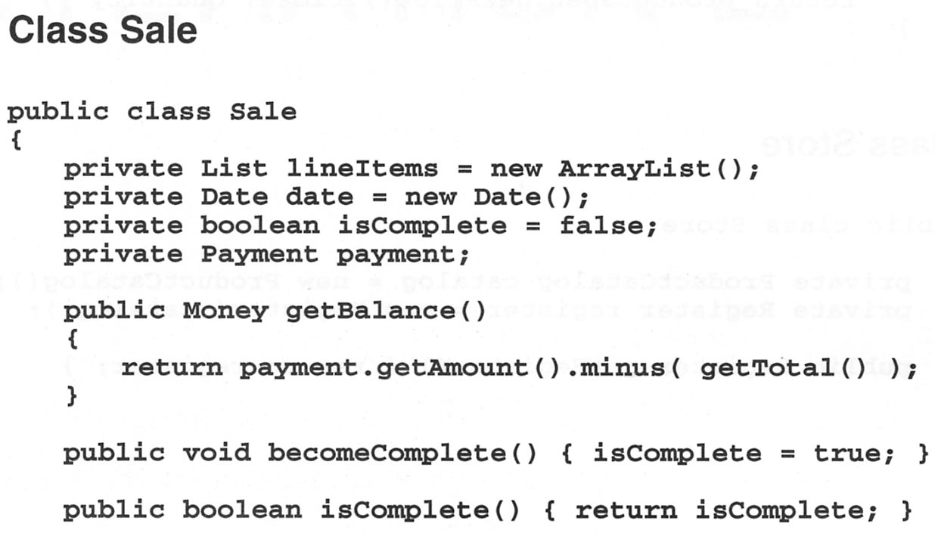
Summary of Mapping Designs to Code

Slide 25
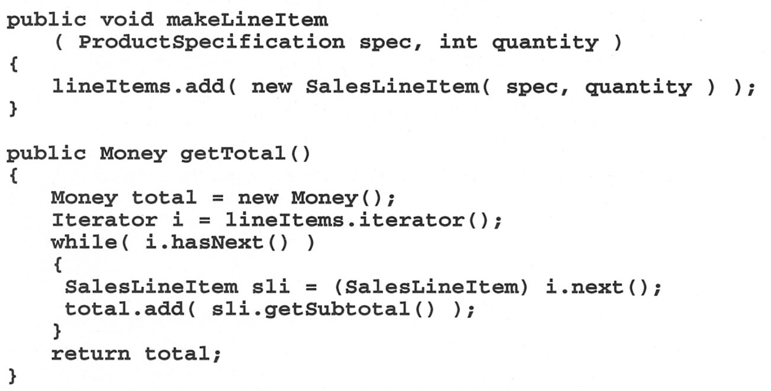
Summary of Mapping Designs to Code

Slide 26
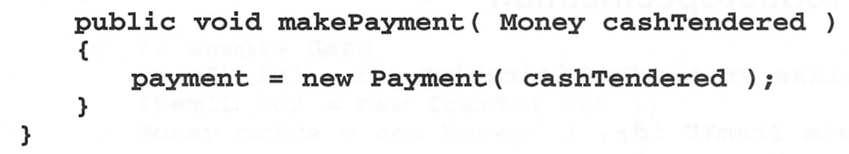
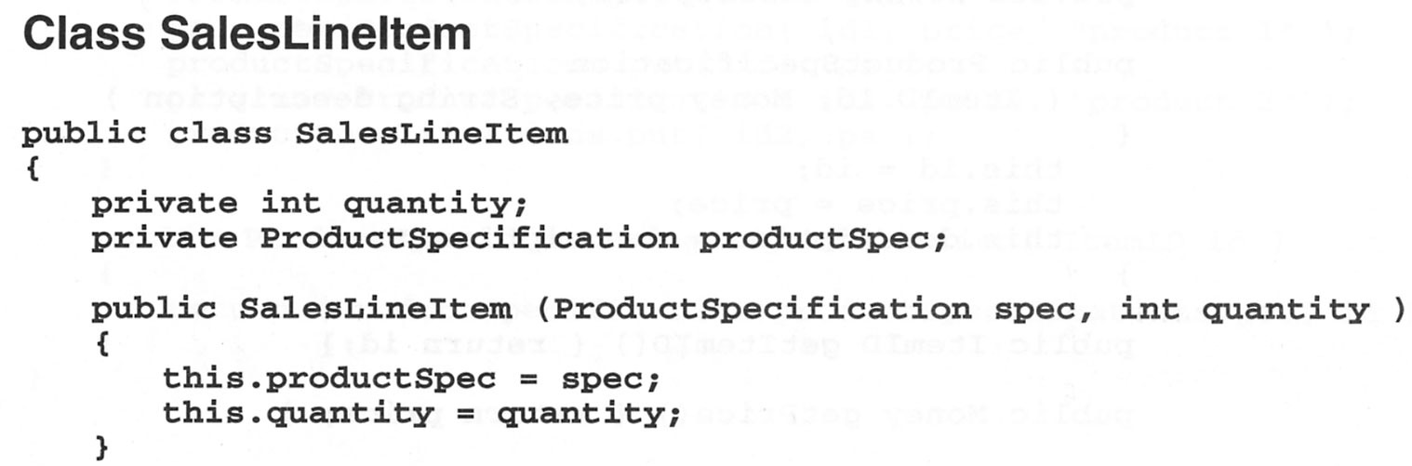
Summary of Mapping Designs to Code

Slide 27
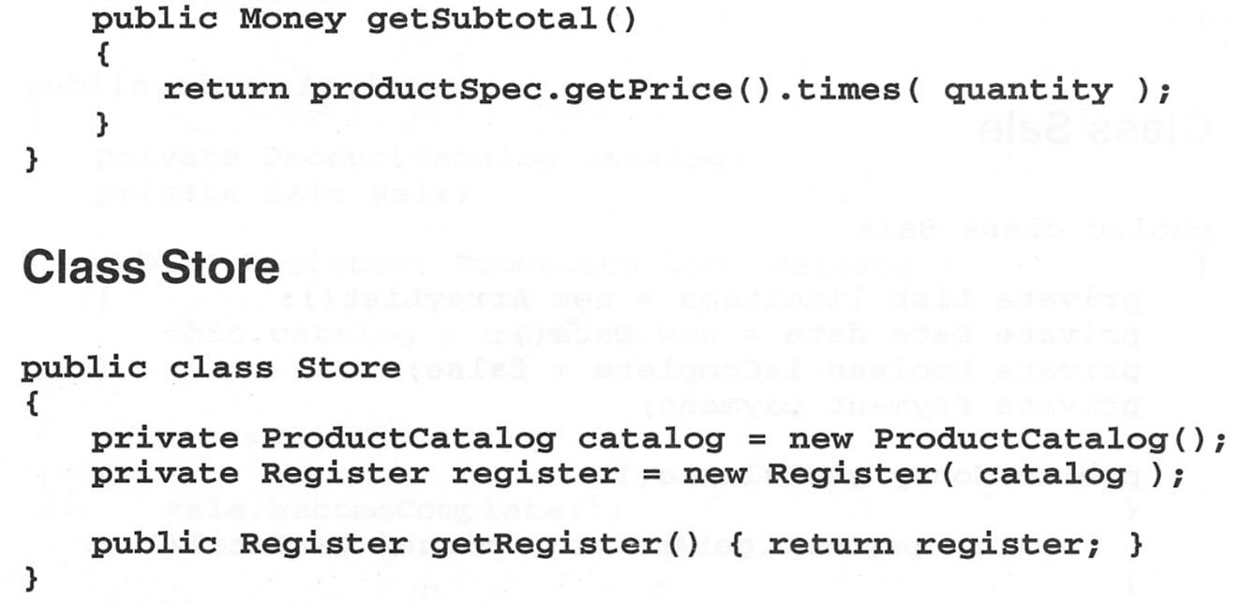
Summary of Mapping Designs to Code

Slide 28
References
Applying UML and Patterns by Craig Larman
  Chapter 20

