Slide 1
Model–view–controller

Slide 2
Model–view–controller (MVC) is a software architecture,^{[1]} currently considered an architectural pattern used in software engineering. The pattern isolates "domain logic" (the application logic for the user) from the user interface (input and presentation), permitting independent development, testing and maintenance of each (separation of concerns).

Slide 3
Model View Controller (MVC) pattern creates applications that separate the different aspects of the application (input logic, business logic, and UI logic), while providing a loose coupling between these elements.^{[2]}

Slide 4
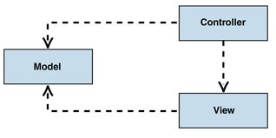
MVC class structure

Slide 5
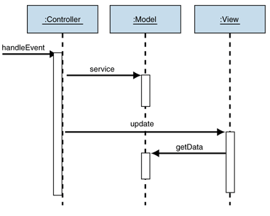
Behavior of the passive model

Slide 6
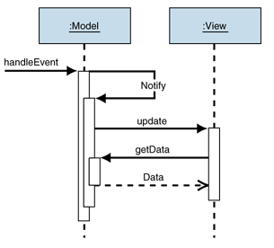
Behavior of the active model

Slide 7
Overview
Though MVC comes in different flavors, control flow is generally as follows:
The user interacts with the user interface in some way (for example, by pressing a mouse button).
The controller handles the input event from the user interface, often via a registered handler or callback, and converts the event into an appropriate user action, understandable for the model.
The controller notifies the model of the user action, possibly resulting in a change in the model's state. (For example, the controller updates the user's shopping cart.)^{[5]}
A view queries the model in order to generate an appropriate user interface (for example the view lists the shopping cart's contents). The view gets its own data from the model. In some implementations, the controller may issue a general instruction to the view to render itself. In others, the view is automatically notified by the model of changes in state (Observer) that require a screen update.
The user interface waits for further user interactions, which restarts the control flow cycle.
Some implementations such as the W3C XForms also use the concept of a dependency graph to automate the updating of views when data in the model changes.
The goal of MVC is, by decoupling models and views, to reduce the complexity in architectural design and to increase flexibility and maintainability of code. MVC has also been used to simplify the design of Autonomic and Self-Managed systems^{[6]}

Slide 8
Concepts
The model manages the behavior and data of the application domain, responds to requests for information about its state (usually from the view), and responds to instructions to change state (usually from the controller). In event-driven systems, the model notifies observers (usually views) when the information changes so that they can react.
The view renders the model into a form suitable for interaction, typically a user interface element. Multiple views can exist for a single model for different purposes. A view port typically has a one to one correspondence with a display surface and knows how to render to it.
The controller receives user input and initiates a response by making calls on model objects. A controller accepts input from the user and instructs the model and a view port to perform actions based on that input.
An MVC application may be a collection of model/view/controller triads, each responsible for a different UI element. The Swing GUI system, for example, models almost all interface components as individual MVC systems. MVC is often seen in web applications where the view is the HTML or XHTML generated by the app. The controller receives GET or POST input and decides what to do with it, handing over to domain objects (i.e. the model) that contain the business rules and know how to carry out specific tasks such as processing a new subscription, and which hand control to (X)HTML-generating components such as templating engines, XML pipelines, Ajax callbacks, etc.
The model is not necessarily merely a database; the 'model' in MVC is both the data and the business/domain logic needed to manipulate the data in the application. Many applications use a persistent storage mechanism such as a database to store data. MVC does not specifically mention the data access layer because it is understood to be underneath or encapsulated by the model. Models are not data access objects; however, in very simple apps that have little domain logic there is no real distinction to be made. Active Record is an accepted design pattern that merges domain logic and data access code — a model which knows how to persist itself.

