Slide 1
By:
  Ms. Amina Mustansir
  Lecturer PUCIT

Slide 2
Use case Operational Contracts
Contracts describes detailed system behavior in terms of state changes to objects in the Domain Model after a system operation execution.
These system operation are visualized from system sequence diagram
System operations that are complex and subtle in their results or which are not clear in the use case, construct a contract from them

Slide 3
Sections of a Contract
Operation: Name of operation and parameters
Cross References (optional): Use case name in which this operation will occur
Precondition: Noteworthy assumptions about the state of the system or objects in domain model before execution of the operation. These will not be tested within the logic of this operation, are assumed to be true.
Post conditions: The state of object in the domain model after the completion of the operation.

Slide 4
Example
Use case: Process Sale
Primary Actor: Cashier
Precondition:
Cashier is authorized to make new sale
Scenario:
  Cashier starts a new sale
  He enters the items and their respective quantity
  System displays the total
  He end the sales
Post condition:
Sale is successfully ended and a total is displayed
:System
:Cashier
MakeNewSale()
EnterItem(ItemID,quantity)
Total
EndSale()

Slide 5
Partial Domain model
Sale
itemID
quantity
1
ProdSpec
1
itemID

Slide 6
Contract C1: EnterItem
Operation:
EnterItem(ItemID, quantity)
Cross Reference:
Use case: ProcessSale
Precondition:
There is a sale underway
Post condition:
  An sale item instance item is created
  Item.itemID become itemID
  item.quantity become quantity
  Item was associated with productspecification based on itemID match

Slide 7
from
Analysis to
Design
Interaction Diagrams

Slide 8
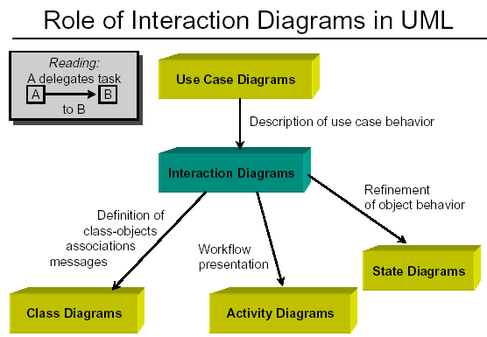

Slide 9
Sequence Diagram
Captures dynamic behavior (time-oriented)
Purpose
  Model flow of control
  Illustrate typical scenarios
A sequence diagram shows
  an interaction arranged in time sequence,
  the objects (not classes)
  and the messages that pass between them when an interaction occurs

Slide 10
OBJECTS are shown in rectangles on the top of the diagrams, Each rectangle contains
Name (always underlined) [objects are underlined not class]
MESSAGES appear as arrows with a text description
objectName:className
getID()
A narrow vertical line called the ACTIVATION represents the period of time an object is actually performing an action
  Directly
  Or through an intermediary (such as another object)
Below each object rectangle, shown with a dotted line, is the LIFELINE, of that object.
A time-ordered visual framework for message exchange between the objects (and with the system)

Slide 11
Message Types
1. Simple Message
  Control is passed from one object to another without providing details
:Sale
Msg()
:Sale
2. Self Message
  A message being sent from an object to itself
Msg()

Slide 12
3. Conditional Message
A condition can be expressed with this message
:Sale
[color=red] calculate()
4. Mutually exclusive conditional messages
  Notation for this kind of message is an angled line emerging from a common point
:Sale
:Product
:Item
[x>10] calculate()
[x<10] calculate()

Slide 13
5. Object destruction message
A message with <<destroy>> stereotype and a short lifeline indicates an explicit object destruction
:Sale
<<destroy>>
:Sale
:Product
6. Return Message
  This message indicates a return from a procedure call
Msg()

Slide 14
Following are the messages that exists in the UML sequence diagrams, along with their graphical representations:
Simple: This is a transfer of control from one object to another.
Synchronous: If an object sends a synchronous message, it waits for an answer to that message before it proceeds with its business.
Asynchronous: If an object sends an asynchronous message, it doesn't wait for an answer before it proceeds.

Slide 15
Sequence Diagram: Example
:Caller
:Operator
:Callee
call
ack
number
time
call
ack
transfer
talk

Slide 16
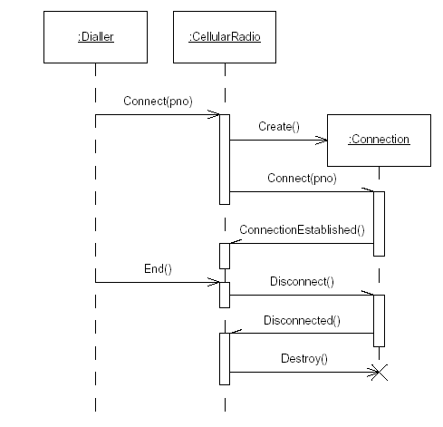

Slide 17
Collaboration Diagram
A Collaboration Diagram also shows the passing of messages between objects BUT focuses on the order of objects and their messages instead of the time sequence
  Basic Notations
    Objects
    Links
    Messages
  Basic Steps
    Identify roles involved
    Identify interactions & concurrent threads
    Sequentially number them and mark with arrows for directions

Slide 18
Collaboration Diagram
1: Picks Up
3: Dial Number
7: Converse
8: Hangs Up
:callSystem
2: Dial Tone
: Caller
5: picks up
4: Ring
6: Converse
: Receiver

Slide 19
Elevator Problem

Slide 20
Problem Statement
A product is to be installed to control n elevators in a building within m floors. The problem concerns the logic required to move elevators between floors according to the following constraints
Each floor , except the first floor and the top floor, has two buttons, one to request an up elevator and one to request a down elevator. These illuminates when pressed. The illumination is cancelled when an elevator visits the floor and then moves in the desired direction
Each elevator has a set of m buttons, one for each floor. These illuminates when pressed and cause the elevator to visit the corresponding floor. The illumination is cancelled when corresponding floor is visited by the elevator
There is a display window that shows the current floor being visited by the elevator
When an elevator has no request, it remains at its current floor with its door closed

Slide 21
Identify Actor, Goals, Use cases
Elevator
Goals
He get authentication and pass the security system
He visits the elevator and wants to move to the destination floor without interruption
Get authenticate
Start elevator
Visitor
Visit Floor

Slide 22
<<UC-1>>Start Elevator SSD
Scenario
Visitor A presses the Up floor button at floor 3 to request an elevator, he wishes to go to floor 7
The up floor button turned on
An elevator arrives at floor 3
The up floor button turn off
The elevator doors open
The timer starts
Visitor A enters the elevator
The elevators door close after the time out
ElevatorSystem:
:Visitor
UpFloorRequest(FloorNo)
ArrivalBeepSound()
CloseDoorBeep()

Slide 23
Partial Domain Model: Elevator Problem
Visitor
Floor
n
*
enters
visits
1
ElevatorDoor
Elevator
1
controls
controls
n
m
FloorButton
ElevatorButton
Illuminate: Boolean
Illuminate: Boolean

Slide 24
<<UC-1>>Start Elevator Sequence Diagram
:ElevatorButton
:Elevator
:ElevatorDoor
:Visitor
UpFloorRequest()
UpFloorRequest(FloorNo)
TurnButtonOn()
MoveFloor()
TurnButtonOff()
OpenDoor()
acknowledgement
StartTimer()
CloseDoor()

Slide 25
<<UC-1>>Start Elevator Collaboration Diagram
:ElevatorButton
:ElevatorDoor
3: Turn Button On
5: Turn Button Off
2: UpFloorRequest
6: Open Door
1: UpFloorRequest
8: Close Door
7: Ack
:Elevator
4: Move to Required Floor
:Visitor

Slide 26
Case study: Rent a car
In order to rent a car first of all customer provides the start date and finish date for the rental and his personal details (name, address and credit card number) as well. All rentals are paid via cash.
Company also provides a facility that if a car is stolen proper assistance and help should be provided to the customer; in this regard they issue a notice that a car is stolen. A clerk may alert the system that a car is now considered to be stolen.
Each week, the clerk will provide a list of the rentals, which have been initiated the previous week, as report to the manager who monitors the over all system flows.
Clerks can also add cars to the system when new cars are purchased by the Company. Store Managers are allowed to delete cars from the system as well. A car is deleted from the system when sold or destroyed in an accident

Slide 27
References
Applying UML and Patterns by Craig Larman
  Chapter 13: 13.1, 13.2, 13,9
  Chapter 15: 15.1, 15.5, 15.6, 15.7
Other Reference
  Object-Oriented and Classical Software Engineering by Stephen. R. Schach
Site Reference
  http://www.agilemodeling.com/artifacts/sequenceDiagram.htm

