Slide 1
Software Automation Testing

Slide 2
Table of Contents:-
1-Introduction to Automation Testing
2-Introduction to Selenium
3-Different flavours in Selenium
4-Introduction to Selenium Webdriver
5-Introduction to Core Java-1
6-Introduction to Junit Framework
7-Locators & Object Identification in Selenium
8-Advanced Webdriver
9-Introduction to TestNG Framework
10-Introduction to Core Java-2
11-Introduction to Robot and Sikuli API
12-Introduction to Apache Log4j API
13-Introduction to Maven
14-Automation Framework Development
15-Continuous Integration Testing using Jenkins

Slide 3
1-Introduction to Automation Testing
1.1-What is Automation Testing
1.2-Why and when will we go for Automation
1.3-Different Kind of Applications in IT to Automate
1.4-Type of Automation Testing
1.5-Automation Testing Tools

Slide 4
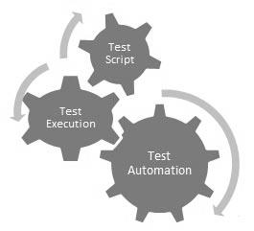
1.1-What is Automation Testing
It is process to automate Manual functional scenarios/TCs using scripts. Where we write scripts once and use whenever we want. Its process to reduce manual effort in software testing.
Automation testing, which is also known as Test Automation, is when the tester writes scripts and uses another software to test the product. This process involves automation of a manual process. Automation Testing is used to re-run the test scenarios that were performed manually, quickly, and repeatedly.
Apart from regression testing, automation testing is also used to test the application from load, performance, and stress point of view. It increases the test coverage, improves accuracy, and saves time and money in comparison to manual testing.

Slide 5
1.2- Why and when will we go for Automation
Test automation can improve the development process of a software product in many cases. The automation of tests is initially associated with increased effort, but the related benefits will quickly pay off.
Following reasons automation testing is required:-
Running tests 24/7:
No matter where you are in the world. You can start the tests when you leave the office and when you get back in the morning you can see the results and keep on working. You can even do that remotely if you don’t have a lot of devices or you don’t have the possibility to buy them.
Fewer human resources:
You don’t need a lot of people: you would need a test automation engineer to write your scripts to automate your tests, instead of a lot of people doing boring manual tests over and over again.
Reusability:
you don’t need new scripts all the time, even if the version of the OS on the device changes
it allows you to redo the test exactly the same, without forgetting any steps
Bugs:
Automation helps you find bugs in the early stages of software development, reducing expenses and working hours to fix these problems as well.
Reliability:
automated testing is more reliable and way quicker when running boring repetitive standardized tests which can not be skipped, ever, but may cause errors when manually tested.
Simultaneity:
you can test more devices simultaneously resulting in comparative detailed reports generated in less time with the exact the same parameters, because the exact same scripts were run.
Continuity:
automated testing helps testers, such as automation engineers. They can see exactly what other engineers have done, what scripts he has already written and what tests have already been performed and what bugs were already found and fixed, through clear reports.
Additional methods:
one of the these methods is the stress test in which the capacities of the application and operational infrastructure will be tested to it’s limits with stress test, which can’t be done manually.
Volume:
automated testing allows to run tests on thousands of mobile devices (more then 18000 devices). Testing all of them manually would be impossible!
In the end you will have a better quality software which will be released earlier, with less problems and you have used less resources.

Slide 6
1.2.1- Why and when will we go for Automation
What to Automate?
It is not possible to automate everything in a software. The areas at which a user can make transactions such as the login form or registration forms, any area where large number of users can access the software simultaneously should be automated.
Furthermore, all GUI items, connections with databases, field validations, etc. can be efficiently tested by automating the manual process.
When to Automate?
Test Automation should be used by considering the following aspects of a software:
• Large and critical projects
• Projects that require testing the same areas frequently
• Requirements not changing frequently
• Accessing the application for load and performance with many virtual users
• Stable software with respect to manual testing
• Availability of time
How to Automate?
Automation is done by using a supportive computer language like VB scripting and an automated software application. There are many tools available that can be used to write automation scripts. Before mentioning the tools, let us identify the process that can be used to automate the testing process:
• Identifying areas within a software for automation
• Selection of appropriate tool for test automation
• Writing test scripts
• Development of test suits
• Execution of scripts
• Create result reports
• Identify any potential bug or performance issues

Slide 7
1.3- Different Kind of Applications in IT to Automate
There are mainly below type of Software Applications we have :-
1-Web-Based Applications (Google, Yahoo)
2-Window Based Applications(MS-Word, Calculator)
3-Client-Based Applications (Gtalk, Yahoo Messenger, FB Messenger)
4-Web-Services-Restbased and SOAPUI(Calculation API)

Slide 8
1.4- Type of Automation Testing
1-Functional automation testing-
In this testing we ensure application behaves as per the functional requirement and we check links, buttons are working fine without considering how much time they are taking.
2-Performacre automation testing-
We ensure the server response time. When we do any action on the web elements after that we verify how much time server takes to response us to show next window. We also do this testing using load and Stress testing where we increase number of users (they can be 2000) and check server response time.

Slide 9
1.5- Automation Testing Tools
There are below 2 types of Automaton Testing Tools in the market:-
1-Paid Tools/Licensed tools – We need to pay license cost to use theses kind of tools. A dedicated and authorized company give these tools after purchasing the license cost.
2-Free/ Open Source tools – We can use these kind of tools free without paying any thing. These are open source and we can download and use them directly.
There are mainly below 3 types of Automation Testing Tools:-
1-Functional Automation Testing- Below are the Functional Automation Testing Tools:-
HP Quick Test Professional (Paid)
Selenium (Free/Open Source)
IBM Rational Functional Tester (Paid)
Silk Test (Paid)
Test Complete (Paid)
2-Performance Automaton Testing Tool
LoadRunner (Paid)
Jmter(Free)
2-Mobile Automaton Testing Tool
Appium for Android and iOS (Free)
Calabash for Android and iOS (Free)
PerfectoMobile for Android and iOS (Paid)
2-WebService Automaton Testing Tool
SoapUI NG Pro (Paid)
HP QTP(UFT) (Paid)
Postman(Free)
HttpMaster(Free)

Slide 10
2-Introduction to Selenium
2.1-What is Selenium and its different flavors
2.2-Difference between Selenium and OTP (other tools available in the Market)
2.3-How Selenium Automate Application

Slide 11
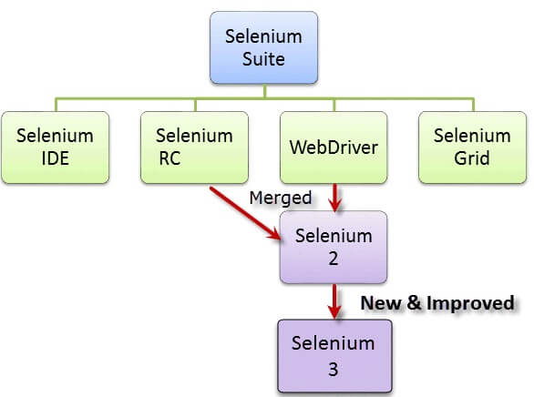
2.1-What is Selenium and its different flavors
Selenium is a functional automation testing tool. It is free/ open source tool. It is used to automate web-based application only.
Selenium is not just a single tool but a suite of software's, each catering to different testing needs of an organization. It has four components.
1- Selenium IDE- It is an plug in of Firefox browser and it is used just for recording and playing the scripts.
2-Selenium RC- - Selenium Remote Control. Which was used before 2.0 release of selenium. In selenium RC we need to start selenium server form the CMD/Dos prompts
3-Selenium Webdriver- It is the selenium version from 2.0. In webdriver we don’t need to start selenium server to interact with web-browser. It does not have a pre-defined UI. We create its UI for scripts. We create its UI using any programming language (Java, C#)
4-Selenium Grid- It is used for parallel execution or multiple scripts execution on the same time, on the same machine in different browsers, on the different machine in different browsers. Using hub and node approach we execute the scripts on the parallel .

Slide 12
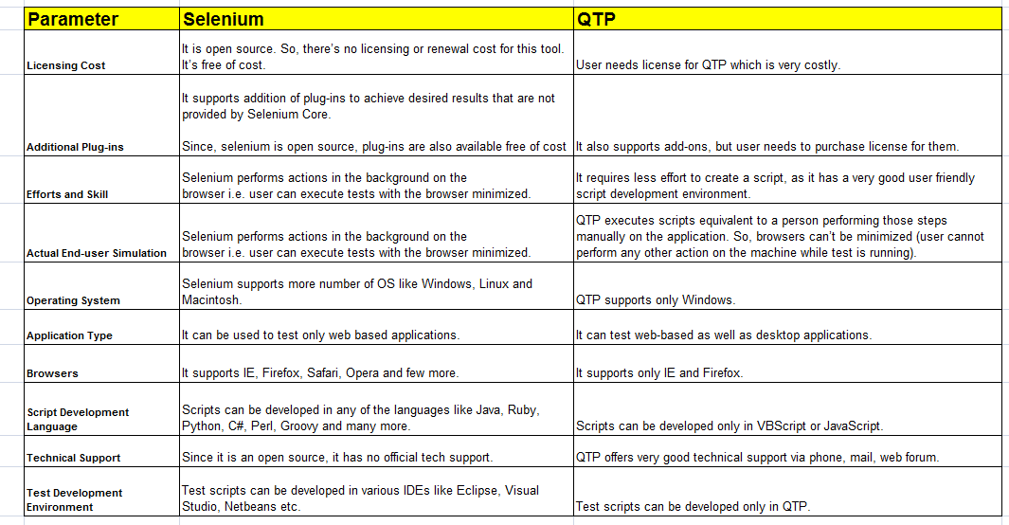
2.2-Difference between Selenium and OTP (other tools available in the Market)

Slide 13
2.3-How Selenium Automate Application
How selenium automates the application.
1-Selenium Launch the web browser
2-Selenium Launch the application on the web browser
Ex-Yahoo, Google
3-Selenium finds the element on the web-page
Ex-Button, links , Input box, Text-on page
3.2-Using locator type selenium finds the elements
1-id
2-xpath
3-lintext
4-css
4-Selenium perform action on the located elements using its pre-defined below methods:
A-click
B-Sendkeys
C-Gettext, Getvalue etc
5-Verification Points to Verify expected Results are coming or not.
Ex- Confirmation Page is coming after doing login successfully.
6-Selenium Close the application with web-browser

Slide 14
3-Introduction to Selenium IDE
3.1-What is Selenium IDE
3.2-Important Features of Selenium IDE
3.3-What are commends in Selenium IDE

Slide 15
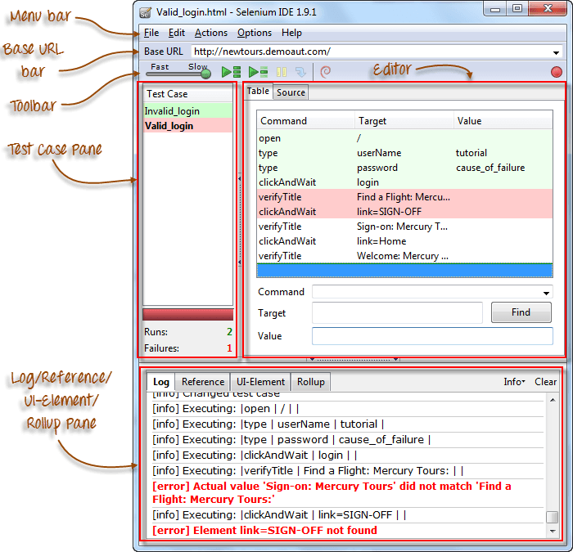
3.1-What is Selenium IDE
Selenium IDE is simple, easy to learn & portable record and play tool for web applications.
Learning curve for Selenium IDE is less & no need to learn test scripting language. It is open-source tool & available for download for free.
Selenium IDE means Integrated Development Environment (IDE) used for selenium tests.
It is come in terms of Firefox extension & used for recording, editing & playback scripts.
Installation of Selenium IDE:-
To learn Selenium-IDE, first you have to download Firefox & Selenium IDE extension on Firefox. Here are the simple steps to be followed to install Selenium IDE:
Download Firefox browser (if required)
Get Selenium IDE here.

Slide 16
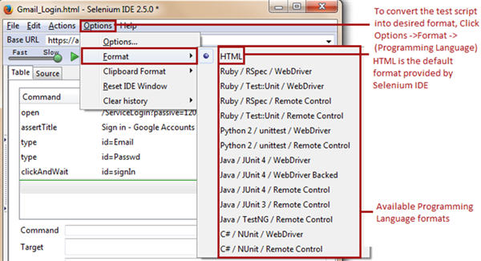
3.2-Important Features of Selenium IDE
Features of Selenium IDE:
1-Easy record and playback – You can record and play your scripts.
2-Using Start point-Selenium IDE allows the user to specify a start point within a test script. The start point points to the test step from where we wish to start the test script execution.
3-Using Break point-Selenium IDE allows the user to specify break points within a test script. The break points indicate Selenium IDE where to pause the test script.
4-Using Find Button-One of the most crucial aspects of Selenium IDE test scripts is to find and locate web elements within a web page. At times, there are web elements which have analogous properties associated with them, thus making it challenging for a user to identify a particular web element uniquely.
5-Export and Convert Script in other Formats-Selenium IDE supports conversion test scripts into set of programming languages from a default type (HTML). The converted test scripts is used in Selenium Web-Driver environment. It cannot be played back using Selenium IDE until and unless it is reverted back to HTML. Following way and in following programming languages scripts can be converted:-

Slide 17
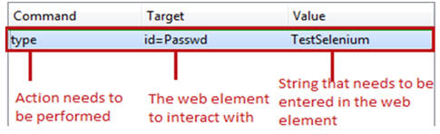
3.3-What are commends in Selenium IDE
Each Selenium IDE test step can chiefly be split into following three components:
Command
Target
Value
Types of Selenium IDE commands-
There are three flavors of Selenium IDE commands. Each of the test step in Selenium IDE falls under any of the following category.
Actions- Actions are those commands which interact directly with the application by either altering its state or by pouring some test data
Accessors- Accessors are those commands which allows user to store certain values to a user defined variable. These stored values can be later on used to create assertions and verifications.
For example, “storeAllLinks” reads and stores all the hyperlinks available within a web page into a user defined variable. Remember the variable is of array type if there are multiple values to store.
Assertions-Assertions are very similar to Accessors as they do not interact with the application directly. Assertions are used to verify the current state of the application with an expected state.
Forms of Assertions:
#1. assert – the “assert” command makes sure that the test execution is terminated in case of failure.
#2. verify – the “verify” command lets the Selenium IDE to carry on with the test script execution even if the verification is failed.
#3. waitFor – the “waitFor” command waits for a certain condition to be met before executing the next test step. The conditions are like page to be loaded, element to be present. It allows the test execution to proceed even if the condition is not met within the stipulated waiting period.

Slide 18
4- Introduction to Selenium Web-Driver
4.1-What is Web-Driver?
4.2-What is the difference between Selenium IDE, RC and WD?
4.3-Downloading web driver Jars configuring in eclipse
4.4-Create few examples using Webdriver
4.5-Drivers for Firefox, IE, Chrome
4.6-Architecture of Selenium WebDriver

Slide 19
4.1-What is Web-Driver?
Web-Driver is a web automation framework that allows you to execute your tests against different browsers, not just Firefox (unlike Selenium IDE).
WebDriver also enables you to use a programming language in creating your test scripts (not possible in Selenium IDE).
You can now use conditional operations like if-then-else or switch-case
You can also perform looping like do-while.
Following programming languages are supported by WebDriver
Java
.Net
PHP
Python
Perl
Ruby
Advantages of Selenium Web-Driver:
Improved features & functionality which were not supported in the Selenium 1.0.
No need to start server prior to start executing scripts.
Added advantage to support for iPhone and Android testing
Similar to QTP, It allows you to extract the objects in bulk. In RC this is big pain to extracting the objects.
It supports features like Page navigation, Drag-and-drop and AJAX-based UI elements.
Using WebDriver can easily find the coordinates of any object.
WebDriver is open source & it allows you to easily integrate with testing framework like JUnit or TestNG.
It allows you to simulate the mouse movements.
It provides the improved reliability between browsers.
A most awaiting feature added in WebDriver is “Implementation of listeners”.
For web application testing, it provides standard programming interface.
It allows you to simulate keyboard key press events using different classes.
You have classes in Webdriver which help you to simulate key press events of keyboard.
It allows you to simulate the clicking of browser front and back button.

Slide 20
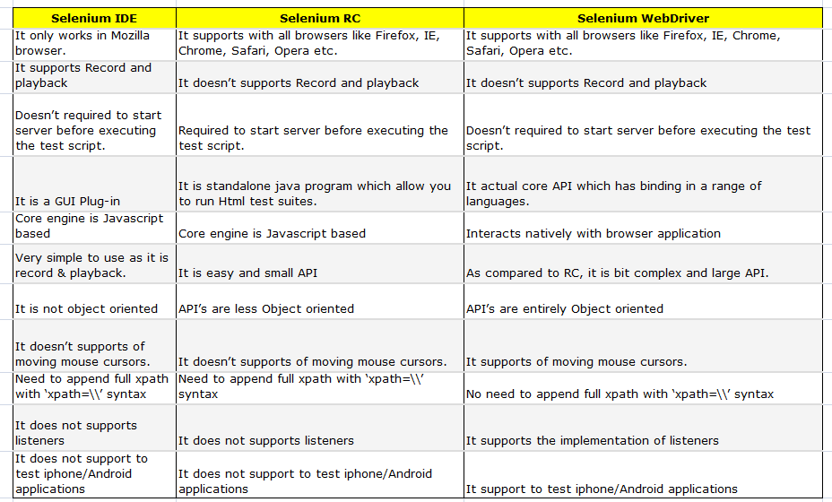
4.2-What is the difference between Selenium IDE, RC and WD?

Slide 21
4.3.1-Downloading and Configuring Web-Driver
Configuring Web-Driver
Web-Driver is supported by multiple languages and to configure Web-Driver we need to install every language IDE (Integrated Environment) then we configure Web-Driver. Find below the following language and ide:-
Java-Eclipse , 2- Net- Visual Studio, 3-PHP-PHPStorm, 4- Python- Pydev with Eclipse
As we would be using Java as the programming language ,We need to follow following steps to configure Selenium Webdriver in JAVA IDE Eclipse:-
Step 1
In the first step, download and install JDK (Java Development Kit) in your system.
For downloading Java, you need to visit the following link:
http://www.oracle.com/technetwork/java/javase/downloads/index.html
Step 2
In the second step, download and install Eclipse from the link below:
http://www.eclipse.org/downloads/
Step 3
In the step, download Selenium Standalone Server from the link below:
The Selenium Server is needed in order to run Remote Selenium WebDriver. Selenium 3.X is no longer capable of running Selenium RC directly, rather it does it through emulation and the WebDriverBackedSelenium interface.
http://docs.seleniumhq.org/download/
Step 4
Download the Selenium Java Client Driver from:-
In order to create scripts that interact with the Selenium Server (Selenium RC, Selenium Remote WebDriver) or create local Selenium WebDriver scripts, you need to make use of language-specific client drivers. These languages include both 1.x and 2.x style clients.
http://docs.seleniumhq.org/download/
Step 4.1
When using Selenium 3 , you have to download geckodriver. Just like the other drivers available to Selenium, Mozilla has released geckodriver executable that will run alongside the browser.
https://github.com/mozilla/geckodriver/releases

Slide 22
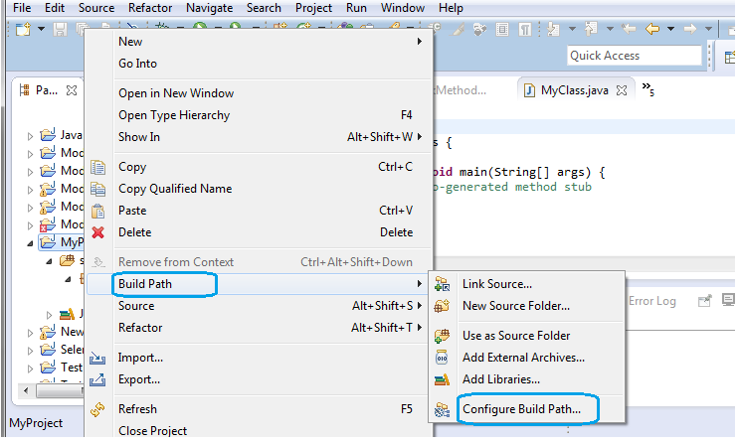
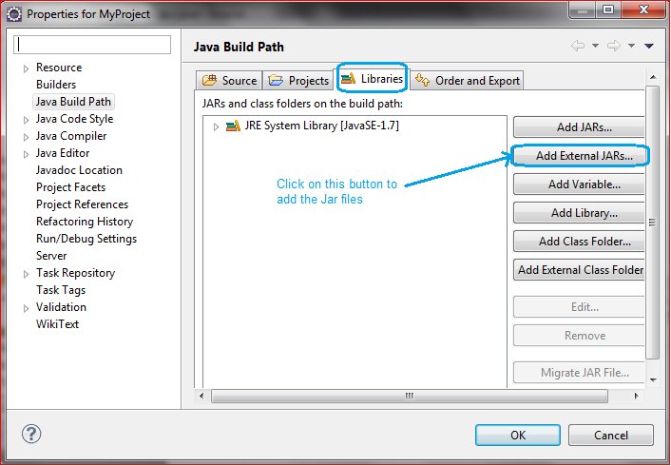
4.3.2-Downloading and Configuring Web-Driver
Step 5
Configure Eclipse to work with Webdriver:
Double click on ‘Eclipse.exe’ to launch eclipse
When asked to select for a workspace, just accept the default location. Or, you can change the location
Create a new project through File ? New ? Java Project. Name the project as “MyProject”.
Right-click on the newly created project and select New > Package, and name that package as “MyPackage”.
Create a new Java class under MyPackage by right-clicking on it and then selecting New > Class, and then name it as “MyClass”.
Step 6
Add Jar Files to the Library:
Right-click on MyProject and select “Build Path” and then “Configure Build Path”. This will open the Libraries tab in Properties dialog. Then on click “Add External JARs...”
Navigate to D:\selenium-2.43.0\ (or any other location where you saved the extracted contents of “selenium-2.43.0.zip”).
Add all the JAR files inside and outside the “libs” folder.
Finally, click on the OK button and we are done with importing Selenium libraries into our project. Now, we are ready to write our test script in Eclipse and run it in WebDriver
Now you can create a new class and do webdriver script writing.

Slide 23
4.4-Create few examples using Web-Driver
I will give one simple example of creating a web-driver script with explanation in the form of comments. For this, we need to write the following code into Eclipse:-
package MyPackage;
import java.util.concurrent.TimeUnit;
import org.openqa.selenium.By;
import org.openqa.selenium.WebDriver;
import org.openqa.selenium.firefox.FirefoxDriver;
public class MyClass {
public static void main(String[] args) {
// Create a new instance of the Firefox driver
WebDriver driver = new FirefoxDriver();
// Wait For Page To Load
// Put a Implicit wait, this means that any search for elements on the page
could take the time the implicit wait is set for before throwing exception
driver.manage().timeouts().implicitlyWait(10, TimeUnit.SECONDS);
// Navigate to URL
driver.get("https://mail.google.com/");
// Maximize the window.
driver.manage().window().maximize();
// Enter UserName
driver.findElement(By.id("Email")).sendKeys(" YOUR USER NAME");
// Enter Password
driver.findElement(By.id("Passwd")).sendKeys("YOUR PASSWORD");
// Wait For Page To Load
driver.manage().timeouts().implicitlyWait(60, TimeUnit.SECONDS);
// Click on 'Sign In' button
driver.findElement(By.id("signIn")).click();
//Click on Compose Mail.
driver.findElement(By.xpath("//div[@class='z0']/div")).click();
// Click on the image icon present in the top right navigational Bar
driver.findElement(By.xpath("//div[@class='gb_1 gb_3a gb_nc gb_e']/div/a")).click();
//Click on 'Logout' Button
driver.findElement(By.xpath("//*[@id='gb_71']")).click();
//Close the browser.
driver.close();}}

Slide 24
4.5-Create examples for Firefox, IE, Chrome
First of all, download latest version of IEDriver server/ChromeDriver Server exe files for webdriver. You can download latest version server exe files from here:-
ChromeDriver-https://sites.google.com/a/chromium.org/chromedriver/downloads
IEDriver-http://docs.seleniumhq.org/download/
Note: Choose the IEdriver server based on your working environment as there are two different zip files for both 32 and 64 bit IE . Recommended 32bit IEDriver which is less prone to errors when compared with 64bit driver.
Save the downloaded file to your local machine.
In you code you need to set the system property for IE driver/ChromeDriver as:-
System.setProperty("webdriver.chrome.driver", "pathofchromedriver\\chromedriver.exe");
System.setProperty("webdriver.ie.driver", "pathofchromedriver\\IEDriverServer.exe");
Create New Java Class as 'CrossBrowser' name and add following:-
Run this class as a Java Applica
public class cross_browser
{
public static void main(String []args) throws InterruptedException
{
WebDriver driver2;
String baseUrl;
baseUrl = "https://www.flipkart.com/";
System.out.println("launching Brower browser");
System.setProperty("webdriver.firefox.marionette","D:\\Selenium jar\\Selenium-3.4.0\\geckodriver.exe");
System.setProperty("webdriver.chrome.driver2", "D:\\Automation_Workshop_2017\\Selenium_exe\\chromedriver.exe");
System.setProperty("webdriver.ie.driver2", "D:\\Automation_Workshop_2017\\Selenium_exe\\IEDriverServer.exe");
System.setProperty("webdriver.opera.driver2", "D:\\Automation_Workshop_2017\\Selenium_exe\\operadriver.exe");
driver2 = new FirefoxDriver();
//driver2 = new InternetExplorerDriver();
//driver2 = new ChromeDriver();
//driver2 = new OperaDriver();
driver2.get(baseUrl);
driver2.findElement(By.cssSelector("input[name=q]")).sendKeys("wallet");
driver2.findElement(By.cssSelector("button.vh79eN[type=submit]")).click();
Thread.sleep(3000);
driver2.findElement(By.xpath("//div[@id='container']/div/div[2]/div[2]/div/div[2]/div/div[2]/div/section/ul/li[2]")).click();
driver2.findElement(By.name("//div[@id='container']/div/div[2]/div[2]/div/div[2]/div/div[2]/div/section/ul/li[2]")).click();
Thread.sleep(3000);
//System.out.println("Page title: - "+strPageTitle);
driver2.quit();
}
}

Slide 25
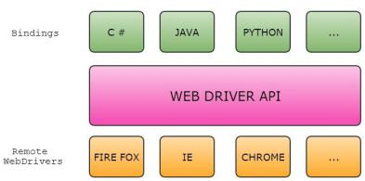

4.6-Architecture of Selenium Web-Driver
Selenium WebDriver:
Selenium-WebDriver makes direct calls to the browser using each browser’s native support for automation.
Since there are so many browsers & so many programming languages there is need for common specification which will be provided by WebDriver API.
Each browser has to implement this API which is called as Remote WebDriver or Remote WebDriver Server.
At a higher level Selenium WebDriver architecture look like this:-
The language binding will send the commands across the common driver API, on the other end there is going to be a driver listening to those commands and they will be executed in browser using remote WebDriver and it’s going to return the result/response via API to the code/Binding.
Actually whatever the commands issued in the code will be interpreted into Webservice methods (JSON Wired Protocol) and the Remote Driver will receive the HTTP request (commands) and execute them in the browser then send the response back.
Example:
Let’s take a sample code and see how the data flows between Client bindings, Server.
driver.get("http://www.google.com");
The client library, as soon as it receives the preceding command, will convert it to the JSON format (shown below) and communicate with the Firefox Driver/Remote WebDriver.
http://localhost:7705/ { "url": "http://www.google.com" }
Firefox Driver will speak to the Firefox browser natively, and then the browser will send a request for the asked URL to load.

