Slide 1
Software Automation Testing

Slide 2
Table of Contents:-
1-Introduction to Automation Testing
2-Introduction to Selenium
3-Different flavours in Selenium
4-Introduction to Selenium Webdriver
5-Introduction to Core Java-1
6-Introduction to Junit Framework
7-Locators & Object Identification in Selenium
8-Advanced Webdriver
9-Introduction to TestNG Framework
10-Introduction to Core Java-2
11-Introduction to Robot and Sikuli API
12-Introduction to Apache Log4j API
13-Introduction to Maven
14-Automation Framework Development
15-Continuous Integration Testing using Jenkins

Slide 3
1-Introduction to Automation Testing
1.1-What is Automation Testing
1.2-Why and when will we go for Automation
1.3-Different Kind of Applications in IT to Automate
1.4-Type of Automation Testing
1.5-Automation Testing Tools

Slide 4
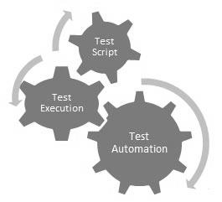
1.1-What is Automation Testing
It is process to automate Manual functional scenarios/TCs using scripts. Where we write scripts once and use whenever we want. Its process to reduce manual effort in software testing.
Automation testing, which is also known as Test Automation, is when the tester writes scripts and uses another software to test the product. This process involves automation of a manual process. Automation Testing is used to re-run the test scenarios that were performed manually, quickly, and repeatedly.
Apart from regression testing, automation testing is also used to test the application from load, performance, and stress point of view. It increases the test coverage, improves accuracy, and saves time and money in comparison to manual testing.

Slide 5
1.2- Why and when will we go for Automation
Test automation can improve the development process of a software product in many cases. The automation of tests is initially associated with increased effort, but the related benefits will quickly pay off.
Following reasons automation testing is required:-
Running tests 24/7:
No matter where you are in the world. You can start the tests when you leave the office and when you get back in the morning you can see the results and keep on working. You can even do that remotely if you don’t have a lot of devices or you don’t have the possibility to buy them.
Fewer human resources:
You don’t need a lot of people: you would need a test automation engineer to write your scripts to automate your tests, instead of a lot of people doing boring manual tests over and over again.
Reusability:
you don’t need new scripts all the time, even if the version of the OS on the device changes
it allows you to redo the test exactly the same, without forgetting any steps
Bugs:
Automation helps you find bugs in the early stages of software development, reducing expenses and working hours to fix these problems as well.
Reliability:
automated testing is more reliable and way quicker when running boring repetitive standardized tests which can not be skipped, ever, but may cause errors when manually tested.
Simultaneity:
you can test more devices simultaneously resulting in comparative detailed reports generated in less time with the exact the same parameters, because the exact same scripts were run.
Continuity:
automated testing helps testers, such as automation engineers. They can see exactly what other engineers have done, what scripts he has already written and what tests have already been performed and what bugs were already found and fixed, through clear reports.
Additional methods:
one of the these methods is the stress test in which the capacities of the application and operational infrastructure will be tested to it’s limits with stress test, which can’t be done manually.
Volume:
automated testing allows to run tests on thousands of mobile devices (more then 18000 devices). Testing all of them manually would be impossible!
In the end you will have a better quality software which will be released earlier, with less problems and you have used less resources.

Slide 6
1.2.1- Why and when will we go for Automation
What to Automate?
It is not possible to automate everything in a software. The areas at which a user can make transactions such as the login form or registration forms, any area where large number of users can access the software simultaneously should be automated.
Furthermore, all GUI items, connections with databases, field validations, etc. can be efficiently tested by automating the manual process.
When to Automate?
Test Automation should be used by considering the following aspects of a software:
• Large and critical projects
• Projects that require testing the same areas frequently
• Requirements not changing frequently
• Accessing the application for load and performance with many virtual users
• Stable software with respect to manual testing
• Availability of time
How to Automate?
Automation is done by using a supportive computer language like VB scripting and an automated software application. There are many tools available that can be used to write automation scripts. Before mentioning the tools, let us identify the process that can be used to automate the testing process:
• Identifying areas within a software for automation
• Selection of appropriate tool for test automation
• Writing test scripts
• Development of test suits
• Execution of scripts
• Create result reports
• Identify any potential bug or performance issues

Slide 7
1.3- Different Kind of Applications in IT to Automate
There are mainly below type of Software Applications we have :-
1-Web-Based Applications (Google, Yahoo)
2-Window Based Applications(MS-Word, Calculator)
3-Client-Based Applications (Gtalk, Yahoo Messenger, FB Messenger)
4-Web-Services-Restbased and SOAPUI(Calculation API)

Slide 8
1.4- Type of Automation Testing
1-Functional automation testing-
In this testing we ensure application behaves as per the functional requirement and we check links, buttons are working fine without considering how much time they are taking.
2-Performacre automation testing-
We ensure the server response time. When we do any action on the web elements after that we verify how much time server takes to response us to show next window. We also do this testing using load and Stress testing where we increase number of users (they can be 2000) and check server response time.

Slide 9
1.5- Automation Testing Tools
There are below 2 types of Automaton Testing Tools in the market:-
1-Paid Tools/Licensed tools – We need to pay license cost to use theses kind of tools. A dedicated and authorized company give these tools after purchasing the license cost.
2-Free/ Open Source tools – We can use these kind of tools free without paying any thing. These are open source and we can download and use them directly.
There are mainly below 3 types of Automation Testing Tools:-
1-Functional Automation Testing- Below are the Functional Automation Testing Tools:-
HP Quick Test Professional (Paid)
Selenium (Free/Open Source)
IBM Rational Functional Tester (Paid)
Silk Test (Paid)
Test Complete (Paid)
2-Performance Automaton Testing Tool
LoadRunner (Paid)
Jmter(Free)
2-Mobile Automaton Testing Tool
Appium for Android and iOS (Free)
Calabash for Android and iOS (Free)
PerfectoMobile for Android and iOS (Paid)
2-WebService Automaton Testing Tool
SoapUI NG Pro (Paid)
HP QTP(UFT) (Paid)
Postman(Free)
HttpMaster(Free)

Slide 10
2-Introduction to Selenium
2.1-What is Selenium and its different flavors
2.2-Difference between Selenium and OTP (other tools available in the Market)
2.3-How Selenium Automate Application

Slide 11
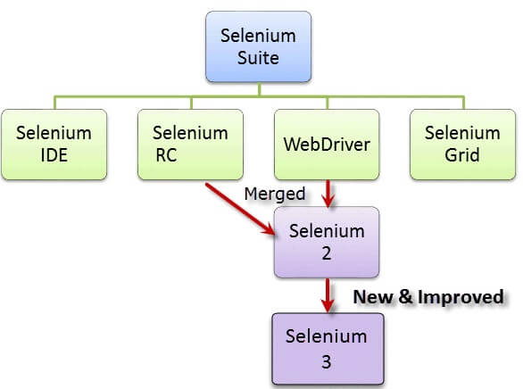
2.1-What is Selenium and its different flavors
Selenium is a functional automation testing tool. It is free/ open source tool. It is used to automate web-based application only.
Selenium is not just a single tool but a suite of software's, each catering to different testing needs of an organization. It has four components.
1- Selenium IDE- It is an plug in of Firefox browser and it is used just for recording and playing the scripts.
2-Selenium RC- - Selenium Remote Control. Which was used before 2.0 release of selenium. In selenium RC we need to start selenium server form the CMD/Dos prompts
3-Selenium Webdriver- It is the selenium version from 2.0. In webdriver we don’t need to start selenium server to interact with web-browser. It does not have a pre-defined UI. We create its UI for scripts. We create its UI using any programming language (Java, C#)
4-Selenium Grid- It is used for parallel execution or multiple scripts execution on the same time, on the same machine in different browsers, on the different machine in different browsers. Using hub and node approach we execute the scripts on the parallel .

Slide 12
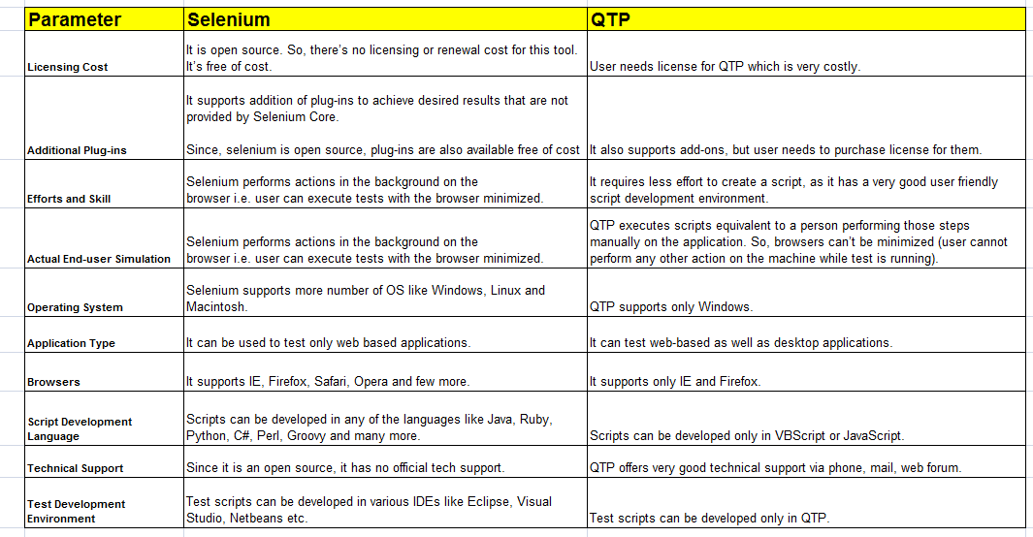
2.2-Difference between Selenium and OTP (other tools available in the Market)

Slide 13
2.3-How Selenium Automate Application
How selenium automates the application.
1-Selenium Launch the web browser
2-Selenium Launch the application on the web browser
Ex-Yahoo, Google
3-Selenium finds the element on the web-page
Ex-Button, links , Input box, Text-on page
3.2-Using locator type selenium finds the elements
1-id
2-xpath
3-lintext
4-css
4-Selenium perform action on the located elements using its pre-defined below methods:
A-click
B-Sendkeys
C-Gettext, Getvalue etc
5-Verification Points to Verify expected Results are coming or not.
Ex- Confirmation Page is coming after doing login successfully.
6-Selenium Close the application with web-browser

Slide 14
3-Introduction to Selenium IDE
3.1-What is Selenium IDE
3.2-Important Features of Selenium IDE
3.3-What are commends in Selenium IDE

Slide 15
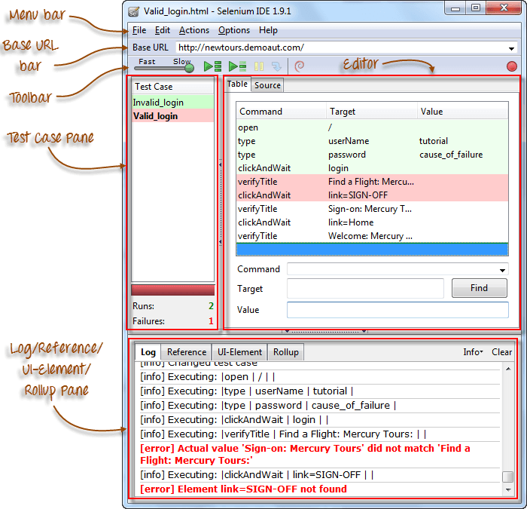
3.1-What is Selenium IDE
Selenium IDE is simple, easy to learn & portable record and play tool for web applications.
Learning curve for Selenium IDE is less & no need to learn test scripting language. It is open-source tool & available for download for free.
Selenium IDE means Integrated Development Environment (IDE) used for selenium tests.
It is come in terms of Firefox extension & used for recording, editing & playback scripts.
Installation of Selenium IDE:-
To learn Selenium-IDE, first you have to download Firefox & Selenium IDE extension on Firefox. Here are the simple steps to be followed to install Selenium IDE:
Download Firefox browser (if required)
Get Selenium IDE here.

Slide 16
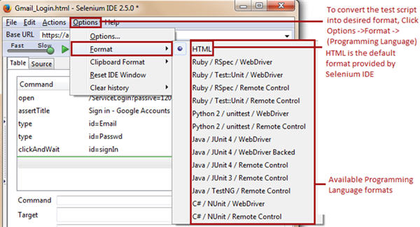
3.2-Important Features of Selenium IDE
Features of Selenium IDE:
1-Easy record and playback – You can record and play your scripts.
2-Using Start point-Selenium IDE allows the user to specify a start point within a test script. The start point points to the test step from where we wish to start the test script execution.
3-Using Break point-Selenium IDE allows the user to specify break points within a test script. The break points indicate Selenium IDE where to pause the test script.
4-Using Find Button-One of the most crucial aspects of Selenium IDE test scripts is to find and locate web elements within a web page. At times, there are web elements which have analogous properties associated with them, thus making it challenging for a user to identify a particular web element uniquely.
5-Export and Convert Script in other Formats-Selenium IDE supports conversion test scripts into set of programming languages from a default type (HTML). The converted test scripts is used in Selenium Web-Driver environment. It cannot be played back using Selenium IDE until and unless it is reverted back to HTML. Following way and in following programming languages scripts can be converted:-

Slide 17
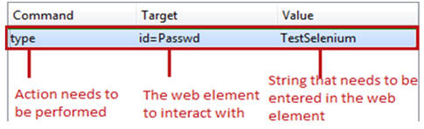
3.3-What are commends in Selenium IDE
Each Selenium IDE test step can chiefly be split into following three components:
Command
Target
Value
Types of Selenium IDE commands-
There are three flavors of Selenium IDE commands. Each of the test step in Selenium IDE falls under any of the following category.
Actions- Actions are those commands which interact directly with the application by either altering its state or by pouring some test data
Accessors- Accessors are those commands which allows user to store certain values to a user defined variable. These stored values can be later on used to create assertions and verifications.
For example, “storeAllLinks” reads and stores all the hyperlinks available within a web page into a user defined variable. Remember the variable is of array type if there are multiple values to store.
Assertions-Assertions are very similar to Accessors as they do not interact with the application directly. Assertions are used to verify the current state of the application with an expected state.
Forms of Assertions:
#1. assert – the “assert” command makes sure that the test execution is terminated in case of failure.
#2. verify – the “verify” command lets the Selenium IDE to carry on with the test script execution even if the verification is failed.
#3. waitFor – the “waitFor” command waits for a certain condition to be met before executing the next test step. The conditions are like page to be loaded, element to be present. It allows the test execution to proceed even if the condition is not met within the stipulated waiting period.

Slide 18
4- Introduction to Selenium Web-Driver
4.1-What is Web-Driver?
4.2-What is the difference between Selenium IDE, RC and WD?
4.3-Downloading web driver Jars configuring in eclipse
4.4-Create few examples using Webdriver
4.5-Drivers for Firefox, IE, Chrome
4.6-Architecture of Selenium WebDriver

Slide 19
4.1-What is Web-Driver?
Web-Driver is a web automation framework that allows you to execute your tests against different browsers, not just Firefox (unlike Selenium IDE).
WebDriver also enables you to use a programming language in creating your test scripts (not possible in Selenium IDE).
You can now use conditional operations like if-then-else or switch-case
You can also perform looping like do-while.
Following programming languages are supported by WebDriver
Java
.Net
PHP
Python
Perl
Ruby
Advantages of Selenium Web-Driver:
Improved features & functionality which were not supported in the Selenium 1.0.
No need to start server prior to start executing scripts.
Added advantage to support for iPhone and Android testing
Similar to QTP, It allows you to extract the objects in bulk. In RC this is big pain to extracting the objects.
It supports features like Page navigation, Drag-and-drop and AJAX-based UI elements.
Using WebDriver can easily find the coordinates of any object.
WebDriver is open source & it allows you to easily integrate with testing framework like JUnit or TestNG.
It allows you to simulate the mouse movements.
It provides the improved reliability between browsers.
A most awaiting feature added in WebDriver is “Implementation of listeners”.
For web application testing, it provides standard programming interface.
It allows you to simulate keyboard key press events using different classes.
You have classes in Webdriver which help you to simulate key press events of keyboard.
It allows you to simulate the clicking of browser front and back button.

Slide 20
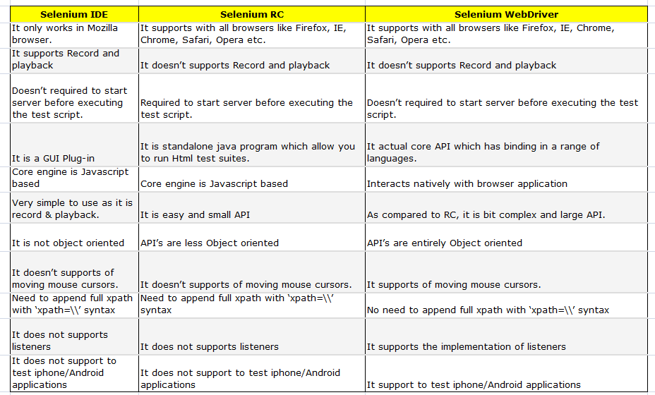
4.2-What is the difference between Selenium IDE, RC and WD?

Slide 21
4.3.1-Downloading and Configuring Web-Driver
Configuring Web-Driver
Web-Driver is supported by multiple languages and to configure Web-Driver we need to install every language IDE (Integrated Environment) then we configure Web-Driver. Find below the following language and ide:-
Java-Eclipse , 2- Net- Visual Studio, 3-PHP-PHPStorm, 4- Python- Pydev with Eclipse
As we would be using Java as the programming language ,We need to follow following steps to configure Selenium Webdriver in JAVA IDE Eclipse:-
Step 1
In the first step, download and install JDK (Java Development Kit) in your system.
For downloading Java, you need to visit the following link:
http://www.oracle.com/technetwork/java/javase/downloads/index.html
Step 2
In the second step, download and install Eclipse from the link below:
http://www.eclipse.org/downloads/
Step 3
In the step, download Selenium Standalone Server from the link below:
The Selenium Server is needed in order to run Remote Selenium WebDriver. Selenium 3.X is no longer capable of running Selenium RC directly, rather it does it through emulation and the WebDriverBackedSelenium interface.
http://docs.seleniumhq.org/download/
Step 4
Download the Selenium Java Client Driver from:-
In order to create scripts that interact with the Selenium Server (Selenium RC, Selenium Remote WebDriver) or create local Selenium WebDriver scripts, you need to make use of language-specific client drivers. These languages include both 1.x and 2.x style clients.
http://docs.seleniumhq.org/download/
Step 4.1
When using Selenium 3 , you have to download geckodriver. Just like the other drivers available to Selenium, Mozilla has released geckodriver executable that will run alongside the browser.
https://github.com/mozilla/geckodriver/releases

Slide 22
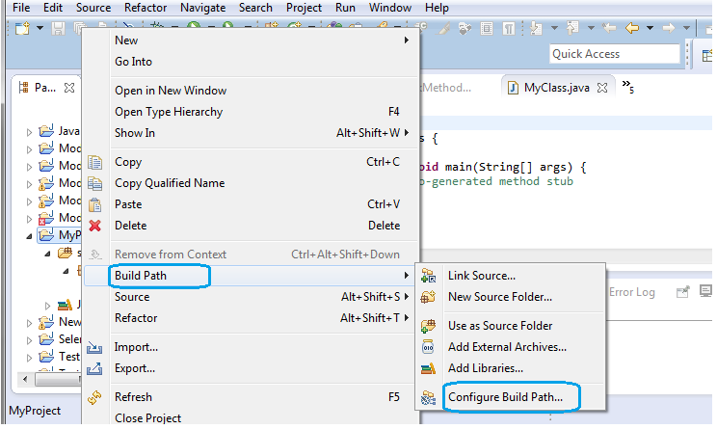
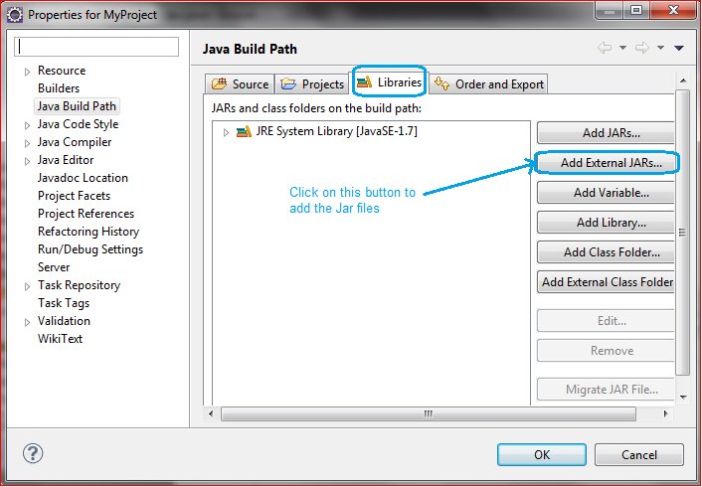
4.3.2-Downloading and Configuring Web-Driver
Step 5
Configure Eclipse to work with Webdriver:
Double click on ‘Eclipse.exe’ to launch eclipse
When asked to select for a workspace, just accept the default location. Or, you can change the location
Create a new project through File ? New ? Java Project. Name the project as “MyProject”.
Right-click on the newly created project and select New > Package, and name that package as “MyPackage”.
Create a new Java class under MyPackage by right-clicking on it and then selecting New > Class, and then name it as “MyClass”.
Step 6
Add Jar Files to the Library:
Right-click on MyProject and select “Build Path” and then “Configure Build Path”. This will open the Libraries tab in Properties dialog. Then on click “Add External JARs...”
Navigate to D:\selenium-2.43.0\ (or any other location where you saved the extracted contents of “selenium-2.43.0.zip”).
Add all the JAR files inside and outside the “libs” folder.
Finally, click on the OK button and we are done with importing Selenium libraries into our project. Now, we are ready to write our test script in Eclipse and run it in WebDriver
Now you can create a new class and do webdriver script writing.

Slide 23
4.4-Create few examples using Web-Driver
I will give one simple example of creating a web-driver script with explanation in the form of comments. For this, we need to write the following code into Eclipse:-
package MyPackage;
import java.util.concurrent.TimeUnit;
import org.openqa.selenium.By;
import org.openqa.selenium.WebDriver;
import org.openqa.selenium.firefox.FirefoxDriver;
public class MyClass {
public static void main(String[] args) {
// Create a new instance of the Firefox driver
WebDriver driver = new FirefoxDriver();
// Wait For Page To Load
// Put a Implicit wait, this means that any search for elements on the page
could take the time the implicit wait is set for before throwing exception
driver.manage().timeouts().implicitlyWait(10, TimeUnit.SECONDS);
// Navigate to URL
driver.get("https://mail.google.com/");
// Maximize the window.
driver.manage().window().maximize();
// Enter UserName
driver.findElement(By.id("Email")).sendKeys(" YOUR USER NAME");
// Enter Password
driver.findElement(By.id("Passwd")).sendKeys("YOUR PASSWORD");
// Wait For Page To Load
driver.manage().timeouts().implicitlyWait(60, TimeUnit.SECONDS);
// Click on 'Sign In' button
driver.findElement(By.id("signIn")).click();
//Click on Compose Mail.
driver.findElement(By.xpath("//div[@class='z0']/div")).click();
// Click on the image icon present in the top right navigational Bar
driver.findElement(By.xpath("//div[@class='gb_1 gb_3a gb_nc gb_e']/div/a")).click();
//Click on 'Logout' Button
driver.findElement(By.xpath("//*[@id='gb_71']")).click();
//Close the browser.
driver.close();}}

Slide 24
4.5-Create examples for Firefox, IE, Chrome
First of all, download latest version of IEDriver server/ChromeDriver Server exe files for webdriver. You can download latest version server exe files from here:-
ChromeDriver-https://sites.google.com/a/chromium.org/chromedriver/downloads
IEDriver-http://docs.seleniumhq.org/download/
Note: Choose the IEdriver server based on your working environment as there are two different zip files for both 32 and 64 bit IE . Recommended 32bit IEDriver which is less prone to errors when compared with 64bit driver.
Save the downloaded file to your local machine.
In you code you need to set the system property for IE driver/ChromeDriver as:-
System.setProperty("webdriver.chrome.driver", "pathofchromedriver\\chromedriver.exe");
System.setProperty("webdriver.ie.driver", "pathofchromedriver\\IEDriverServer.exe");
Create New Java Class as 'CrossBrowser' name and add following:-
Run this class as a Java Applica
public class cross_browser
{
public static void main(String []args) throws InterruptedException
{
WebDriver driver2;
String baseUrl;
baseUrl = "https://www.flipkart.com/";
System.out.println("launching Brower browser");
System.setProperty("webdriver.firefox.marionette","D:\\Selenium jar\\Selenium-3.4.0\\geckodriver.exe");
System.setProperty("webdriver.chrome.driver2", "D:\\Automation_Workshop_2017\\Selenium_exe\\chromedriver.exe");
System.setProperty("webdriver.ie.driver2", "D:\\Automation_Workshop_2017\\Selenium_exe\\IEDriverServer.exe");
System.setProperty("webdriver.opera.driver2", "D:\\Automation_Workshop_2017\\Selenium_exe\\operadriver.exe");
driver2 = new FirefoxDriver();
//driver2 = new InternetExplorerDriver();
//driver2 = new ChromeDriver();
//driver2 = new OperaDriver();
driver2.get(baseUrl);
driver2.findElement(By.cssSelector("input[name=q]")).sendKeys("wallet");
driver2.findElement(By.cssSelector("button.vh79eN[type=submit]")).click();
Thread.sleep(3000);
driver2.findElement(By.xpath("//div[@id='container']/div/div[2]/div[2]/div/div[2]/div/div[2]/div/section/ul/li[2]")).click();
driver2.findElement(By.name("//div[@id='container']/div/div[2]/div[2]/div/div[2]/div/div[2]/div/section/ul/li[2]")).click();
Thread.sleep(3000);
//System.out.println("Page title: - "+strPageTitle);
driver2.quit();
}
}

Slide 25
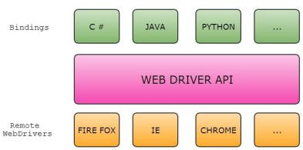

4.6-Architecture of Selenium Web-Driver
Selenium WebDriver:
Selenium-WebDriver makes direct calls to the browser using each browser’s native support for automation.
Since there are so many browsers & so many programming languages there is need for common specification which will be provided by WebDriver API.
Each browser has to implement this API which is called as Remote WebDriver or Remote WebDriver Server.
At a higher level Selenium WebDriver architecture look like this:-
The language binding will send the commands across the common driver API, on the other end there is going to be a driver listening to those commands and they will be executed in browser using remote WebDriver and it’s going to return the result/response via API to the code/Binding.
Actually whatever the commands issued in the code will be interpreted into Webservice methods (JSON Wired Protocol) and the Remote Driver will receive the HTTP request (commands) and execute them in the browser then send the response back.
Example:
Let’s take a sample code and see how the data flows between Client bindings, Server.
driver.get("http://www.google.com");
The client library, as soon as it receives the preceding command, will convert it to the JSON format (shown below) and communicate with the Firefox Driver/Remote WebDriver.
http://localhost:7705/ { "url": "http://www.google.com" }
Firefox Driver will speak to the Firefox browser natively, and then the browser will send a request for the asked URL to load.

Slide 26
5- Introduction to Core Java-1
5.1-Java Features
5.2-Write Simple Java Program
5.3-Variables and Data Type in Java
5.4-Operators in Java
5.5-Modifier in Java
5.6-Decision Making Statement (If, Else)
5.7-Java - Loop control
5.8-Java - String
5.9-Java - Arrays
5.10-Java - Exception Handling

Slide 27
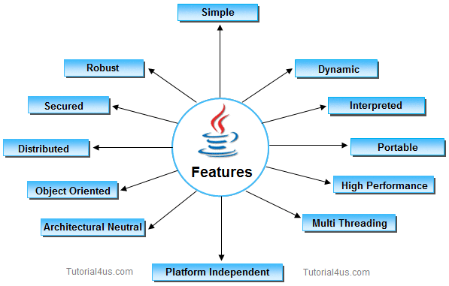
5.1-Java Features
1. Simple:-
It is simple because of the following factors:
It is free from pointer due to this execution time of application is improve. [whenever we write a Java program without pointers then internally it is converted into the equivalent pointer program].
It have Rich set of API (application protocol interface).
It have Garbage Collector which is always used to collect un-Referenced (unused) Memory location for improving performance of a Java program.
It contains user friendly syntax for developing any applications
2. Platform Independent:-A program or technology is said to be platform independent if and only if which can run on all available operating systems with respect to its development and compilation. (Platform represents O.S).
3. Architectural Neutral-Architecture represents processor. A Language or Technology is said to be Architectural neutral which can run on any available processors in the real world without considering there architecture and vendor (providers) irrespect to its development and compilation.
4. Portable-If any language supports platform independent and architectural neutral feature known as portable. The languages like C, CPP, Pascal are treated as non-portable language. It is a portable language. According to SUN microsystem.

Slide 28
5.1.2-Java Features
5. Multithreaded-A flow of control is known as thread. When any Language execute multiple thread at a time that language is known as multithreaded Language. It is multithreaded Language.
6. Distributed-Using this language we can create distributed application. RMI and EJB are used for creating distributed applications. In distributed application multiple client system are depends on multiple server systems so that even problem occurred in one server will never be reflected on any client system.
7. Networked-It is mainly design for web based applications, J2EE is used for developing network based applications.
8. Robust-Simply means of Robust is strong. It is robust or strong Programming Language because of its capability to handle Run-time Error, automatic garbage collection, lack of pointer concept, Exception Handling. All these points makes It robust Language.
9. Dynamic-It support Dynamic memory allocation due to this memory wastage is reduce and improve performance of application. The process of allocating the memory space to the input of the program at a run-time is known as dynamic memory allocation, To programming to allocate memory space by dynamically we use an operator called 'new' 'new' operator is known as dynamic memory allocation operator.
10. Secure-It is more secured language compare to other language; In this language all code is covered into byte code after compilation which is not readable by human.
11. High performance
It have high performance because of following reasons;
This language uses Bytecode which is more faster than ordinary pointer code so Performance of this language is high.
Garbage collector, collect the unused memory space and improve the performance of application.
It have no pointers so that using this language we can develop an application very easily.
It support multithreading, because of this time consuming process can be reduced to execute the program.
12. Interpreted
It is one of the highly interpreted programming languages.
13. Object Oriented
It supports OOP's concepts because of this it is most secure language, for this topic you can read our oop's concepts in detail.

Slide 29
5.2-Write Simple Java Program
Requirements for java Program
For executing any java program we need given things.
Install the JDK any version if you don't have installed it.
Set path of the jdk/bin directory.
Create the java program
Compile and run the java program
Programs
class First
{
public static void main(String[] args)
{
System.out.println("Hello Java");
System.out.println("My First Java Program");
}
}
Explain Public static void main (String args[])
Public-It means that you can call this method from outside of the class you are currently in. This is necessary because this method is being called by the Java runtime system which is not located in you current class.
Static-When the JVM makes call to the main method there is no object existing for the class being called therefore it has to have static method to allow invocation from class.
Void-Java is platform independent language and if it will return some value then the value may mean different things to different platforms.
Main-It's just the name of method. This name is fixed and as it's called by the JVM as entry point for an application.
String args[]-These are the arguments of type String that your Java application accepts when you run it.
This code contains public static void main (String [] args). It can not be like ‘public static void main (int[] args) ’ which does not works. Because the JVM takes the argument values as a string argument. It does not take any int argument. So if we want a int argument means we have to convert the string argument into integer argument. For running this code valid main method is required (ex:public static void main(String args[]))
Difference between JDK, JVM and JRE
Jvm, Jre, Jdk these all the backbone of java language. Each components have separate works. Jdk and Jre physically exists but Jvm are abstract machine it means it not physically exists.
JVM-JVM (Java Virtual Machine) is a software. It is a specification that provides runtime environment in which java bytecode can be executed. It not physically exists.
JVMs are not same for all hardware and software, for example for window os JVM is different and for Linux VJM is different. JVM, JRE and JDK are platform dependent because configuration of each OS differs. But, Java is platform independent.
JRE-The Java Runtime Environment (JRE) is part of the Java Development Kit (JDK). It contains set of libraries and tools for developing java application. The Java Runtime Environment provides the minimum requirements for executing a Java application. It physically exists. It contains set of libraries + other files that JVM uses at runtime.
JDK-The Java Development Kit (JDK) is primary components. It physically exists. It is collection of programming tools and JRE, JVM.

Slide 30
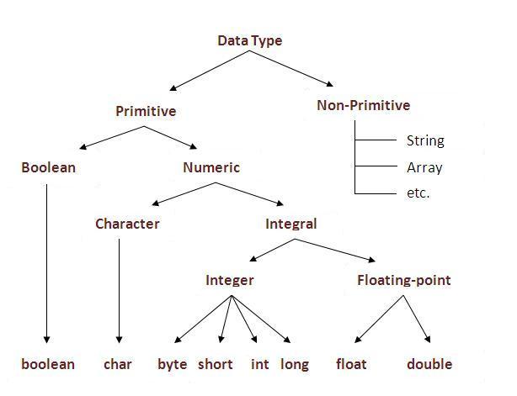
5.3-Variables and Data Type in Java
Variables
A Java variable is a piece of memory that can contain a data value. Variables are typically used to store information which your Java program needs to do its job. This can be any kind of information ranging from texts, codes (e.g. country codes, currency codes etc.) to numbers, temporary results of multi step calculations etc.
A variable has a data type
Variable is an identifier which holds data or another one variable is an identifier whose value can be changed at the execution time of program. Variable is an identifier which can be used to identify input data in a program.
Variable is name of reserved area allocated in memory. In other words, it is a name of memory location. It is a combination of "vary + able" that means its value can be changed.
Types of Variables
Local Variable- A variable which is declared inside the method is called local variable.
Instance Variable- A variable which is declared inside the class but outside the method, is called instance variable. It is not declared as static.
Static variable-A variable that is declared as static is called static variable. It cannot be local. When a variable is declared with the keyword static, its called a class variable. All instances share the same copy of the variable. A class variable can be accessed directly with the class, without the need to create a instance.
Datatype
It is a spacial keyword used to allocate sufficient memory space for the data, in other words Data type is used for representing the data in main memory (RAM) of the computer.
In general every programming language is containing three categories of data types. They are
1-primitive data types, 2-Non-primitive data types

Slide 31
5.3.2-Variables and Data Type in Java
1-Fundamental or primitive data types- Primitive data types are those whose variables allows us to store only one value but they never allows us to store multiple values of same type. This is a data type whose variable can hold maximum one value at a time.
Data Type | Default Value | Default size | Example
boolean | FALSE | 1 bit | boolean one = true
char | '\u0000' | 2 byte | char letterA = 'A'
byte | 0 | 1 byte | byte a = 100, byte b = -50
short | 0 | 2 byte | short s = 10000, short r = -20000
int | 0 | 4 byte | int a = 100000, int b = -200000
long | 0L | 8 byte | long a = 100000, long b = -200000
float | 0.0f | 4 byte | float f1 = 234.5
double | 0.0d | 8 byte | double d1 = 123.4
2-Non-Primitive (Reference) data type- Derived data types are those whose variables allow us to store multiple values of same type. But they never allows to store multiple values of different types. These are the data type whose variable can hold more than one value of similar type. In general derived data type can be achieve using array. Example--String, Array etc
Non-primitive, or reference data types, are the more sophisticated members of the data type family. They don't store the value, but store a reference to that value. Instead of partNumber 4030023, Java keeps the reference, also called address, to that value, not the value itself.
Reference types can be a class, interface, or array variable. Remember that a class is a set of plans for a given object. There are thousands of tree objects, but the parent set of plans would belong in the tree class. Variables can exist inside the tree class, such as height or tree type. These are reference variables.
An array is a single object that contains multiple values of the same type. We could have declared our integer for partNumbers as an array to hold a given number of partNumbers in a single object.

Slide 32
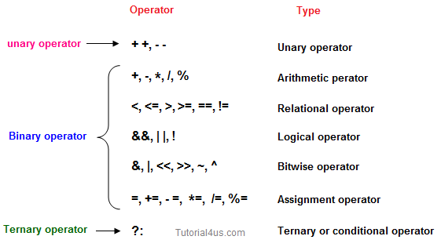
5.4-Operators in Java
Operators
Operator is a special symbol that tells the compiler to perform specific mathematical or logical Operation. Java supports following lists of operators.
Arithmetic Operators
Relational Operators
Logical Operators
Bitwise Operators
Assignment Operators
Ternary or Conditional Operators
1-Arithmetic Operators- Given table shows all the Arithmetic operator supported by Java Language. Lets suppose variable A hold 8 and B hold 3.
Arithmetic Operators | Example (int A=8, B=3) | Result
+ | A+B | 11
- | A-B | 5
* | A*B | 24
/ | A/B | 2
% | A%4 | 0
Relational Operators | Example (int A=8, B=3) | Result
< | A<B | False
<= | A<=10 | True
> | A>B | True
>= | A<=B | False
== | A== B | False
!= | A!=(-4) | True
2Relational Operators
Which can be used to check the Condition, it always return true or false. Lets suppose variable A hold 8 and B hold

Slide 33
5.4.2-Operators in Java
Logical Operator- | Example (int A=8, B=3, C=-10) | Result
&& | (A<B) && (B>C) | False
|| | (B!=-C) || (A==B) | True
! | !(B<=-A) | True
3-Logical Operator- Which can be used to combine more than one Condition. Suppose you want to combined two conditions A<B and B>C, then you need to use Logical Operator like (A<B) && (B>C). Here &&is Logical Operator.
Truth table of Logical Operator
C1 | C2 | C1 && C2 | C1 || C2 | !C1 | !C2
T | T | T | T | F | F
T | F | F | T | F | T
F | T | F | T | T | F
F | F | F | F | T | T
Assignment Operators | Example (int A=8, B=3) | Result
+= | A+=B or A=A+B | 11
-= | A-=3 or A=A+3 | 5
*= | A*=7 or A=A*7 | 56
/= | A/=B or A=A/B | 2
%= | A%=5 or A=A%5 | 3
=a=b | Value of b will be assigned to a
4-Assignment operators- Which can be used to assign a value to a variable. Lets suppose variable A hold 8 and B hold 3.
5-Bitwise Operators- Java defines several bitwise operators like &, | etc which can be applied to the integer types(long, int, short, char, and byte).
Bitwise operator works on bits(0 or 1) and perform bit by bit operation. Assume if x = 60; and y = 13; Now in binary format they will be as follows:
x = 0011 1100
y = 0000 1101
-----------------
x&y = 0000 1100
x|y = 0011 1101
x^y = 0011 0001
~x = 1100 0011
The following table lists the bitwise operators:
Assume integer variable X=60 and variable Y=13 then:
Bitwise Op. | Description
& | Binary AND Operator copies a bit to the result if it exists in both operands.
| | Binary OR Operator copies a bit if it exists in either operand.
^ | Binary XOR Operator copies the bit if it is set in one operand but not both.
~ | Binary Ones Complement Operator is unary and has the effect of 'flipping' bits.
<< | Binary Left Shift Operator. The left operands value is moved left by the number of bits specified by the right operand.
>> | Binary Right Shift Operator. The left operands value is moved right by the number of bits specified by the right operand.
>>> | Shift right zero fill operator. The left operands value is moved right by the number of bits specified by the right operand and shifted values are filled up with zeros.

Slide 34
5.4.3-Operators in Java
6-Ternary operator-If any operator is used on three operands or variable is known as ternary operator. It can be represented with " ?:
The ternary operator "?:" earns its name because it's the only operator to take three operands. It is a conditional operator that provides a shorter syntax for the if..then..else statement. The first operand is a boolean expression; if the expression is true then the value of the second operand is returned otherwise the value of the third operand is returned:
boolean expression ? value1 : value2
The first operand in java ternary operator should be a boolean or a statement with boolean result. If the first operand is true then java ternary operator returns second operand else it returns third operand.
Syntax of java ternary operator is- result = testStatement ? value1 : value2;
If testStatement is true then value1 is assigned to result variable else value2 is assigned to result variable.
Example:-5.1 – For Operators

Slide 35
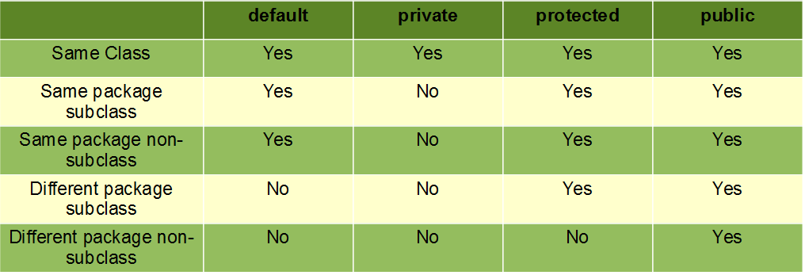
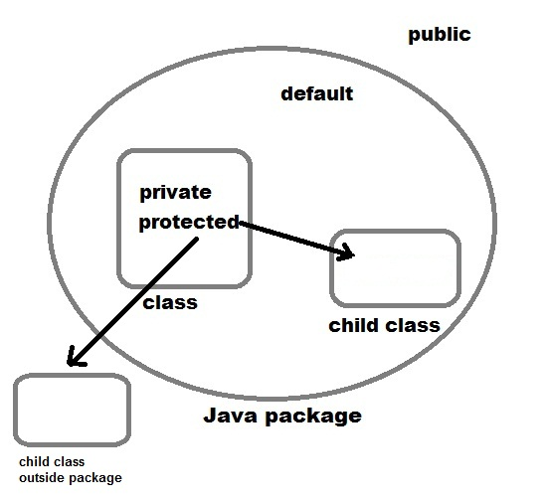
5.5.1-Modifier in Java
Modifiers are keywords that are added to change meaning of a definition. In Java, modifiers are categorized into two types,
1-Access control modifier
2-Non Access Modifier
1- Access Modifiers in Java
Access modifiers are used to control the accessibility to classes, interfaces, fields, constructors and methods. In other words, we can use access modifiers to protect data and behaviors from the outside world. At a high level, access modifiers facilitate the encapsulation feature in Object-Oriented Programming.
They are the core, fundamental and important concepts in Java which you have to grasp a deep understanding in order to write code properly, efficiently, securely an professionally.
As the name suggests access modifiers in Java helps to restrict the scope of a class, constructor , variable , method or data member. There are four types of access modifiers available in java:
Default – No keyword required/ When no access modifier is specified for a class , method or data member – It is said to be having the default access modifier by default.
Ex- void display()
2- Private- The methods or data members declared as private are accessible only within the class in which they are declared.
Ex-private void display()
3- Protected- The methods or data members declared as protected are accessible within same package or sub classes in different package.
Ex- protected void display()
4- Public- The public access modifier has the widest scope among all other access modifiers. Classes, methods or data members which are declared as public are accessible from every where in the program. There is no restriction on the scope of a public data members.
Ex-public void display()

Slide 36
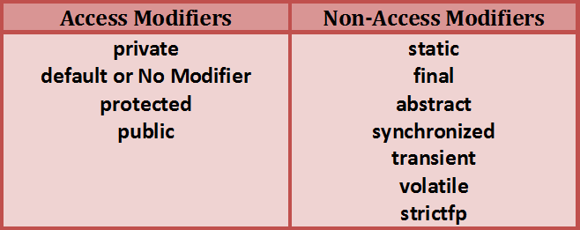
5.5.2-Modifier in Java
2-Non Access Modifier
Java provides some other modifiers to provide the functionalities other than the visibility. These modifiers are called Non-Access Modifiers. There are many non-access modifiers available in java. Each modifier have their own functionality. Some of the most used non-access modifiers are listed below.
1-static : The members which are declared as static are common to all instances of a class. Static members are class level members which are stored in the class memory.
2-final : This modifier is used to restrict the further modification of a variable or a method or a class. The value of a variable which is declared as final can’t be modified once it gets a value. A final method can not be overridden in the sub class and you can not create a sub class to a final class.
3-abstract : This modifier can be used either with a class or with a method. You can not apply this modifier to variable and constructor. A method which is declared as abstract must be modified in the sub class. You can’t instantiate a class which is declared as abstract.
4-synchronized : This modifier is used to control the access of a particular method or a block by multiple threads. Only one thread can enter into a method or a block which is declared as synchronized.
5-volatile : volatile modifier is used in multi threaded programming. If you declare a field as volatile it will be signal to the threads that it’s value must be read from the main memory rather then their own stack. Because volatile field is common to all threads and it will be updated frequently by multiple threads.
6-strictfp : This modifier is used for floating-point calculations. This keyword ensures that you will get same floating point presentation on every platform. This modifier makes floating point variable more consistent across multiple platforms.

Slide 37
5.6-Decision Making Statement (If, Else, Switch)
Decision making statement statements is also called selection statement. That is depending on the condition block need to be executed or not which is decided by condition. If the condition is "true" statement block will be executed, if condition is "false" then statement block will not be executed. In java there are three types of decision making statement.
If - if-then is most basic statement of Decision making statement. It tells to program to execute a certain part of code only if particular condition is true.
Syntax
if(condition)
{
Statement(s)
}
2- if-else - In general it can be used to execute one block of statement among two blocks, in java language if and else are the keyword in java.
Syntax
if(condition)
{
Statement(s)
}
else
{
Statement(s)
}
3- Switch- The switch statement in java language is used to execute the code from multiple conditions or case. It is same like if else-if ladder statement. A switch statement work with byte, short, char and int primitive data type, it also works with enumerated types and string.Syntax
switch(expression/variable)
{ case value: //statements // any number of case statements break; //optional default: //optional //statements}
Rules for apply switch statement
With switch statement use only byte, short, int, char data type (float data type is not allowed). You can use any number of case statements within a switch. Value for a case must be same as the variable in switch.
Limitations of switch statement
Logical operators cannot be used with switch statement. For instance
Programe Code-

Slide 38
5.7.1-Java - Loop control
Loop
A loop statement allows us to execute a statement or group of statements multiple times and following is the general form of a loop statement in most of the programming languages. There may be a situation when we need to execute a block of code several number of times, and is often referred to as a loop. There are four types of loops:
1. For loop
2. For each loop
3. While loop
4. Do..While loop
1-For Loop in Java Programming –
For Loop is one of the looping statement in java programming.
For Loop is used to execute set of statements repeatedly until the condition is true.
For Loop checks the contrition and executes the set of the statements , It is loop control statement in java.
For Loop contain the following statements such as “Initialization” , “Condition” and “Increment/Decrement” statement.
Syntax:-
for (initialization; condition ; increment)
{
Statement1
Statement2
. . . StatementN
}
Example:-
class ForDemo
{
public static void main(String[] args)
{ for(int i=1; i<11; i++)
{
System.out.println("Count is : " + i);
}
}
}

Slide 39
5.7.2-Java - Loop control
2-While Loop statement in Java
In java “while” is iteration statements like for and do-while.
It is also called as “Loop Control Statement“.
While Statement repeatedly executes the same set of instructions until a termination condition is met.
While loop is Entry Controlled Loop because condition is check at the entrance.
If initial condition is true then and then only control enters into the while loop body
In for loop initialization, condition and increment all three statements are combined into the one statement , in “while loop” all these statements are written as separate statements.
Conditional Expression written inside while must return boolean value.
Syntax:-
while(condition)
{
// body of loop
}
Example:-
class ForDemo
{
public static void main(String[] args)
{
int cnt = 1; while (cnt < 11) { System.out.println("Number Count : " + cnt); count++; }
}
}

Slide 40
5.7.3-Java - Loop control
3-DO While Loop statement in Java
do-while loop is similar to while loop, however there is a single difference between these two. Unlike while loop, do-while guarantees at-least one execution of block of statements. This happens because the do-while loop evaluates the boolean expression at the end of the loop’s body. Therefore the set of statements gets executed at-least once before the check of boolean expression.
Syntax:-
do{
statement(s)
//block of statements
}while (Boolean expression);
Example:-
class ForDemo
{
int i=10; do
{
System.out.println(i); i--;
}while(i>1);
}
}

Slide 41
5.7.4-Java - Loop control
3-For Each Loop statement in Java
The for-each loop introduced in Java5. It is mainly used to traverse array or collection elements. The advantage of for-each loop is that it eliminates the possibility of bugs and makes the code more readable.
Advantage of for-each loop:
It makes the code more readable.
It eliminates the possibility of programming errors.
Syntax:-
for(data_type variable : array | collection)
{}
Example:-
class ForDemo
{
public static void main(String args[])
{
int arr[]={12,13,14,44};
for(int i:arr){
System.out.println(i);
}
}
}

Slide 42
5.8.1-Java - String
Java – String
String is nothing but a sequence of characters, for e.g. “Hello” is a string of 5 characters. In java, string is an immutable object which means it is constant and can cannot be changed once it has been created..
Creating a String
There are two ways to create a String in Java
String literal-
String str1 = "Welcome";
String str2 = "Welcome";
The problem with this approach: As I stated in the beginning that String is an object in Java. However we have not created any string object using new keyword above. The compiler does that task for us it creates a string object having the string literal (that we have provided , in this case it is “Welcome”) and assigns it to the provided string instances.
But if the object already exist in the memory it does not create a new Object rather it assigns the same old object to the new instance, that means even though we have two string instances above(str1 and str2) compiler only created on string object (having the value “Welcome”) and assigned the same to both the instances. For example there are 10 string instances that have same value, it means that in memory there is only one object having the value and all the 10 string instances would be pointing to the same object.
What if we want to have two different object with the same string? For that we would need to create strings using new keyword.
Using new keyword
when we tried to assign the same string object to two different literals, compiler only created one object and made both of the literals to point the same object. To overcome that approach we can create strings like this:
String str1 = new String("Welcome");
String str2 = new String("Welcome");
Example
public class StringExample{
public static void main(String args[]){
String s1="java";//creating string by java string literal
char ch[]={'s','t','r','i','n','g','s'};
String s2=new String(ch);//converting char array to string
String s3=new String("example");//creating java string by new keyword
System.out.println(s1);
System.out.println(s2);
System.out.println(s3);
}}

Slide 43
5.8.2-Java - String
Java – String Methods
1-+ operator (Concatenation)
String str4 = str1 + str2;
2-concat
String str3 = str1.concat(str2);
3-String "Length" Method
str_Sample.length()
4-String "indexOf" Method
str_Sample.indexOf('S')
5-String "charAt" Method
str_Sample.charAt(5)
6-String "CompareTo" Method
str_Sample.compareTo("rockstar")
7-String "Contain" Method
str_Sample.contains("tar")
8-String "endsWith" Method
str_Sample.endsWith("r")
Java StringBuffer class
Java StringBuffer class is used to created mutable (modifiable) string. The StringBuffer class in java is same as String class except it is mutable i.e. it can be changed.Java StringBuffer class is thread-safe i.e. multiple threads cannot access it simultaneously. So it is safe and will result in an order.
Important Constructors of StringBuffer class
StringBuffer(): creates an empty string buffer with the initial capacity of 16.
StringBuffer(String str): creates a string buffer with the specified string.
StringBuffer(int capacity): creates an empty string buffer with the specified capacity as length.
StringBuffer Example:-
The reverse() method of StringBuilder class reverses the current string.
class A
{
public static void main(String args[]){
StringBuffer sb=new StringBuffer("Hello");
sb.reverse();
System.out.println(sb);//prints olleH
}
}

Slide 44
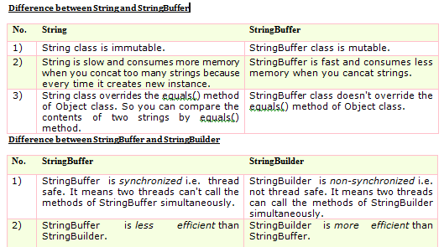
5.8.3-Java - String
Java StringBuilder class
Java StringBuilder class is used to create mutable (modifiable) string. The Java StringBuilder class is same as StringBuffer class except that it is non-synchronized. It is available since JDK 1.5.
Important Constructors of StringBuilder class
StringBuilder(): creates an empty string Builder with the initial capacity of 16.
StringBuilder(String str): creates a string Builder with the specified string.
StringBuilder(int length): creates an empty string Builder with the specified capacity as length.
Example-StringBuilder ensureCapacity() method
The ensureCapacity() method of StringBuilder class ensures that the given capacity is the minimum to the current capacity. If it is greater than the current capacity, it increases the capacity by (oldcapacity*2)+2. For example if your current capacity is 16, it will be (16*2)+2=34.
class A
{ public static void main(String args[]){
StringBuilder sb=new StringBuilder();
System.out.println(sb.capacity());//default 16
sb.append("Hello");
System.out.println(sb.capacity());//now 16
sb.append("java is my favourite language");
System.out.println(sb.capacity());//now (16*2)+2=34 i.e (oldcapacity*2)+2
sb.ensureCapacity(10);//now no change
System.out.println(sb.capacity());//now 34
sb.ensureCapacity(50);//now (34*2)+2
System.out.println(sb.capacity());//now 70
} }

Slide 45
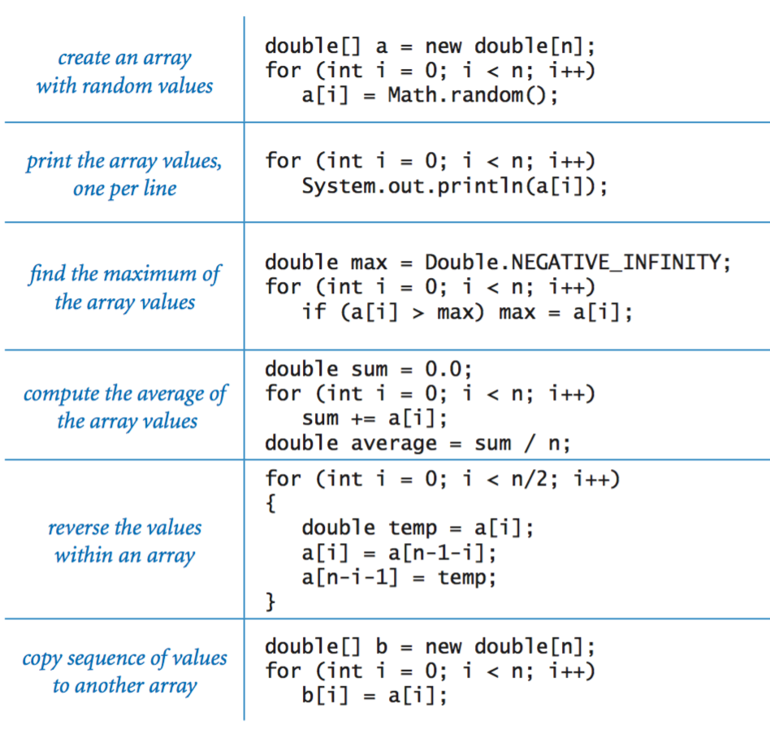

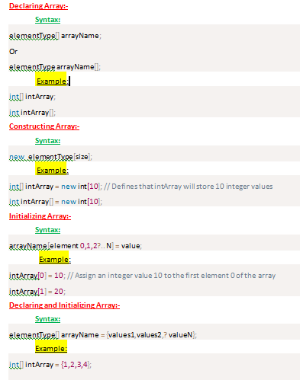
5. 9.1-Java - Arrays
Arrays in Java
An array stores a sequence of values that are all of the same type. We want not just to store values but also to be able to quickly access each individual value. The method that we use to refer to individual values in an array is to number and then index them—if we have n values, we think of them as being numbered from 0 to n−1.
Making an array in a Java program involves three distinct steps: ArrayExamples.java contains typical examples of using arrays in
Declare the array name.
Create the array.
Initialize the array values.

Slide 46
5. 9.2-Java - Arrays
Programming with arrays:-
Before considering more examples, we consider a number of important characteristics of programming with arrays:-
.Zero-based indexing. We always refer to the first element of an array a[] as a[0], the second as a[1], and so forth. It might seem more natural to you to refer to the first element as a[1], the second value as a[2], and so forth, but starting the indexing with 0 has some advantages and has emerged as the convention used in most modern programming languages.
Array length. Once we create an array, its length is fixed. You can refer to the length of an a[] in your program with the code a.length.
Default array initialization. For economy in code, we often take advantage of Java's default array initialization convention. For example, the following statement is equivalent to the four lines of code at the top of this page:
double[] a = new double[n];
//The default initial value is 0 for all numeric primitive types and false for type boolean.
Memory representation. When you use new to create an array, Java reserves space in memory for it (and initializes the values). This process is calledmemory allocation.
Bounds checking. When programming with arrays, you must be careful. It is your responsibility to use legal indices when accessing an array element.
Setting array values at compile time. When we have a small number of literal values that we want to keep in array, we can initialize it by listing the values between curly braces, separated by a comma. For example, we might use the following code in a program that processes playing cards.
String[] SUITS = { "Clubs", "Diamonds", "Hearts", "Spades" };
String[] RANKS = { "2", "3", "4", "5", "6", "7", "8", "9", "10", "Jack", "Queen", "King", "Ace" };
After creating the two arrays, we might use them to print a random card name such as Queen of Clubs, as follows.
int i = (int) (Math.random() * RANKS.length);
int j = (int) (Math.random() * SUITS.length);
System.out.println(RANKS[i] + " of " + SUITS[j]);

Slide 47
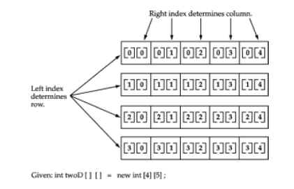
5. 9.3-Java - Arrays
Multi-Dimensional Arrays in Java
In Java, multidimensional arrays are actually arrays of arrays. These, as you might expect, look and act like regular multidimensional arrays. However, as you will see, there are a couple of subtle differences. To declare a multidimensional array variable, specify each additional index using another set of square brackets. For example, the following declares a two-dimensional array variable called twoD
Two-dimensional arrays in Java. To refer to the element in row i and column j of a two-dimensional array a[][], we use the notation a[i][j]; to declare a two-dimensional array, we add another pair of brackets; to create the array, we specify the number of rows followed by the number of columns after the type name (both within brackets), as follows:
.int twoD[][] = new int[4][5];
This allocates a 4 by 5 array and assigns it to twoD. Internally this matrix is implemented as an array of arraysof int.Conceptually, this array will look like the one shown in Figure below:
Example-
// Demonstrate a two-dimensional array. class TwoDArray { public static void main(String args[]) { int twoD[][]= new int[4][5]; int i, j, k = 0; for(i=0; i<4; i++) for(j=0; j<5; j++) { twoD[i][j] = k; k++; } for(i=0; i<4; i++) { for(j=0; j<5; j++) System.out.print(twoD[i][j] + " "); System.out.println(); } } }This program generates the following output:
0 1 2 3 4 5 6 7 8 9 10 11 12 13 14 15 16 17 18 19

Slide 48
5. 9.3-Java - Arrays
Multi-Dimensional Arrays in Java
In Java, multidimensional arrays are actually arrays of arrays. These, as you might expect, look and act like regular multidimensional arrays. However, as you will see, there are a couple of subtle differences. To declare a multidimensional array variable, specify each additional index using another set of square brackets. For example, the following declares a two-dimensional array variable called twoD
Two-dimensional arrays in Java. To refer to the element in row i and column j of a two-dimensional array a[][], we use the notation a[i][j]; to declare a two-dimensional array, we add another pair of brackets; to create the array, we specify the number of rows followed by the number of columns after the type name (both within brackets), as follows:
.int twoD[][] = new int[4][5];
This allocates a 4 by 5 array and assigns it to twoD. Internally this matrix is implemented as an array of arraysof int.Conceptually, this array will look like the one shown in Figure below:
Example-
// Demonstrate a two-dimensional array. class TwoDArray { public static void main(String args[]) { int twoD[][]= new int[4][5]; int i, j, k = 0; for(i=0; i<4; i++) for(j=0; j<5; j++) { twoD[i][j] = k; k++; } for(i=0; i<4; i++) { for(j=0; j<5; j++) System.out.print(twoD[i][j] + " "); System.out.println(); } } }This program generates the following output:
0 1 2 3 4 5 6 7 8 9 10 11 12 13 14 15 16 17 18 19

Slide 49
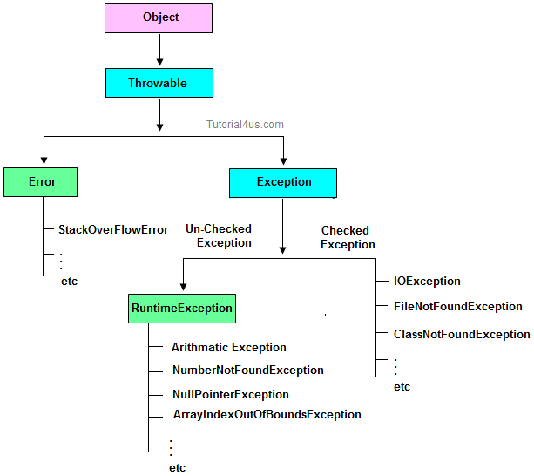
5.10.1 Java - Exception Handling
What is Error?
Error are exceptional scenario that are out of scope for application and it’s not possible to recover. E.g Hardware Failure, Network failure.
What is an exception?
An Exception can be anything which interrupts the normal flow of the program. When an exception occurs program processing gets terminated and doesn’t continue further. In such cases we get a system generated error message. The good thing about exceptions is that they can be handled. We will cover the handling part later in this same tutorial.
When an exception can occur?
Exception can occur at runtime (known as runtime exceptions) as well as at compile-time (known Compile-time exceptions).
Reasons for Exceptions
There can be several reasons for an exception. For example, following situations can cause an exception – Opening a non-existing file, Network connection problem, Operands being manipulated are out of prescribed ranges, class file missing which was supposed to be loaded and so on.
Difference between error and exception
Errors indicate serious problems and abnormal conditions that most applications should not try to handle. Error defines problems that are not expected to be caught under normal circumstances by our program. For example memory error, hardware error, JVM error etc.
Advantages of Exception Handling
Exception handling allows us to control the normal flow of the program by using exception handling in program.
It throws an exception whenever a calling method encounters an error providing that the calling method takes care of that error.
It also gives us the scope of organizing and differentiating between different error types using a separate block of codes. This is done with the help of try-catch blocks.
Why to handle exception?
If an exception is raised, which has not been handled by programmer then program execution can get terminated and system prints a non user friendly error message.
Handling exceptions – Three styles
Using try-catch block; the robust way
Using throws in place of try-catch, not a robust way
To throw the exception object to the system using throw keyword, not a robust way

Slide 50
5.10.2 Java - Exception Handling
Exception Handling Example
Without Exception Handling-
class ExceptionDemo1
{
public static void main(String args[])
{
int num1=30, num2=0;
int output=num1/num2;
System.out.println ("Result = " +output);
}
}
With Exception Handling
class ExceptionDemo1
{
public static void main(String args[])
{
try{
int num1=30, num2=0;
int output=num1/num2;
System.out.println ("Result = " +output);
}
catch(ArithmeticException e){
System.out.println ("Arithmetic Exception: You can't divide an integer by 0");
}
}
}

Slide 51
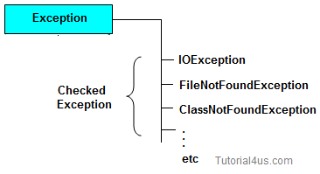
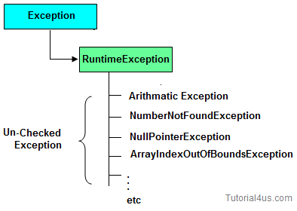
5.10.3 Java - Exception Handling
Type of Exception
Checked Exception
Un-Checked Exception
Checked Exception
Checked Exception are the exception which checked at compile-time. These exception are directly sub-class of java.lang.Exception class.
Only for remember: Checked means checked by compiler so checked exception are checked at compile-time..
Un-Checked Exception
Un-Checked Exception are the exception both identifies or raised at run time. These exception are directly sub-class of java.lang.RuntimeException class.
Note: In real time application mostly we can handle un-checked exception.
Only for remember: Un-checked means not checked by compiler so un-checked exception are checked at run-time not compile time.
 | Checked Exception | Un-Checked Exception
1 | checked Exception are checked at compile time | un-checked Exception are checked at run time
2 | e.g. FileNotFoundException, NumberNotFoundException etc. | e.g. ArithmeticException, NullPointerException, ArrayIndexOutOfBoundsException etc.

Slide 52
5.10.4 Java - Exception Handling
How to resolve the error? There are two ways to avoid this error. We will see both the ways one by one.
Method 1: Declare the exception using throws keyword.
As we know that all three occurrences of checked exceptions are inside main() method so one way to avoid the compilation error is: Declare the exception in the method using throws keyword. You may be thinking that our code is throwing FileNotFoundException and IOException both then why we are declaring the IOException alone. Th reason is that IOException is a parent class of FileNotFoundException so it by default covers that.
class Example {
public static void main(String args[]) throws IOException
{
FileInputStream fis = null;
fis = new FileInputStream("B:/myfile.txt");
int k;
while(( k = fis.read() ) != -1)
{
System.out.print((char)k);
}
fis.close(); }}
Output:
File content is displayed on the screen.
Method 2: Handle them using try-catch blocks.
The above approach is not good at all. It is not a best exception handling practice. You should give meaningful message for each exception type so that it would be easy for someone to understand the error. The code should be like this:
import java.io.*;
class Example {
public static void main(String args[])
{
FileInputStream fis = null;
try{
fis = new FileInputStream("B:/myfile.txt");
}catch(FileNotFoundException fnfe){
System.out.println("The specified file is not " +
"present at the given path");
}
int k;
try{
while(( k = fis.read() ) != -1)
{
System.out.print((char)k);
}
fis.close();
}catch(IOException ioe){
System.out.println("I/O error occurred: "+ioe);
}
}
}

Slide 53
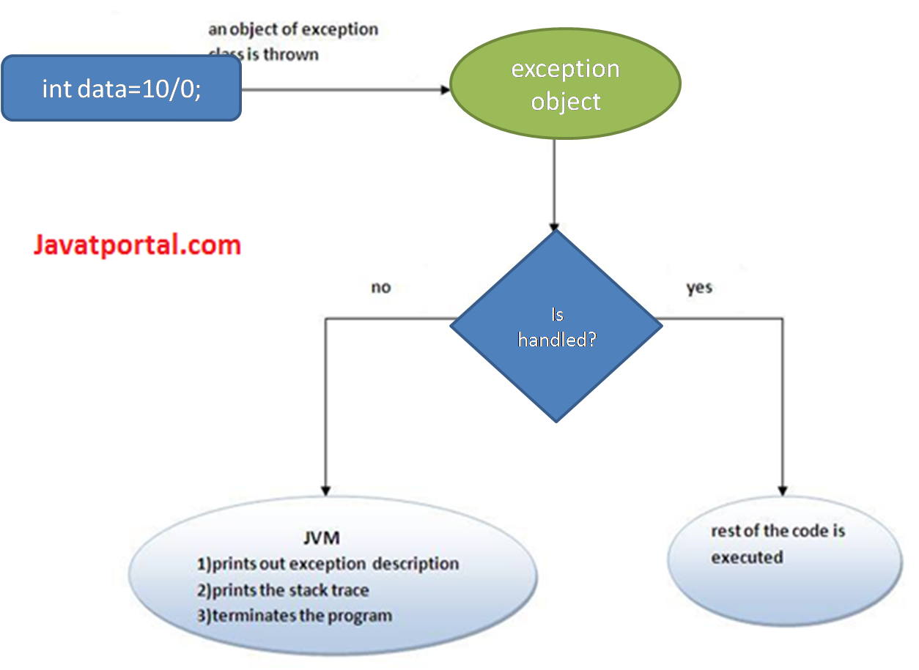
5.10.5 Java - Exception Handling
Java Exception Handling Keywords-1
Try- The try block contains a block of program statements within which an exception might occur. A try block is always followed by a catch block, which handles the exception that occurs in associated try block. A try block must followed by a Catch block or Finally block or both.
Important points about try block
If any exception occurs in try block then CPU controls comes out to the try block and executes appropriate catch block.
After executing appropriate catch block, even through we use run time statement, CPU control never goes to try block to execute the rest of the statements.
Each and every try block must be immediately followed by catch block that is no intermediate statements are allowed between try and catch block.
Catch –A catch block must be associated with a try block. The corresponding catch block executes if an exception of a particular type occurs within the try block. For example if an arithmetic exception occurs in try block then the statements enclosed in catch block for arithmetic exception executes.
Flow of try catch block
If an exception occurs in try block then the control of execution is passed to the catch block from try block. The exception is caught up by the corresponding catch block. A single try block can have multiple catch statements associated with it, but each catch block can be defined for only one exception class. The program can also contain nested try-catch-finally blocks.

Slide 54
5.10.6 Java - Exception Handling
Multiple catch blocks in Java
1. A try block can have any number of catch blocks.
2. A catch block that is written for catching the class Exception can catch all other exceptions
1. A try block can have any number of catch blocks.
2. A catch block that is written for catching the class Exception can catch all other exceptions
3. If multiple catch blocks are present in a program then the above mentioned catch block should be placed at the last as per the exception handling best practices.
4. If the try block is not throwing any exception, the catch block will be completely ignored and the program continues.
5. If the try block throws an exception, the appropriate catch block (if one exists) will catch it
–catch(ArithmeticException e) is a catch block that can catch ArithmeticException
–catch(NullPointerException e) is a catch block that can catch NullPointerException
6. All the statements in the catch block will be executed and then the program continues.
Example of Multiple catch blocks
class Example2
{
public static void main(String args[])
{
try{
int a[]=new int[7];
a[4]=30/0;
System.out.println("First print statement in try block");
}
catch(ArithmeticException e){
System.out.println("Warning: ArithmeticException");
}
catch(ArrayIndexOutOfBoundsException e){
System.out.println("Warning: ArrayIndexOutOfBoundsException");
}
catch(Exception e){
System.out.println("Warning: Some Other exception");
}
System.out.println("Out of try-catch block...");
}
}
Output:
Warning: ArithmeticException
Out of try-catch block…

Slide 55
5.10.7 Java - Exception Handling
Java Exception Handling Keywords-2
Throw keyword in java-
Throw keyword is used to throw exception manually.
The throw keyword in Java is used to explicitly throw an exception from a method or any block of code. General form of throw is as shown below: "throw Instance"
But this exception i.e, Instance must be of type Throwable or a subclass of Throwable. For example Exception is a sub-class of Throwable and user defined exceptions typically extend Exception class. Unlike C++, data types such as int, char, floats or non-throwable classes cannot be used as exceptions.
The flow of execution of the program stops immediately after the throw statement is executed and the nearest enclosing try block is checked to see if it has a catch statement that matches the type of exception. If it finds a match, controlled is transferred to that statement otherwise next enclosing try block is checked and so on. If no matching catch is found then the default exception handler will halt the program.
In order to throw user defined exceptions, throw keyword is being used. In this tutorial, we will see how to create a new exception and throw it in a program using throw keyword.
You can also throw an already defined exception like -ArithmeticException, IOException etc.
Throw" is used by the programmer to throw an exception object explicitly to the system. Mostly used with user-defined exceptions.
By default, when an exception condition occurs the system automatically throw an exception to inform user that there is something wrong. However we can also throw exception explicitly based on our own defined condition. Using “throw keyword” we can throw checked, unchecked and user -defined exceptions
The below program explains the use of throw: // Java program that demonstrates the use of throw class ThrowExcep { static void fun() { try { throw new NullPointerException("demo"); } catch(NullPointerException e) { System.out.println("Caught inside fun()."); throw e; // rethrowing the exception } } public static void main(String args[]) { try { fun(); } catch(NullPointerException e) { System.out.println("Caught in main."); } } }
Output:
Caught inside fun(). Caught in main.

Slide 56
5.10.8 Java - Exception Handling
Throws keyword in java-
Throws is used in method signature to declare Exception possibly thrown by any method,
“Throws keyword” is mainly used for handling checked exception as using throws we can declare multiple exceptions in one go Use of throws keyword in Java
1. The throws keyword is used in method declaration, in order to explicitly specify the exceptions that a particular method might throw. When a method declaration has one or more exceptions defined using throws clause then the method-call must handle all the defined exceptions.
2. When defining a method you must include a throws clause to declare those exceptions that might be thrown but doesn’t get caught in the method.
3. If a method is using throws clause along with few exceptions then this implicitly tells other methods that – “ If you call me, you must handle these exceptions that I throw”.
“Throws" can be utilized by the programmer in two ways.
It is used by the designer of a method to claim the exception. Claiming is nothing but informing the programmer about the potential problems that may arise while using the method.
The other way is to use as an alternative to try-catch block which is not a robust way.
//Java program to illustrate the use of throws: //Java program to demonstrate working of throws class ThrowsExecp { static void fun() throws IllegalAccessException { System.out.println("Inside fun(). "); throw new IllegalAccessException("demo"); } public static void main(String args[]) { try { fun(); } catch(IllegalAccessException e) { System.out.println("caught in main."); } } }
Output:
Inside fun(). caught in main.

Slide 57
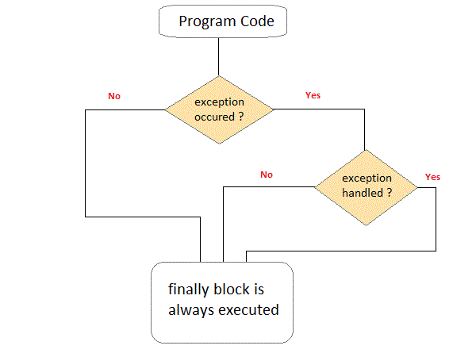
5.10.9 Java - Exception Handling
Finaaly keyword in java-
Java finally block is a block that is used to execute important code such as closing connection, stream etc.
Java finally block is always executed whether exception is handled or not.
Java finally block follows try or catch block
Why use java finally
Finally block in java can be used to put "cleanup" code such as closing a file, closing connection etc.
.
Let's see the java finally example where exception occurs and handled public class TestFinallyBlock2{ public static void main(String args[]){ try{ int data=25/0; System.out.println(data); } catch(ArithmeticException e){System.out.println(e);} finally{System.out.println("finally block is always executed");} System.out.println("rest of the code..."); } }
Output:
Exception in thread main java.lang.ArithmeticException:/ by zero finally block is always executed rest of the code...

Slide 58
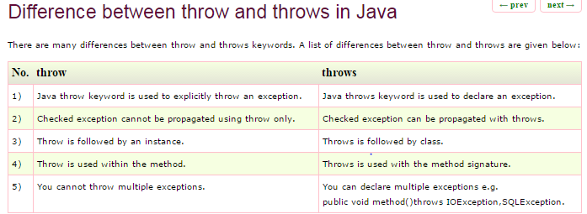
5.10.10 Java - Exception Handling
Rules for Throw and Throws:-
Exception1, Exception2, …: the exception class must be a direct subclass of Throwable class one of its subclasses.
The throws keyword can be followed by one more exception class, separated by commas.
The throw keyword must be followed by an instance of Throwable class or one of its subclasses.
When using the throw keyword to throw a checked exception from within a method, the method must either:
Declares the throws clause followed by the exceptions thrown by the throw statements, or:
Catches the exceptions thrown by the throw statements.
When a method contains statements which may throw exceptions (not using throw statements explicitly), it also has to either catch or declare to throw the exceptions.
If the throw statements throw unchecked exceptions, the method is not required to declare those unchecked exceptions in its throws clause.
A concrete method can declare throws clause if only if its body throws checked exceptions. Otherwise a compile error occurs.
An interface’s method can declare throws clause freely.
The throws clause can declare exceptions which are super types of the exception thrown by the throw statements, but not sub types..

Slide 59
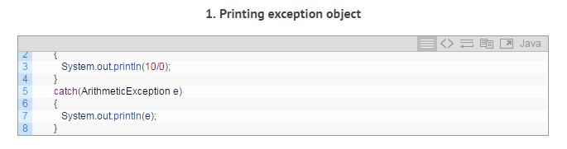
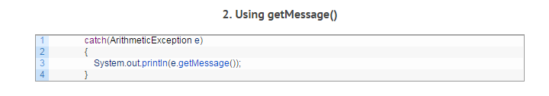
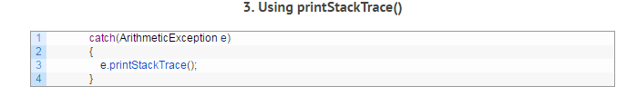
5.10.11 Java - Exception Handling
An exception message can be printed in three ways:-
The first way is printing the exception object thrown by the JVM.
The other two are using the methods of Throwable class – getMessage() and printStackTrace().
1-System.out.println(e) prints the exception class name (java.lang.ArithmeticException) and also the exception message ( / by zero).
2- System.out.println(e.getMessage()) prints exception message ( / by zero) only indicating the cause of exception.
3-e.printStackTrace() prints the exception class name with the message particulars and also the line number where the problem arises (traces the actual problem).

Slide 60
6- Introduction to Junit Framework
6.1-What is Junit
6.2- Annotations and Asserts in Junit
6.3-How to run Testsuits in Junit
6.-4Writing Selenium tests from scratch using Junit Framework

Slide 61
6.1-What is Junit
What is JUnit ?
JUnit is a unit testing framework for Java programming language. JUnit has been important in the development of test-driven development.
JUnit promotes the idea of "first testing then coding", which emphasizes on setting up the test data for a piece of code that can be tested first and then implemented. This approach is like "test a little, code a little, test a little, code a little." It increases the productivity of the programmer and the stability of program code, which in turn reduces the stress on the programmer and the time spent on debugging.
Features of JUnit
JUnit is an open source framework, which is used for writing and running tests.
Provides annotations to identify test methods.
Provides assertions for testing expected results.
Provides test runners for running tests.
JUnit tests allow you to write codes faster, which increases quality.
JUnit is elegantly simple. It is less complex and takes less time.
JUnit tests can be run automatically and they check their own results and provide immediate feedback. There's no need to manually comb through a report of test results.
JUnit tests can be organized into test suites containing test cases and even other test suites.
JUnit shows test progress in a bar that is green if the test is running smoothly, and it turns red when a test fails.
Write the program logic with and without Junit
Without Junit -Let's write the logic to find the maximum number for an array.
package com.javatpoint.logic;
public class Calculation {
public static int findMax(int arr[]){
int max=arr[0];//arr[0] instead of 0
for(int i=1;i<arr.length;i++){
if(max<arr[i])
max=arr[i];
}
return max;
}
}
Wiith Junit The main testing code is written in the testFindMax() method.
package com.javatpoint.testcase;
import static org.junit.Assert.*;
import com.javatpoint.logic.*;
import org.junit.Test;
public class TestLogic {
@Test
public void testFindMax(){
assertEquals(4,Calculation.findMax(new int[]{1,3,4,2}));
assertEquals(-1,Calculation.findMax(new int[]{-12,-1,-3,-4,-2}));
}
}

Slide 62
6.2-Annotations and Asserts in Junit
Junit Annotatins-
Annotations are like meta-tags that you can add to your code, and apply them to methods or in class. These annotations in JUnit provide the following information about test methods −
which methods are going to run before and after test methods.
which methods run before and after all the methods, and.
which methods or classes will be ignored during the execution.
The Junit 4.x framework is annotation based, so let's see the annotations that can be used while writing the test cases.
@Test annotation specifies that method is the test method.
@Test(timeout=1000) annotation specifies that method will be failed if it takes longer than 1000 milliseconds (1 second).
@BeforeClass annotation specifies that method will be invoked only once, before starting all the tests.
@Before annotation specifies that method will be invoked before each test.
@After annotation specifies that method will be invoked after each test.
@AfterClass annotation specifies that method will be invoked only once, after finishing all the tests.
Junit Assetts
Java assertion feature allows developer to put assert statements in Java source code to help unit testing and debugging. Assert keyword validates certain expressions. It replaces the if block effectively and throws an AssertionError on failure.
Methods of Assert class
The common methods of Assert class are as follows:
void assertEquals(boolean expected,boolean actual): checks that two primitives/objects are equal. It is overloaded.
void assertTrue(boolean condition): checks that a condition is true.
void assertFalse(boolean condition): checks that a condition is false.
void assertNull(Object obj): checks that object is null.
void assertNotNull(Object obj): checks that object is not null.

Slide 63
6.3-How to run Testsuits in Junit
Using @RunWith and @SuiteClasses annotations we will execute all of them together as a TestSuite. Lets do it Juint Example:-
Create a new Package (e.g. com.selftechy.testsuite)
Create three JUnit Test Cases in Eclipse under this package (First, Second, and Third)
Create a fourth JUnit test case as RunTestSuite
Right Click on RunTestSuite –> Run As –> JUnit Test
Console output should be as in the below picture
TC-1
package com.selftechy.testsuite;
import org.junit.Test;
public class First
{
@Test
public void testOne()
{
System.out.println("Executing first test");
}
}
TC-2
package com.selftechy.testsuite;
import org.junit.Test;
public class Second
{
@Test
public void testTwo()
{
System.out.println("Executing second test");
}
}
TC-3
package com.selftechy.testsuite;
import org.junit.Test;
public class Third
{
@Test
public void testThree()
{
System.out.println("Executing third test");
}
}
TestSuite
package com.selftechy.testsuite;
import org.junit.runner.RunWith;
import org.junit.runners.Suite;
import org.junit.runners.Suite.SuiteClasses;
{
@RunWith(Suite.class)
@SuiteClasses({First.class,Second.class,Third.class})
public class RunTestSuite
{
}

Slide 64
6.4-Writing Selenium tests from scratch using Junit Framework
JUnit Selenium Test case
import junit.framework.TestCase;
import org.openqa.selenium.*;
import org.openqa.selenium.remote.*;
import java.net.URL;
import java.util.concurrent.TimeUnit;
public class SimpleTest extends TestCase
{
private WebDriver driver;
@Before
public void setUp() throws Exception
{
driver = new FirefoxDriver();
driver.manage().timeouts().implicitlyWait(10, TimeUnit.SECONDS);
}
@Test
public void testSimple() throws Exception
{
this.driver.get("http://www.google.com");
assertEquals("Google", this.driver.getTitle());
}
@After
public void tearDown() throws Exception
{
this.driver.quit();
}
}
1-Before Class Annotation-Annotation before class will tell Junit to run this piece of code before starting any test. So Set-up Method will execute.
2-Test Method - This annotation excutes after before class.
3-After Class-This is to tell Junit engine that execute this piece of code once all the test has been executed. This will finally close the browser down, as after this no test would be needed any browser to execute any steps.
Difference between @Before and @BeforeClass annotations
@Before
Test method marked with @Before annotation will be executed before the each @Test method. Means if there are 5 @Test methods in your class then @Before software test method will be executed 5 times.
@BeforeClass
Test method marked with @BeforeClass annotation will be executed just before the class. Means @BeforeClass method will be executed only once before the class even if there are 5 @Test methods in your class of software test case.
Difference between @After and @AfterClass annotations
@After
Same as @Before annotation, Test method marked with @After annotation will be executed after the each @Test method.
@AfterClass
@AfterClass annotation will be executed only once after last @Test method executed.

Slide 65
6.6-Writing Selenium tests from scratch using Junit Framework
Assertion in Junit
Assert is a method useful in determining Pass or Fail status of a test case,. The assert methods are provided by the class org.junit.Assert which extends java.lang.Object class.
The are various types of assertions like Boolean, Null, Identical etc.
Junit provides a class named Assert, which provides a bunch of assertion methods useful in writing test cases and to detect test failure
The assert methods are provided by the class org.junit.Assert which extends java.lang.Object class.
Sr.No. | Methods & Description
1 | void assertEquals(boolean expected, boolean actual) Checks that two primitives/objects are equal.
2 | void assertTrue(boolean expected, boolean actual) Checks that a condition is true.
3 | void assertFalse(boolean condition) Checks that a condition is false.
4 | void assertNotNull(Object object) Checks that an object isn't null.
5 | void assertNull(Object object) Checks that an object is null.

Slide 66
7- Locators & Object Identification in Selenium 7.1-Tools to identify elements/objects
7.2-Locatoer Types in Selenium webdriver

Slide 67
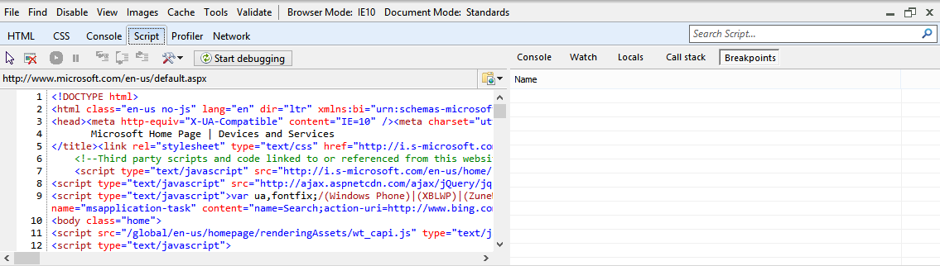
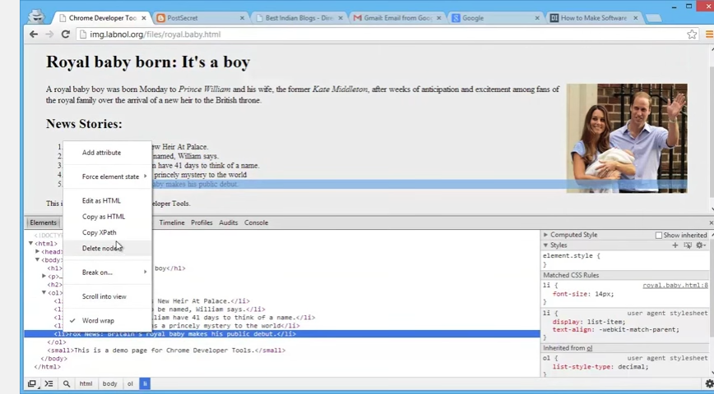
7.1-Tools to identify elements/objects
What is the Elements/objects on a web-page.
When you land on a website, all the items you see in front of you -- the paragraph texts, the page banners, and the navigation links are all elements of the web page. The term element is a just a name given to any piece of a web page. Many HTML elements are actually invisible to visitors and work quietly behind the scenes to provide web crawlers and search engines useful information about the site.
A web page has following kind of web-elements:-
Link , TextArea , Inputbox,Label,Button,Listbox,Checkbox,Optionbox,DropDown etc
In Selenium Webdriver, we need to find elements before performing action on them. We need to use following tools to find the elements on the page:-
1-Firebug- Firebug integrates with Firefox to put a wealth of web development tools at your fingertips while you browse. You can edit, debug, and monitor CSS, HTML, and JavaScript live in any web page. The whole content of this page is taken from the https://getfirebug.com/html.Firepath
2-FirePath is a Firebug extension that adds a development tool to edit, inspect and generate XPath expressions and CSS3 Selectors.
How to setup Firebug and firepath
1. Open Firefox and open Google.com 2. Enter install firebug 3. You get this link fireBug 4. Open this link and click on Download Now button 5. Same way search for firepath 6. You get firepath 7. Download and install firepath
How to use firebug and firepath ? 1. Open any website and inspect element and check all properties get by firebug 2. Go to firepath and inspect element and get Xpath of that element
3- IE Developer tools-This is Internet Explorer too. The F12 tools is a suite of on-demand tools that is built into every installation of Windows Internet Explorer 9. F12 tools is available anytime, on any page, and enables website developers to quickly debug JavaScript, HTML, and Cascading Style Sheets (CSS), as well track down performance problems on a webpage or network.
4-The Chrome Developer Tools (DevTools for short), are a set of web authoring and debugging tools built into Google Chrome. The DevTools provide web developers deep access into the internals of the browser and their web application. Use the DevTools to efficiently track down layout issues, set JavaScript breakpoints, and get insights for code optimization. To access the DevTools-
Select the Chrome menu at the top-right of your browser window, then select Tools > Developer Tools.
Right-click on any page element and select Inspect Element.

Slide 68
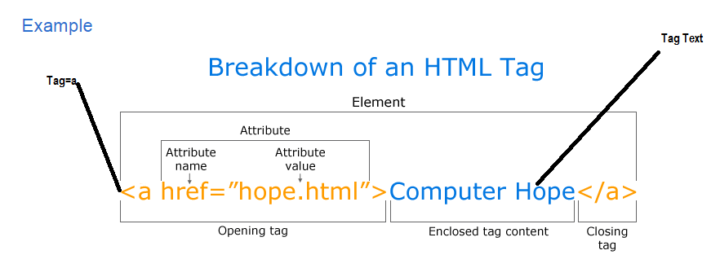
7.2.1-Locatoer Types in Selenium webdriver
What are Locators?
Locator is a command that tells Selenium IDE which GUI elements ( say Text Box, Buttons, Check Boxes etc) its needs to operate on. Identification of correct GUI elements is a prerequisite to creating an automation script.
HTML page Structures
Elements- When you land on a website, all the items you see in front of you -- the paragraph texts, the page banners, and the navigation links are all elements of the web page. The term element is a just a name given to any piece of a web page. Many HTML elements are actually invisible to visitors and work quietly behind the scenes to provide web crawlers and search engines useful information about the site.
Tag-A web browser reads an HTML document from top to bottom, left to right. Each time the browser finds a tag, the tag is rendered accordingly. Paragraph tags render paragraph text, image tags render images, etc. By adding tags to an HTML document, you are not only coding HTML, but also signaling to the browser, "Hey look, this is paragraph text; now treat it as such!“
Text-Text is the backbone of any web page. It plays an double role; it provides content for web surfers to enjoy as they skim through articles and articles of information, but it also gives Search Engines and Spiders keywords and meta data. It is because of text on web pages that we have a network of seemingly endless information available at our fingers.
Attributes-Web page customization begins with HTML attributes. Attributes are like blue print schematics informing the browser how to render an HTML element. As an HTML tag is processed, the web browser looks to these attributes as guides for the construction of web elements. Without any attribute values specified, the browser will render the element using the default setting(s) (usually very boring).
http://htmldog.com/guides/html/beginner/tags/

Slide 69
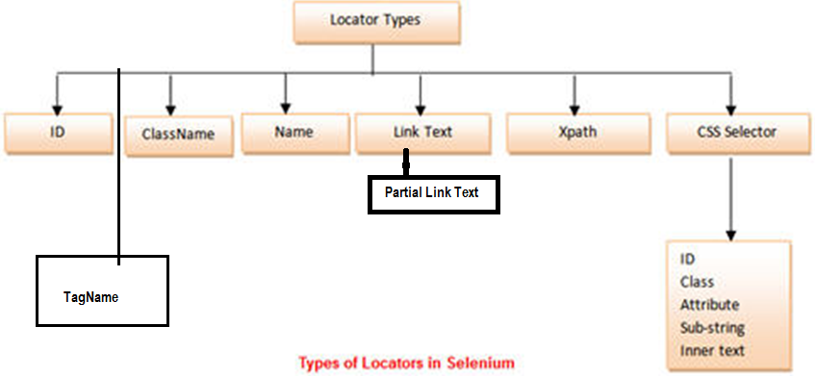
7.2.2-Locatoer Types in Selenium webdriver
Types of Locators-
Every Selenium command requires locators to find the web elements. Thus, to identify these web elements accurately and precisely we have different types of locators.
Selenium Web-Driver uses 8 locators to find the elements on web page. The following are the list of object identifier or locators supported by selenium.
Now let’s understand further by exercising each of them independently:-

Slide 70
7.2.3-Locatoer Types in Selenium webdriver
id - Select element with the specified @id attribute.
Ex- id=submit
HTML-<a id="submit" name="Submit" class="name" href="https://mail.google.com/" value="Gmail">submit</a>
driver.findElement(By.id("submit")).click();
Name - Select first element with the specified @name attribute.
Ex- name=submit
HTML-<a id="submit" name="Submit" class="name" href="https://mail.google.com/" value="Gmail">submit</a>
driver.findElement(By.name(“Submit")).click();
Linktext - Select link (anchor tag) element which contains text matching the specified link text
Ex- linText=submit
HTML-<a id="submit" name="Submit" class="name" href="https://mail.google.com/" value="Gmail">submit</a>
driver.findElement(By.linkText("submit")).click();
Partial Linktext - Select link (anchor tag) element which contains text matching the specified partial link text
Ex- partialLinkText=submit
HTML-<a id="submit" name="Submit" class="name" href="https://mail.google.com/" value="Gmail">submit</a>
driver.findElement(By.partialLinkText("submit"));
Tag Name - Locate Element using a Tag Name .
Ex- tagName=a
HTML-<a id="submit" name="Submit" class="name" href="https://mail.google.com/" value="Gmail">submit</a>
driver.findElement(By.tagName("a"));
6. Class name - Locate Element using a Class Name ..
Ex-class=name
HTML-<a id="submit" name="Submit" class="name" href="https://mail.google.com/" value="Gmail">submit</a>
driver.findElement(By.className("name"));

Slide 71
7.2.4-Locatoer Types in Selenium webdriver
7-Locating by CSS Selector-
CSS Selectors are string patterns used to identify an element based on a combination of HTML tag, id, class, and attributes. Locating by CSS Selector is more complicated than the previous methods, but it is the most common locating strategy of advanced Selenium users because it can access even those elements that have no ID or name.
CSS Selectors have many formats, but we will only focus on the most common ones.
Tag and ID
Tag and class
Tag and attribute
Tag, class, and attribute
Inner text
1-Locating by CSS Selector - Tag and ID
Syntax- css=tag#id
tag = the HTML tag of the element being accessed
# = the hash sign. This should always be present when using a CSS Selector with ID
id = the ID of the element being accessed
Ex:-
HTML-<Input id="submit" name="Submit" class="name" href="https://mail.google.com/" value="Gmail">submit</a>
Ex- css=input#submit
driver.findElement(By.cssSelector(“input#submit")).click();
2-Locating by CSS Selector - Tag and Class
Syntax- css=tag.class
tag = the HTML tag of the element being accessed
. = the dot sign. This should always be present when using a CSS Selector with class
class = the class of the element being accessed
Ex:-
HTML-<Input id="submit" name="Submit" class="name" href="https://mail.google.com/" value="Gmail">submit</a> Ex- css=input.name
driver.findElement(By.cssSelector("input.name")).click()

Slide 72
7.2.5-Locatoer Types in Selenium webdriver
3-Locating by CSS Selector - Tag and Attribute
Syntax- css=tag[attribute=value]
tag = the HTML tag of the element being accessed
[ and ] = square brackets within which a specific attribute and its corresponding value will be placed
attribute = the attribute to be used. It is advisable to use an attribute that is unique to the element such as a name or ID.
value = the corresponding value of the chosen attribute.
Ex:-
HTML-<Input id="submit" name="Submit" class="name" href="https://mail.google.com/" value="Gmail">submit</a>
Ex-css=input[name=Submit]
driver.findElement(By.cssSelector("input[name=Submit]")).click()
4-Locating by CSS Selector - tag, class, and attribute
Syntax- css=tag.class[attribute=value]
tag = the HTML tag of the element being accessed
. = the dot sign. This should always be present when using a CSS Selector with class
class = the class of the element being accessed
[ and ] = square brackets within which a specific attribute and its corresponding value will be placed
attribute = the attribute to be used. It is advisable to use an attribute that is unique to the element such as a name or ID.
value = the corresponding value of the chosen attribute.
Ex:-
HTML-<Input id="submit" name="Submit" class="name" href="https://mail.google.com/" value="Gmail">submit</a>
Ex-css=input.name[name=Submit]
driver.findElement(By.cssSelector(“input.name[name=Submit]")).click()

Slide 73
7.2.6-Locatoer Types in Selenium webdriver
5-Locating by CSS Selector - inner text
Syntax-css=tag:contains("inner text")
tag = the HTML tag of the element being accessed
inner text = the text of the element
Ex:-
HTML-<Input id="submit" name="Submit" class="name" href="https://mail.google.com/" value="Gmail">submit</a>
Ex-css=input:contains(“submit:")
driver.findElement(By.cssSelector("input:contains(“submit:“))).click()

Slide 74
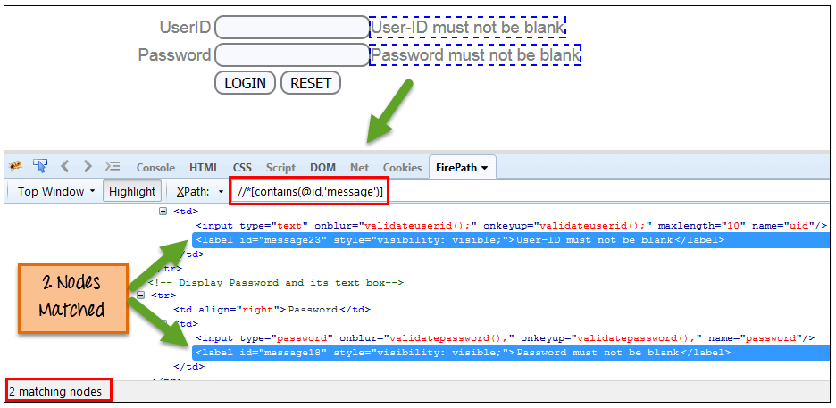
7.2.7-Locatoer Types in Selenium webdriver
Locating by Xpath
XPath is the language used when locating XML (Extensible Markup Language) nodes.
XPath is defined as XML path. It is a syntax or language for finding any element on the web page using XML path expression. XPath is used to find the location of any element on a webpage using HTML DOM structure.
Advantage: It can access almost any element, even those without class, name, or id attributes.
Disadvantage: It is the most complicated method of identifying elements because of too many different rules and considerations.
Syntax:-
//*[contains[@id,’message’]]

Slide 75
7.2.8-Locatoer Types in Selenium webdriver
Types of X-path-
There are two types of XPath:
Application-https://www.google.co.in/
Element- Sign in
1) Absolute XPath - html/body/div[1]/div[3]/div[1]/div/div/div/div[2]/div[3]/div/a
2) Relative XPath - .//a[contains(text(),'Sign in')]
Absolute XPath :-
Absolute XPath starts with the root node or a forward slash (/).
The advantage of using absolute is, it identifies the element very fast.
Disadvantage here is, if any thing goes wrong or some other tag added in between, then this path will no longer works.
Example:
If the Path we defined as 1. html/head/body/table/tbody/tr/th
If there is a tag that has added between body and table as below
2. html/head/body/form/table/tbody/tr/th
The first path will not work as 'form' tag added in between
Relative Xpath A relative xpath is one where the path starts from the node of your choise - it doesn't need to start from the root node.
It starts with Double forward slash(//)
Syntax: //table/tbody/tr/th
Advantage of using relative xpath is, you don't need to mention the long xpath, you can start from the middle or in between.
Disadvantage here is, it will take more time in identifying the element as we specify the partial path not (exact path).
If there are multiple elements for the same path, it will select the first element that is identified

Slide 76
7.2.9-Locatoer Types in Selenium webdriver
What are XPath axes.
XPath axes search different nodes in XML document from current context node. XPath Axes are the methods used to find dynamic elements, which otherwise not possible by normal XPath method having no ID , Classname, Name, etc.
Axes methods are used to find those elements, which dynamically change on refresh or any other operations. There are few axes methods commonly used in Selenium Webdriver like child, parent, ancestor, sibling, preceding, self, etc.
1) Basic XPath:
XPath expression select nodes or list of nodes on the basis of attributes like ID , Name, Classname, etc. Example:-
Xpath=//input[@type='text']
Xpath= //label[@id='message23']
Xpath= //input[@value='RESET']
Xpath=//*[@class='barone']
Xpath=//a[@href='http://demo.guru99.com/']
Xpath= //img[@src='//cdn.guru99.com/images/home/java.png']
2) Contains() : Contains() is a method used in XPath expression. It is used when the value of any attribute changes dynamically, for example, login information.
The contain feature has an ability to find the element with partial text as shown in below example.
Xpath=//*[contains(@type,'sub')]
Xpath=.//*[contains(@name,'btn')]
Xpath=//*[contains(@id,'message')]
Xpath=//*[contains(text(),'here')]
Xpath=//*[contains(@href,'guru99.com')]
3) Using OR & AND:
In OR expression, two conditions are used, whether 1st condition OR 2nd condition should be true. It is also applicable if any one condition is true or maybe both. Means any one condition should be true to find the element.
In the below XPath expression, it identifies the elements whose single or both conditions are true.
Xpath=//*[@type='submit' OR @name='btnReset']
Xpath=//input[@type='submit' AND @name='btnLogin']

Slide 77
7.2.10-Locatoer Types in Selenium Web-Driver
4) Start-with function: Start-with function finds the element whose attribute value changes on refresh or any operation on the webpage. In this expression, match the starting text of the attribute is used to find the element whose attribute changes dynamically. You can also find the element whose attribute value is static (not changes).
For example -: Suppose the ID of particular element changes dynamically like:
Id=" message12“
Id=" message345“
Id=" message8769“
Ex-
Xpath=//label[starts-with(@id,'message')]
Xpath=//a[starts-with(@name,'Sign in')]
5) Text(): In this expression, with text function, we find the element with exact text match.
Xpath=//td[text()='UserID']
Xpath=//a[starts-with(text(),'Sign in')]
XPath axes methods-
These XPath axes methods are used to find the complex or dynamic elements. Below we will see some of these methods.
1) Following: It contains all nodes which occur after the context node, in document order
Xpath=//*[@type='text']//following::input[1]
2) Ancestor:The ancestor axis selects all ancestors element (grandparent, parent, etc.) of the current node.
Xpath=//*[text()='Enterprise Testing']//ancestor::div
3) Child : Selects all children elements of the current node
Xpath=//*[@id='java_technologies']/child::li
4) Preceding: Select all nodes that come before the current node
Xpath=//*[@type='submit']//preceding::input

Slide 78
7.2.11-Locatoer Types in Selenium Web-Driver
5) Following-sibling: Select the following siblings of the context node. Siblings are at the same level of the current node.
xpath=//*[@type='submit']//following-sibling::input
5) Preceding-sibling : Select the following siblings of the context node. Siblings are at the same level of the current node.
xpath=//*[@type='submit']//preceding-sibling ::input
6) Parent: It Contains the parent of the context node if it has one
Xpath=//*[@id='rt-feature']//parent::div
7) Self: Selects the current node or 'self' means it indicates the node itself
Xpath =//*[@type='password']//self::input
8) Descendant: It contains the children of the context node, the children of those children, etc.
Xpath=//*[@id='rt-feature']//descendant::a[1]
Few Examples:-
1-Find nth number in case of similar xpath
(.//span[@id='sideBar']/ul//li//a)[2]
(//span[contains(text(), 'Cancel All')])[1]
2-xpath contains text for commnet teg-
//text()[contains(., 'Author test')]
3-Sibblings-
.//span[contains(text(),'Collection')]/following-sibling::select
.//span[contains(text(),'Collection')]/preceding-sibling::select
4-Signle-Tag-xpth-
//div[@class="dpBibTitle"][contains(.,'0 of 1 copies available; 0 on hold')]
//div[@class='recordHighlight']//a[contains(text(),'T')]/ancestor::div[@class='record']//div[@class='recordCart']/a[1]

Slide 79
7.2.12-Locatoer Types in Selenium Web-Driver
5-Nearast parent
//span[contains(text(),'T1A')]/ancestor::div[1]
//tbody//tr[1]/td[5]/div[starts-with(text(),'1')]
6-Xapth with Mulitples chckes
//div[(@class = "gridBrowseContent2 searchResult")]/div[2]/div[2]/div[4][contains(., 'Available Online')]/ancestor::div[contains(@class, 'gridBrowseContent2 searchResult')]/div[2]/div[2]/span[1]/a
7-Click on Be the First Review link where Request it button is available
.//a[contains(.,'Request it')]/ancestor::div[@class='gridBrowseCol1']/following-sibling::div//a[contains(text(),'Be the first')]
8-Click on Request it button where Be the First Review link is available
//a[contains(text(),'see all')]/ancestor::div[@class='gridBrowseCol2']/preceding-sibling::div//a[contains(.,'Request it')]
9-Click on Request it button where See all link is available
//a[contains(text(),'see all')]/ancestor::div[@class='gridBrowseCol2']/preceding-sibling::div//a[contains(.,'Request it')]
10-Click on 5th Request it button where See all link is available
(//a[contains(text(),'see all')]/ancestor::div[@class='gridBrowseCol2']/preceding-sibling::div//a[contains(.,'Request it')])[5]
11-Click on Request it button where See all link and Be the first Review link is available
//a[contains(text(),'see all')]/ancestor::div[@class='ItemsContainer']/following-sibling::div[@class='ratingReviewsSummary']//a[contains(text(),'Be the first')]/ancestor::div[@class='gridBrowseCol2']/preceding-sibling::div//a[contains(.,'Request it')]
9-Click on Add to review button where See all link is available
//a[contains(text(),'see all')]/ancestor::div[@class='gridBrowseCol2']/preceding-sibling::div//img[@title='Add a Review']

Slide 80
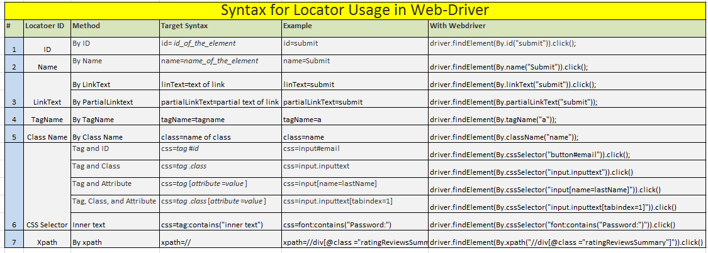
7.2.13-Locatoer Types in Selenium Web-Driver
Xpath VS CSS selectors
— Css Selctors method is faster — Browsers them selves use css selectors — Latest browsers optimize the use of css selctors.
–Xpath – Cummon language for xml/html parsing –Xpath is a two way search mechanism (up and down the Dom tree) –Xpath handles the text recognition better.
-XPATH can traverse up the document from a child element to parents but CSS not

Slide 81
8- Advanced Web-Driver
8.1-Exception in WebDriver
8.2-Different Wait in Web-Driver
8.3-Adanced Elements Handling
8.4-Action Class in Web-Driver
8.5-Handling Alert and Windows

Slide 82
8.1-Exception in Web-Driver
Selenium Exceptions
Selenium has its own set of exceptions. While developing selenium scripts, programmer has to handle or throw those exceptions. Below are types of exceptions in selenium:-
1-NoSuchElementException
2-ElementNotVisibleException
3-NoSuchFrameException
4-NoAlertPresentException
5-NoSuchWindowException
6-WebDriverException
7-SessionNotFoundException
8-StaleElementReferenceException
1-NoSuchElementException:
This exception occurs when WebDriver is unable to identify the elements during run time. Due to wrong selector or selector, which is, not exist.
1-Exmaple:-
public void findSearchTextBox() throws IOException { By incorrectSearchTextBoxLocator = By.xpath("//input[@id='globalQuery1']"); driver.get("http://www.vpl.ca"); try { WebElement searchField = driver.findElement(incorrectSearchTextBoxLocator); } catch(NoSuchElementException exception) { openLog(); addToLog(exception.getMessage()); } finally { closeLog(); fail("search text box not found"); } }

Slide 83
8.1.2-Exception in Web-Driver
3-NoSuchFrameException
This Exception occurs when the driver is switching to an invalid frame, which is not available.
3-Exmaple:-
public void findSearchTextBox() throws IOException { By incorrectSearchTextBoxLocator = By.id(“hiddenid"); driver.get("http://www.vpl.ca"); try { WebElement searchField = driver.findElement(incorrectSearchTextBoxLocator);
driver.switchTo().frame(invalidindex);
} catch(NoSuchFrameException exception) { openLog(); addToLog(exception.getMessage()); } finally { closeLog(); fail("search text box not found"); } }
2-ElementNotVisibleException
This Exception occurs when the element presence is in DOM, it is not visible.
Hidden Elements, which has presence in DOM and it, is not visible. Visibility means the height and width should be greater than zero. Hidden Elements are defined in HTML using of type=”hidden”.
2-Exmaple:-
public void findSearchTextBox() throws IOException { By incorrectSearchTextBoxLocator = By.id(“hiddenid"); driver.get("http://www.vpl.ca"); try { WebElement searchField = driver.findElement(incorrectSearchTextBoxLocator); } catch(ElementNotVisibleException exception) { openLog(); addToLog(exception.getMessage()); } finally { closeLog(); fail("search text box not found"); } }

Slide 84
8.1.3-Exception in Web-Driver
4-NoAlertPresentException
This Exception occurs when the driver is switching to an invalid Alert, which is not available.
4-Exmaple:-
public void findSearchTextBox() throws IOException { By incorrectSearchTextBoxLocator = By.id(“hiddenid"); driver.get("http://www.vpl.ca"); try { WebElement searchField = driver.findElement(incorrectSearchTextBoxLocator);
driver.switchTo().alert().accept();
//Execute this command on browser without invoking the alert } catch(ElementNotVisibleException exception) { openLog(); addToLog(exception.getMessage()); } finally { closeLog(); fail("search text box not found"); } }
5-NoSuchWindowException
This Exception occurs when the driver is switching to an invalid Window, which is not available.
5-Exmaple:-
public void findSearchTextBox() throws IOException { By incorrectSearchTextBoxLocator = By.id(“hiddenid"); driver.get("http://www.vpl.ca"); try { WebElement searchField = driver.findElement(incorrectSearchTextBoxLocator);
driver.switchTo().window("invalidwindowname"); } catch(NoSuchFrameException exception) { openLog(); addToLog(exception.getMessage()); } finally { closeLog(); fail("search text box not found"); } }

Slide 85
8.1.4-Exception in Web-Driver
6-SessionNotFoundException
This Exception occurs when the driver is performing the action after immediately quitting the browser. Example:-
6-Exmaple:-
public void findSearchTextBox() throws IOException { By incorrectSearchTextBoxLocator = By.id(“hiddenid"); driver.get("http://www.vpl.ca"); try { WebElement searchField = driver.findElement(incorrectSearchTextBoxLocator);
driver.quit(); driver.findElement(By.id("username")).sendKeys("Mukesh");
} catch(SessionNotFoundException exception) { openLog(); addToLog(exception.getMessage()); } finally { closeLog(); fail("search text box not found"); } }
7-WebDriverException
This Exception occurs when the driver is performing the action after immediately closing the browser.
7-Exmaple:-
public void findSearchTextBox() throws IOException { By incorrectSearchTextBoxLocator = By.id(“hiddenid"); driver.get("http://www.vpl.ca"); try { WebElement searchField = driver.findElement(incorrectSearchTextBoxLocator);
driver.close();
driver.findElement(By.id("username")).sendKeys("Mukesh");
} catch(WebDriverException exception) { openLog(); addToLog(exception.getMessage()); } finally { closeLog(); fail("search text box not found"); } }

Slide 86
8.1.5-Exception in Web-Driver
8-StaleElementReferenceException
This Exception occurs when the Element belongs to a different frame than the current one. The user has navigated away to another page.
8-Exmaple:-
public void findSearchTextBox() throws IOException { By incorrectSearchTextBoxLocator = By.id(“hiddenid"); driver.get("http://www.vpl.ca"); try { WebElement searchField = driver.findElement(incorrectSearchTextBoxLocator);
WebElement element=driver.findElement(By.id("username"));// Element is available in parent window
driver.switchTo().window(Child_Window);//Switch to Child Window
element.sendKeys("Mukesh");//perform the action on the element which is not visible in the child window
} catch(StaleElementReferenceException exception) { openLog(); addToLog(exception.getMessage()); } finally { closeLog(); fail("search text box not found"); } }

Slide 87
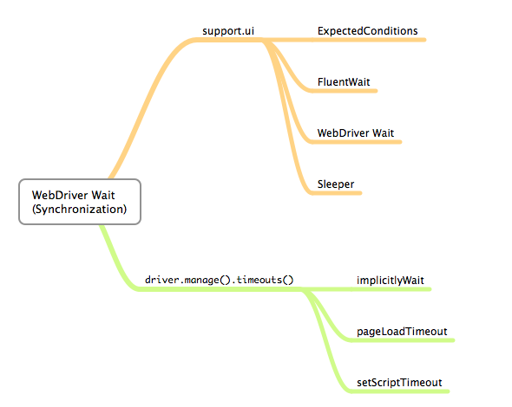
8.2-Different Wait in Web-Driver
Why Do We Need Waits In Selenium?
Most of the web applications are developed using Ajax and Javascript. When a page is loaded by the browser the elements which we want to interact with may load at different time intervals.
Not only it makes this difficult to identify the element but also if the element is not located it will throw an "ElementNotVisibleException" exception. Using Waits, we can resolve this problem.
Let's consider a scenario where we have to use both implicit and explicit waits in our test. Assume that implicit wait time is set to 20 seconds and explicit wait time is set to 10 seconds.
Different Waits in Web Driver
A-WebDriver.manage().timeouts()
1-Implicit Wait
2-pageLoadTimeout
3- setScriptTimeout
B-Explicit Wait
4-Expected Conditions
5-Fluent Wait
6-Thread.Sleep

Slide 88
8.2.3-Different Wait in Web-Driver
1-Implicit Wait
Implicit waits are used to provide a default waiting time (say 30 seconds) between each consecutive test step/command across the entire test script. Thus, subsequent test step would only execute when the 30 seconds have elapsed after executing the previous test step/command.
Key Notes
Implicit wait is a single line of a code and can be declared in the setup method of the test script.
When compared to Explicit wait, Implicit wait is transparent and uncomplicated. The syntax and approach is simpler than explicit wait.
Being easy and simple to apply, implicit wait introduces a few drawbacks as well. It gives rise to the test script execution time as each of the command would be ceased to wait for a stipulated amount of time before resuming the execution.
Thus, in order to trouble shoot this issue, WebDriver introduces Explicit waits where we can explicitly apply waits whenever the situation arises instead of forcefully waiting while executing each of the test step.
Import Statements
import java.util.concurrent.TimeUnit – To be able to access and apply implicit wait in our test scripts, we are bound to import this package into our test script.
Syntax drv.manage().timeouts().implicitlyWait(10, TimeUnit.SECONDS);
2-pageLoadTimeout
Sets the amount of time to wait for a page load to complete before throwing an error. If the timeout is negative, page loads can be indefinite.
Syntax driver.manage().timeouts().pageLoadTimeout(100, SECONDS);
3-setScriptTimeout
Sets the amount of time to wait for an asynchronous script to finish execution before throwing an error. If the timeout is negative, then the script will be allowed to run indefinitely
Syntax driver.manage().timeouts().setScriptTimeout(100,SECONDS);

Slide 89
8.2.4-Different Wait in Web-Driver
4-Expected Condition
Explicit waits are used to halt the execution till the time a particular condition is met or the maximum time has elapsed. Unlike Implicit waits, Explicit waits are applied for a particular instance only.
WebDriver introduces classes like WebDriverWait and ExpectedConditions to enforce Explicit waits into the test scripts. In the ambit of this discussion, we will use “gmail.com” as a specimen
Object Instantiation for WebDriverWait class
WebDriverWait wait = new WebDriverWait(drv,30);
We create a reference variable “wait” for WebDriverWait class and instantiate it using WebDriver instance and maximum wait time for the execution to layoff. The maximum wait time quoted is measured in “seconds”.
wait.until(ExpectedConditions.visibilityOfElementLocated(By.xpath("//div[contains(text(),'COMPOSE')]"))); drv.findElement(By.xpath("//div[contains(text(),'COMPOSE')]")).click();
The above command waits for a stipulated amount of time or an expected condition to occur whichever occurs or elapses first.
Thus to be able to do this, we use the “wait” reference variable of WebDriverWait class created in the previous step with ExpectedConditions class and an actual condition which is expected to occur. Therefore, as soon as the expected condition occurs, the program control would move to the next execution step instead of forcefully waiting for the entire 30 seconds.
In our specimen, we wait for the “compose” button to be present and loaded as a part of home page load and thus, then we move forward with calling the click command on the “compose” button.
Types of Expected Conditions
ExpectedConditions class provides a great help to deal with scenarios where we have to ascertain for a condition to occur before executing the actual test step.
ExpectedConditions class comes with a wide range of expected conditions that can be accessed with the help of the WebDriverWait reference variable and until() method.

Slide 90
8.2.5-Different Wait in Web-Driver
Types of Expected Conditions
#1) elementToBeClickable() – The expected condition waits for an element to be clickable i.e. it should be present/displayed/visible on the screen as well as enabled.
Sample Code wait.until(ExpectedConditions.elementToBeClickable(By.xpath(“//div[contains(text(),’COMPOSE’)]”)));
#2) textToBePresentInElement() – The expected condition waits for an element having a certain string pattern. Sample Code wait.until(ExpectedConditions.textToBePresentInElement(By.xpath(“//div[@id= ‘forgotPass'”), “text to be found”));
#3) alertIsPresent()- The expected condition waits for an alert box to appear.
Sample Code wait.until(ExpectedConditions.alertIsPresent()) !=null);
#4) titleIs() – The expected condition waits for a page with a specific title.
Sample Code wait.until(ExpectedConditions.titleIs(“gmail”));
#5) frameToBeAvailableAndSwitchToIt() – The expected condition waits for a frame to be available and then as soon as the frame is available, the control switches to it automatically.
6-elementSelectionStateToBe()
7-frameToBeAvaliableAndSwitchToIt()
8-invisibilityOfTheElementLocated()
9-invisibilityOfElementWithText()
10-presenceOfAllElementsLocatedBy()
11-presenceOfElementLocated()
12-textToBePresentInElementLocated()
13-textToBePresentInElementValue()
14-titleContains()
15-visibilityOf()
16-visibilityOfAllElements()
17-visibilityOfAllElementsLocatedBy()
18-visibilityOfElementLocated()

Slide 91
8.2.6-Different Wait in Web-Driver
5-Flaunt Wait
The fluent wait is used to tell the web driver to wait for a condition, as well as the frequency with which we want to check the condition before throwing an "ElementNotVisibleException" exception.
Fluent Wait uses two parameters – timeout value and polling frequency.
First of all, it sets the following values.
1- The maximum amount of time to wait for a condition, and
2- The frequency to check the success or failure of a specified condition.
Also, if you want to configure the wait to ignore exceptions such as <NoSuchElementException>, then you can add it to the Fluent Wait command syntax.
Below is a sample code which shows the implementation of Fluent Wait.
Wait wait = new FluentWait(driver)
.withTimeout(30, SECONDS)
.pollingEvery(5, SECONDS)
.ignoring(NoSuchElementException.class);
WebElement foo = wait.until(new Function() {
public WebElement apply(WebDriver driver) {
return driver.findElement(By.id("foo"));
}
})
Step By Step Analysis Of The Above Sample Code.
Step-1: Fluent Wait starts with capturing the start time to determine delay.
Step-2: Fluent Wait then checks the condition defined in the until() method.
Step-3: If the condition fails, Fluent Wait makes the application to wait as per the value set by the <pollingEvery(5, SECONDS)> method call. Here in this example, it’s 5 seconds.
Step-4: After the wait defined in Step 3 expires, start time is checked against the current time. If the difference of the wait start time (set in step-1) and the current time is less than the time set in <withTimeout(30, SECONDS)> method, then Step-2 will need to repeat.
The above steps will recur until either the timeout expires or the condition becomes true.

Slide 92
8.2.7-Different Wait in Web-Driver
6-Thread.Sleep
Thread.sleep() will stop the current (java) thread for the specified amount of time. It's done only once.
Thread.sleep() method is used to pause the for defined time. Time is defined in milliseconds for this method.
Thread.sleep(5000);
Difference between Implicit Wait and Explicit Wait
# | Implicit Wait | Explicit Wait
1 | Implicit Wait time is applied to all the elements in the script | Explicit Wait time is applied only to those elements which are intended by us
2 | In Implicit Wait, we need not specify "ExpectedConditions" on the element to be located | In Explicit Wait, we need to specify "ExpectedConditions" on the element to be located
3 | t is recommended to use when the elements are located with the time frame specified in implicit wait | It is recommended to use when the elements are taking long time to load and also for verifying the property of the element like(visibilityOfElementLocated, elementToBeClickable,elementToBeSelected)

Slide 93
8.3.1.Adanced Elements Handling
Below are the important commands to Handle object Dynamically:-
1-Actions Class –
In order to do action events, you need to use org.openqa.selenium.interactions.Actions class. The Action class is user-facing API for emulating complex user action events. You can directly use this class rather than using the input devices, i.e. Keyboard or Mouse. It Implements builder pattern, in which a complex object is constructed that can be further used to create different representation of same object. In below code, a complex object ‘builder’ is created, which is used to create different actions.
Here is the code snippet for using actions:
// Configure the Action Actions builder = new Actions(driver);
// To focus on element using webdriver builder .moveToElement(element).perform();
// To click on the element to focus builder.moveToElement(element).click().perform();
Perform method is used here to execute the action. The sequence of actions should be minimal. There are 2 types of actions: Keyboard and Mouse actions.
A-Keyboard Interactions using Actions API:
In keyboard interaction, normally we consider events such as scrolling the element and focusing on it. With the help of Action API, keyboard interactions are easier now. In Advanced User Interactions API, absolute interaction with element is possible either by clicking on element or sending a Keys.TAB before sending text. The Keyboard interface has three methods:
Void sendKeys(CharSequence… keysToSend) – Similar to the existing sendKeys() method in Webdriver
Void pressKey- Sends a key press only, without releasing it. Should only be implemented for modifier keys (Control, Alt and Shift)
Void releaseKey(Keys keyToRelease) – Releases a modifier key
Ex-
Actions action = new Actions(driver);
action.keyDown(Keys.CONTROL).sendKeys("a").keyUp(Keys.CONTROL).perform()

Slide 94
8.3.1.Adanced Elements Handling
B-Mouse Interactions using Actions API:
In mouse actions we use current location of the element as a standard. First action will be relative to the location of the standard element, the next action will be relative to the location of the mouse at the end of the last action, etc. The Mouse interface includes the following methods:
Void click (WebElement onElement): Simply click on element
Void double click (WebElement onElement): Double clicks onElement
Void mouseDown(WebElement onElement) : Holds down the left mouse button on an element
Void mouseUp(WebElement onElement) : Releases the mouse button on an element
Void mouseMove(WebElement onElement) : Move (from the current location ) to another element or Void mosueMove(WebElement onElement ,long xOffset, long yOffset ) : Move (from the current location) to new coordinates
Void contextClick(WebElement onElement) : Performs a context-click (right click) on an element
2-Scroll up and down
We can scroll the web page using javaScript Executor in the java code.We have taken the below example with three different scenarios of scrolling a webpage:-
1.We may require to scroll to bottom of the page and then perform operations. For this scenario we have created a test 'scrollingToBottomofAPage'/
((JavascriptExecutor) driver) .executeScript("window.scrollTo(0, document.body.scrollHeight)");
2. Some times, we may require to scroll to particular element and peform operations on that particular element. For this we need to pass the element on which we need to perform operation. For this scenario we have created a test 'scrollingToElementofAPage'/
((JavascriptExecutor) driver).executeScript( "arguments[0].scrollIntoView();", element);
3. We can also use the coordinates to scroll to particular position by passing the coordinates. For this scenario we have created a test 'scrollingByCoordinatesofAPage'/
((JavascriptExecutor) driver).executeScript("window.scrollBy(0,500)");

Slide 95
8.3.1.Adanced Elements Handling
3-Alert Handling
Alert is a small message box which displays on-screen notification to give the user some kind of information or ask for permission to perform certain kind of operation. It may be also used for warning purpose.
Here are few alert types:
1) Simple Alert
This simple alert displays some information or warning on the screen.
2) Prompt Alert.
This Prompt Alert asks some input from the user and selenium webdriver can enter the text using sendkeys(" input….
3) Confirmation Alert.
This confirmation alert asks permission to do some type of operation.
How to handle Alert in Selenium WebDriver
Alert interface provides the below few methods which are widely used in Selenium Webdriver.
1) void dismiss() // To click on the 'Cancel' button of the alert.
driver.switchTo().alert().dismiss();
2) void accept() // To click on the 'OK' button of the alert.
driver.switchTo().alert().accept();
3) String getText() // To capture the alert message.
driver.switchTo().alert().getText();
4) void sendKeys(String stringToSend) // To send some data to alert box.
driver.switchTo().alert().sendKeys("Text");
You can see a number of Alert methods are displayed as shown in below screen suggested by Eclipse.
We can easily switch to alert from the main window by using Selenium's .switchTo() method.

Slide 96

8.3.1.Adanced Elements Handling
4-Window Handling
Dealing with multiple windows in Automation Testing has always been a little tricky and require an extra effort.
Before commencing, let us first consider a few situations when we are likely to deal with multiple windows.
Filling forms may require to select the date from a separately opened window.
Clicking on some link/button can kick-off yet another window.
Handling Advertisement windows
Hence, we can come up with various scenarios depending upon the application.
Now let us motion ourselves towards the challenge we face under above situations. The most particular of all is switching the focus from one window to another. Let us understand the same in the following way:
Comprehending from the above figure, the entire process can be fundamentally segregated into following steps:
Step 1 : Clicking on Link1 on Window A
A new Window B is opened.
Step 2 : Move Focus from Window A to Window B
Window B is active now
Step 3 : Perform Actions on Window B
Complete the entire set of Actions
Step 4 : Move Focus from Window B to Window A
Window A is active now
//Get Windoes Hanldes command and Switch to child window-
String winHandleBefore = driver.getWindowHandle();
for (String winHandle : driver.getWindowHandles())
{
// Switch to child window
driver.switchTo().window(winHandle);
}
Thread.sleep(3000);
WebElement admin= driver.findElement(By.xpath(".//*[@id='hmenue']//a[contains(text(),'Admissions')]"));
admin.click();
Thread.sleep(5000);
//Close the Child winodw and go to the parent-3
driver.close();
driver.switchTo().window(winHandleBefore);
WebElement results= driver.findElement(By.xpath(" .//*[@id='hmenue']//a[contains(text(),'Results')]"));
results.click();
Thread.sleep(5000);

Slide 97
8.3.1.Adanced Elements Handling
5-Page Source Command-
driver.get("http://puchd.ac.in/");
Thread.sleep(2000);
if(driver.getPageSource().contains("Established in 1882 as University"))
{
System.out.println(" Text is persent");
}
else
{
System.out.println(" Text is not persent");
}
6-List box-
driver.navigate().to("file:///C:/Ashu%20Folder/Actions_Examples/Lisrbox/list-box.html");
Thread.sleep(5000);
WebElement val=driver.findElement(By.xpath(".//*[@id='selenium_commands']"));
((JavascriptExecutor) driver).executeScript("arguments[0].scrollIntoView();", val);
Select s=new Select(val);
List<WebElement> allvals=s.getOptions();
for(int i=0;i<allvals.size();i++)
{
Thread.sleep(1000);
System.out.println("CheckBox:"+ allvals.get(i).getAttribute("value"));
s.selectByIndex(i); //select one by one
}
s.deselectAll();
s.selectByIndex(0);
s.selectByIndex(1);

Slide 98
8.3.1.Adanced Elements Handling
7-DropDownbox
driver.navigate().to("file:///C:/Ashu%20Folder/Actions_Examples/Lisrbox/list-box.html");
Thread.sleep(5000);
WebElement va2=driver.findElement(By.xpath(".//*[@id='continents']"));
((JavascriptExecutor) driver).executeScript("arguments[0].scrollIntoView();", va2);
Select s1=new Select(va2);
//List<WebElement> allvals1=s1.getOptions();
for(int i=0;i<allvals1.size();i++)
{
Thread.sleep(1000);
System.out.println("CheckBox:"+ allvals1.get(i).getAttribute("value"));
s1.selectByIndex(i); //select one by one
}
s1.selectByIndex(0);
//s1.selectByValue("Africa");
s1.selectByVisibleText("Antartica");
8-Tooltips Verifications-13 ----------------------------
driver.get(Url_puch);
WebElement Admissions = driver.findElement(By.xpath("//a[text()='Admissions']"));
String attribute ="href";
String Actualattribute = Admissions.getAttribute(attribute);
System.out.println("Actual Attribute value:"+ Actualattribute);
String ExpectedAttribute="http://admissions.puchd.ac.in/";
System.out.println("Expecpted Attribute value:"+ ExpectedAttribute);
if(Actualattribute.equals(ExpectedAttribute))
{
System.out.println("Test Case is passed");
}
else
System.out.println("Test Case is failed");

Slide 99
8.3.1.Adanced Elements Handling
9-Auto suggest
driver.get("http://google.com");
WebElement textBoxElement = driver.findElement(By.id("lst-ib"));
textBoxElement.sendKeys("war");
WebElement wholist = driver.findElement(By.xpath("//ul[@role='listbox']"));
int indexToSelect =2;
try
{
wait.until(ExpectedConditions.visibilityOf(wholist));
List<WebElement> optionsToSelect = wholist.findElements(By.tagName("li"));
if(indexToSelect<=optionsToSelect.size())
{
System.out.println("Trying to select based on index: "+indexToSelect);
optionsToSelect.get(indexToSelect).click();
Thread.sleep(3000);
}
}
catch (NoSuchElementException e)
{
System.out.println(e.getStackTrace());
}
catch (Exception e)
{
System.out.println(e.getStackTrace());
}
10-count number of link on the page -15
driver.get(Url_puch);
List<WebElement> allLinkElements = driver.findElements(By.xpath("//a"));
int linkcount = allLinkElements.size();
System.out.println(linkcount);
for (int i=0;i<allLinkElements.size(); i++)
{
System.out.println("The number of link is :" +i + " = " + allLinkElements.get(i).getText());
}

Slide 100
8.3.1.Robat Class
In certain Selenium Automation Tests, there is a need to control keyboard or mouse to interact with OS windows like Download pop-up, Alerts, Print Pop-ups, etc. or native Operation System applications like Notepad, Skype, Calculator, etc.
Selenium Webdriver cannot handle these OS pop-ups/applications.
In Java version 1.3 Robot Class was introduced. Robot Class can handle OS pop-ups/applications.
Benefits of Robot Class
Robot Class can simulate Keyboard and Mouse Event
Robot Class can help in upload/download of files when using selenium web driver
Robot Class can easily be integrated with current automation framework (keyword, data-driven or hybrid)
Understanding Robot Class internal methods and usage
Robot Class methods can be used to interact with keyboard/mouse events while doing browser automation. Alternatively AutoIT can be used, but its drawback is that it generates an executable file (exe) which will only work on windows, so it is not a good option to use.
Some commonly and popular used methods of Robot Class during web automation:
1-keyPress(): Example: robot.keyPress(KeyEvent.VK_DOWN) : This method with press down arrow key of Keyboard
2-mousePress() : Example : robot.mousePress(InputEvent.BUTTON3_DOWN_MASK) : This method will press the right click of your mouse.
3-mouseMove() : Example: robot.mouseMove(point.getX(), point.getY()) : This will move mouse pointer to the specified X and Y coordinates.
4-keyRelease() : Example: robot.keyRelease(KeyEvent.VK_DOWN) : This method with release down arrow key of Keyboard
5-mouseRelease() : Example: robot.mouseRelease(InputEvent.BUTTON3_DOWN_MASK) : This method will release the right click of your mouse
Sample code to automate common use cases using Robot Class
Lets take example of web site http://spreadsheetpage.com/index.php/file/C35/P10/ wherein after you click on a web element (.//a[@href=contains(text(),'yearly-calendar.xls']) a O.S download pop-up appears.
To handle this we use Robot class (by creating an instance of Robot Class in your code say Robot robot = new Robot()) . Robot class us present in AWT package of JDK.
To press down arrow key of Keyboard we use (robot.keyPress(KeyEvent.VK_DOWN))
To press TAB key of keyboard (we use robot.keyPress(KeyEvent.VK_TAB))
To press Enter key we use (robot.keyPress(KeyEvent.VK_ENTER)).

Slide 101
8.3.1.Robat Class
In certain Selenium Automation Tests, there is a need to control keyboard or mouse to interact with OS windows like Download pop-up, Alerts, Print Pop-ups, etc. or native Operation System applications like Notepad, Skype, Calculator, etc.
Selenium Webdriver cannot handle these OS pop-ups/applications.
In Java version 1.3 Robot Class was introduced. Robot Class can handle OS pop-ups/applications.
Benefits of Robot Class
Robot Class can simulate Keyboard and Mouse Event
Robot Class can help in upload/download of files when using selenium web driver
Robot Class can easily be integrated with current automation framework (keyword, data-driven or hybrid)
Some commonly and popular used methods of Robot Class during web automation:
1-keyPress(): Example: robot.keyPress(KeyEvent.VK_DOWN) : This method with press down arrow key of Keyboard
2-mousePress() : Example : robot.mousePress(InputEvent.BUTTON3_DOWN_MASK) : This method will press the right click of your mouse.
3-mouseMove() : Example: robot.mouseMove(point.getX(), point.getY()) : This will move mouse pointer to the specified X and Y coordinates.
4-keyRelease() : Example: robot.keyRelease(KeyEvent.VK_DOWN) : This method with release down arrow key of Keyboard
5-mouseRelease() : Example: robot.mouseRelease(InputEvent.BUTTON3_DOWN_MASK) : This method will release the right click of your mouse
Sample code to automate common use cases using Robot Class
Lets take example of web site http://spreadsheetpage.com/index.php/file/C35/P10/ wherein after you click on a web element (.//a[@href=contains(text(),'yearly-calendar.xls']) a O.S download pop-up appears.
To handle this we use Robot class (by creating an instance of Robot Class in your code say Robot robot = new Robot()) . Robot class us present in AWT package of JDK.
To press down arrow key of Keyboard we use (robot.keyPress(KeyEvent.VK_DOWN))
To press TAB key of keyboard (we use robot.keyPress(KeyEvent.VK_TAB))
To press Enter key we use (robot.keyPress(KeyEvent.VK_ENTER)).
Example
Robot robot = new Robot();
Thread.sleep(2000); //
robot.keyPress(KeyEvent.VK_DOWN);
Thread.sleep(2000); //
robot.keyPress(KeyEvent.VK_TAB);

