Slide 1
Robotics Process Automation - Part-16

Slide 2
Table of Contents:-
27-Introduction to RPA

Slide 3
27-Introduction to RPA (Robotics Process Automation)

Slide 4
27-1.1-What is RPA
1-Robotics Process Automation
Robotic process automation (RPA) is the use of software with artificial intelligence (AI) and machine learning capabilities to handle high-volume, repeatable tasks that previously required a human to perform.
Symphony defines RPA as any capability (software and services) that allows you to transact in any IT application or website, typically in the same way a human would, to automate complex, rule-based work. In other words, RPA software allows developers to tailor complex automations to a company’s processes. When an RPA robot is at work, it performs tasks just like a human would: logging in, operating applications, entering data, performing complex calculations and logging out.
What Can RPA Do?
Because RPA is software-based, it can be used to perform various tasks. These include maintenance of records, queries, calculations, and transactions. Additionally, any application commonly used by your company can be operated by RPA. For example, Citrix, .NET, HTML, and Java are all technologies commonly supported by RPA. Compatible systems include Mainframe Terminals, SAP, Oracle, Blackline, and many more. Programmable automation means that RPA can be configured to perform almost any rule-based task.
Benefits of RPA
RPA can help digitally transform your business and unlock value by providing:-
Higher Quality Services: Better accuracy and better customer service.
Greater Compliance: Business processes can be set to operate in accordance with the necessary regulations and standards.
Increased Speed: Processes can be completed at unprecedented speeds.
Increased Agility: Reduced overhead and more flexible business resources.
Comprehensive Insights: Improved efficiency by digitizing and auditing process data.
Reduced Costs: Manual or repetitive tasks are carried out by RPA software at a fraction of the cost
Employee Experience: Increased staff productivity and reduced attrition.
All these factors can set your company apart from competitors and are highly valuable in terms of shaping your business’s digital operations strategy.

Slide 5
27-1.1-What is RPA
1-Robotics Process Automation
Robotic process automation (RPA) is the use of software with artificial intelligence (AI) and machine learning capabilities to handle high-volume, repeatable tasks that previously required a human to perform.
Symphony defines RPA as any capability (software and services) that allows you to transact in any IT application or website, typically in the same way a human would, to automate complex, rule-based work. In other words, RPA software allows developers to tailor complex automations to a company’s processes. When an RPA robot is at work, it performs tasks just like a human would: logging in, operating applications, entering data, performing complex calculations and logging out.
What Can RPA Do?
Because RPA is software-based, it can be used to perform various tasks. These include maintenance of records, queries, calculations, and transactions. Additionally, any application commonly used by your company can be operated by RPA. For example, Citrix, .NET, HTML, and Java are all technologies commonly supported by RPA. Compatible systems include Mainframe Terminals, SAP, Oracle, Blackline, and many more. Programmable automation means that RPA can be configured to perform almost any rule-based task.
Benefits of RPA
RPA can help digitally transform your business and unlock value by providing:-
Higher Quality Services: Better accuracy and better customer service.
Greater Compliance: Business processes can be set to operate in accordance with the necessary regulations and standards.
Increased Speed: Processes can be completed at unprecedented speeds.
Increased Agility: Reduced overhead and more flexible business resources.
Comprehensive Insights: Improved efficiency by digitizing and auditing process data.
Reduced Costs: Manual or repetitive tasks are carried out by RPA software at a fraction of the cost
Employee Experience: Increased staff productivity and reduced attrition.
All these factors can set your company apart from competitors and are highly valuable in terms of shaping your business’s digital operations strategy.

Slide 6
27-1.1-What is RPA
What distinguishes RPA from traditional IT automation-
1- RPA is software's ability to be aware and adapt to changing circumstances, exceptions and new situations. Once RPA software has been trained to to capture and interpret the actions of specific processes in existing software applications.
2- It can then manipulate data, trigger responses, initiate new actions and communicate with other systems autonomously. Large and small companies will be able to reap the benefits of RPA by expediting back-office and middle-office tasks.
RPA For Your Company-
RPA can be applied to all sorts of rules-based process in a wide range of sectors, including process automation of office tasks, IT support, and assisted automation in customer service. With such a variety of areas that RPA is known to be successful in, it’s no wonder that so many companies are taking advantage of the technology.
If you’re worried about RPA being able to suit your company’s needs, don’t be. Symphony has worked with clients across a wide range of industries including banking, healthcare, logistics, consumer products, food & beverage, entertainment and more; and on as wide a scope of processes as HR, Finance, Supply Chain, Procurement and beyond. So we can assure you that RPA easily translates to many different industries and functions.
Industries using the RPA are:-
Insurance
Finance
Procurement supply chain management (SCM)
Accounting
Customer relationship management (CRM)
Human resource management (HRM)

Slide 7
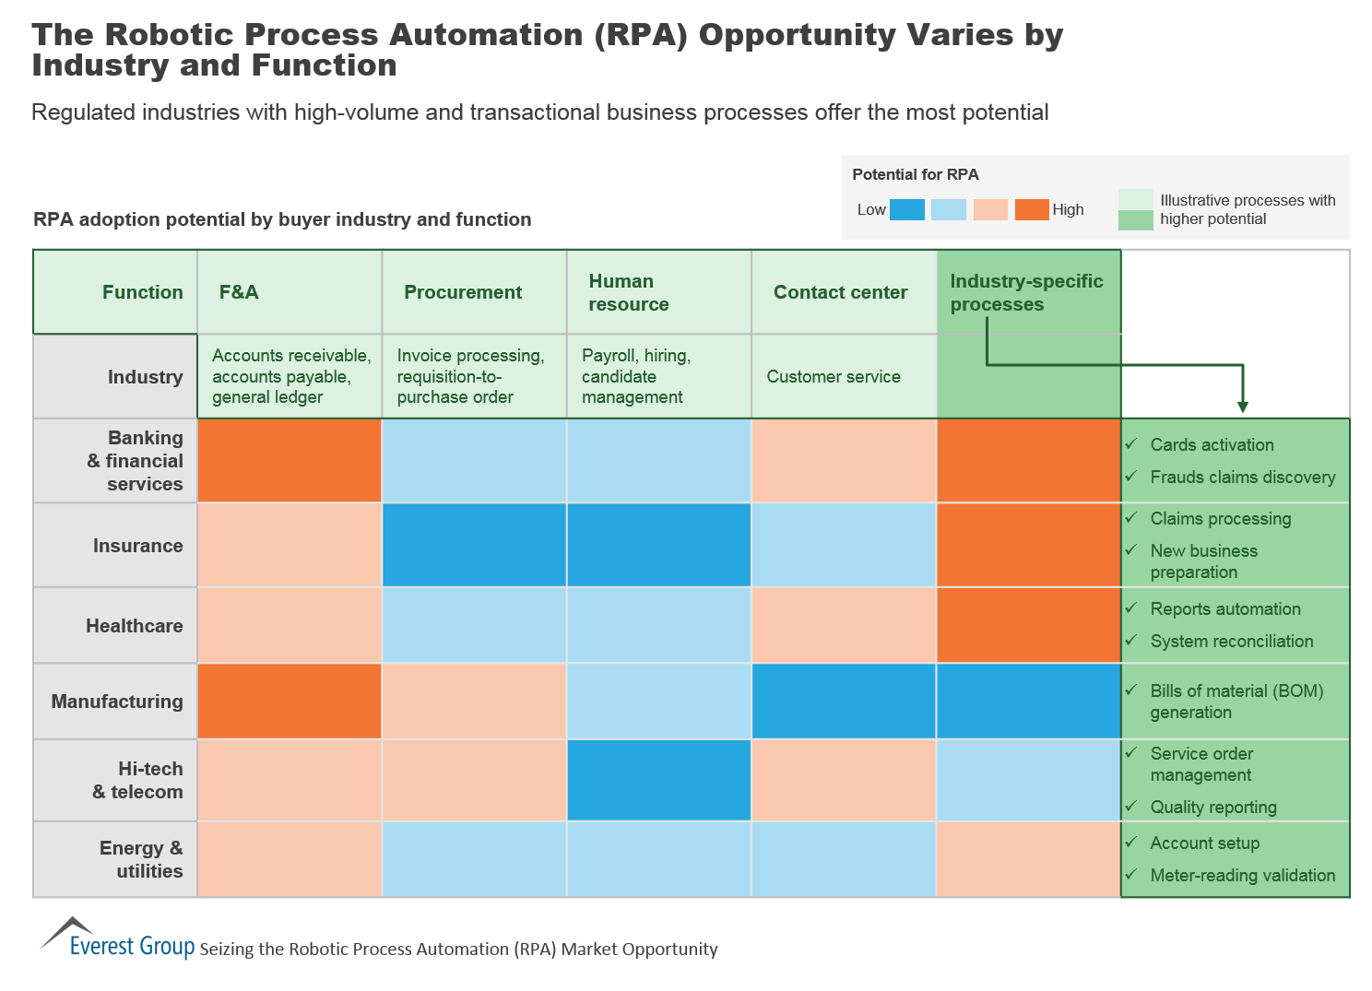
27-1.2-What is RPA
3-Industries using the RPA are:-

Slide 8
27-1.2-What is RPA
Four Industries that Robotic Process Automation is a Perfect Fit for-
As the concept of robotic process automation becomes better understood and more widely embraced, it will inevitably end up in just about every industry. For now, however, there are still certain fields for which RPA is ideal. Here are four such industries that we believe will ultimately revolution the way work is done through automation.
Banking/Finance
Banks and other financial institutions are already leveraging automation to handle many of their day to day functions, but given the ability of robotic process automation to integrate and bridge legacy systems, its adoption will only continue to rise. Not only can RPA make the lives of database administrators much easier, but it can dramatically cut costs at the same time by reducing and/or eliminating the need for human input in a growing number of functions.
Legal
If there was ever an industry that relied heavily on record keeping, legal would be at the top of the list. For this reason, robotic process automation is poised to make a huge impact. And while implementing RPA may be a bit more of an undertaking for the legal system, the outcome will be well worth it. Imagine using technology to sort through mountains of documentation in mere seconds as opposed to having a human worker handle such a time-consuming and labor-intensive task. Not to mention the enhanced analytics ability.
Insurance
Another awesome benefit of robotic process automation is its ability to maximize efficiency in fields that have an extremely high volume of transactions. This is why the insurance industry is such a great fit for RPA. Not only can automation revolutionize the claims process, but it can also save a good deal of money because of its scalability. As needs fluctuate, RPA can adapt instantaneously.
Utilities
Another transaction-heavy industry is that of utilities. Electric, gas and water companies can leverage RPA to automate a wide variety of routine tasks, from billing and debt recovery to meter-readings and even customer service. Additionally, instead of humans having to handle time-consuming duties like trouble-shooting failed readings, robotic process automation can tackle the majority of the work, drastically improving productivity.

Slide 9
27-1.2-What is RPA
RPA Today: What Are the Most Common Automated Processes?
It’s critical to select business processes to be the first candidates for automation that are the simple, repetitive ones. IRPA-AI recommends considering rule based processes that are labor intensive, standardized and with structured data. Processes that can be well-defined, utilize rote labor, doing repetitive tasks in very large volumes, like back office work, data entry, and certain help desk tasks are good candidates. In the IRPA-AI survey, companies who were “testing” or “thinking about implementing” RPA – i.e. those who are selecting their first candidates – identified.
The following as the processes to automate:
Finance
Core Business Operations
Procurement
Self Service Operations
Human Resources
Training and Development
Top Five Automated Processes
The following processes have been identified by organizations who have already implemented RPA.
1-Financial Operations – The repetitive processes of accounting, data entry and invoicing naturally lend themselves to automation. This is one of the primary reasons financial processes were the most commonly cited categories when asked both what processes were currently automated and what processes the company planned to automate in the future. [1] RPA can help companies automatically keep track of receipts, calculate taxes and pay invoices on time with minimal input from human workers. This can provide significant savings and improve efficiency across the organization.

Slide 10
27-1.2-What is RPA
RPA Today: What Are the Most Common Automated Processes?
2-Human Resources – HR departments have to keep track of a wide range of data for personnel across the entire company. New tools allow HR workers to rapidly track timesheets, store documents, calculate benefits, and issue onboarding information to employees. This makes it one of the most common targets of automation, with over 15% of respondents reporting that they have automated processes in HR and 13% saying that they planned to automate HR processes in the future.
3-Information Technology – IT may be responsible for delivering and supporting automation for business units, but many processes within IT itself can also be automated. Today, RPA can automatically diagnose and fix technical problems, track support tickets and even provide technical customer service such as password resetting and minor issue resolution. End-user automation tools can also automatically backup data, perform system maintenance and help the user when errors occur.
4-Procurement – Requisition approvals, MRO re-orders and invoice processing can all be substantially automated using RPA. This can streamline the procurement process and reduce dependency on large staffs while improving service to business units. This has made procurement the third highest ranked process that companies plan to automate, according to the 2017 IRPA study. [1]
5-Data and Analytics – An overarching capability of RPA is the automatic collection and analysis of data. In every area, automated tools can gather information about efficiency, issues and costs, allowing companies to iteratively improve processes and monitor performance. Many companies are realizing that this is one of the primary applications of RPA, allowing for more effective decision making guided by accurate information.
These are just some of processes that RPA is dramatically changing. As technological solutions continue to advance and a greater number of companies adopt these tools, an increasingly large portion of activities will be performed entirely through automation, dramatically reducing dependence on costly labor and increasing service efficiency. Those companies that continue to innovate and implement automation throughout their enterprise will be poised to capture a larger share of the market and meet business objectives in 2017 and beyond.

