Slide 1
Software Automation Testing- Part-2

Slide 2
Table of Contents:-
9-Introduction to Core Java-2
10-Introduction to TestNG Framework
11-Introduction to Apache Log4j API

Slide 3
9-Introduction to Core Java-2
9.1- Java - OOP Concepts
9.2- Java - Final, Static
9.3- Java Collections
9.4- Java – Files(txt,xml,exl) I/O
9.5- Java Threading

Slide 4
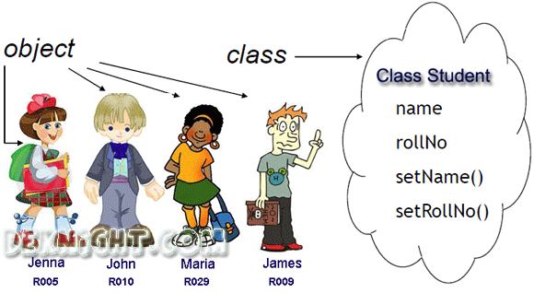
9.1.1-Java - OOP Concepts
Object means a real word entity such as pen, chair, table etc. Object-Oriented Programming is a methodology or paradigm to design a program using classes and objects. It simplifies the software development and maintenance by providing some concepts:
Object
Class
Inheritance
Polymorphism
Abstraction
Encapsulation
1- Object
Any entity that has state and behavior is known as an object. For example: chair, pen, table, keyboard, bike etc. It can be physical and logical and object has attributes,
2-Class
A class is a group of objects that has common properties. A class in java can contain:
Attributes

Slide 5
9.1.2-Java - OOP Concepts
Object in Java
Object is an instance of a class. Class is a template or blueprint from which objects are created. So object is the instance(result) of a class.
Creating an Object:
There are three steps for creating object from class.
Declaration: A variable declaration with a variable name with an object type.
Instantiation: The 'new' key word is used to create the object.
Initialization: The 'new' keyword is followed by a call to a constructor. This call initializes the new object.
Example - Student s1=new Student();//creating an object of Student
Class in Java
A class is a group of objects that has common properties. A class in java can contain:
Variables
Method
Variables in Java
A variable provides us with named storage that our programs can manipulate. Each variable in Java has a specific type, which determines the size and layout of the variable's memory; the range of values that can be stored within that memory; and the set of operations that can be applied to the variable
There are three kinds of Java variables:-
Local variables Instance variables Class/Static variables
1-Local variables -
Local variables are declared in methods, constructors, or blocks.
Local variables are created when the method, constructor or block is entered and the variable will be destroyed once it exits the method, constructor, or block.
Access modifiers cannot be used for local variables.
Local variables are visible only within the declared method, constructor, or block.
Local variables are implemented at stack level internally.
There is no default value for local variables, so local variables should be declared and an initial value should be assigned before the first use.
Example
public class Test {
public void pupAge() {
int age = 0;
age = age + 7;
System.out.println("Puppy age is : " + age);
}
public static void main(String args[]) {
Test test = new Test();
test.pupAge();
}}
Here, age is a local variable. This is defined inside pupAge() method and its scope is limited to only this method.
Output
Puppy age is: 7

Slide 6
9.1.3-Java - OOP Concepts
Example-2
import java.io.*;
public class Employee
{
// this instance variable is visible for any child class.
public String name;
// salary variable is visible in Employee class only.
private double salary;
// The name variable is assigned in the constructor.
public Employee (String empName)
{
name = empName;
}
// The salary variable is assigned a value.
public void setSalary(double empSal)
{
salary = empSal;
}
// This method prints the employee details.
public void printEmp()
{
System.out.println("name : " + name );
System.out.println("salary :" + salary);
}
public static void main(String args[])
{
Employee empOne = new Employee("Ransika");
empOne.setSalary(1000);
empOne.printEmp();
}
}
2-Instance Variables
Instance variables are declared in a class, but outside a method, constructor or any block.
When a space is allocated for an object in the heap, a slot for each instance variable value is created.
Instance variables are created when an object is created with the use of the keyword 'new' and destroyed when the object is destroyed.
Instance variables hold values that must be referenced by more than one method, constructor or block, or essential parts of an object's state that must be present throughout the class.
Instance variables can be declared in class level before or after use.
Access modifiers can be given for instance variables.
The instance variables are visible for all methods, constructors and block in the class. Normally, it is recommended to make these variables private (access level). However, visibility for subclasses can be given for these variables with the use of access modifiers.
Instance variables have default values. For numbers, the default value is 0, for Booleans it is false, and for object references it is null. Values can be assigned during the declaration or within the constructor.
Instance variables can be accessed directly by calling the variable name inside the class. However, within static methods (when instance variables are given accessibility), they should be called using the fully qualified name. ObjectReference.VariableName.
Output
name : Ransika
salary :1000.0

Slide 7
9.1.4-Java - OOP Concepts
3-Class/Static Variables
Class variables also known as static variables are declared with the static keyword in a class, but outside a method, constructor or a block.
There would only be one copy of each class variable per class, regardless of how many objects are created from it.
Static variables are rarely used other than being declared as constants. Constants are variables that are declared as public/private, final, and static. Constant variables never change from their initial value.
Static variables are stored in the static memory. It is rare to use static variables other than declared final and used as either public or private constants.
Static variables are created when the program starts and destroyed when the program stops.
Visibility is similar to instance variables. However, most static variables are declared public since they must be available for users of the class.
Default values are same as instance variables. For numbers, the default value is 0; for Booleans, it is false; and for object references, it is null. Values can be assigned during the declaration or within the constructor. Additionally, values can be assigned in special static initializer blocks.
Static variables can be accessed by calling with the class name ClassName.VariableName.
When declaring class variables as public static final, then variable names (constants) are all in upper case. If the static variables are not public and final, the naming syntax is the same as instance and local variables.
Example-3
import java.io.*;
public class Employee
{
// salary variable is a private static variable
private static double salary;
// DEPARTMENT is a constant
public static final String DEPARTMENT = "Development ";
public static void main(String args[])
{
salary = 1000;
System.out.println(DEPARTMENT + "average salary:" + salary);
}
}
Output
Development average salary:1000

Slide 8
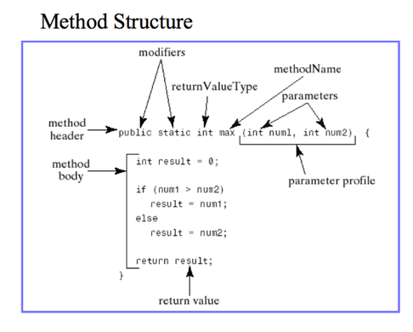
9.1.5-Java - OOP Concepts
Method in Java
A Java method is a collection of statements that are grouped together to perform an operation. When you call the System.out.println() method, for example, the system actually executes several statements in order to display a message on the console.
Exmaple-
public static int max(int num1, int num2)
{
// body
}

Slide 9
9.1.6-Java - OOP Concepts
Method in Java
The syntax shown above includes −
modifier − It defines the access type of the method and it is optional to use.
returnType − Method may return a value.
nameOfMethod − This is the method name. The method signature consists of the method name and the parameter list.
Parameter List − The list of parameters, it is the type, order, and number of parameters of a method. These are optional, method may contain zero parameters.
method body − The method body defines what the method does with the statements.
The void Keyword
The void keyword allows us to create methods which do not return a value.
Example-4
public class ExampleMinNumber
{
/** returns the minimum of two numbers */
public static int minFunction(int n1, int n2)
{
int min;
if (n1 > n2)
min = n2;
else
min = n1;
return min;
}
public static void main(String[] args)
{
int a = 11;
int b = 6;
int c = minFunction(a, b);
System.out.println("Minimum Value = " + c);
}
}
Example-5
public class ExampleVoid {
public static void main(String[] args) {
methodRankPoints(255.7);
}
public static void methodRankPoints(double points) {
if (points >= 202.5) {
System.out.println("Rank:A1");
}else if (points >= 122.4) {
System.out.println("Rank:A2");
}else {
System.out.println("Rank:A3");
}
}
}
Output
Minimum value = 6
Output
Rank:A1

Slide 10
9.1.7-Java - OOP Concepts
Constructors in Java
A constructor is a special method that is used to initialize an object.Every class has a constructor,if we don't explicitly declare a constructor for any java class the compiler builds a default constructor for that class. A constructor does not have any return type.
A constructor has same name as the class in which it resides. Constructor in Java can not be abstract, static, final or synchronized. These modifiers are not allowed for constructor.
There are two types of Constructor
Default Constructor
Parameterized constructor
Each time a new object is created at least one constructor will be invoked.
Constructor overloading is a technique in Java in which a class can have any number of constructors that differ in parameter lists.The compiler differentiates these constructors by taking into account the number of parameters in the list and their type.
class Student4
{
int id;
String name;
Student4(int i,String n)
{
id = i;
name = n;
}
void display(){System.out.println(id+" "+name);}
public static void main(String args[]){
Student4 s1 = new Student4(111,"Karan");
Student4 s2 = new Student4(222,"Aryan");
s1.display();
s2.display();
}
}
Example- Constructor Overloading
class Student5{
int id;
String name;
int age;
Student5(int i,String n){
id = i;
name = n;
}
Student5(int i,String n,int a){
id = i;
name = n;
age=a;
}
void display(){System.out.println(id+" "+name+" "+age);}
public static void main(String args[]){
Student5 s1 = new Student5(111,"Karan");
Student5 s2 = new Student5(222,"Aryan",25);
s1.display();
s2.display();
} }
Output:
111 Karan
222 Aryan
Output:
111 Karan 0
222 Aryan 25

Slide 11
9.1.8-Java - OOP Concepts
No. | Methods | Constructors
1 | It is not necessary to use the same name of the class to create a Method. | The name of the Constructor should be same as the class name it resides.
2 | Method is an ordinary member function which is used to expose the behavior of an object | Constructor is a member function of a class used to initialize the state of an object
3 | Methods must have return type unless it is specified as void. | Constructor does not have a return type.
4 | Compiler does not create a method in any case if one is not available. | Java compiler creates default constructor if the program doesn’t have one.
5 | Methods invoked explicitly. Invoked using the dot operator. | Constructor invoked implicitly. i. e. Invoked using the keyword ‘new’.

Slide 12
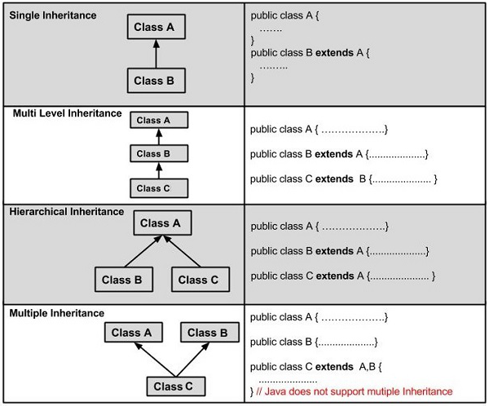
9.1.7-Java - OOP Concepts
3- Inheritance
When one object acquires all the properties and behaviors of parent object i.e. known as inheritance.
Inheritance is one of the key features of Object Oriented Programming.
Inheritance provided mechanism that allowed a class to inherit property of another class. When a Class extends another class it inherits all non-private members including fields and methods.
Inheritance in Java can be best understood in terms of Parent and Child relationship, also known as Super class(Parent) and Sub class(child) in Java language.
Inheritance defines is-a relationship between a Super class and its Sub class. extends and implements keywords are used to describe inheritance in Java.
Example-3.1
class Parent
{
public void p1()
{
System.out.println("Parent method");
}
}
public class Child extends Parent
{
public void c1()
{
System.out.println("Child method");
}
public static void main(String[] args)
{
Child cobj = new Child();
cobj.c1(); //method of Child class
cobj.p1(); //method of Parent class
}
}
Output :
Child method
Parent method

Slide 13
9.1.8-Java - OOP Concepts
Difference between this and super Keyword
What is this Keyword
This is a keyword in Java. It can be used inside the Method or constructor of Class. It(this) works as a reference to the current Object whose Method or constructor is being invoked. The this keyword can be used to refer to any member of the current object from within an instance Method or a constructor.
What is Super keyword
The super keyword in java is a reference variable that is used to refer immediate parent class object.
Whenever you create the instance of subclass, an instance of parent class is created implicitly i.e. referred by super reference variable.
Usage of java super Keyword
super is used to refer immediate parent class instance variable.
super() is used to invoke immediate parent class constructor.
super is used to invoke immediate parent class method.
this(current class) | super(super class)
1.It is a keyword used to store current object reference. | 1.It is a keyword used to store super class object in sub class.
2.Pre define instance variable used to hold current object reference. | 2.Pre define instance variable used to hold super class object reference through sub class object.
3.Used to separate state of multiple objects of same class and also used to separate local variables and class level variables in a non-static method if both have same name. | 3.Used to seperate super class and subclass members if both have same name.
4.It must be used explicitly if non-static variables and local variables or parameter name is same. | 4.It must be used explicitly if super class and sub class members have same names.
5.Can't be referred from static context. It can be printed, means can be called from System.out.println. For example System.out.println(this.x); | 5.Can't be referred from static context.It can't be printed, means cannot be called from System.out.println. For example System.out.println(super.x); it leads to compile time error.

Slide 14
9.1.9-Java - OOP Concepts
Example-Using Super
public class Person
{
int speed=10;
Person()
{
System.out.println("Person is created");
}
void message()
{
System.out.println("Person welcome");
}
}
public class PersonC extends Person
{
int speed=100;
void displaySpeed()
{
System.out.println(super.speed);//will print speed of Person now
}
PersonC()
{
super();//will invoke parent class constructor
System.out.println("PersonC is created");
}
void message()
{
System.out.println("welcome PersonC");
}
void display()
{
super.message();//will invoke parent class message() method
message();//will invoke current class message() method
}
public static void main(String args[])
{
PersonC b=new PersonC();
b.displaySpeed();
b.display();
}
}
OutPut:-
Person is created
PersonC is created
10
welcome PersonC
Person welcome
Difference between this and super Keyword Using Example
Using This Keyword
class JBT
{
int variable = 5;
void method(int variable)
{
variable = 10;
System.out.println("Value of Instance variable :" + this.variable);
System.out.println("Value of Local variable :" + variable);
}
void method()
{
int variable = 40;
System.out.println("Value of Instance variable :" + this.variable);
System.out.println("Value of Local variable :" + variable);
}
}
public static void main(String args[])
{
JBT obj = new JBT();
obj.method(20);
obj.method();
}
Output:-
Value of Instance variable :5
Value of Local variable :10
Value of Instance variable :5
Value of Local variable :40

Slide 15
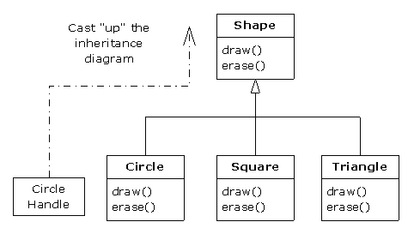
9.1.10-Java - OOP Concepts
4- Polymorphism
When one task is performed by different ways i.e. known as polymorphism. For example: to convince the customer differently, to draw something e.g. shape or rectangle etc.
In java, we use method overloading and method overriding to achieve polymorphism.

Slide 16
9.1.10-Java - OOP Concepts
4- Polymorphism
When one task is performed by different ways i.e. known as polymorphism. For example: to convince the customer differently, to draw something e.g. shape or rectangle etc.
Polymorphism in java is a concept by which we can perform a single action by different ways. Polymorphism is derived from 2 greek words: poly and morphs. The word "poly" means many and "morphs" means forms. So polymorphism means many forms.
In java language, polymorphism is essentially considered into two versions.:-
1- Compile time polymorphism (static binding or method overloading)
2-Runtime polymorphism (dynamic binding or method overriding)
1-Compile time polymorphism (static binding or method overloading):-
As the meaning is implicit, this is used to write the program in such a way, that flow of control is decided in compile time itself. It is achieved using method overloading.
In Java, it is possible to define two or more methods of same name in a class, provided that there argument list or parameters are different. This concept is known as Method Overloading.
Types:-
public static double Math.max(double a, double b){..}
public static float Math.max(float a, float b){..}
public static int Math.max(int a, int b){..}
public static long Math.max(long a, long b

Slide 17
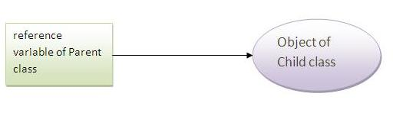
9.1.11-Java - OOP Concepts
Example:- Compile time polymorphism (static binding or method overloading)
class Overload
{
void demo (int a)
{
System.out.println ("a: " + a);
}
void demo (int a, int b)
{
System.out.println ("a and b: " + a + "," + b);
}
double demo(double a) {
System.out.println("double a: " + a);
return a*a;
}
}
class MethodOverloading
{
public static void main (String args [])
{
Overload Obj = new Overload();
double result;
Obj .demo(10);
Obj .demo(10, 20);
result = Obj .demo(5.5);
System.out.println("O/P : " + result);
}
}
Output
a: 10
a and b: 10,20
double a: 5.5
O/P : 30.25
Rules for Method Overloading
Overloading can take place in the same class or in its sub-class.
Constructor in Java can be overloaded
Overloaded methods must have a different argument list.
Overloaded method should always be the part of the same class (can also take place in sub class), with same name but different parameters.
The parameters may differ in their type or number, or in both.
They may have the same or different return types.
It is also known as compile time polymorphism.
2-Runtime polymorphism (dynamic binding or method overriding):-
Runtime polymorphism is essentially referred as method overriding. Method overriding is a feature which you get when you implement inheritance in your program.
Child class has the same method as of base class. In such cases child class overrides the parent class method without even touching the source code of the base class. This feature is known as method overriding.
Let's first understand the upcasting before Runtime Polymorphism.
Upcasting
When reference variable of Parent class refers to the object of Child class, it is known as upcasting. For example
class A{}
class B extends A{}
A a=new B();//upcasting

Slide 18
9.1.12-Java - OOP Concepts
Example:- Runtime polymorphism (dynamic binding or method overriding)
public class BaseClass
{
public void methodToOverride() //Base class method
{
System.out.println ("I'm the method of BaseClass");
}
}
public class DerivedClass extends BaseClass
{
public void methodToOverride() //Derived Class method
{
System.out.println ("I'm the method of DerivedClass");
}
}
public class TestMethod
{
public static void main (String args []) {
// BaseClass reference and object
BaseClass obj1 = new BaseClass();
// BaseClass reference but DerivedClass object
BaseClass obj2 = new DerivedClass();
// Calls the method from BaseClass class
obj1.methodToOverride();
//Calls the method from DerivedClass class
obj2.methodToOverride();
}
}
Output:
I'm the method of BaseClass
I'm the method of DerivedClass
Rules for Method Overriding:
applies only to inherited methods
object type (NOT reference variable type) determines which overridden method will be used at runtime
Overriding method can have different return type (refer this)
Overriding method must not have more restrictive access modifier
Abstract methods must be overridden
Static and final methods cannot be overridden
Constructors cannot be overridden
It is also known as Runtime polymorphism.
super keyword in Overriding:
When invoking a superclass version of an overridden method the super keyword is used.
Example:
class Vehicle {
public void move () {
System.out.println ("Vehicles are used for moving from one place to another ");
}
}
class Car extends Vehicle {
public void move () {
super. move (); // invokes the super class method
System.out.println ("Car is a good medium of transport ");
}
}
public class TestCar {
public static void main (String args []){
Vehicle b = new Car (); // Vehicle reference but Car object
b.move (); //Calls the method in Car class
}
}
Output:
Vehicles are used for moving from one place to another
Car is a good medium of transport

Slide 19
9.1.13-Java - OOP Concepts
5- Abstraction
Hiding internal details and showing functionality is known as abstraction. For example: phone call, we don't know the internal processing.
Abstraction is a process of hiding the implementation details and showing only functionality to the user.
Another way, it shows only important things to the user and hides the internal details for example sending sms, you just type the text and send the message. You don't know the internal processing about the message delivery.
Abstraction lets you focus on what the object does instead of how it does it.
Hiding internal details and showing functionality is known as abstraction. For example: phone call, we don't know the internal processing.
Ways to achieve Abstraction. There are two ways to achieve abstraction in java
Abstract class (0 to 100%)
Interface (100%)
1-What is an Abstract Class?
A class that is declared as abstract is known as abstract class. It needs to be extended and its method implemented. It cannot be instantiated.
Let’s start understanding Abstract class first and then we will go over Example.
1.An abstract class is a class that is declared abstract
2.Abstract classes cannot be instantiated
3.Abstract classes can be subclassed
4.It may or may not include abstract methods
5.When an abstract class is subclassed, the subclass usually provides implementations for all of the abstract methods in its parent class
6.If subclass doesn’t provide implementations then the subclass must also be declared abstract.
Example-abstract class A{}
What is an Abstract Method?
An abstract method is a method that is declared without an implementation.
It just has a method signature.
Example-abstract void printStatus();//no body and abstract

Slide 20
9.1.14-Java - OOP Concepts
Understanding the real scenario of abstract class
In this example, Shape is the abstract class, its implementation is provided by the Rectangle and Circle classes. Mostly, we don't know about the implementation class (i.e. hidden to the end user) and object of the implementation class is provided by the factory method.
A factory method is the method that returns the instance of the class. We will learn about the factory method later.
In this example, if you create the instance of Rectangle class, draw() method of Rectangle class will be invoked.
abstract class Shape
{
abstract void draw();
}
//In real scenario, implementation is provided by others i.e. unknown by end user
class Rectangle extends Shape
{
void draw(){System.out.println("drawing rectangle");}
}
class Circle1 extends Shape
{
void draw(){System.out.println("drawing circle");}
}
//In real scenario, method is called by programmer or user
class TestAbstraction1
{
public static void main(String args[])
{
Shape s=new Circle1();//In real scenario, object is provided through method e.g. getShape() method
s.draw();
}
}
OutPut
drawing circle

Slide 21
9.1.15-Java - OOP Concepts
2-What is an Interface Class?
Interface is a pure abstract class.They are syntactically similar to classes, but you cannot create instance of an Interface and their methods are declared without any body. Interface is used to achieve complete abstraction in Java. When you create an interface it defines what a class can do without saying anything about how the class will do it..
Why use Java interface?
There are mainly three reasons to use interface. They are given below.
It is used to achieve abstraction.
By interface, we can support the functionality of multiple inheritance.
It can be used to achieve loose coupling.
Example-2 Interfaces supports Multiple Inheritance-
Though classes in java doesn't suppost multiple inheritance, but a class can implement more than one interface.
interface Moveable
{
boolean isMoveable();
}
interface Rollable
{
boolean isRollable
}
class Tyre implements Moveable, Rollable
{
int width;
boolean isMoveable()
{
return true;
}
boolean isRollable()
{
return true;
}
public static void main(String args[])
{
Tyre tr=new Tyre();
System.out.println(tr.isMoveable());
System.out.println(tr.isRollable());
}
}
Output :
true
true
1-Example of Interface implementation-
interface Moveable
{
int AVG-SPEED = 40;
void move();
}
class Vehicle implements Moveable
{
public void move()
{
System .out. print in ("Average speed is"+AVG-SPEED");
}
public static void main (String[] arg)
{
Vehicle vc = new Vehicle();
vc.move();
}
}
OutPut:
Average speed is 40.

Slide 22
9.1.16-Java - OOP Concepts
Difference between abstract class and interface
# | abstract Classes | Interfaces
1 | abstract class can extend only one class or one abstract class at a time | interface can extend any number of interfaces at a time
2 | abstract class can extend from a class or from an abstract class | interface can extend only from an interface
3 | abstract class can have both abstract and concrete methods | interface can have only abstract methods
4 | A class can extend only one abstract class | A class can implement any number of interfaces
5 | In abstract class keyword ‘abstract’ is mandatory to declare a method as an abstract | In an interface keyword ‘abstract’ is optional to declare a method as an abstract
6 | abstract class can have protected , public and public abstract methods | Interface can have only public abstract methods i.e. by default
7 | abstract class can have static, final or static final variable with any access specifier | interface can have only static final (constant) variable i.e. by default
8 | Example: public abstract class Shape{ public abstract void draw(); } | Example: public interface Drawable{ void draw(); }

Slide 23

9.1.17-Java - OOP Concepts
6- Encapsulation
Binding (or wrapping) code and data together into a single unit is known as encapsulation. For example: capsule, it is wrapped with different medicines.
A java class is the example of encapsulation. Java bean is the fully encapsulated class because all the data members are private here.
Encapsulation in Java is a mechanism of wrapping the data (variables) and code acting on the data (methods) together as a single unit. In encapsulation, the variables of a class will be hidden from other classes, and can be accessed only through the methods of their current class. Therefore, it is also known as data hiding.
To achieve encapsulation in Java −
Declare the variables of a class as private.
Provide public setter and getter methods to modify and view the variables values.
Advantage of Encapsulation in java
By providing only setter or getter method, you can make the class read-only or write-only.
It provides you the control over the data. Suppose you want to set the value of id i.e. greater than 100 only, you can write the logic inside the setter method
The fields of a class can be made read-only or write-only.
A class can have total control over what is stored in its fields.
The users of a class do not know how the class stores its data. A class can change the data type of a field and users of the class do not need to change any of their code

Slide 24
9.1.18-Java - OOP Concepts
Example
Following is an example that demonstrates how to achieve Encapsulation in Java −
/* File name : EncapTest.java */
public class EncapTest {
private String name;
private String idNum;
private int age;
public int getAge() {
return age;
}
public String getName() {
return name;
}
public String getIdNum() {
return idNum;
}
public void setAge( int newAge) {
age = newAge;
}
public void setName(String newName) {
name = newName;
}
public void setIdNum( String newId) {
idNum = newId;
}
}
The public setXXX() and getXXX() methods are the access points of the instance variables of the EncapTest class. Normally, these methods are referred as getters and setters. Therefore, any class that wants to access the variables should access them through these getters and setters.
The variables of the EncapTest class can be accessed using the following program −
/* File name : RunEncap.java */
public class RunEncap {
public static void main(String args[])
{
EncapTest encap = new EncapTest();
encap.setName("James");
encap.setAge(20);
encap.setIdNum("12343ms");
System.out.print("Name : " + encap.getName() + " Age : " + encap.getAge());
}
}
This will produce the following result −
Output
Name : James Age : 20
Encapsulation is also known as “data Hiding”.
Objects encapsulate data and implementation details. To the outside world, an object is a black box that exhibits a certain behavior.
The behavior of this object is what which is useful for the external world or other objects.
An object exposes its behavior by means of public methods or functions.
The set of functions an object exposes to other objects or external world acts as the interface of the object.

Slide 25
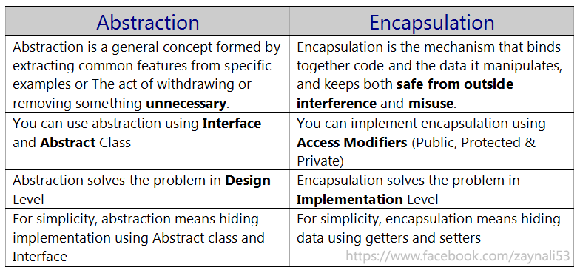
9.1.19-Java - OOP Concepts
Difference between Abstraction and Encapsulation

Slide 26
9.2.1- Java - Keywords Break, Enum,Final, Static
1-Break Keyword-
The break statement in Java programming language has the following two usages −
When the break statement is encountered inside a loop, the loop is immediately terminated and the program control resumes at the next statement following the loop.
It can be used to terminate a case in the switch statement.
2-Enum Keyword
Enum in java is a data type that contains fixed set of constants.
It can be used for days of the week (SUNDAY, MONDAY, TUESDAY, WEDNESDAY, THURSDAY, FRIDAY and SATURDAY) , directions (NORTH, SOUTH, EAST and WEST) etc. The java enum constants are static and final implicitly. It is available from JDK 1.5.
Java Enums can be thought of as classes that have fixed set of constants.
Points to remember for Java Enum
enum improves type safety
enum can be easily used in switch
enum can be traversed
enum can have fields, constructors and methods
enum may implement many interfaces but cannot extend any class because it internally extends Enum class
Rules for enum type
An enum constant specifies an instance of the enum type.
An enum constant can be optionally followed by a list of arguments and a class body. The class body is an anonymous class which conforms to rules of anonymous classes and:
It cannot have any constructor.
It cannot have any abstract methods.
Instance methods declared in the class body are only accessible if they override accessible methods declared in the enclosing enum type.
An enum type cannot be declared abstract or final.
The Enum<E> is the direct superclass of an enum type.
An enum type can be only declared inside class level, same as class level or in a separate source file. It cannot be declared inside a method or an inner class.
An enum type can have constructors, methods and variables just like a regular Java class.

Slide 27
9.2.2- Java - Keywords Break, Enum,Final, Static
3-Final Keyword-
The final keyword in java is used to restrict the user. The java final keyword can be used in many context. Final can be:
Class
Method
Variable
Final class: -if a class is marked as final, it cannot be subclassed/inherited by another class. For example:
final class A { }
then the following code will not compile:
class B extends A {} // compile error
Final method: when a method is final, that means it cannot be overriden, neither by methods in the same class or in sub class. For example:
class C
{
final void foo() { }
}
the subclass D attempts to override the method foo(), but fail because foo() is marked as final:
class D extends C
{
void foo() { } // compile error
}
Final variable:- if a variable is marked as final, its reference cannot be changed to refer to another object, once initialized. For example:
final String message = "HELLO";
Once the variable message is initialized and marked as final, the following code attempts to assign another value to it, will fails:
message = "BONJOUR"; // compile error

Slide 28
9.2.3- Java - Keywords Break, Enum,Final, Static
Points to Remember for fianl: 1) A constructor cannot be declared as final. 2) Local final variable must be initializing during declaration. 3) All variables declared in an interface are by default final. 4) We cannot change the value of a final variable. 5) A final method cannot be overridden. 6) A final class not be inherited. 7) If method parameters are declared final then the value of these parameters cannot be changed. 8) It is a good practice to name final variable in all CAPS. 9) final, finally and finalize are three different terms. finally is used in exception

Slide 29
9.2.4- Java - Keywords Break, Enum,Final, Static
4-Static Keyword-
The static keyword in java is used for memory management mainly. We can apply java static keyword with variables, methods, blocks and nested class. The static keyword belongs to the class than instance of the class.
The static can be:
I-variable (also known as class variable)
II-method (also known as class method)
III-block
I-Static variable
If you declare any variable as static, it is known static variable:-
The static variable can be used to refer the common property of all objects (that is not unique for each object) e.g. company name of employees,college name of students etc.
The static variable gets memory only once in class area at the time of class loading.
It makes your program memory efficient (i.e it saves memory).
Suppose we want to store record of all employee of any company, in this case employee id is unique for every employee but company name is common for all. When we create a static variable as a company name then only once memory is allocated otherwise it allocate a memory space each time for every employee.
II-Static Method
If you apply static keyword with any method, it is known as static method:-
A static method belongs to the class rather than object of a class.
A static method can be invoked without the need for creating an instance of a class.
static method can access static data member and can change the value of it.
Restrictions for static method
The static method can not use non static data member or call non-static method directly.
this and super cannot be used in static context.

Slide 30
9.2.5- Java - Keywords Break, Enum,Final, Static
II-Static Block
Static blocks are nothing but a normal block of code, enclosed in braces { }, preceded with static keyword. These static blocks will be called when JVM loads the class into memory. Incase a class has multiple static blocks across the class, then JVM combines all these blocks as a single block of code and executes it. Static blocks will be called only once, when it is loaded into memory. These are also called initialization blocks.
Is used to initialize the static data member.
It is executed before main method at the time of class loading even before the constructor.
This code inside static block is executed only once: the first time you make an object of that class or the first time you access a static member of that class (even if you never make an object of that class).

Slide 31
9.3.1-Java Collections
The Java Collections Framework is a collection of interfaces and classes which helps in storing and processing the data efficiently. This
framework has several useful classes which have tons of useful functions which makes a programmer task super easy.
Advantages of Collection Framework:
Consistent API : The API has basic set of interfaces like Collection, Set, List, or Map. All those classes (such as ArrayList, LinkedList, Vector etc) which implements, these interfaces have some common set of methods.
Reduces programming effort: The programmer need not to worry about design of Collection rather than he can focus on its best use in his program.
Increases program speed and quality: Increases performance by providing high-performance implementations of useful data structures and algorithms.
Reusability and Interoperability
Code quality is enhanced with the use of well tested collections framework classes.
Disadvantages of collections framework:
It must cast to correct type.
It can't be done compile-time type checking.

Slide 32
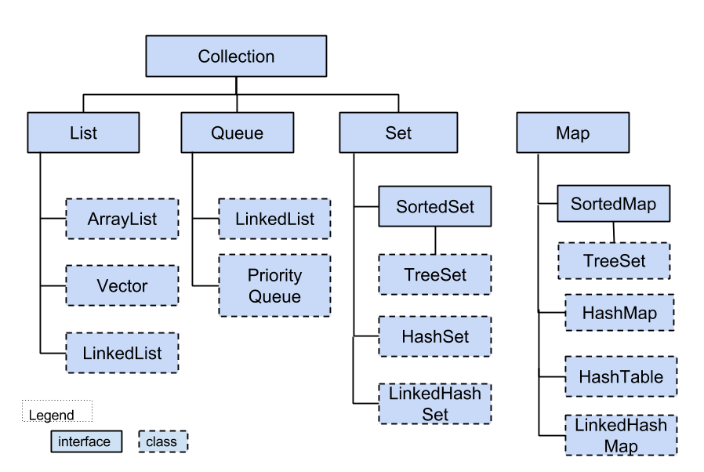
9.3.2 Java Collections

Slide 33
9.3.3 Java Collections
Difference between List Set Map
 | List | Set | Map
Storage Type | Value | Value | Key and Value pair
Ordered | Yes | No | No
Duplicate elements | hold duplicate elements | unique elements allowed | unique keys allowed
Null elements | multiple null elements | single null element | Single null key and multiple null values

Slide 34
9.3.4-Java Collections
Iterator interface:-
Iterator is used for iterating (looping) various collection classes such as HashMap, ArrayList, LinkedList etc
Methods of Iterator interface
•There are only three methods in the Iterator interface. They are:
•public boolean hasNext() it returns true if iterator has more elements.
•public object next() it returns the element and moves the cursor pointer to the next element.
•public void remove() it removes the last elements returned by the iterator. It is rarely used.
Iterator itr = al.iterator();
while(itr.hasNext())
{
}
Iterator/ListIterator
Both Iterator and ListIterator are used to iterate through elements of a collection class. Using Iterator we can traverse in one direction (forward) while using ListIterator we can traverse the collection class on both the directions(backward and forward).
Difference between Iterator vs ListIterator
Iterator is used for traversing List and Set both.
We can use ListIterator to traverse List only, we cannot traverse Set using ListIterator.
We can traverse in only forward direction using Iterator.
Using ListIterator, we can traverse a List in both the directions (forward and Backward).

Slide 35
9.3.5-Java Collections
1-List
A List is an ordered Collection (sometimes called a sequence). Lists may contain duplicate elements. Elements can be inserted or accessed by their position in the list, using a zero-based index.
1-ArrayList
2-LinkedList
3-Vector-The Vector class implements a growable array of objects. Similar to array, elements of Vector can be accessed using an integer index. However, the size of a Vector can grow or shrink as needed to accommodate adding and removing items after the Vector has been created.
Vector is synchronized which means it is suitable for thread-safe operations but it gives poor performance when used in multi-thread environment. It is recommended to use ArrayList (it is non-synchronized, gives good performance) in place of Vector when there is no need of thread-safe operations
The List interface extends Collection and declares the behavior of a collection that stores a sequence of elements:-
Elements can be inserted or accessed by their position in the list, using a zero-based index.
A list may contain duplicate elements.
In addition to the methods defined by Collection, List defines some of its own, which are summarized in the following table.
Several of the list methods will throw an UnsupportedOperationException if the collection cannot be modified, and a ClassCastException is generated when one object is incompatible with another.

Slide 36
9.3.6-Java Collections
List -ArrayList-1
ArrayList is a resizable-array implementation of the List interface. It implements all optional list operations, and permits all elements, including null. In addition to implementing the List interface, this class provides methods to manipulate the size of the array that is used internally to store the list. Java ArrayList class uses a dynamic array for storing the elements. It inherits AbstractList class and implements List interface.
The important points about Java ArrayList class are:
Java ArrayList class can contain duplicate elements.
Java ArrayList class maintains insertion order.
Java ArrayList class is non synchronized.
Java ArrayList allows random access because array works at the index basis.
In Java ArrayList class, manipulation is slow because a lot of shifting needs to be occurred if any element is removed from the array list.
ArrayList al=new ArrayList(); //creating old non-generic arraylist
ArrayList<String> al=new ArrayList<String>(); //creating new generic arraylist
races.add(s);
ArrayList class provides methods for basic array operations:
add( Object o ) - puts reference to object into ArrayList
get( int index ) - retrieves object reference from ArrayList index position
size() - returns ArrayList size
remove( int index ) - removes the element at the specified position in this list. Shifts any subsequent elements to the left and returns the element that was removed from the list.
indexOf( Object o) - finds the index in this list of the first occurrence of the specified element
clear() - removes all of the elements

Slide 37
9.3.7-Java Collections
Array | ArrayList
Arrays are static in nature. Arrays are fixed length data structures. You can’t change their size once they are created. | ArrayList is dynamic in nature. Its size is automatically increased if you add elements beyond its capacity.
Arrays can hold both primitives as well as objects. | ArrayList can hold only objects.
Arrays can be iterated only through for loop or for-each loop. | ArrayList provides iterators to iterate through their elements.
The size of an array is checked using length attribute. | The size of an ArrayList can be checked using size() method.
Array gives constant time performance for both add and get operations. | ArrayList also gives constant time performance for both add and get operations provided adding an element doesn’t trigger resize.
Arrays don’t support generics. | ArrayList supports generics.
Arrays are not type safe. | ArrayList are type safe.
Arrays can be multi-dimensional. | ArrayList can’t be multi-dimensional.
Elements are added using assignment operator. | Elements are added using add() method.

Slide 38
9.3.8-Java Collections
List -LiknedList-2
Java LinkedList class uses doubly linked list to store the elements. It provides a linked-list data structure. It inherits the AbstractList class and implements List and Deque interfaces.
The important points about Java LinkedList are:
Java LinkedList class can contain duplicate elements.
Java LinkedList class maintains insertion order.
Java LinkedList class is non synchronized.
In Java LinkedList class, manipulation is fast because no shifting needs to be occurred.
Java LinkedList class can be used as list, stack or queue.
Ex- LinkedList<String> ls= new LinkedList<String>();
ls.add(“abce”)
Linked List Methods | Description
void add(int index, Object element) | It is used to insert the specified element at the specified position index in a list.
void addFirst(Object o) | It is used to insert the given element at the beginning of a list.
void addLast(Object o) | It is used to append the given element to the end of a list.
int size() | It is used to return the number of elements in a list
boolean add(Object o) | It is used to append the specified element to the end of a list.
boolean contains(Object o) | It is used to return true if the list contains a specified element.
boolean remove(Object o) | It is used to remove the first occurence of the specified element in a list.
Object getFirst() | It is used to return the first element in a list.
Object getLast() | It is used to return the last element in a list.
int indexOf(Object o) | It is used to return the index in a list of the first occurrence of the specified element, or -1 if the list does not contain any element.
int lastIndexOf(Object o) | It is used to return the index in a list of the last occurrence of the specified element, or -1 if the list does not contain any element.

Slide 39
9.3.8-Java Collections
ArrayList | LinkedList
1) ArrayList internally uses dynamic array to store the elements. | LinkedList internally uses doubly linked list to store the elements.
2) Manipulation with ArrayList is slow because it internally uses array. If any element is removed from the array, all the bits are shifted in memory. | Manipulation with LinkedList is faster than ArrayList because it uses doubly linked list so no bit shifting is required in memory.
3) ArrayList class can act as a list only because it implements List only. | LinkedList class can act as a list and queue both because it implements List and Deque interfaces.
4) ArrayList is better for storing and accessing data. | LinkedList is better for manipulating data.
S.No. | Singly Linked List | Doubly Linked List
1 | Singly linked list allows you to go one way direction | Doubly linked list has two way directions next and previous
2 | Singly linked list uses less memory per node (one pointer) | Doubly linked list uses More memory per node than Singly Linked list (two pointers)
3 | There is a little-known trick that lets you delete from a singly-linked list in O(1), but the list must be circular for it to work (move the content of next into the current, and delete next). | Doubly-linked lists can be used in places where singly-linked lists would not work (a doubly-ended queue), but they require slightly more "housekeeping", and are slightly less efficient on insertions as the result
4 | Complexity of Insertion and Deletion at known position is O (n). | Complexity of Insertion and Deletion at known position is O (1).
5 | If we need to save memory in need to update node values frequently and searching is not required, we can use Singly Linked list. | If we need faster performance in searching and memory is not a limitation we use Doubly Linked List
6 |  | For B-Tree, Heap we need doubly linked list. .Net Framework only provides the LinkedList<T> class which is double-linked.
7 | If we know in advance that element to be searched is found near the end of the list(for example name 'Yogesh' in a telephone directory), even then singly linked list is traversed sequentially from beginning. | In doubly linked list If we know in advance that element to be searched is found near the end of the list(for example name 'Yogesh' in a telephone directory), then the list can traversed from the end thereby saving time
8 | In single list Each node contains at least two parts: a) info b) link | In doubly linked list Each node contains at least three parts: a) info b) link to next node c) link to previous node

Slide 40
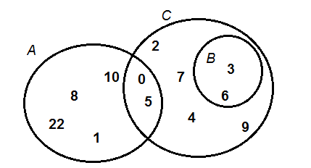
9.3.9-Java Collections
2-Set
Basically, Set is a type of collection that does not allow duplicate elements. That means an element can only exist once in a Set. It models the set abstraction in mathematics. The following picture illustrates three sets of numbers in mathematics:
Characteristics of a Set collection:
The following characteristics differentiate a Set collection from others in the Java Collections framework:
•Duplicate elements are not allowed.
•Elements are not stored in order. That means you cannot expect elements sorted in any order when iterating over elements of a Set.
Why and When Use Sets?
Based on the characteristics, consider using a Set collection when:
•You want to store elements distinctly without duplication, or unique elements.
•You don’t care about the order of elements.
For example, you can use a Set to store unique integer numbers; you can use a Set to store cards randomly in a card game; you can use a Set to store numbers in random order, etc.
Implementation of Set
•HashSet: is the best-performing implementation and is a widely-used Set implementation. It represents the core characteristics of sets: no duplication and unordered.
•LinkedHashSet: This implementation orders its elements based on insertion order. So consider using a LinkedHashSet when you want to store unique elements in order.
•TreeSet: This implementation orders its elements based on their values, either by their natural ordering, or by a Comparator provided at creation time.

Slide 41
9.3.10-Java Collections
Set -HashSet-1
Java HashSet class is used to create a collection that uses a hash table for storage.
HashSet<String> hs=new HashSet<Book>();
hs.add(“abc”)
The important points about Java HashSet class are:-
HashSet stores the elements by using a mechanism called hashing.
HashSet doesn’t maintain any order, the elements would be returned in any random order.
HashSet doesn’t allow duplicates. If you try to add a duplicate element in HashSet, the old value would be overwritten.
HashSet allows null values however if you insert more than one nulls it would still return only one null value.
HashSet is non-synchronized.
The iterator returned by this class is fail-fast which means iterator would throw ConcurrentModificationException if HashSet has been modified after creation of iterator, by any means except iterator’s own remove method.
HashSet contains unique elements only.
HashSet Methods
void clear()-It is used to remove all of the elements from this set.
boolean contains(Object o)-It is used to return true if this set contains the specified element.
boolean add(Object o)-It is used to adds the specified element to this set if it is not already present.
boolean isEmpty()-It is used to return true if this set contains no elements.
boolean remove(Object o)-It is used to remove the specified element from this set if it is present.
Object clone()-It is used to return a shallow copy of this HashSet instance: the elements themselves are not cloned.
Iterator iterator()-It is used to return an iterator over the elements in this set.
int size()-It is used to return the number of elements in this set.

Slide 42
9.3.11-Java Collections
Set -LinkedHashSet-2
Java LinkedHashSet class is a Hash table and Linked list implementation of the set interface. It inherits HashSet class and implements Set interface.
LinkedHashSet<String> al=new LinkedHashSet<String>();
al.add("Ravi");
The important points about Java LinkedHashSet class are:
•Contains unique elements only like HashSet.
•Provides all optional set operations, and permits null elements.
•Maintains insertion order.
•HashSet doesn’t maintain any kind of order of its elements.
•TreeSet sorts the elements in ascending order.
•LinkedHashSet maintains the insertion order. Elements gets sorted in the same sequence in which they have been added to the Set.
LinkedHashSet Methods
void clear()-It is used to remove all of the elements from this set.
boolean contains(Object o)-It is used to return true if this set contains the specified element.
boolean add(Object o)-It is used to adds the specified element to this set if it is not already present.
boolean isEmpty()-It is used to return true if this set contains no elements.
boolean remove(Object o)-It is used to remove the specified element from this set if it is present.
Object clone()-It is used to return a shallow copy of this HashSet instance: the elements themselves are not cloned.
Iterator iterator()-It is used to return an iterator over the elements in this set.
int size()-It is used to return the number of elements in this set.

Slide 43
9.3.12-Java Collections
Set -TreeSet-3
Java TreeSet class implements the Set interface that uses a tree for storage
TreeSet is similar to HashSet except that it sorts the elements in the ascending order while HashSet doesn’t maintain any order. TreeSet allows null element but like HashSet it doesn’t allow.
Like most of the other collection classes this class is also not synchronized, however it can be synchronized explicitly.
TreeSet<String> al=new TreeSet<String>();
al.add("Ravi");
The important points about Java TreeSet class are:
Contains unique elements only like HashSet.
Access and retrieval times are quiet fast.
Maintains ascending order
LinkedHashSet Methods-
boolean addAll(Collection c)-It is used to add all of the elements in the specified collection to this set.
boolean contains(Object o)-It is used to return true if this set contains the specified element.
boolean isEmpty()-It is used to return true if this set contains no elements.
boolean remove(Object o)-It is used to remove the specified element from this set if it is present.
void add(Object o)-It is used to add the specified element to this set if it is not already present.
void clear()-It is used to remove all of the elements from this set.
Object clone()-It is used to return a shallow copy of this TreeSet instance.
Object first()-It is used to return the first (lowest) element currently in this sorted set.
Object last()-It is used to return the last (highest) element currently in this sorted set.
int size()-It is used to return the number of elements in this set.

Slide 44
9.3.15-Java Collections
HashSet Vs LinkedHashSet Vs TreeSet
Points | HashSet | LinkedHashSet | TreeSet
How they work internally? | HashSet uses HashMap internally to store it’s elements. | LinkedHashSet uses LinkedHashMap internally to store it’s elements. | TreeSet uses TreeMap internally to store it’s elements.
Order Of Elements | HashSet doesn’t maintain any order of elements. | LinkedHashSet maintains insertion order of elements. i.e elements are placed as they are inserted. | TreeSet orders the elements according to supplied Comparator. If no comparator is supplied, elements will be placed in their natural ascending order.
Performance | HashSet gives better performance than the LinkedHashSet and TreeSet. | The performance of LinkedHashSet is between HashSet and TreeSet. It’s performance is almost similar to HashSet. But slightly in the slower side as it also maintains LinkedList internally to maintain the insertion order of elements. | TreeSet gives less performance than the HashSet and LinkedHashSet as it has to sort the elements after each insertion and removal operations.
Insertion, Removal And Retrieval Operations | HashSet gives performance of order O(1) for insertion, removal and retrieval operations. | LinkedHashSet also gives performance of order O(1) for insertion, removal and retrieval operations. | TreeSet gives performance of order O(log(n)) for insertion, removal and retrieval operations.
How they compare the elements? | HashSet uses equals() and hashCode() methods to compare the elements and thus removing the possible duplicate elements. | LinkedHashSet also uses equals() and hashCode() methods to compare the elements. | TreeSet uses compare() or compareTo() methods to compare the elements and thus removing the possible duplicate elements. It doesn’t use equals() and hashCode() methods for comparision of elements.
Null elements | HashSet allows maximum one null element. | LinkedHashSet also allows maximum one null element. | TreeSet doesn’t allow even a single null element. If you try to insert null element into TreeSet, it throws NullPointerException.
Memory Occupation | HashSet requires less memory than LinkedHashSet and TreeSet as it uses only HashMap internally to store its elements. | LinkedHashSet requires more memory than HashSet as it also maintains LinkedList along with HashMap to store its elements. | TreeSet also requires more memory than HashSet as it also maintains Comparator to sort the elements along with the TreeMap.
When To Use? | Use HashSet if you don’t want to maintain any order of elements. | Use LinkedHashSet if you want to maintain insertion order of elements. | Use TreeSet if you want to sort the elements according to some Comparator.

Slide 45
9.3.16-Java Collections
3-Map
A map contains values on the basis of key i.e. key and value pair. Each key and value pair is known as an entry. Map contains only unique keys. Map is useful if you have to search, update or delete elements on the basis of key.
Given a key and a value, you can store the value in a Map object. After the value is stored, you can retrieve it by using its key.
Several methods throw a NoSuchElementException when no items exist in the invoking map.
A ClassCastException is thrown when an object is incompatible with the elements in a map.
A NullPointerException is thrown if an attempt is made to use a null object and null is not allowed in the map.
An UnsupportedOperationException is thrown when an attempt is made to change an unmodifiable map.
A Map is an object that maps keys to values. A map cannot contain duplicate keys
The entrySet() -method is used to return a Set view of the mappings contained in this map. The set's iterator returns the entries in ascending key order. The set is backed by the map, so changes to the map are reflected in the set, and vice-versa.
Map.Entry-Sometimes you need to work with map entry. This can be done using Map.Entry Interface of Java.
Object getKey() It is used to obtain key.
Object getValue() It is used to obtain value.
There are three main implementations of Map interfaces:
1-HashMap: it makes no guarantees concerning the order of iteration
2-TreeMap: It stores its elements in a red-black tree, orders its elements based on their values; it is substantially
slower than HashMap.
3-LinkedHashMap: It orders its elements based on the order in which they were inserted into the set (insertion-order).
Map Method | Description
Object put(Object key, Object value) | It is used to insert an entry in this map.
void putAll(Map map) | It is used to insert the specified map in this map.
Object remove(Object key) | It is used to delete an entry for the specified key.
Object get(Object key) | It is used to return the value for the specified key.
pboolean containsKey(Object key) | It is used to search the specified key from this map.
Set keySet() | It is used to return the Set view containing all the keys.
Set entrySet() | It is used to return the Set view containing all the keys and values.

Slide 46
9.3.17-Java Collections
Map -HashMap-1
Java HashMap class implements the map interface by using a hashtable. It inherits AbstractMap class and implements Map interface.
HashMap<Integer, String> hmap = new HashMap<Integer, String>();
HashMap*/ hmap.put(12, "Chaitanya");
Set mapset=hmap.entrySet();
The important points about Java HashMap class are:
A HashMap contains values based on the key.
It contains only unique elements.
It may have one null key and multiple null values.
It maintains no order.
It is a Map based collection class that is used for storing Key & value pairs. This class makes no guarantees as to the order of the map.
It is similar to the Hashtable class except that it is unsynchronized.
HashMap Methods | Description
void clear() | It is used to remove all of the mappings from this map.
boolean containsKey(Object key) | It is used to return true if this map contains a mapping for the specified key.
boolean containsValue(Object value) | It is used to return true if this map maps one or more keys to the specified value.
boolean isEmpty() | It is used to return true if this map contains no key-value mappings.
Object clone() | It is used to return a shallow copy of this HashMap instance: the keys and values themselves are not cloned.
Set entrySet() | It is used to return a collection view of the mappings contained in this map.
Set keySet() | It is used to return a set view of the keys contained in this map.
Object put(Object key, Object value) | It is used to associate the specified value with the specified key in this map.
int size() | It is used to return the number of key-value mappings in this map.
Collection values() | It is used to return a collection view of the values contained in this map.

Slide 47
9.3.18-Java Collections
Map -TreeMap-2
The TreeMap class implements the Map interface by using a tree. A TreeMap provides an efficient means of storing key/value pairs in sorted order, and allows rapid retrieval.
You should note that, unlike a hash map, a tree map guarantees that its elements will be sorted in an ascending key order. TreeMap is unsynchronized collection class which means it is not suitable for thread-safe operations until unless synchronized explicitly.
TreeMap<Integer, String> tmap = new TreeMap<Integer, String>();
tmap.put(1, "Data1");
The important points about Java TreeMap class are:
It implements Map interface similar to HashMap class.
The main difference between them is that HashMap is an unordered collection while TreeMap is sorted in the ascending order of its keys.
It is unsynchronized collection class which means it is not suitable for thread-safe operations until unless synchronized explicitly.
It implements the Map interface by using a tree. It provides an efficient means of storing key/value pairs in sorted order.
It contains values based on the key. It implements the NavigableMap interface and extends AbstractMap class.
It contains only unique elements.
It cannot have null key but can have multiple null values.
It is same as HashMap instead maintains ascending order.

Slide 48
9.3.19-Java Collections
Methods of Java TreeMap class-
Method | Description
boolean containsKey(Object key) | It is used to return true if this map contains a mapping for the specified key.
boolean containsValue(Object value) | It is used to return true if this map maps one or more keys to the specified value.
Object firstKey() | It is used to return the first (lowest) key currently in this sorted map.
Object get(Object key) | It is used to return the value to which this map maps the specified key.
Object lastKey() | It is used to return the last (highest) key currently in this sorted map.
Object remove(Object key) | It is used to remove the mapping for this key from this TreeMap if present.
void putAll(Map map) | It is used to copy all of the mappings from the specified map to this map.
Set entrySet() | It is used to return a set view of the mappings contained in this map.
int size() | It is used to return the number of key-value mappings in this map.
Collection values() | It is used to return a collection view of the values contained in this map.

Slide 49
9.3.20-Java Collections
Map -LinkedHash-3
It is a Hash table and linked list implementation of the Map interface, with predictable iteration order. This implementation differs from HashMap in that it maintains a doubly-linked list running through all of its entries. This linked list defines the iteration ordering, which is normally the order in which keys were inserted into the map (insertion-order).
LinkedHashMap<Integer, String> lhmap = new LinkedHashMap<Integer, String>();
lhmap.put(22, "Abey");
The important points about Java LinkedHashMap class are:
A LinkedHashMap contains values based on the key.
It contains only unique elements.
It may have one null key and multiple null values.
It is same as HashMap instead maintains insertion order.
HashMap doesn’t maintain any order.
TreeMap sort the entries in ascending order of keys.
LinkedHashMap maintains the insertion order.
Method | Description
Object get(Object key) | It is used to return the value to which this map maps the specified key.
void clear() | It is used to remove all mappings from this map.
boolean containsKey(Object key) | It is used to return true if this map maps one or more keys to the specified value.

Slide 50
9.3.20-Java Collections
HashMap | LinkedHashMap | TreeMap
Extends AbstractMap class. | Extends HashMap class. | Extends AbstractMap class.
Implements Map interface. | Implements Map interface. Implementation of Hash Table and Linked List. | Implements NavigableMap and SortedMap interfaces.
Provide constant time performance for ‘get’ and ‘put’ operations. | Maintains a doubly-linked list | Underlying data structure is Red-Black Tree.
No Iteration Order. | Iteration takes place in the order in which the entries were put into the map. | Insertion order is not maintained. Sorted according to the natural order of keys.
Key can be null. | Value can be null. | Key can’t be null; if it’s null, java.lang.NullPointerException occurs.
Value can be null. | Value can be null. | Value can be null.
Fail-fast. | Fail-fast. | Fail-fast behavior is not guaranteed always.
Duplicate keys are not allowed. | Duplicate keys are not allowed. | Duplicate keys are not allowed.
Implementation is not synchronized. | Implementation is not synchronized. | Implementation is not synchronized.
HashMap doesn't provide any ordering guarantee for entries, which means, you can not assume any order while iterating over keys and values of HashMap. This behavior of HashMap is similar to Hashtable while other two Map implementation provides ordering guarantee. | LinkedHashMap can be used to maintain insertion order, on which keys are inserted into Map or it can also be used to maintain an access order, on which keys are accessed. This provides LinkedHashMap an edge over HashMap without compromising too much performance | TreeMap provides you complete control over sorting elements by passing custom Comparator of your choice, but with the expense of some performance. Since entries are stored in a tree-based data structure, it provides lower performance than HashMap and LinkedHashMap.
HashMap allows one null key and multiple null values. It keeps null key based entries on index[0] on an internal bucket. If you look at the put() method of HashMap, you can see, it doesn't throw NullPointerException for null keys | LinkedHashMap is a subclass of HashMap, it also allows null keys and values. | TreeMap, which sorts elements in natural order doesn't allow null keys because compareTo() method throws NullPointerException if compared with null. If you are using TreeMap with user defined Comparator than it depends upon the implementation of compare() method.

Slide 51
9.4.1- Java – Files(txt,xml,exl) I/O
IO Stream
Java performs I/O through Streams. A Stream is linked to a physical layer by java I/O system to make input and output operation in java. In general, a stream means continuous flow of data. Streams are clean way to deal with input/output without having every part of your code understand the physical.
Java encapsulates Stream under java.io package. Java defines two types of streams. They are,
Byte Stream : It provides a convenient means for handling input and output of byte.
Character Stream : It provides a convenient means for handling input and output of characters. Character stream uses Unicode and therefore can be internationalized.
Some important Byte stream classes.
BufferedInputStream - Used for Buffered Input Stream.
BufferedOutputStream - Used for Buffered Output Stream.
DataInputStream - Contains method for reading java standard datatype
DataOutputStream - An output stream that contain method for writing java standard data type
FileInputStream - Input stream that reads from a file
FileOutputStream- Output stream that write to a file.
InputStream - Abstract class that describe stream input.
OutputStream- Abstract class that describe stream output.
PrintStream - Output Stream that contain print() and println() method
Some important Charcter stream classes.
BufferedReader - Handles buffered input stream.
BufferedWriter - Handles buffered output stream.
FileReader - Input stream that reads from file.
FileWriter - Output stream that writes to file.
InputStreamReader - Input stream that translate byte to character
OutputStreamReader - Output stream that translate character to byte.
PrintWriter - Output Stream that contain print() and println() method.
Reader - Abstract class that define character stream input
Writer - Abstract class that define character stream output

Slide 52
9.4.2- Java – Files(txt,xml,exl) I/O
1-IO For Text File
How to create a file in Java-
The File.createNewFile() method is used to create a file in Java, and return a boolean value : true if the file is created successful; false if the file is already exists or the operation failed.
Exampe-
package com.mkyong.file;
import java.io.File;
import java.io.IOException;
public class CreateFileExample
{
public static void main( String[] args )
{
try {
File file = new File("c:\\newfile.txt");
if (file.createNewFile()){
System.out.println("File is created!");
}else{
System.out.println("File already exists.");
}
} catch (IOException e) {
e.printStackTrace();
}
}
}

Slide 53
9.4.3- Java – Files(txt,xml,exl) I/O
2-IO For XML File
What is XML?
XML is a markup language for documents containing structured information.
Structured information contains both content (words, pictures, etc.) and some indication of what role that content plays (for example, content in a section heading has a different meaning from content in a footnote, which means something different than content in a figure caption or content in a database table, etc.). Almost all documents have some structure.
XML Document
An XML document is a basic unit of XML information composed of elements and other markup in an orderly package. An XML document can contains wide variety of data. For example, database of numbers, numbers representing molecular structure or a mathematical equation.
What is DOM
The Document Object Model (DOM) is an application programming interface (API) for valid HTML and well-formed XML documents. It defines the logical structure of documents and the way a document is accessed and manipulated. In the DOM specification, the term "document" is used in the broad sense - increasingly, XML is being used as a way of representing many different kinds of information that may be stored in diverse systems, and much of this would traditionally be seen as data rather than as documents. Nevertheless, XML presents this data as documents, and the DOM may be used to manage this data.
DOM provides many handy classes to create XML file easily. Firstly, you have to create a Document with DocumentBuilder class, define all the XML content – node, attribute with Element class. In last, use Transformer class to output the entire XML content to stream output, typically a File.
The Document Object Model is an official recommendation of the World Wide Web Consortium (W3C). It defines an interface that enables programs to access and update the style, structure,and contents of XML documents. XML parsers that support the DOM implement that interface.
When to use?
You should use a DOM parser when:
You need to know a lot about the structure of a document
You need to move parts of the document around (you might want to sort certain elements, for example)
You need to use the information in the document more than once

Slide 54
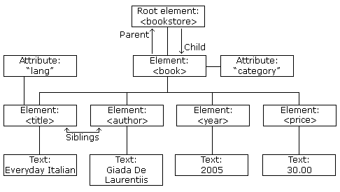
9.4.4- Java – Files(txt,xml,exl) I/O
Advantages
The DOM is a common interface for manipulating document structures. One of its design goals is that Java code written for one DOM-compliant parser should run on any other DOM-compliant parser without changes.
DOM interfaces
The DOM defines several Java interfaces. Here are the most common interfaces:
Node - The base datatype of the DOM.
Element - The vast majority of the objects you'll deal with are Elements.
Attr Represents an attribute of an element.
Text The actual content of an Element or Attr.
Document Represents the entire XML document. A Document object is often referred to as a DOM tree.
<?xml version="1.0" encoding="UTF-8"?> <bookstore> <book category="cooking"> <title lang="en">Everyday Italian</title> <author>Giada De Laurentiis</author> <year>2005</year> <price>30.00</price> </book> <book category="children"> <title lang="en">Harry Potter</title> <author>J K. Rowling</author> <year>2005</year> <price>29.99</price> </book> <book category="web"> <title lang="en">Learning XML</title> <author>Erik T. Ray</author> <year>2003</year> <price>39.95</price> </book> </bookstore>

Slide 55
9.4.5- Java – Files(txt,xml,exl) I/O
Common DOM methods
When you are working with the DOM, there are several methods you'll use often:-
Document.getDocumentElement() - Returns the root element of the document.
Node.getFirstChild() - Returns the first child of a given Node.
Node.getLastChild() - Returns the last child of a given Node.
Node.getNextSibling() - These methods return the next sibling of a given Node.
Node.getPreviousSibling() - These methods return the previous sibling of a given Node.
Node.getAttribute(attrName) - For a given Node, returns the attribute with the requested name.
Steps to Using DOM
Following are the steps used while parsing a document using DOM Parser:-
Import XML-related packages.
Create a DocumentBuilder
Create a Document from a file or stream
Extract the root element
Examine attributes
Examine sub-elements

Slide 56
9.4.6- Java – Files(txt,xml,exl) I/O
3-IO For Excel File
The fundamental interfaces of an Excel includes:
Workbook
Sheet
Row
Cell.
For basic formatting, use the CellStyle and Font interfaces. Concrete implementing classes include:
Excel 2003: HSSFWorkbook, HSSFSheet, HSSFRow, HSSFCell, etc.
Excel 2007: XSSFWorkbook, XSSFSheet, XSSFRow, XSSFCell, etc.
Here are the basic steps for writing an Excel file:-
Create a Workbook.
Create a Sheet.
Repeat the following steps until all data is processed:
Create a Row.
Create Cells in a Row. Apply formatting using CellStyle.
Write to an OutputStream.
Close the output stream.
Here are the basic steps for Reading an Excel file:-
Create workbook instance from excel sheet
Get to the desired sheet
Increment row number
iterate over all cells in a row
repeat step 3 and 4 until all data is read
Here are the basic Loginc for Reading an Excel file:-
We will get the workbook instance for XLS and takes excel file to read
We will pass the name / index of the sheet which starts from '0'.
We will iterate all the rows in the sheet
We will be iterating all the cells of the current row

Slide 57
9.5.1- Java Threading
1-Multi-Threading
What are Java Threads?
A thread is a:
Facility to allow multiple activities within a single process
Referred as lightweight process
A thread is a series of executed statements
Each thread has its own program counter, stack and local variables
A thread is a nested sequence of method calls
Its shares memory, files and per-process state
What's the need of a thread or why we use Threads?
To perform asynchronous or background processing
Increases the responsiveness of GUI applications
Take advantage of multiprocessor systems
Simplify program logic when there are multiple independent entities
What happens when a thread is invoked?
When a thread is invoked, there will be two paths of execution. One path will execute the thread and the other path will follow the statement after the thread invocation. There will be a separate stack and memory space for each thread.
Thread vs Process
1) A program in execution is often referred as process. A thread is a subset(part) of the process.
2) A process consists of multiple threads. A thread is a smallest part of the process that can execute concurrently with other parts(threads) of the process.
3) A process is sometime referred as task. A thread is often referred as lightweight process.
4) A process has its own address space. A thread uses the process’s address space and share it with the other threads of that process.

Slide 58
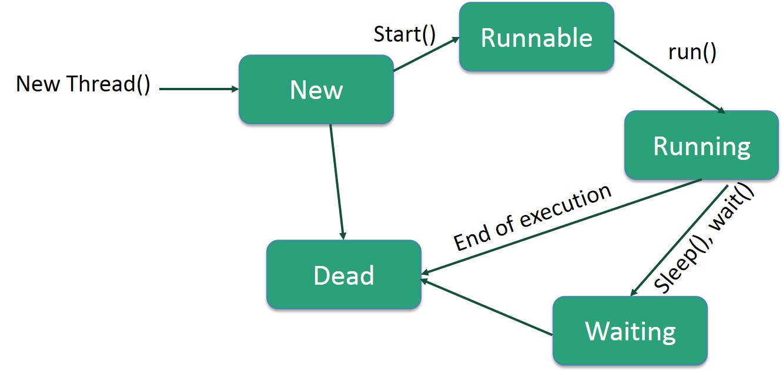
9.5.2- Java Threading
What is Multi-Threading
Java is a multi-threaded programming language which means we can develop multi-threaded program using Java. A multi-threaded program contains two or more parts that can run concurrently and each part can handle a different task at the same time making optimal use of the available resources specially when your computer has multiple CPUs.
Life Cycle of a Thread
A thread goes through various stages in its life cycle. For example, a thread is born, started, runs, and then dies. The following diagram shows the complete life cycle of a thread.
Thread creation in Java
Thread implementation in java can be achieved in two ways:
Extending the java.lang.Thread class
Implementing the java.lang.Runnable Interface
Note: The Thread and Runnable are available in the java.lang.* package

Slide 59
10-Introduction to TestNG

Slide 60
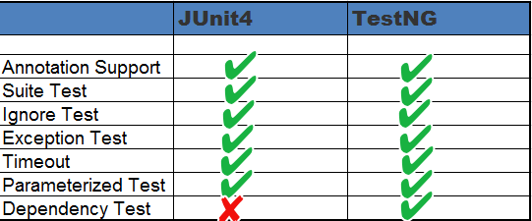
10.1-Java Collections
TestNG
TestNG is a testing framework inspired from JUnit and NUnit but introducing some new functionality that make it more powerful and easier to use.
It is an open source automated testing framework; where NG of TestNG means Next Generation. TestNG is similar to JUnit but it is much more powerful than JUnit but still it’s inspired by JUnit. It is designed to be better than JUnit, especially when testing integrated classes. Pay special thanks to Cedric Beust who is the creator of TestNG.
TestNG eliminates most of the limitations of the older framework and gives the developer the ability to write more flexible and powerful tests with help of easy annotations, grouping, sequencing & parametrizing.
JUnit4 and TestNG Feature comparison
Both TestNG and JUnit4 looks similar, except one or two features. Let's have a comparison between the two to quickly decide, which technology is more favourable for unit testing. Below table highlights the features supported by both:

Slide 61
10.1-Java Collections
S.N. | Description | TestNG | JUnit 4
1 | Test annotation | @Test | @Test
2 | Executes before the first test method is invoked in the current class | @BeforeClass | @BeforeClass
3 | Executes after all the test methods in the current class | @AfterClass | @AfterClass
4 | Executes before each test method | @BeforeMethod | @Before
5 | Executes after each test method | @AfterMethod | @After
6 | annotation to ignore a test | @Test(enbale=false) | @ignore
7 | annotation for exception | @Test(expectedExceptions = ArithmeticException.class) | @Test(expected = ArithmeticException.class)
8 | timeout | @Test(timeout = 1000) | @Test(timeout = 1000)
9 | Executes before all tests in the suite | @BeforeSuite | n/a
10 | Executes after all tests in the suite | @AfterSuite | n/a
11 | Executes before a test runs | @BeforeTest | n/a
12 | Executes after a test runs | @AfterTest | n/a
13 | Executes before the first test method is invoked that belongs to any of these groups is invoked | @BeforeGroups | n/a
14 | run after the last test method that belongs to any of the groups here | @AfterGroups | n/a

Slide 62
10.1-Java Collections
TestNG Annotations
@BeforeSuite:- The annotated method will be run before all tests in this suite have run.
@AfterSuite:- The annotated method will be run after all tests in this suite have run.
@BeforeTest: -The annotated method will be run before any test method belonging to the classes inside the tag is run.
@AfterTest: The annotated method will be run after all the test methods belonging to the classes inside the tag have run.
@BeforeGroups: The list of groups that this configuration method will run before. This method is guaranteed to run shortly before the first test method that belongs to any of these groups is invoked.
@AfterGroups: The list of groups that this configuration method will run after. This method is guaranteed to run shortly after the last test method that belongs to any of these groups is invoked.
@BeforeClass: The annotated method will be run before the first test method in the current class is invoked.
@AfterClass: The annotated method will be run after all the test methods in the current class have been run.
@BeforeMethod: The annotated method will be run before each test method.
@AfterMethod: The annotated method will be run after each test method.
@Test: The annotated method is a part of a test case
Benefits of using Annotations
It identifies the methods it is interested in by looking up annotations. Hence method names are not restricted to any pattern or format.
We can pass additional parameters to annotations.
Annotations are strongly typed, so the compiler will flag any mistakes right away.
Test classes no longer need to extend anything (such as Test Case, for JUnit 3).

Slide 63
11-Introduction to Log4j API

Slide 64

11.1-Logging using Log4j
What is Logging
Logging is a powerful aid for understanding and debugging program’s run-time behavior. Logs capture and persist the important data and make it available for analysis at any point in time. Log4j is one the APIs that provides logging capabilities.
Introduction Log4j
log4j is a reliable, fast and flexible logging framework (APIs) written in Java, which is distributed under the Apache Software License.
log4j has been ported to the C, C++, C#, Perl, Python, Ruby, and Eiffel languages.
Why use Log4j?
It is an open source
Log4j is used for large as well as small projects
In Log4j, we use log statements rather than SOPL statements in the code to know the status of a project while it is executing
Log4j has three principal components

Slide 65
11.2-Logging using Log4j
Log4j has three principal components
1-Loggers: It is responsible for logging information. To implement loggers into a project following steps need to be performed -
Create an instance for logger class: Logger class is a Java-based utility that has got all the generic methods already implemented to use log4j
Define the Log4j level: Primarily there are 5 kinds of log levels:-
All - This level of logging will log everything ( it turns all the logs on )
DEBUG – print the debugging information and is helpful in development stage
INFO – print informational message that highlights the progress of the application
WARN – print information regarding faulty and unexpected system behavior.
ERROR – print error message that might allow system to continue
FATAL – print system critical information which are causing the application to crash
OFF – No logging
2-Appenders: It is used to deliver LogEvents to their destination. It decides what will happen with log information. In simple words, it is used to write the logs in file. Following are few types of Appenders:-
ConsoleAppender logs to standard output
File appender prints logs to some file
Rolling file appender to a file with maximum size
Note: In log4j properties we can call appender with any name. There are other appenders as well but we will restrict to these few.
3-Layouts: It is responsible for formatting logging information in different styles.

Slide 66
11.3-Logging using Log4j
What is log4j.properties file
This is the main properties file having all runtime configuration used by log4j. This file will have appenders information, log level information and output file names for file appenders.
Log4j.properties file
# Root logger option
log4j.rootLogger=DEBUG, stdout, file
# Redirect log messages to console
log4j.appender.stdout=org.apache.log4j.ConsoleAppender
log4j.appender.stdout.Target=System.out
log4j.appender.stdout.layout=org.apache.log4j.PatternLayout
log4j.appender.stdout.layout.ConversionPattern=%d{yyyy-MM-dd HH:mm:ss} %-5p %c{1}:%L - %m%n
# Redirect log messages to a log file, support file rolling.
log4j.appender.file=org.apache.log4j.RollingFileAppender
log4j.appender.file.File=D:\\log4j-application.log
log4j.appender.file.MaxFileSize=5MB
log4j.appender.file.MaxBackupIndex=10
log4j.appender.file.layout=org.apache.log4j.PatternLayout
log4j.appender.file.layout.ConversionPattern=%d{yyyy-MM-dd HH:mm:ss} %-5p %c{1}:%L - %m%n

