Slide 1
Software Automation Testing- Part-3

Slide 2
Table of Contents:-
12-Automation Framework Development
13-Introduction to Maven
14-Continuous Integration Testing using Jenkins

Slide 3
12-Introduction to Automation Framework Development
12.1-Data-Driven Framework
12.2-Keyword Driven Framework
12.3-Hybird Framework
12.4-Page-Object Framework
12.5-BBD Framework (Cucumber)

Slide 4
12.1-Automation Framework
What is Framework?
A framework is considered to be a combination of set protocols, rules, standards and guidelines that can be incorporated or followed as a whole so as to leverage the benefits of the scaffolding provided by the Framework.
Let us consider a real life scenario
We very often use lifts or elevators. There are a few guidelines those are mentioned within the elevator to be followed and taken care off so as to leverage the maximum benefit and prolonged service from the system.
Thus, the users might have noticed the following guidelines:
Keep a check on the maximum capacity of the elevator and do not get onto an elevator if the maximum capacity has reached.
Press the alarm button in case of any emergency or trouble.
Allow the passenger to get off the elevator if any before entering the elevator and stand clear off the doors.
In case of fire in the building or if there is any haphazard situation, avoid the use of elevator.
Do not play or jump inside the elevator.
Do not smoke inside the elevator.
Call for the help/assistance if door doesn’t open or if the elevator doesn’t work at all. Do not try to open the doors forcefully.
There can be many more rules or sets of guidelines. Thus, these guidelines if followed, makes the system more beneficial, accessible, scalable and less troubled for the users.
Moreover, the need of a single and standard Test Automation Framework arises when you have a bunch of developers working on the different modules of the same application and when we want to avoid situations where each of the developer implements his/her approach towards automation.

Slide 5
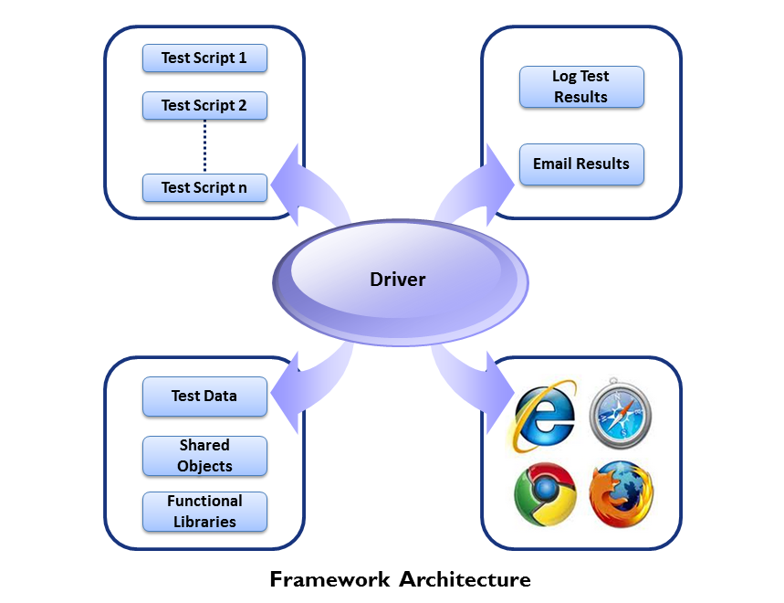
12.2-Automation Framework
Advantage of Test Automation framework
Reusability of code
Maximum coverage
Recovery scenario
Low cost maintenance
Minimal manual intervention
Easy Reporting
Generic Automation Framework Architecture

Slide 6
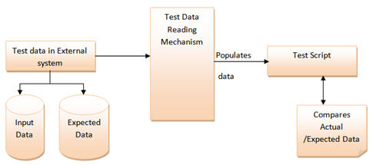
12.3-Automation Framework
Different kind of Automation Framework
1-Data-Driven Framework
2-Keyword Driven Framework
3-Hybird Framework
4-Page-Object Framework
5-BBD Framework (Cucumber)
1-Data-Driven Framework
Data Driven Testing Framework helps the user segregate the test script logic and the test data from each other. It lets the user store the test data into an external database. The external databases can be property files, xml files, excel files, text files, CSV files, ODBC repositories etc. The data is conventionally stored in “Key-Value” pairs. Thus, the key can be used to access and populate the data within the test scripts.
Note: The test data stored in an external file can belong to the matrix of expected value as well as matrix of input values.

Slide 7
12.4-Automation Framework
Pros:
The most important feature of this framework is that it considerably reduces the total number of scripts required to cover all the possible combinations of test scenarios. Thus lesser amount of code is required to test a complete set of scenarios.
Any change in the test data matrix would not hamper the test script code.
Increases flexibility and maintainability
A single test scenario can be executed altering the test data values.
Cons:
The process is complex and requires an extra effort to come up with the test data sources and reading mechanisms.
Requires proficiency in a programming language that is being used to develop test scripts.
2- Keyword Driven Testing Framework-
The Keyword driven testing framework is an extension to Data driven Testing Framework in a sense that it not only segregates the test data from the scripts, it also keeps the certain set of code belonging to the test script into an external data file.
These set of code are known as Keywords and hence the framework is so named. Key words are self-guiding as to what actions needs to be performed on the application.
The keywords and the test data are stored in a tabular like structure and thus it is also popularly regarded as Table driven Framework. Take a notice that keywords and test data are entities independent of the automation tool being used.

Slide 8
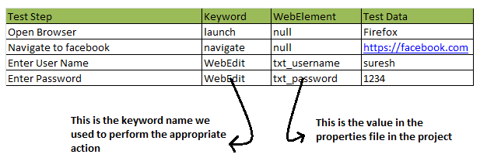
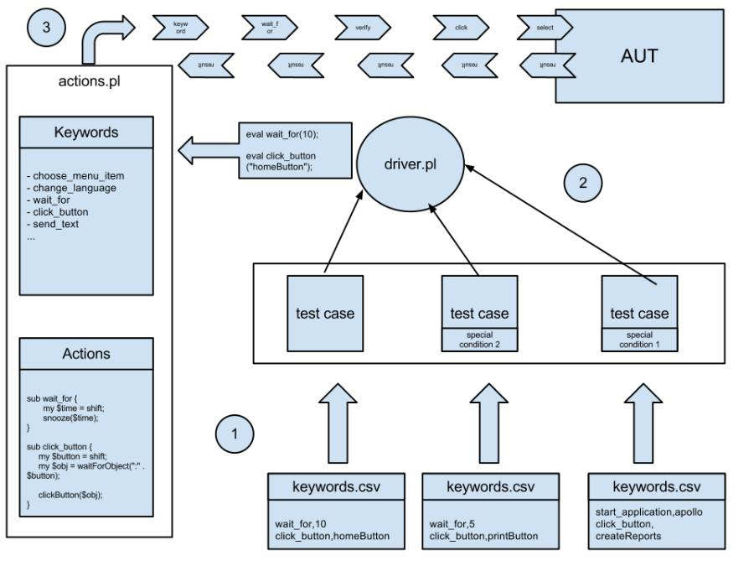
12.5-Automation Framework

Slide 9
12.6-Automation Framework
Pros:
In addition to advantages provided by Data Driven testing, Keyword driven framework doesn’t require the user to possess scripting knowledge unlike Data Driven Testing.
A single keyword can be used across multiple test scripts.
Cons:
The user should be well versed with the Keyword creation mechanism to be able to efficiently leverage the benefits provided by the framework.
The framework becomes complicated gradually as it grows and a number of new keywords are introduced.

Slide 10
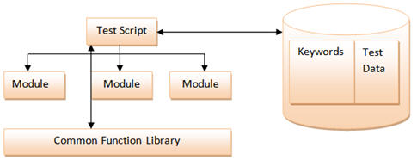
12.7-Automation Framework
3- Hybrid Testing Framework
As the name suggests, the Hybrid Testing Framework is a combination of more than one above mentioned frameworks. The best thing about such a setup is that it leverages the benefits of all kinds of associated frameworks.
In most of the organization development team is involved in the creation of automation frameworks such as Data driven or Hybrid. Since it requires some programming expertise to build up the architecture and integrate different components in it.

Slide 11
12.8-Automation Framework
4-Page Object Model Framework-
Page Object Model Framework has now a days become very popular test automation framework in the industry and many companies are using it because of its easy test maintenance and reduces the duplication of code.
What is POM?
Page Object Model is a design pattern to create Object Repository for web UI elements.
Under this model, for each web page in the application, there should be corresponding page class.
This Page class will find the WebElements of that web page and also contains Page methods which perform operations on those WebElements.
Name of these methods should be given as per the task they are performing, i.e., if a loader is waiting for the payment gateway to appear, POM method name can be waitForPaymentScreenDisplay().
Advantages of POM
Page Object Patten says operations and flows in the UI should be separated from verification. This concept makes our code cleaner and easy to understand.
The Second benefit is the object repository is independent of test cases, so we can use the same object repository for a different purpose with different tools. For example, we can integrate POM with TestNG/JUnit for functional Testing and at the same time with JBehave/Cucumber for acceptance testing.
Code becomes less and optimized because of the reusable page methods in the POM classes.
Methods get more realistic names which can be easily mapped with the operation happening in UI. i.e. if after clicking on the button we land on the home page, the method name will be like 'gotoHomePage()'.

Slide 12
12.9-Automation Framework
4-Page Object Model Framework-
Page Object Model Framework has now a days become very popular test automation framework in the industry and many companies are using it because of its easy test maintenance and reduces the duplication of code.
What is POM?
Page Object Model is a design pattern to create Object Repository for web UI elements.
Under this model, for each web page in the application, there should be corresponding page class.
This Page class will find the WebElements of that web page and also contains Page methods which perform operations on those WebElements.
Name of these methods should be given as per the task they are performing, i.e., if a loader is waiting for the payment gateway to appear, POM method name can be waitForPaymentScreenDisplay().
Advantages of POM
Page Object Patten says operations and flows in the UI should be separated from verification. This concept makes our code cleaner and easy to understand.
The Second benefit is the object repository is independent of test cases, so we can use the same object repository for a different purpose with different tools. For example, we can integrate POM with TestNG/JUnit for functional Testing and at the same time with JBehave/Cucumber for acceptance testing.
Code becomes less and optimized because of the reusable page methods in the POM classes.
Methods get more realistic names which can be easily mapped with the operation happening in UI. i.e. if after clicking on the button we land on the home page, the method name will be like 'gotoHomePage()'.

Slide 13
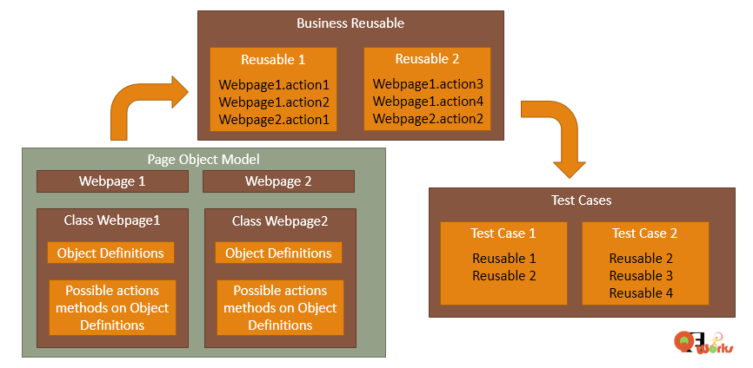
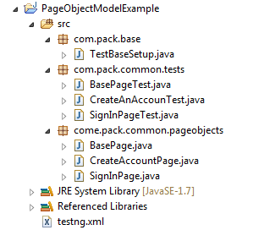
12.10-Automation Framework
Page Object Model Architecture

Slide 14
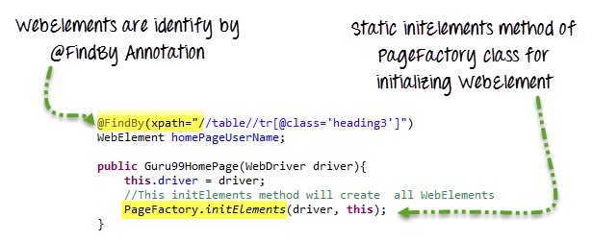
12.11-Automation Framework
What is Page Factory?
Page Factory is an inbuilt Page Object Model concept for Selenium WebDriver but it is very optimized.
Additionally, with the help of PageFactory class, we use annotations @FindBy to find WebElement. We use initElements method to initialize web elements
Pros And Cons Of POM-
Pros.
It enforces to create classes which are simple and follow user-friendly naming conventions.
You can rename the methods to make them relevant to the situation.
Since all the objects of a page stay in one class, so it’s easy to form a context between the page and locators.
The code is more maintainable and easy to debug.
Cons.
Since the code in POM rests behind an abstraction layer, so the testers may find it a bit difficult to grasp at the onset.
This model leads to loose coupling as it creates additional objects. And it could cause a slight drop in the performance at runtime.

Slide 15
12.12-Automation Framework
5-BBD Framework (Cucumber)
What is Behavior Driven Development framework?
Behavior-driven development (BDD) is a software development methodology in which an application is specified and designed by describing how its behavior should appear to an outside observer. The way BDD works is really simple – it is a bridge between business language (User Stories) and automatic tests (JUnit, TestNG). In order to keep the documentation in sync with the code – we need to run it as test in Continuous Integration build (Jenkins, Bamboo). Test specification should be written in business friendly form, for example in some text or HTML file. This way it will be easily accessible by Business Analysts. On the other hand in must fail just like any other test during Surefire or Failsafe execution. After the build we should be able to get user friendly HTML report.
Behavior Driven Development (BDD) is a rising methodology to test and check your code.
Features of Behavior Driven Development:-
Shifting from thinking in “tests” to thinking in “behavior”
Collaboration between Business stakeholders, Business Analysts, QA Team and developers
Ubiquitous language, it is easy to describe
Driven by Business Value
Extends Test Driven Development (TDD) by utilizing natural language that non technical stakeholders can understand
BDD frameworks such as Cucumber or JBehave are an enabler, acting a “bridge” between Business & Technical Language

Slide 16
12.13-Automation Framework
BDD has following frameworks:
JDave
Easyb
JBehave
Cucumber
Steps to Create a BDD Automation Framework
Step-1) Selecting Cucumber as BDD Framework -
What is Cucumber
Cucumber is basically a framework which is used for testing the application where the testscripts are written in plain english language.Mostly it is used for Acceptance testing and Functional Testing. BDD(Behavior Driven Development) technique is used while writting testcases.
In BDD, users (business analysts, product owners) first write scenarios or acceptance tests that describes the behavior of the system from the customer's perspective, for review and sign-off by the product owners before developers write their codes.

Slide 17
12.14-Automation Framework
What are the benefits of Cucumber?
It is helpful to involve business stakeholders who can't easily read code
Cucumber focuses on end-user experience
Style of writing tests allow for easier reuse of code in the tests
Quick and easy set up and execution
Efficient tool for testing
One more and very important feature of using Cucumber is ,it allows heavy reuse of code.
Prerequisites for Cucumber:
1.One must have understanding on core java. 2.One must be comfortable with using Selenium WebDriver and Maven
Basically We need three things to run the project with Cucumber. Those are listed below 1.Feature Files where the test scripts are written in plain english. 2.Step Definitions java class files where code resides 3.One Runner class which is used to run the test it can be Junit or TestNG.

Slide 18
12.15-Automation Framework
Advantages of Cucumber over other tools
Cucumber | HP ALM (QTP) | Selenium
It is free | QTP is expensive | It is free
It's a behavior driven development tool | It's a Functional Automation Tool | It's a Functional and Performance ( Selenium Grid) test tool
Plugin in cucumber works faster | Plugin are slower compare to Cucumber and Selenium | Plugins are slower than cucumber
Cucumber supports other language as well beyond Ruby like Java, Scala, Groovy etc. | QTP supports only VB script | Selenium supports Java, .Net and many other languages
Writing automation steps are joint effort of testers and developer | In QTP only tester writes automation steps | Like Cucumber, writing automation steps are joint effort of testers and developer
Cucumber supports only web environment | Support web, desktop and any client server application | Supports only web environment

Slide 19
12.16-Automation Framework
Step-2) Writing features file
What is Features File
A Feature File is an entry point to the Cucumber tests. We write feature file in Gherkin format. This is a file where you will describe your tests in Descriptive language (Like English). It is an essential part of Cucumber, as it serves as an automation test script as well as live documents. A feature file can contain a scenario or can contain many scenarios in a single feature file but it usually contains a list of scenarios. Let’s create one such file. This file can be created by BA/ QA/ Automation Engineer.
Feature File consist of following components -
Feature: A feature would describe the current test script which has to be executed.
Scenario: Scenario describes the steps and expected outcome for a particular test case.
Scenario Outline: Same scenario can be executed for multiple sets of data using scenario outline. The data is provided by a tabular structure separated by (I I).
Given: It specifies the context of the text to be executed. By using datatables "Given", step can also be parameterized.
When: "When" specifies the test action that has to performed
Then: The expected outcome of the test can be represented by "Then"
One can create as many feature files as needed. To have an organized structure, each feature should have one feature file.
Sr.No | Feature | Feature File name
1 | User Login | userLogin.feature
2 | Share the Post | sharePost.feature
3 | Create Account | createAccount.feature
4 | Delete Account | deleteAccount.feature

Slide 20
12.17-Automation Framework
What is Gherkin
Gherkin is plain-text English (or one of 60+ other languages) with a little extra structure. Gherkin is designed to be easy to learn by non-programmers, yet structured enough to allow concise description of examples to illustrate business rules in most real-world domains.
Gherkin provides the common set of keywords in English text, which can be used by people amongst the different community and yet get the same output in the form of test scripts.
Gherkin is primarily used to write structured tests which can later be used as project documentation.
Gherkin Keywords/Cucumber Annotations-1:-
1-Feature- A feature usually contains a list of scenarios to be tested for that feature. Each Gherkin file begins with a Feature keyword. Feature defines the logical test functionality you will test in this feature file. Example-
Feature − Login functionality for a social networking site.
2-Description (optional) − It Describes about feature under test. Example:-
Feature: LogIn Action Test
Description: This feature will test a LogIn and LogOut functionality
3-Background- This keyword is used to define steps which are common to all the tests in the feature file. It generally has the instruction on what to setup before each scenario runs. Example-
Feature: LogIn Action Test
Description: This feature will test a LogIn and LogOut functionality
Background: User is Logged In

Slide 21
12.18-Automation Framework
Gherkin Keywords/Cucumber Annotations-2:-
4-Scenario -Each Feature will contain some number of tests to test the feature. Each test is called a Scenario. Example-
Feature: LogIn Action Test
Description: This feature will test a LogIn and LogOut functionality
Background: User is Logged In
Scenario: Successful LogIn with Valid Credentials
5-Given - It describes the pre-requisite for the test to be executed. Example-
Feature: LogIn Action Test
Description: This feature will test a LogIn and LogOut functionality
Background: User is Logged In
Scenario: Successful LogIn with Valid Credentials
Given: User is on Home Page
6-When- It defines the trigger point for any test scenario execution or it defines the test action that will be executed. By test action we mean the user input action. Example-
Feature: LogIn Action Test
Description: This feature will test a LogIn and LogOut functionality
Background: User is Logged In
Scenario: Successful LogIn with Valid Credentials
Given: User is on Home Page
When: User Navigate to LogIn Page

Slide 22
12.19-Automation Framework
Gherkin Keywords/Cucumber Annotations-3:-
7-And-This keyword is used to add conditions to your steps. It provides the logical AND condition between any two statements. AND can be used in conjunction with GIVEN, WHEN and THEN statement. Example-
Feature: LogIn Action Test
Description: This feature will test a LogIn and LogOut functionality
Background: User is Logged In
Scenario: Successful LogIn with Valid Credentials
Given: User is on Home Page
When: User Navigate to LogIn Page
And: User enters UserName and Password
8-Then-Then holds the expected result for the test to be executed or It defines the Outcome of previous steps. Example-
Feature: LogIn Action Test
Description: This feature will test a LogIn and LogOut functionality
Background: User is Logged In
Scenario: Successful LogIn with Valid Credentials
Given: User is on Home Page
When: User Navigate to LogIn Page
And: User enters UserName and Password
Then: Message displayed LogIn Successfully
And: LogOut Link displayed

Slide 23
12.20-Automation Framework
Gherkin Keywords/Cucumber Annotations-4:-
9-But-It signifies logical OR condition between any two statements. OR can be used in conjunction with GIVEN, WHEN and THEN statement. This keyword is used to add negative type comments. It is not a hard & fast rule to use but only for negative conditions. It makes sense to use But when you will try to add a condition which is opposite to the premise your test is trying to set. Example-
Feature: LogIn Action Test
Description: This feature will test a LogIn and LogOut functionality
Background: User is Logged In
Scenario: Successful LogIn with Valid Credentials
Given: User is on Home Page
When: User Navigate to LogIn Page
And: User enters UserName and Password
But The user credentials are wrong
Then Message displayed Wrong UserName & Password
And: LogOut Link is not displayed
10-*-This keyword is very special. This keyword defies the whole purpose of having Given, When, Then and all the other keywords. Basically Cucumber doesn’t care about what Keyword you use to define test steps, all it cares about what code it needs to execute for each step. That code is called a step definition. Just remember that all the keywords can be replaced by the * keyword and your test will just work fine. Example-

Slide 24
12.21-Automation Framework
Gherkin Keywords/Cucumber Annotations-5:-
Using * Keyword
Feature: LogIn Action Test
Description: This feature will test a LogIn and LogOut functionality
Background: User is Logged In
Scenario: Successful LogIn with Valid Credentials
* User is on Home Page
* User Navigate to LogIn Page
* User enters UserName and Password
* Message displayed LogIn Successfully
* LogOut Link displayed
11-Scenario outline- It is used when same test has to be performed with different data set and used to replaces variable/keywords with the value from the table. Each row in the table is considered to be a scenario. Example-
Feature: LogIn Action Test
Description: This feature will test a LogIn and LogOut functionality
Background: User is Logged In
Scenario Outline: Successful LogIn with Valid Credentials
Given: User is on Home Page
When: User enters <UserName> and <Password>
Then: Message displayed LogIn Successfully
Examples:
|username |password |
|Tom |password1 |

Slide 25
12.22-Automation Framework
Step-3) Writing Step Definition File
Step Definitions
Every step in the scenario needs to be matched with a glue code for the same. We call this Glue file as step definition.
Step Definitions is where the automation code is written. The steps in the gherkin file directly map to the step definitions. Each step in the gherkin maps to a step definition that in turn contains a block of code that gets executed when the scenario is ran.
If any line of code inside the step definition returns an error or exception to the Cucumber Runner, then that step is marked as failed, otherwise pass.
An extremely simple representation of step definitions and how it is connected in the big picture is as below.
The steps in feature file map to each step definition in the Step Definitions file
Automation code (<code>) has to be written within each step definition block
Automation code can further refer to the support system for including modules, classes, libraries etc [For example it can include selenium library to handle browser UI automation]
The support system in turn depends on the packages/libraries provided by the programming language stack that is used. In Ruby, it is called gems and in Java it is called jars.

Slide 26
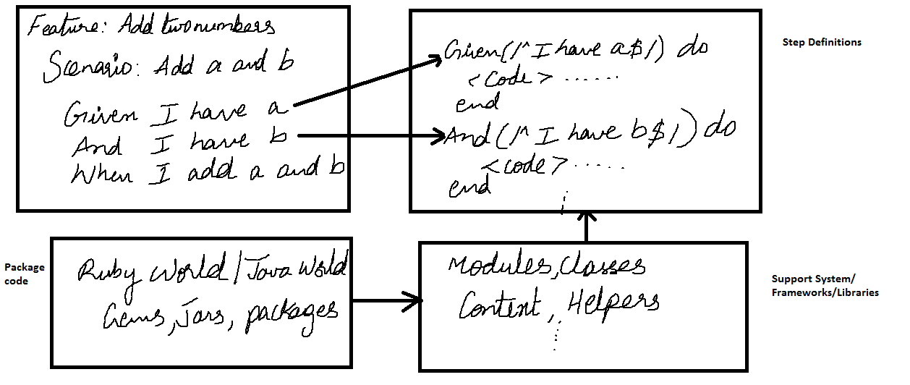
12.23-Automation Framework
Tag.feature file
@SmokeTest
Feature: Google Testing
Scenario: Verify that Search functinality for Google.
Given I am on the Google page
StepDefination.java
@Given("^I am on the Google page$")
public void user_Navigate_to_LogIn_Page() throws Throwable
{
driver.findElement(By.xpath(".//*[@id='account']/a")).click();
}

Slide 27
12.24-Automation Framework
Step-4) Writing Test Runner File
Test Runner Class
Cucumber uses Junit/Testng framework to run step definition file. As Cucumber uses Junit we need to have a Test Runner class. This class will use the Junit annotation @RunWith(), which tells JUnit what is the test runner class. It more like a starting point for Junit to start executing your tests.
The same way we use TestNG to run cucumber test.
Run with TestNG-
import cucumber.api.CucumberOptions;
import cucumber.api.testng.AbstractTestNGCucumberTests;
@CucumberOptions(features="classpath:dataTable", // path for feature file
glue={"classpath:dataTable"}, // path for stepdefination file
format={"pretty","html:target/Destination"}, // report type
tags = {"@ReggressionTest","@negaviveScenario"} ) // tags to be executed
public class dataTableRunnerTNG extends AbstractTestNGCucumberTests
{}
Run with Junit-
import org.junit.runner.RunWith;
import cucumber.api.junit.Cucumber;
import cucumber.api.CucumberOptions;
@RunWith(Cucumber.class)
@CucumberOptions(features="src/msn.feature"
, format={"pretty","html:target/Destination"})
public class runner
{}

Slide 28
12.25-Automation Framework
Following are Technologies Required to develop a Automation Solution using Cucumber:-
1-Java - As a Programming language
2-BDD- As a Development framework
3-Cucumber- As a BDD framework
3-Maven - As Build Tools
4-Jenkins -As Continues Integration Tool
5-Junit/Testng- As a Unit testing framework to run the scripts
6-Selenium- Selenium will be used to interact the web-application.

Slide 29
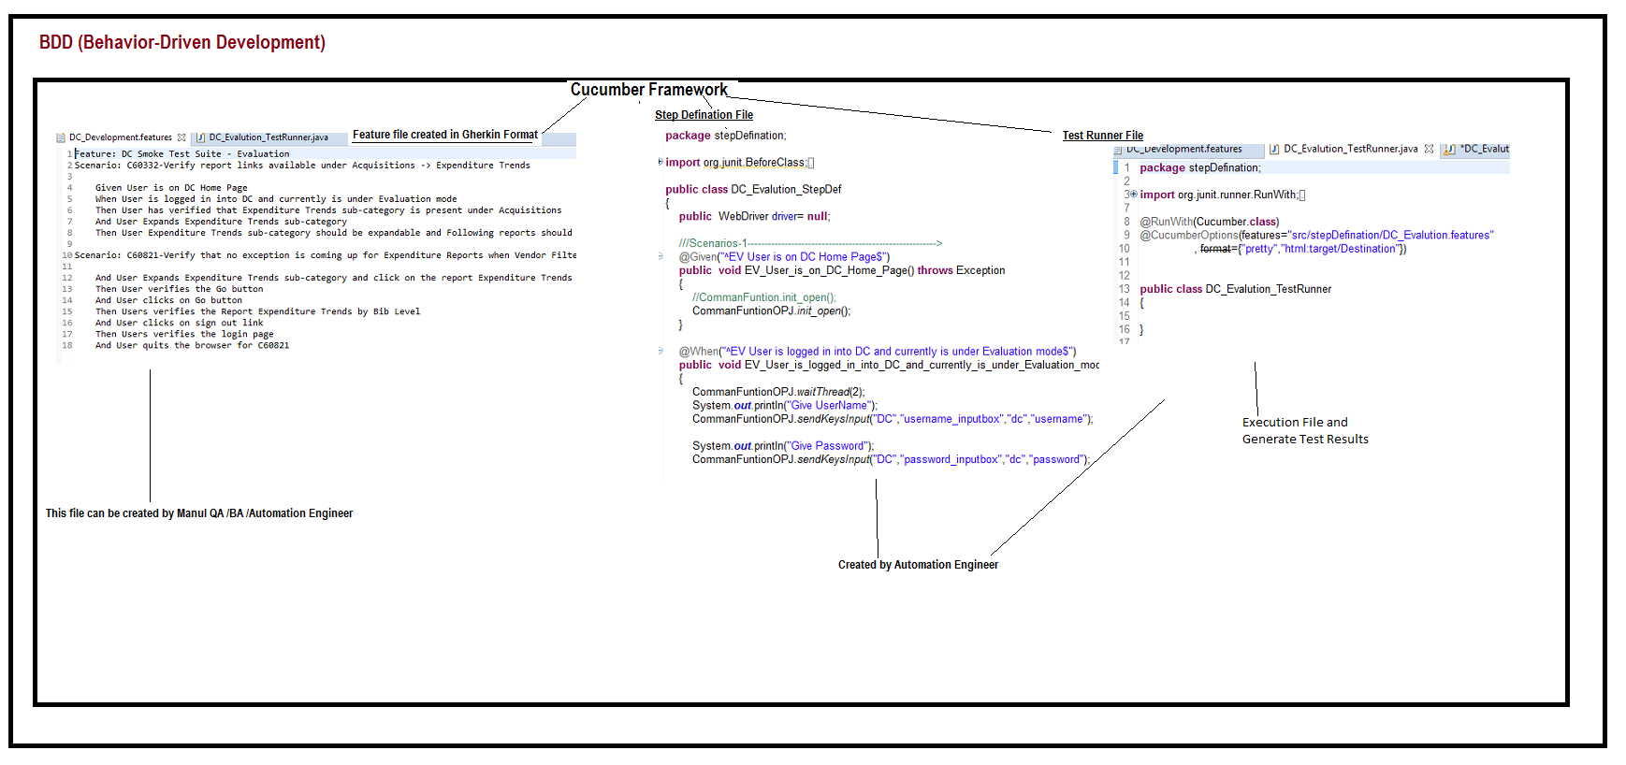
12.26-Automation Framework
BBD Framework (Cucumber)-Architecture

Slide 30
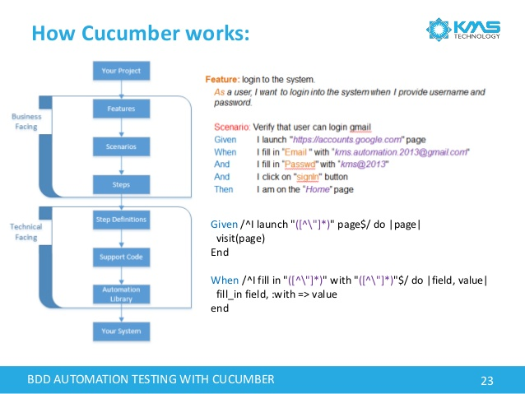
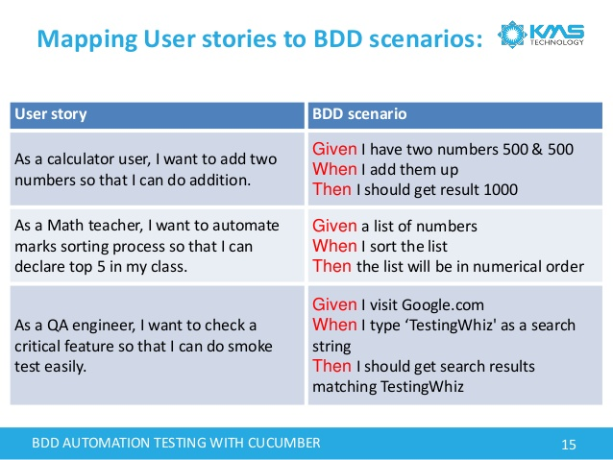
12.27-Automation Framework

Slide 31
12.28-Automation Framework
Cucumber - Data Tables
Data Tables in Cucumber are quite interesting and can be used in many ways. DataTables are also used to handle large amount of data. They are quite powerful but not the most intuitive as you either need to deal with a list of maps or a map of lists. Most of the people gets confused with Data tables & Scenario outline, but these two works completely differently.
Example-Feature file:-
Feature: Data table
Scenario: Verify that the new user registration is unsuccessful after passing incorrect inputs.
Given I am on the new user registration page
When I enter invalid data on the page
| Fields | Values |
| First Name | Tom |
| Last Name | Kenny |
| Email Address | someone@someone.com |
| Re-enter Email Address | someone@someone.com |
| Password | Password1 |
| Birthdate | 01 |
StepDefination
@When("^I enter invalid data on the page$")
public void enterData(DataTable table)
{
List<List<String>> data = table.raw();
System.out.println(data.get(1).get(1));
driver.findElement(By.name("firstname")).sendKeys(data.get(1).get(1));
}

Slide 32
12.29-Automation Framework
Difference between Scenario Outline & Data Table
Scenario Outline:
This uses Example keyword to define the test data for the Scenario
This works for the whole test
Cucumber automatically run the complete test the number of times equal to the number of data in the Test Set
Test Data:
No keyword is used to define the test data
This works only for the single step, below which it is defined
A separate code is need to understand the test data and then it can be run single or multiple times but again just for the single step, not for the complete test

Slide 33
12.30-Automation Framework
Cucumber - Tags
It looks simple when we just have one, two, or maybe five scenarios in a feature file. However, in real life it does not happen. For each feature under test, we may have 10, 20, or may be more number of scenarios in a single feature file. They may represent different purpose (Smoke test/Regression test), different prospectives (Developer/QA/BA), different status (Ready for execution/Work in progress), etc. How to manage execution for such a mass?
For this, Cucumber has already provided a way to organize your scenario execution by using tags in feature file. We can define each scenario with a useful tag. Later, in the runner file, we can decide which specific tag (and so as the scenario(s)) we want Cucumber to execute. Tag starts with “@”. After “@” you can have any relevant text to define your tag. Let’s understand this with an example.
Suppose, there are two or more scenarios in a feature file. We want to execute only one scenario as part of smoke test. So first thing is to identify that scenario and second is to tag it with “@SmokeTest” text at the beginning of the scenario
There is no limit in defining tags within the feature file. Based on your need, you can derive tags to be used and scenarios to be executed.
There are mainly two types of tag −
Default tag − Default tag has their predefined meanings. Example @Dev,@Ignore
Custom tag − Custom tag provides you full flexibility to choose appropriate text for defining your tag.

Slide 34
12.31-Automation Framework
Cucumber – Tags Example
Example- tag.feature
@ReggressionTest
Feature: Yahoo Testing
@positiveScenario
Scenario: Verify that Login functinality for Yahoo
Given I am on the Yahoo Home page
When I Click Login link
Then Close Yahoo Application
Scenario: Verify that Email functinality for Yahoo
Given I am on the Yahoo Home page
When I Click Email link
Then Close Yahoo Application
@negaviveScenario
Scenario: Verify that Cricket functinality for Yahoo
Given I am on the Yahoo Home page
When I Click Cricket link
Then Close Yahoo Application
Example- Runner.Java
package dataTable;
@CucumberOptions(features="classpath:dataTable",
glue={"classpath:dataTable"},
format={"pretty","html:target/Destination"},
tags = {"@ReggressionTest","@negaviveScenario"}
)
public class dataTableRunnerTNG extends AbstractTestNGCucumberTests
{
static ‘
{
System.out.println("In DC_Evalution_TestRunner Runner file");
}
}

Slide 35
12.32-Automation Framework
Cucumber - Hooks
Cucumber hook allows us to better manage the code workflow and helps us to reduce the code redundancy. We can say that it is an unseen step, which allows us to perform our scenarios or tests.
So to bring optimization, hooks can be utilized. More often we use two types of hooks: “Before” hook and “After” hook. Method/function/piece of code, defined within Before and After hooks, always run, even if the scenario gets passed or failed.
As the name suggests, before hook gets executed well before any other test scenarios, and after hook gets executed after executing all the scenarios.
Hooks are defined within the step definition file only.
They can be used in 2 ways:
@Before
@After
Tagged Hooks
These are much like the scenario hooks but the only difference is that they are executed before and after the specified tag.
So basically, they can also be run in the following two ways:
Before ('tagName')
After ('tagName')
This can be used when we need some kind of a feature level setup and teardown, assuming that all the scneario are tagged with the same feature name.

Slide 36
12.33-Automation Framework
Cucumber – Hooks Example
Example- ScenarioHook.Java
@Before public void setUp()
{
driver = new FirefoxDriver();
}
@Given("^user navigates to facebook$")
public void goToFacebook()
{
driver.navigate().to("https://www.facebook.com/");
}
Example- TagggedHook.Java
@Before("Signup-DataDriven")
public void signupSetup()
{
System.out.println("This should run everytime before any of the @Signup-DataDriven tagged scenario is going to run");
}
@Given("^user navigates to facebook$")
public void goToFacebook()
{
driver.navigate().to("https://www.facebook.com/");
}
@After("Signup-DataDriven")
public void signupTeardown()
{
System.out.println("This should run everytime after any of the @Signup-DataDriven tagged scenario has run");
}

Slide 37
13-Introduction to Maven

Slide 38
13.0-Introduction to Maven
What are build tools?
Build tools are programs that automate the creation of executable applications from source code(eg. .apk for android app). Building incorporates compiling, linking and packaging the code into a usable or executable form.
Basically build automation is the act of scripting or automating a wide variety of tasks that software developers do in their day-to-day activities like:
Downloading dependencies.
Compiling source code into binary code.
Packaging that binary code.
Running tests.
Deployment to production systems.
Why do we use build tools or build automation?
In small projects, developers will often manually invoke the build process. This is not practical for larger projects, where it is very hard to keep track of what needs to be built, in what sequence and what dependencies there are in the building process. Using an automation tool allows the build process to be more consistent.
Various build tools available(Naming only few):
For java - Ant,Maven,Gradle.
For .NET framework - NAnt
c# - MsBuild.

Slide 39
13.1-Introduction to Maven
What Maven build toos?
Apache Maven is an advanced build tool to support the developer at the whole process of a software project. Typical tasks of a build tool are the compilation of source code, running the tests and packaging the result into JAR_ files. In additional to these typical build capabilities, Maven can also perform related activities, e.g., create web sites, upload build results or generate reports.
Maven allows the developer to automate the process of the creation of the initial folder structure for the Java application, performing the compilation, testing, packaging and deployment of the final product. It is implemented in Java which makes it platform-independent. Java is also the best work environment for Maven.
What is POM in Maven?
POM stands for Project Object Model. It is fundamental unit of work in Maven. It is an XML file that resides in the base directory of the project as pom.xml.
Maven dependency?
Maven’s dependency mechanism help to download all the necessary dependency libraries automatically, and maintain the version upgrade as well.
Ex-
<dependencies>
<dependency>
<groupId>log4j</groupId>
<artifactId>log4j</artifactId>
<version>1.2.14</version>
</dependency>
</dependencies>

Slide 40
13.2-Introduction to Maven
Sr.No. | Node & Description
1 | Project root This is project root tag. You need to specify the basic schema settings such as apache schema and w3.org specification.
2 | Model version Model version should be 4.0.0.
3 | groupId This is an Id of project's group. This is generally unique amongst an organization or a project. For example, a banking group com.company.bank has all bank related projects.
4 | artifactId This is an Id of the project. This is generally name of the project. For example, consumer-banking. Along with the groupId, the artifactId defines the artifact's location within the repository.
5 | version This is the version of the project. Along with the groupId, It is used within an artifact's repository to separate versions from each other. For example − com.company.bank:consumer-banking:1.0 com.company.bank:consumer-banking:1.1.

Slide 41
13.3-Introduction to Maven
How to install Maven on windows
You can download and install maven on windows, linux and MAC OS platforms. Here, we are going to learn how to install maven on windows OS.
To install maven on windows, you need to perform following steps:
Download maven and extract it
Add JAVA_HOME and MAVEN_HOME in environment variable
Add maven path in environment variable
Verify Maven

Slide 42
13.4-Introduction to Maven
How to install Maven on Eclipse:-
Maven Eclipse plugin installation step by step:
Open Eclipse IDE
Click Help -> Install New Software...
Click Add button at top right corner
At pop up: fill up Name as "M2Eclipse" and Location as "http://download.eclipse.org/technology/m2e/releases" or http://download.eclipse.org/technology/m2e/milestones/1.0
Now click OK
After that installation would be started.
Another way to install Maven plug-in for Eclipse:
Open Eclipse
Go to Help -> Eclipse Marketplace
Search by Maven
Click "Install" button at "Maven Integration for Eclipse" section
Follow the instruction step by step
After successful installation do the followings in Eclipse:
Go to Window --> Preferences
Observe, Maven is enlisted at left panel
Finally,
Click on an existing project
Select Configure -> Convert to Maven Project

Slide 43
14-Introduction to CI - Jenkins

Slide 44
14.1-Introduction to Continues Integration
What Continues Integration?
Continuous Integration (CI) is the process of automating the build and testing of code every time a team member commits changes to version control.
CI encourages developers to share their code and unit tests by merging their changes into a shared version control repository after every small task completion. Committing code triggers an automated build system to grab the latest code from the shared repository and to build, test, and validate the full master branch (also known as the trunk or main).
CI requires the development team’s code be merged to a shared version control branch continuously to avoid these problems.
CI has the following built in automation to check the validity of the code that was checked in:
Static code analysis: Reporting the results of static code execution
Compile: Generating the executable files by linking the code and compiling after
Unit test: Writing unit tests, executing them, checking code coverage and reporting the results
Deploy: Build the code and install it into a test/production environment.
Integration test: Providing results by executing the integration tests.
Report (dashboard): Indicating the status of key parameters by posting Red, Green, and Yellow to a publicly visible location.

Slide 45
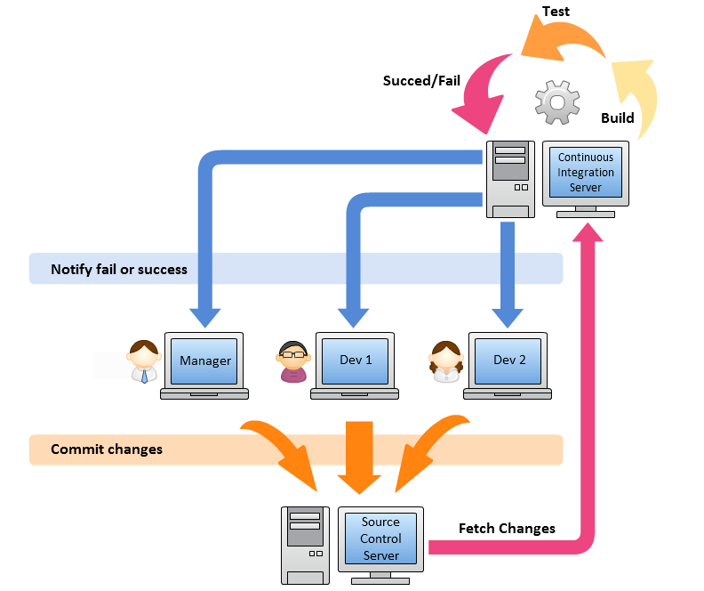
14.2-Introduction to Continues Integration

Slide 46
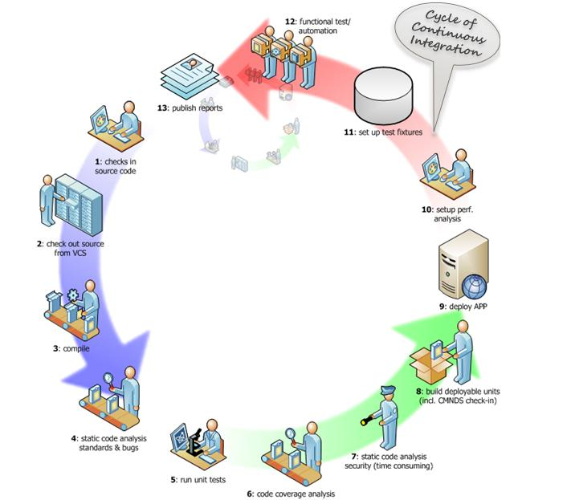
14.3-Introduction to Continues Integration

Slide 47
1.4-Introduction to Continues Integration
CI provides the following benefits to its users
Reduced integration risk. More often than not, working on projects means multiple people are working on the separate tasks or parts of the code. The more people, the riskier the integration. Depending on how bad the problem really is, debugging and solving the issue can be really painful and can potentially mean a lot of changes to the code. Integrating on a daily basis or even more frequently can help reduce these kinds of problems to a minimum.
Higher code quality. Not having to worry about the problems, and focusing more on the functionality of the code results in a higher quality product.
The code in version control works. If you have committed something that breaks the build, you and your team get the notice immediately and the problem is fixed before anyone else pulls the “broken” code.
Reduced friction between team members. Having the impartial system in place reduces the frequency of quarrels between team members.
The quality of life improvement for testers. Having different versions and builds of the code can help isolate and trace bugs efficiently, and it makes life easier for the QA team.
Less time deploying. Deploying projects can be very tedious and time-consuming, and automating that process makes perfect sense.
Increased confidence and morale. People that don’t work for fear of breaking something, are more likely to produce better results and can focus their energy and concentration on producing instead of worrying about potential consequences of their actions.

Slide 48
14.5-Introduction to Continues Integration
There are six practices that help individuals and teams running CI on a project:-
Commit code frequently
Don’t commit broken code
Write unit tests
Fix broken builds immediately
All tests must pass
Avoid getting broken code
CI also has the following risks and challenges:
CI tools maintenance and their administration have associated costs to it.
CI guidelines need to be well established before starting it.
Test automation is a rare skill in the market and existing testers may have to be trained on that.
Full fledge test coverage is required to see the benefits to automation.
Teams sometimes depend too much on the unit testing and ignore automation and acceptance testing.
So in summary, CI is advantageous to a project team, if the required tools are put in place for automating the build process.

Slide 49
14.6-Introduction to Continues Integration
CI Servers
CI server (or build server) is the software tool that centralizes all your CI operations and provides a reliable and stable environment for you to build your projects on. CI servers are highly configurable and adjustable to be able to build a variety of projects for different platforms. Running builds and tests are the basic features of every build server.
The most important things to consider when using CI server is to have a clean machine prepared for its installation. Having a neutral environment, untainted by unnecessary tools, environment variables, and other configurations, is crucial for the successful usage of the CI server and CI overall. If it’s not possible to install the CI server physical machine, you can set up a virtual environment and use it as the last resort.
Using development machines without setting up virtual environments will probably leave you with false assumptions and results, and you will have the same problems when deploying as you would without using the CI server.
Typically CI server uses a version control system like Subversion or Git or any other to pull your project files. It monitors your project’s repository and on the successful commit it pulls the changes and performs the tasks you defined previously for that project. Upon completion of the tasks, CI server sends feedback to the relevant project members with the details of the build. Checking out the latest version of your project, running the build scripts, running the tests, and sending notifications are the most basic functionalities of the CI servers.
Besides these, features like code analysis, code coverage, code quality reports, agent pooling, pipelines, build comparisons, IDE integration, third party tools support and many others make the CI servers very flexible and comfortable to use.

Slide 50
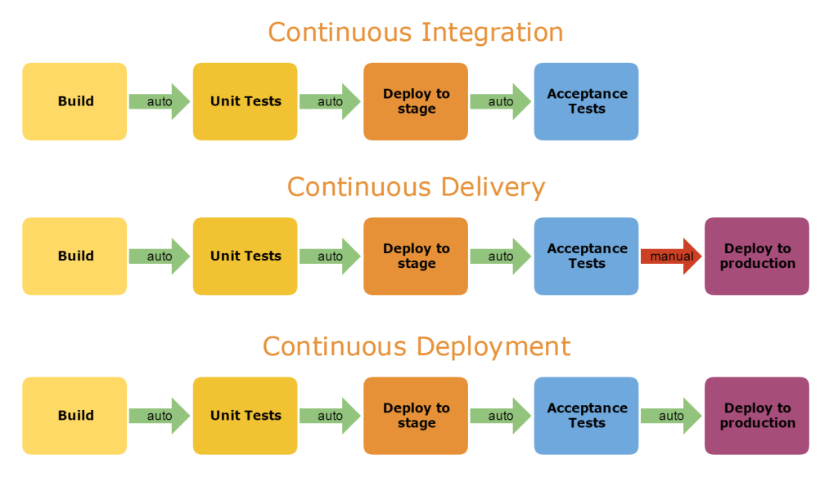
14.7-Introduction to Continues Integration
CI Servers

Slide 51
14.8-Introduction to Continues Integration
Top Continuous Integration Tools
1-Jenkins
Official website: Jenkins Availability: Free Platform: Cross-platform
2-TeamCity
Official website: TeamCity Availability: Free for 3 agents and 20 build configurations and paid for additional agents Platform: Servlet container (On-premises)
3-Bamboo
Official website: Bamboo Availability: Paid with free trial Platform: On-premises
4-GitLab CI
Official website: GitLab CI Availability: Free and paid with trial Platform: Hosted (can be hosted for you on Gitlab.com)

Slide 52
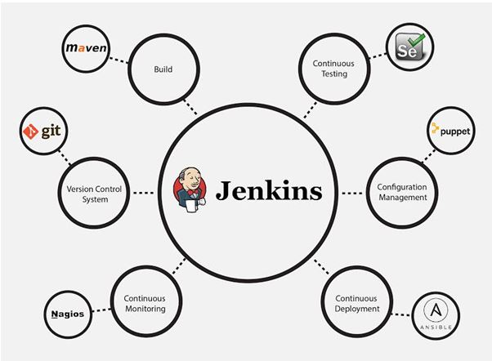
14.9-Introduction to Continues Integration
What is Jenkins?
Jenkins is an open source automation tool written in Java with plugins built for Continuous Integration purpose. Jenkins is used to build and test your software projects continuously making it easier for developers to integrate changes to the project, and making it easier for users to obtain a fresh build. It also allows you to continuously deliver your software by integrating with a large number of testing and deployment technologies.
With Jenkins, organizations can accelerate the software development process through automation. Jenkins integrates development life-cycle processes of all kinds, including build, document, test, package, stage, deploy, static analysis and much more.
Jenkins achieves Continuous Integration with the help of plugins. Plugins allows the integration of Various DevOps stages. If you want to integrate a particular tool, you need to install the plugins for that tool. For example: Git, Maven 2 project, Amazon EC2, HTML publisher etc.
The image below depicts that Jenkins is integrating various DevOps stages

Slide 53
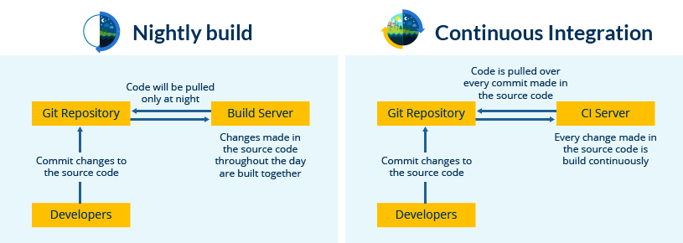
14.10-Introduction to Continues Integration
Advantages of Jenkins
Jenkins is an open source tool with much support from its community.
Installation is easier.
It has more than 1000 plug-in to make the work easier.
It is easy to create new Jenkins plugin if one is not available.
It is a tool which is written in Java. Hence it can be portable to almost all major platforms.
Type of Build Process

Slide 54
14.11-Introduction to Continues Integration
Continuous Integration With Jenkins
Let us imagine a scenario where the complete source code of the application was built and then deployed on test server for testing. It sounds like a perfect way to develop a software, but, this process has many flaws. I will try to explain them one by one:
Developers have to wait till the complete software is developed for the test results.
There is a high possibility that the test results might show multiple bugs. It was tough for developers to locate those bugs because they have to check the entire source code of the application.
It slows the software delivery process.
Continuous feedback pertaining to things like coding or architectural issues, build failures, test status and file release uploads was missing due to which the quality of software can go down.
The whole process was manual which increases the risk of frequent failure.
It is evident from the above stated problems that not only the software delivery process became slow but the quality of software also went down. This leads to customer dissatisfaction. So to overcome such a chaos there was a dire need for a system to exist where developers can continuously trigger a build and test for every change made in the source code. This is what CI is all about. Jenkins is the most mature CI tool available so let us see how Continuous Integration with Jenkins overcame the above shortcomings.

Slide 55
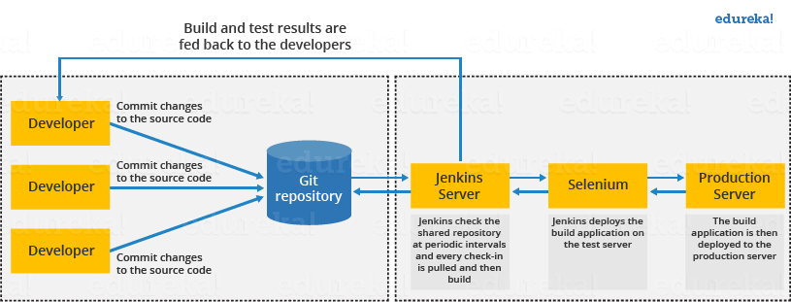
14.12-Introduction to Continues Integration
Continuous Integration With Jenkins
A generic flow diagram of Continuous Integration with Jenkins so that it becomes self explanatory, how Jenkins overcomes the above shortcomings:

Slide 56
14.13-Introduction to Continues Integration
The above diagram is depicting the following functions:
First, a developer commits the code to the source code repository. Meanwhile, the Jenkins server checks the repository at regular intervals for changes.
Soon after a commit occurs, the Jenkins server detects the changes that have occurred in the source code repository. Jenkins will pull those changes and will start preparing a new build.
If the build fails, then the concerned team will be notified.
If built is successful, then Jenkins deploys the built in the test server.
After testing, Jenkins generates a feedback and then notifies the developers about the build and test results.
It will continue to check the source code repository for changes made in the source code and the whole process keeps on repeating.
You now know how Jenkins overcomes the traditional SDLC shortcomings. The table below shows the comparison between “Before and After Jenkins”.
Before Jenkins | After Jenkins
The entire source code was built and then tested. Locating and fixing bugs in the event of build and test failure was difficult and time consuming, which in turn slows the software delivery process. | Every commit made in the source code is built and tested. So, instead of checking the entire source code developers only need to focus on a particular commit. This leads to frequent new software releases.
Developers have to wait for test results | Developers know the test result of every commit made in the source code on the run.
The whole process is manual | You only need to commit changes to the source code and Jenkins will automate the rest of the process for you

Slide 57
14.14-Introduction to Continues Integration
Steps to install Jenkin-1
https://www.guru99.com/maven-jenkins-with-selenium-complete-tutorial.html
Step 1) Go to http://jenkins-ci.org/and download correct package for your OS. Install Jenkins.
Step 2) Unzip Jenkins to specified folder. Run exe file as shown in zip.
Step 3) In Jenkins 1.607 Setup window click on Next button.
Step 4) Once installation is done, navigate to the Jenkins Dashboard (http://localhost:8080 by default) in the browser window.
Step 6) Click on the New Item link to create a CI job.
Step 7) Select the Maven project radio button as shown.
Step 6) Click on OK button. A new job with name "WebdriverTest" is created in Jenkins Dashboard.
Step 7) Go to Manage Jenkins => Configure System as shown.
Step 8) Go to the Build section of new job.
In the Root POM textbox, enter full path to pom.xml
In Goals and options section, enter "clean test"
Step 9) Click on Apply button.
Step 10) On the WebdriverTest project page, click on the Build Now link.
Step 11) Once the build process is completed, in Jenkins Dashboard click on the WebdriverTest project
Step 12) The WebdriverTest project page displays the build history and links to the results as shown in the following screenshot:
Step 13) Click on the "Latest Test Result" link to view the test results as shown in the following screenshot:
Step 14). Select specific build, and you will see the current status by clicking on "console output".

Slide 58
14.15-Introduction to Continues Integration
Features of Jenkins-2
-Easy Installation
-Easy Upgrade
-Scriptability
-View Filters
-Maven
This plugin allows you to take advantage of Maven’s features. Jenkins reads your project’s dependencies from your POM and, if those are also built on Jenkins, sets up triggers in such a way that a new build in one of those dependencies will automatically start a new build in this project. Jenkins understands all kinds of dependencies in POM, namely:
parent POM
<dependencies> section of your project
<extensions> section of your project
<reporting> section of your project
-Amazon EC2
Amazon Elastic Compute Cloud (Amazon EC2) is a web service that provides resizable compute capacity in the cloud. It is designed to make web-scale cloud computing easier for developers.Amazon EC2’s simple web service interface allows you to obtain and configure capacity with minimal friction. It provides you with complete control of your computing resources and lets you run on Amazon’s proven computing environment.

Slide 59
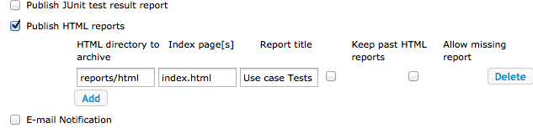
14.16-Introduction to Continues Integration
-HTML publisher
This plugin is handy with built-in copy to master functionality. Imagine that you have some files generated through your builds that are not actual artifacts.Html Publisher plugin is useful to publish the html reports that your build generates to hudson webpage.
Below are the steps to publish and archive the html report files.
-Click on the Configure option for your Hudson job.
-In the post build portion, look for the Publish HTML Reports option and select the checkbox. See the screen shot below.
-Throttle Builds
This plugin allows you to group jobs, and allow only some defined number of jobs run concurrently (in most cases, it is one) in the same environment. Take test jobs that use some container instances preinstalled on your master/slaves, for example: this plugin allows you to configure your jobs so that they will run on different slaves or wait for another job to finish before starting.

Slide 60
14.17-Introduction to Continues Integration
Jenkin Projects and Build Setups-3
A-Jenkins – Maven Setup
https://www.tutorialspoint.com/jenkins/jenkins_maven_setup.htm
B-Jenkins - Git Setup
https://www.tutorialspoint.com/jenkins/jenkins_git_setup.htm
C-Jenkins - Setup Build Jobs
https://www.tutorialspoint.com/jenkins/jenkins_setup_build_jobs.htm
D-Jenkins - Unit Testing
https://www.tutorialspoint.com/jenkins/jenkins_unit_testing.htm
E-Jenkins – Selenium Automated Testing
https://www.tutorialspoint.com/jenkins/jenkins_automated_testing.htm
F-Jenkins- Cucumber Reporting Setup in Jenkins
http://www.seleniumframework.com/continuous-test-automation/cucumber-jenkins-plugins/
D- Configure a Schedule/Corn Job in Jenkins
https://www.youtube.com/watch?v=xRhEkLxmi0s
https://davedevelopment.co.uk/2015/06/04/scheduled-tasks-with-jenkins.html

Slide 61
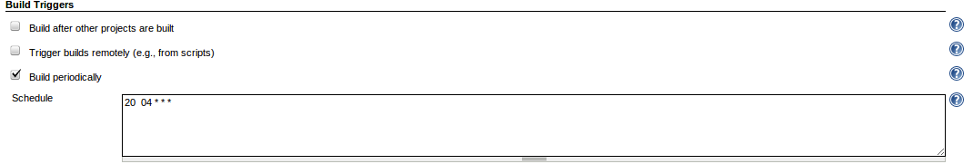
14.18-Introduction to Continues Integration
Configure a Schedule/Corn Job in Jenkins-4
Configure a Schedule/Corn Job in Jenkins
https://www.youtube.com/watch?v=xRhEkLxmi0s
https://davedevelopment.co.uk/2015/06/04/scheduled-tasks-with-jenkins.html
Under the build triggers section, check Build periodically and enter a schedule. The schedule is much like the cron schedule, but there are a few differences - use jenkins' built in help to learn more
Format to schedule a Job:-
MINUTE (0-59), HOUR (0-23), DAY (1-31), MONTH (1-12), DAY OF THE WEEK (0-6)
The letter H, representing the word Hash can be inserted instead of any of the values, it will calculate the parameter based on the hash code of your project name, this is so that if you are building several projects on your build machine at the same time, lets say midnight each day, they do not all start there build execution at the same time, each project starts its execution at a different minute depending on its hash code. You can also specify the value to be between numbers, i.e. H(0,30) will return the hash code of the project where the possible hashes are 0-30

Slide 62
14.19-Introduction to Continues Integration
Examples:
A-Start build daily at 08:30 in the morning, Monday – Friday= 30 08 * * 1-5
B-Weekday daily build twice a day, at lunchtime 12:00 and midnight 00:00, Sunday to Thursday=00 0,12 * * 0-4
C-Start build daily in the late afternoon between 4:00 p.m. - 4:59 p.m. or 16:00 -16:59 depending on the projects hash =H 16 * * 1-5
D-Start build at midnight=@midnight
F-Start build at midnight, every Saturday= 59 23 * * 6
G-Every first of every month between 2:00 a.m. - 02:30 a.m= H(0,30) 02 01 * *
H-A job which runs every Day of the week, every Month in a year , every Day in a month at a time between 3 – 4 am in the morning at any minute = H H(3-4) * * *
I-A job which runs every Day of the week, every Month in a year , every Day in a month at 3 am in the morning between 30 -45 minutes= H (30 -45) 3 * * *
J-If you want to shedule your build every 5 minutes, this will do the job = */5 * * * *
K-Schedule your build every day at 8h 00, this will do the job= 4 : 0 8 * * *

