Slide 1
Software Automation Testing- Part-4

Slide 2
Table of Contents:-
15-Introduction to Robot Sikuli Auto-IT

Slide 3
15-Introduction to Robot, Sikuli Auto-IT
15.1-What is Robot Framework
15.2- What is Sikuli
15.3- What is Auto-IT

Slide 4
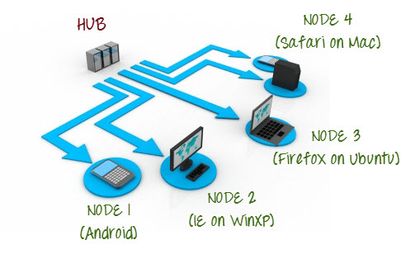
15.1-What is Robot Framework
Selenium Grid?
Selenium Grid is a part of the Selenium Suite that specializes in running multiple tests across different browsers, operating systems, and machines in parallel.
Selenium Grid has 2 versions - the older Grid 1 and the newer Grid 2. We will only focus on Grid 2 because Grid 1 is gradually being deprecated by the Selenium Team.
Selenium Grid uses a hub-node concept where you only run the test on a single machine called a hub, but the execution will be done by different machines called nodes.

