Slide 1
Software Automation Testing- Part-5

Slide 2
Table of Contents:-
16-Selenium Grid

Slide 3
16-Introduction to Selenium Grid
16.1-What is Selenium Grid
16.2- Selenium Grid Architecture
16.3- Selenium Grid Implementation

Slide 4
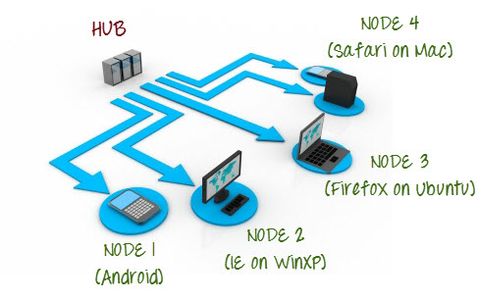
16.1-What is Selenium Grid
Selenium Grid?
Selenium Grid is a part of the Selenium Suite that specializes in running multiple tests across different browsers, operating systems, and machines in parallel.
Selenium Grid has 2 versions - the older Grid 1 and the newer Grid 2. We will only focus on Grid 2 because Grid 1 is gradually being deprecated by the Selenium Team.
Selenium Grid uses a hub-node concept where you only run the test on a single machine called a hub, but the execution will be done by different machines called nodes.

Slide 5
16.2-What is Selenium Grid
When to Use Selenium Grid?
You should use Selenium Grid when you want to do either one or both of following:
Run your tests against different browsers, operating systems, and machines all at the same time. This will ensure that the application you are Testing is fully compatible with a wide range of browser-O.S combinations.
Save time in the execution of your test suites. If you set up Selenium Grid to run, say, 4 tests at a time, then you would be able to finish the whole suite around 4 times faster.
Benefits of Selenium Grid:
Selenium Grid gives the flexibility to distribute your test cases for execution.
Reduces batch processing time.
Can perform multi browser testing.
Can perform multi OS testing.

Slide 6
16.3-What is Selenium Grid
Selenium Grid Architecture
The Hub-
The hub is the central point where you load your tests into.
There should only be one hub in a grid.
The hub is launched only on a single machine, say, a computer whose O.S is Windows 7 and whose browser is IE.
The machine containing the hub is where the tests will be run, but you will see the browser being automated on the node.
The Nodes:-
Nodes are the Selenium instances that will execute the tests that you loaded on the hub.
There can be one or more nodes in a grid.
Nodes can be launched on multiple machines with different platforms and browsers.
The machines running the nodes need not be the same platform as that of the hub.
How it works?
First you need to create a hub. Then you can connect (or “register”) nodes to that hub. Nodes are where your tests will run, and the hub is responsible for making sure your tests end up on the right one (e.g., the machine with the operating system and browser you specified in your test).

Slide 7
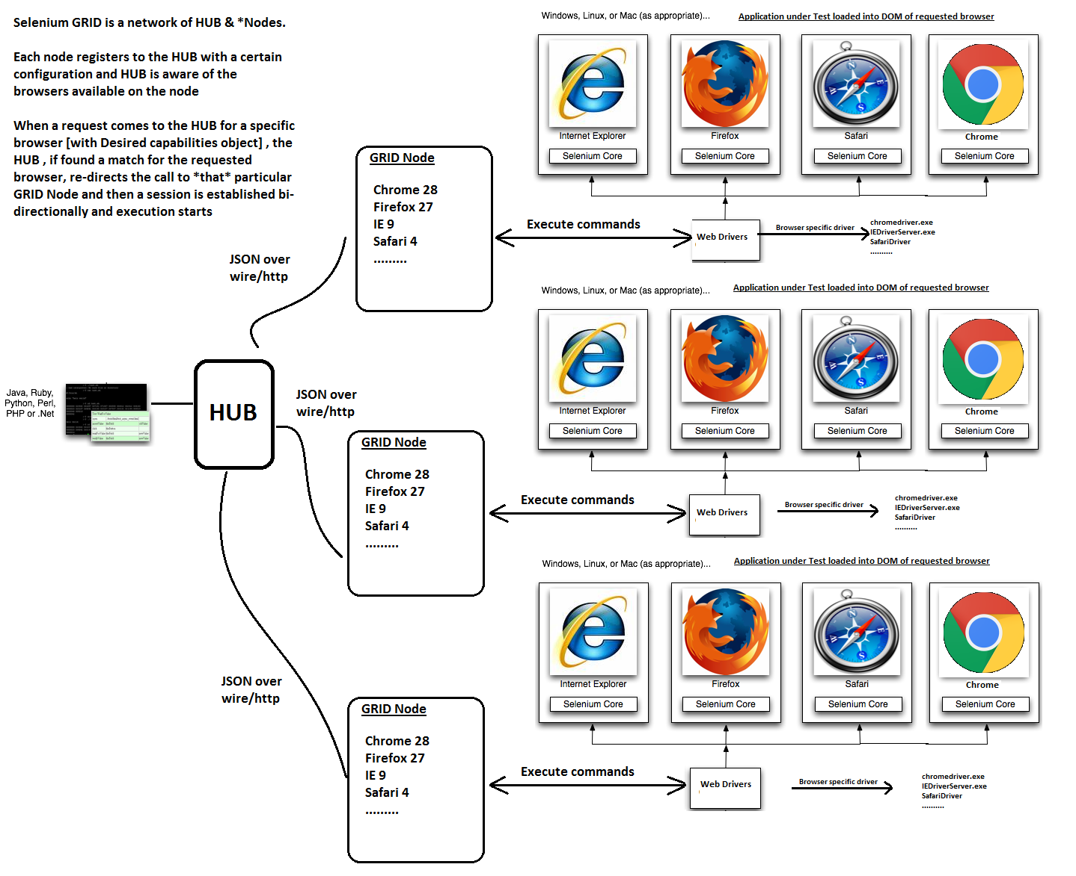
16.3-What is Selenium Grid
Selenium Grid Architecture-2

Slide 8
16.3-What is Selenium Grid
Selenium Grid Architecture-3
Some of the important term in GRID:-
JSON over wire: JSON messages hold the entire information that is required by the server [can be Selenium GRID or WebDriver components] and hence instead of RPC, plain JSON messages are exchanged between server and client. Also referred to as WebDriver protocol
Desired Capabilities: Object in automation code that has requesting browser configuration information
RemoteWebDriver: Object in automation code that knows how to communicate remotely with WebDriver / Selenium GRID

Slide 9
16.3-What is Selenium Grid
Selenium Grid Installation Steps:1
Step 1 : Download Selenium Server and Set up GRID Hub
1) Download the latest Selenium Server file from http://docs.seleniumhq.org/download/.
2) You can place the Selenium Server jar file anywhere in your hard drive. But for the purpose of this tutorial, place it on the C: Drive of Hub Machine. After doing this, you are now done installing Selenium Grid.
3) We are now going to launch a hub. Open command prompt and navigate to the C: Drive, because that is the directory where we placed the Selenium Server. On the command prompt, type java -jar selenium-server-standalone-3.3.1.jar -role hub.
Note:
Make sure you change the version number from the command accordingly.
Your Grid server will up and running till the time command prompt window is opened, if you close it, that will also stop the selenium server.
Selenium Grid, by default uses port 4444 for its web interface. To start the same on other port, use this command: java -jar selenium-server-standalone-3.3.1.jar -port 4455 -role hub
The hub will be launched and command prompt should look similar to the image below
4) To verify whether hub is running, open the browser and navigate to http://localhost:4444
Console gives the information what is available on the Hub. As of now it will be blank, as there is no machine connected to it.

Slide 10
16.3-What is Selenium Grid
Selenium Grid Installation Steps:2
5) Now click the Console link and then click View Config. The config of the hub would be displayed.
This page contains lots of details which may or may not be necessary for your test. We will cover these in the later tutorial of Grid.

