Slide 1
Software Automation Testing- Part-6

Slide 2
Table of Contents:-
17-Configuration Management

Slide 3
17-Introduction to Configuration Management
17.1-What is Configuration Management
17.2- Configuration Management Architecture
17.3- Configuration Management Implementation

Slide 4
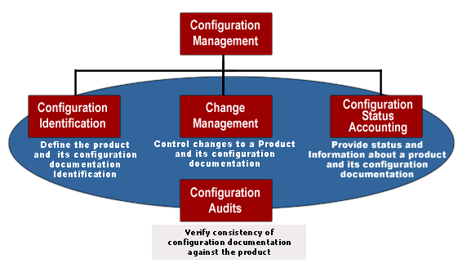
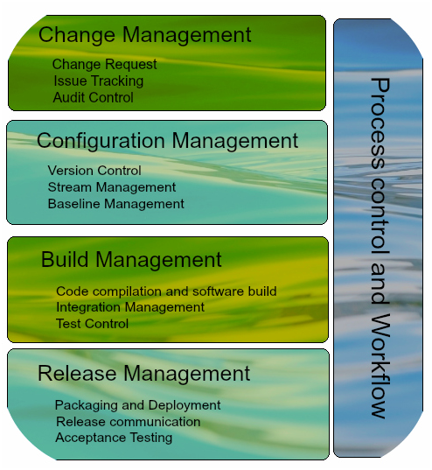
17.1-What is Configuration Management
Configuration Management?
Software Configuration management (SCM) is the task of tracking and controlling changes in the software. Configuration management practices include revision control and the establishment of baselines. It is a field of management that focuses on establishing and maintaining consistency of a system or product's performance and its functional and physical attributes with its requirements, design, and operational information throughout its life.

Slide 5
17.2-What is Configuration Management
Features Configuration Management?
Enter configuration management tools. Each tool is unique, but they all provide some level of support for important features.
Enforcement- Configuration enforcement may be the single most important feature of a configuration management tool. By running regularly and ensuring the machine is configured to the desired state, configuration management tools prevent configuration drift. Configuration drift can happen in a variety of ways: Package updates, live debugging, "helpful" coworkers, etc. Whatever the cause, being able to say with confidence, "This is how this machine is configured," is a great way to shorten incident resolution time and reduce surprises.
Enables cooperation- Configuration management tools make it easier for team members to cooperate. With one change, configuration can be updated across the entire infrastructure. Hand-editing configuration on machines can only lead to unexpected differences. By putting all of the configuration in one place, you can keep from stepping on someone else's (including future you) toes.
Version control friendly- Of course, the best way to enable cooperation is to have everything in a version control system. All of the tools listed below use some form of text for configuration. This means you can take advantage of the benefits of your favorite version control system. The benefits of version control are beyond the scope of this article, but let me assure you from experience that you really, really want your configuration in a version control system.
Enables change control processes- Because configuration management tools are textual and VCS-friendly, you can treat infrastructure changes like code. Changes can be submitted as diffs or merge requests and be subject to code review before approval. Having explicitly enumerated changes with timestamps can make reconstructing incidents much easier. With atomic changes, you can release them at a rate you're comfortable with instead of throwing a bucket of changes at your infrastructure all at once.
Abstraction-Few sysadmins maintain completely homogeneous environments. Even if you're an all-Linux shop, you probably have multiple distros that you support, or at least multiple versions of a distro. With configuration management tools, many of the operating-system-specific implementations of a configuration are abstracted away for you. The same configuration file can be used to manage, for example, the installation of Apache HTTPD on both Red Hat and Ubuntu systems.

Slide 6
17.3-What is Configuration Management
Configuration Management Process?
The configuration management process is comprised of 5 disciplines that will establish a product’s baseline, and manage any changes over time:
Planning and Management: This guides the design of the product, who has what responsibilities, and includes which tools and procedures to use. It identifies third-party requirements and the audit and review process.
Identification: Allows for setting baselines and identifying the configuration of assets and/or software.
Control: Maintain control of configurations, change requests, and execution of changes to a system and its documentation.
Status Accounting: The process of recording and reporting configuration item descriptions and changes from the baseline over the item’s life-cycle. If a problem arises, this allows for a quick determination of the baseline configuration and changes that have taken place over time.
Verification/Audit: Be able to audit what you have implemented and maintain positive control of all managed product

Slide 7
17.4-What is Configuration Management
Why Is Configuration Management Important?
Configuration Management (CM) ensures that the current design and build state of the system is known, good & trusted and doesn’t rely on the tacit knowledge of the development team.
CM help in accessing accurate historical record of system, which is very useful for project management and audit purposes. By knowing what has changed between one set of tests and the next, it helps to identify what could possibly be causing a fault.
Some of the key benefits of Configuration Management include:
It facilitates the ability to communicate status of documents and code as well as changes that have been made to them. High-quality of the software that has been tested and used, makes it a reusable asset and saves development costs
Increased efficiencies, stability and control by improving visibility and tracking.
The ability to define and enforce formal policies and procedures that govern asset identification, status monitoring, and auditing.
All components and sub-components are carefully itemized. This means there is a clear understanding of a product and its component elements and how they relate to each other.
Maintains project team morale. A change to a specification of a product can have a detrimental effect when the team have to redo all their work.
It helps to eliminate confusion, chaos, double maintenance and the shared data problem.

Slide 8
17.5-What is Configuration Management
What Happens If We Don’t Do Configuration Management?
There’s a commercial that you may have seen. An auto mechanic talks about a costly engine repair that could have been avoided if the car’s owner had replaced his oil filter. The mechanic says, “You can pay me now, or you can pay me later.” The quote is just as valid with regard to configuration management.
You can avoid the costs associated with configuration management by not bothering to employ it in your enterprise. If you do, however, you’ll probably pay instead in costs for:
Figuring out which system components to change when requirements change.
Re-doing an implementation because you implemented to meet requirements that had changed and you didn’t communicate that to all parties.
Losing productivity when you replace a component with a flawed new version and can’t quickly revert to a working state.
Replacing the wrong component because you couldn’t accurately determine which component needed replacing.
The reason that configuration management is included as a key systems engineering practice is simple. It works! It keeps you from incurring costs preventatively and helps IT stop fire fighting. And, good systems engineers have learned, through practical experience, that it pays for itself many times over.

Slide 9
17.6-What is Configuration Management
Configuration Management Tools-1
https://www.upguard.com/articles/the-7-configuration-management-tools-you-need-to-know
http://electric-cloud.com/wiki/display/releasemanagement/Configuration+Management+Tools#ConfigurationManagementTools-ListofAutomation-DrivenConfigurationManagementTools
1-IBM Rational ClearCase
www-03.ibm.com
An enterprise-grade configuration management system that provides highly secure version control, work management and build management support.
2-CFEngine
cfengine.com
A configuration management and automation framework that lets you securely manage your mission critical IT infrastructure.
3-SaltStack Enterprise DevOps
saltstack.com
Orchestration and automation software for CloudOps, ITOps and DevOps at speed and scale.
4-Ansible
ansible.com
A solution for configuration management, designed to be minimal in nature, consistent, secure, and highly reliable, with a low learning curve for administrators, developers, and IT managers.
5-Borland AccuRev
borland.com
Software configuration and change management uniquely suited to optimize large scale agile software delivery.

Slide 10
17.7-What is Configuration Management
Configuration Management Tools-2
6-Rudder
rudder-project.org
Web-Driven, Role-Based Solution for IT Infrastructure Automation & Compliance
7-Aras Solutions
aras.com
Provides configuration identification, control, status accounting and verification. Tracks baselines at different stages of the product lifecycle, e.g. as-designed, as-built, as-maintained.
8-Capistrano
capistranorb.com
A remote server automation tool which supports scripting and execution of arbitrary tasks, and includes a set of sane-default deployment workflows.
9-Chef
chef.io
Automate how you build, deploy, and manage your infrastructure.
10Vagrant
docs.vagrantup.com
Provides easy to configure, reproducible, and portable work environments built on top of industry-standard technology and controlled by a single consistent workflow
11-Puppet Labs
puppetlabs.com
Automated configuration management eliminates a lot of manual work, and creates greater stability and predictability.

Slide 11
17.8- Configuration Management Architecture
Pros:
The most important feature of this framework is that it considerably reduces the total number of scripts required to cover all the possible combinations of test scenarios. Thus lesser amount of code is required to test a complete set of scenarios.
Any change in the test data matrix would not hamper the test script code.
Increases flexibility and maintainability
A single test scenario can be executed altering the test data values.
Cons:
The process is complex and requires an extra effort to come up with the test data sources and reading mechanisms.
Requires proficiency in a programming language that is being used to develop test scripts.
2- Keyword Driven Testing Framework-
The Keyword driven testing framework is an extension to Data driven Testing Framework in a sense that it not only segregates the test data from the scripts, it also keeps the certain set of code belonging to the test script into an external data file.
These set of code are known as Keywords and hence the framework is so named. Key words are self-guiding as to what actions needs to be performed on the application.
The keywords and the test data are stored in a tabular like structure and thus it is also popularly regarded as Table driven Framework. Take a notice that keywords and test data are entities independent of the automation tool being used.

Slide 12
17.7-What is Configuration Management
Configuration Management Tools-2
6-Rudder
rudder-project.org
Web-Driven, Role-Based Solution for IT Infrastructure Automation & Compliance
7-Aras Solutions
aras.com
Provides configuration identification, control, status accounting and verification. Tracks baselines at different stages of the product lifecycle, e.g. as-designed, as-built, as-maintained.
8-Capistrano
capistranorb.com
A remote server automation tool which supports scripting and execution of arbitrary tasks, and includes a set of sane-default deployment workflows.
9-Chef
chef.io
Automate how you build, deploy, and manage your infrastructure.
10Vagrant
docs.vagrantup.com
Provides easy to configure, reproducible, and portable work environments built on top of industry-standard technology and controlled by a single consistent workflow
11-Puppet Labs
puppetlabs.com
Automated configuration management eliminates a lot of manual work, and creates greater stability and predictability.

