Slide 1
Software Automation Testing- Part-7

Slide 2
Table of Contents:-
18-Unix and Sever Configuration
19-Shell Scripts integration in Automation

Slide 3
18-Introduction to Unix/Linux
18.1-What is UNIX/Linux OS
18.2- Unix/Linux Commands
18.3- Shell Scripts

Slide 4
18.1-What is UNIX/Linux OS
What is UNIX?
UNIX® License PlateUNIX is an operating system which was first developed in the 1960s, and has been under constant development ever since. By operating system, we mean the suite of programs which make the computer work. It is a stable, multi-user, multi-tasking system for servers, desktops and laptops.
UNIX systems also have a graphical user interface (GUI) similar to Microsoft Windows which provides an easy to use environment. However, knowledge of UNIX is required for operations which aren't covered by a graphical program, or for when there is no windows interface available, for example, in a telnet session.
Types of UNIX
The Linux PenguinThere are many different versions of UNIX, although they share common similarities. The most popular varieties of UNIX are Sun Solaris, GNU/Linux, and MacOS X.
Here in the School, we use Solaris on our servers and workstations, and Fedora Linux on the servers and desktop PCs.
The UNIX operating system
The UNIX operating system is made up of three parts; the kernel, the shell and the programs. To understand what the UNIX operating system is, you should have a basic understanding of its key components. The following diagram is a visual representation of the UNIX operating system environment:

Slide 5
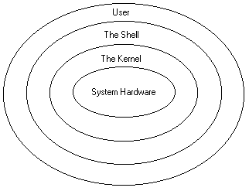
18.1-What is UNIX/Linux OS
The user is someone who utilizes the UNIX operating system to perform a specific task. The system hardware includes components such as the computer's CPU (central processing unit), memory, disk drives, CDROM drives, or network interface cards. If you have not used a computer running the UNIX operating system before, the terms kernel and shell may be new to you. The following is a brief overview of these very important pieces of the overall environment.
The kernel
The kernel of UNIX is the hub of the operating system: it allocates time and memory to programs and handles the filestore and communications in response to system calls.
As an illustration of the way that the shell and the kernel work together, suppose a user types rm myfile (which has the effect of removing the file myfile). The shell searches the filestore for the file containing the program rm, and then requests the kernel, through system calls, to execute the program rm on myfile. When the process rm myfile has finished running, the shell then returns the UNIX prompt % to the user, indicating that it is waiting for further commands.

Slide 6
18.1-What is UNIX/Linux OS
The Shell
As you can see from the diagram above, the shell is not part of the kernel, but it does communicate directly with the kernel. It is the "shell around the kernel."
The shell is a command line interpreter that executes the commands you type in. It translates your commands from a human-readable format into a format that can be understood by the computer. In addition to carrying out your commands, the shell also allows you to manage your working environment and is an effective programming language.
[ If you are new to UNIX and need an overview of important UNIX commands and concepts, check out our Basic UNIX Commands and Concepts Tutorial for Beginners ]
Since the shell is a program, just like a word processor or spreadsheet application, different shells can be used on a single system. This allows users to work with the shell they like the best, and can also make the computer system appear different to users using different shells because each shell has its own way of doing things.
The following is a list of commonly used shell programs:
� The Bourne Shell
� The C Shell
� The Bourne Again Shell
� The Korn Shell

Slide 7
18.1-What is UNIX/Linux OS
Files and processes
Everything in UNIX is either a file or a process.
A process is an executing program identified by a unique PID (process identifier).
A file is a collection of data. They are created by users using text editors, running compilers etc.
Examples of files:
a document (report, essay etc.)
the text of a program written in some high-level programming language
instructions comprehensible directly to the machine and incomprehensible to a casual user, for example, a collection of binary digits (an executable or binary file);
a directory, containing information about its contents, which may be a mixture of other directories (subdirectories) and ordinary files.
All the files are grouped together in the directory structure. The file-system is arranged in a hierarchical structure, like an inverted tree. The top of the hierarchy is traditionally called root (written as a slash / )
Multiuser and Multitasking
The UNIX operating systems is a multiuser operating systems. This means that the operating system can be used by multiple users simultaneously. This functionality is possible because of the ability of the kernel to allocate CPU time to many programs at once, which allows it to serve many users at once when each user is running one or more programs. The process of the kernel rapidly switching from one program to another is called time-sharing because the kernel shares the CPU's time with each program running on the system.
Multitasking is the ability for a single system user to carry out multiple tasks simultaneously. For example, say you wanted to extract a large amount of data from a database. Since this task may take a significant amount of time, it would be nice if you could work on something else while the data is being extracted. UNIX allows you to process this time-consuming task in the background while you are working on another task (e.g. composing a document in a word processor).

Slide 8
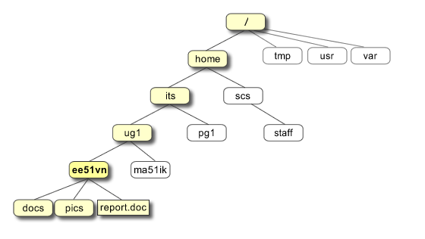
18.1-What is UNIX/Linux OS
The Directory Structure
All the files are grouped together in the directory structure. The file-system is arranged in a hierarchical structure, like an inverted tree. The top of the hierarchy is traditionally called root (written as a slash / )
In the diagram above, we see that the home directory of the undergraduate student "ee51vn" contains two sub-directories (docs and pics) and a file called report.doc.
The full path to the file report.doc is "/home/its/ug1/ee51vn/report.doc"

Slide 9
18.1-What is UNIX/Linux OS
UNIX vs. Windows Hosting
In the world of web site hosting there are two main types of operating system platforms on which you may host your web site, namely: UNIX and Windows. Each has its own set of unique features, advantages and disadvantages.
While it is difficult to say which one is the better choice, it is not as difficult to answer which is the better choice given your needs. The language which your site is programmed in is what primarily dictates the type of hosting you need.
Note: The operating system that you use on your desktop computer (the vast majority of people use some flavor of Windows) has absolutely nothing to do with the one that your host needs to serve your web site. Most personal sites are created with MS FrontPage and even although that is a Microsoft product, it can be hosted perfectly on a UNIX web server with FrontPage Extensions installed.
Stability:
UNIX systems (we actually use Linux but for comparison purposes they are identical) are hands-down the winner in this category. There are many factors here but to name just a couple big ones: in our experience UNIX handles high server loads better than Windows and UNIX machines seldom require reboots while Windows is constantly needing them. Servers running on UNIX enjoy extremely high up-time and high availability/reliability.
Performance:
While there is some debate about which operating system performs better, in our experience both perform comparably in low-stress conditions however UNIX servers under high load (which is what is important) are superior to Windows.
Scalability:
Web sites usually change over time. They start off small and grow as the needs of the person or organization running them grow. While both platforms can often adapt to your growing needs, Windows hosting is more easily made compatible with UNIX-based programming features like PHP and MySQL. UNIX-based web software is not always 100% compatible with Microsoft technologies like .NET and VB development. Therefore if you wish to use these, you should choose Windows web hosting.

Slide 10
18.1-What is UNIX/Linux OS
UNIX vs. Windows Hosting
Compatibility:
Web sites designed and programmed to be served under a UNIX-based web server can easily be hosted on a Windows server, whereas the reverse is not always true. This makes programming for UNIX the better choice.
Price:
Servers hosting your web site require operating systems and licenses just like everyone else. Windows 1803 and other related applications like SQL Server each cost a significant amount of money; on the other hand, Linux is a free operating system to download, install and operate. Windows hosting results in being a more expensive platform.
Conclusion:
To sum it up, UNIX-based hosting is more stable, performs faster and more compatible than Windows-based hosting. You only need Windows hosting if you are going to developing in .NET or Visual Basic, or some other application that limits your choices.

