Slide 1
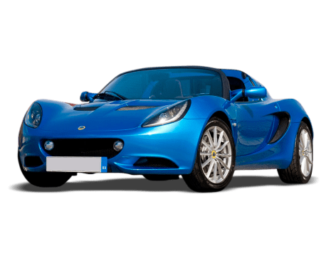
Used Car Analysis
Capstone Project
Author : Carla Kirby
This Photo by Unknown Author is licensed under CC BY-NC

Slide 2
Overview
In this multiple linear regression project we will review a used car data set.
The insights gathered will be used to address the following questions:
fuel type affect car price? dependent variable
Define the variables which share high correlation to the sale price based on region.
Are there any Electric cars in the dataset, and do they make an impact on overall result?
Any additional insights will be used to train and educate the staff

Slide 3
Business Problem
Used Car Lot TM is a car sales company running for 2 years as a local business in India. The General Manager has requested some information about second hand car sales in the various North, South, East and West regions. With fuel prices increasing and transport a dominant necessity, some important business questions were asked.
What regions in India sold the highest number of used cars?
Does fuel type affect the car sale price?
Do electric cars make an impact on a sales? (Elaborate from a business perspective).
What are some other factors that share a connection to sales prices?
From this analysis we intend on building a multiple linear regression (OLS) to model the relationships amongst the sale price. The Used Car Lot intends on using the insights extracted to ensure their business prosperity and overall sales objectives are met proportionally. The information obtained will also be used to educate their sales team and help the business thrive.

Slide 4
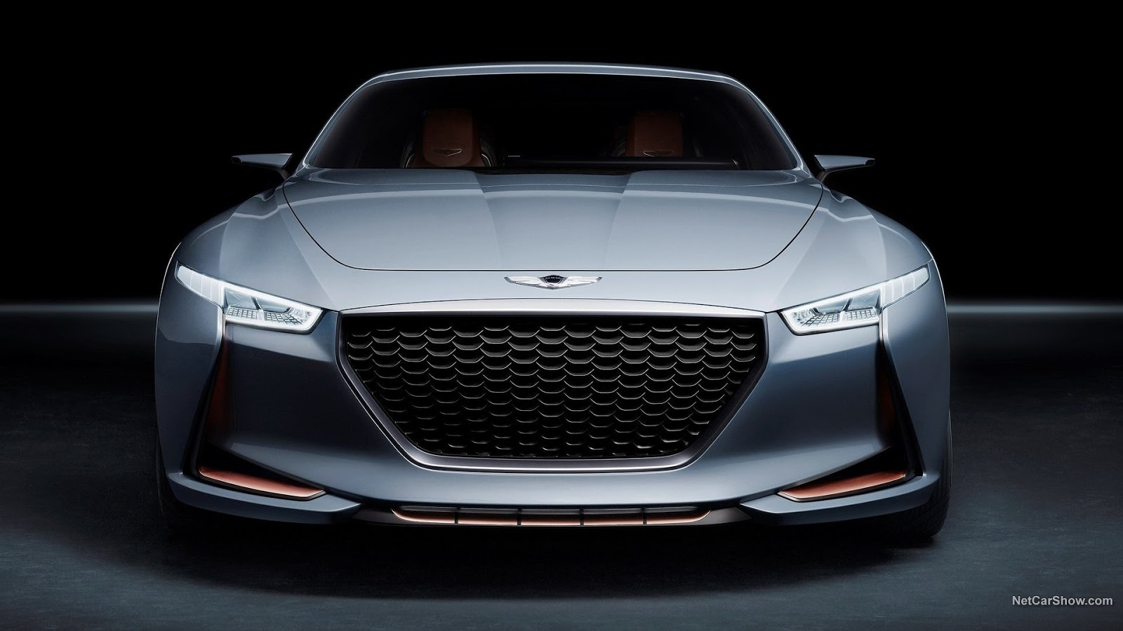
Discussion Points
Data
Model used to investigate CRISP –DM
Discuss common Business Problems
Process methods used
Results
Conclusions

Slide 5
Data
Models & Visualizations
Dataset size is over 7000
Source of used cars in India. Regions span across Mumbai, Pune, Chennai, Hyderabad, Jaipur, Delhi, Bangalore, Delhi and more.
The dataset is comprised of values such as mileage, year built, power, seats, engine type, kilometers driven and the price.
Sourced from data.gov, a reliable data source online.
Dataset required much categorical refinement in order to wrangle and manipulate for exploratory analysis, in conjunction with basic data analysis functions using matplot lib, numPy, pandas, statsmodels, and scikitlearn.
OLS – Ordinary Least Square in statsmodels
Box plots
Histograms
Heat Maps
Bell Graphs
QQ Plot
Created fata frames to tabulate the data
Created test data
Trained the model to predict
MSE – Mean Squared Error using

Slide 6
Business Questions
Results
Does fuel type affect car price?
Define variables that possess a high correlation to price via region?
Discover variables that share the strongest correlations to price overall?
Are there any Electric cars in the dataset, and do they make an impact on overall result?
A used car lot would know what are the top vehicles sold by region and any suggesting factors found that attribute to the sales.
Electric Fuel Price & Diesel scored the highest based on the data set directly affecting the cost of the car. Petrol, LPG, and CNG vehicles were sold for less.
Region, year, kilometers driven, mileage, engine, seats and price were the chosen variables to price correlation.
Electric car impact was noted to directly align with price with slight multicollinearity to fuel consumption biases.
Model fit perfectly – without over or under fitting based on the variables

Slide 7
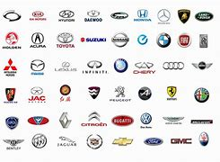
Conclusions
1. Top Region in India that sold the most cars is Mumbai
8. Manual Cars sold for less than automatic
2. Diesel is the preferred fuel type
3. Electric vehicles sold are in similar price range of diesel fueled premium cars
7. Transmission & Owner type are negatively correlated
6. Price has a high correlation with Power
4.Year, mileage, number of seats and power have a positive correlation with sale price
5. Top 5 Used Cars sold in India were: Maruti, Hyundai, Honda, Toyota, Mercedes Benz
What regions in India sold the highest number of used cars? : Mumbai
Does fuel type affect the car sale price? Data represented Diesel is the preferred fuel
Do electric cars make an impact on a sales
What are some other factors that share a connection to sales prices
Best Sellers Maruti, Hyundai, Honda, Toyota, Mercedes Benz
Price has a high correlation with Power
Transmission & Owner type are negatively correlated
Manual Cars sold for less than automatic
Notes:
#Import the necessary libraries.
import warnings
warnings.filterwarnings("ignore")
%matplotlib inline
import numpy as np
import pandas as p
from matplotlib import pyplot as plt
import seaborn as sns
#from sklearn.model_selection import train_test_split
#from sklearn.linear_model import LinearRegression

Slide 8
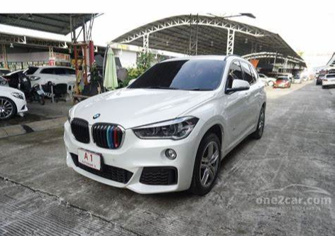
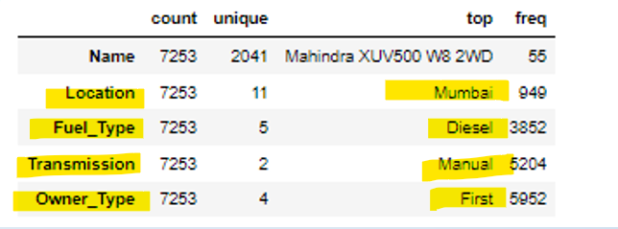
Facts & Stats:
Statistic | Value
Adj R Squared Value | .953
F Statistic | 1.033
P-Value | .201

