Slide 1
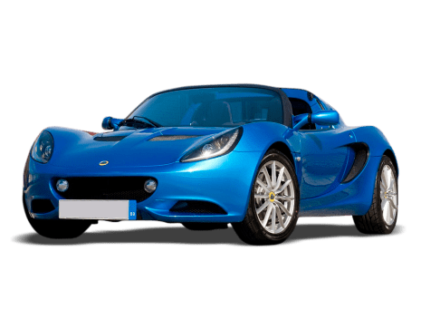
Used Car Analysis
Author : Carla Kirby
Capstone Project
This Photo by Unknown Author is licensed under CC BY-NC

Slide 2
Overview
In this multiple linear regression project we will review a used car data set.
The insights gathered they will be used to address the following questions:
Does fuel type affect car price?
Define the variables have the highest correlation to the price based on region
Discover the variables that share the strongest correlations to price?
Are there any Electric cars in the dataset, and do they make an impact on overall result?
Additionally, factual credible information will be used to educate the staff

Slide 3
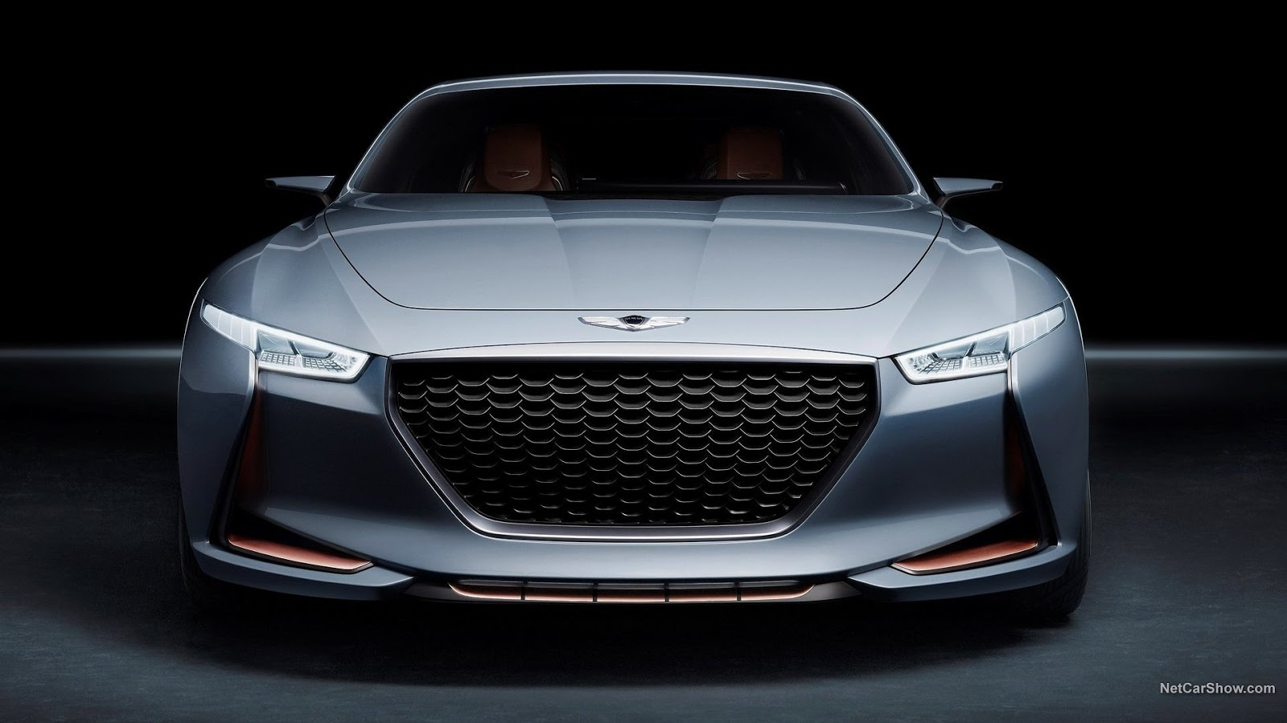
Agenda Discussion Points
Data
Model used to investigate
Discuss common Business Problems
Process methods used
Results
Conclusions

Slide 4
Data
Models & Visualizations
Data set is over 7000 lines
Source of used cars in India
Comprised of values such as mileage,Year built, power, seats, engine type, kilometers driven and the price
Sourced from data.gov, a reliable data source online
Dataset require categorical refinement and many functions to be created in order to wrangle and manipulate for exploratory analysis
OLS – Ordinary Least Square in statsmodels
Box plots
Histograms
Heat Maps
Bell Graphs
QQ Plot
Created fata frames to tabulate the data
Created test data
Trained the model to predict
MSE – Mean Squared Error using

Slide 5
Business Problem
Results
Yes – Electric Fuel Price & Diesel scored the highest based on the data set directly affecting the cvost pf the car. Petrol, LPG, and CNG were significantly less.
Region, Year, Kilometers driven, Mileage, engine, Seats and price were the chosen variables to price correlation.
Electric car impact was noted to directly align with price with slight multicollinearity to fuel consumption biases.
Does fuel type affect car price?
Define variables that possess a high correlation to price via region?
Discover variables that share the strongest correlations to price overall?
Are there any Electric cars in the dataset, and do they make an impact on overall result?
A used car lot would know what are the top vehicles sold by region and any suggesting factors that attribute to the sales.

Slide 6

Conclusions
Top 5 Used Cars in India were: Maruti, Hyundai, Honda, Toyota, Mercedes Benz

Slide 7
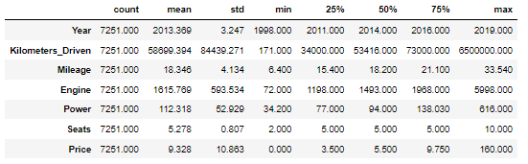
Two Content Layout with Table
First bullet point here
Second bullet point here
Third bullet point here
Class | Group A | Group B
Class 1 | 82 | 95
Class 2 | 76 | 88
Class 3 | 84 | 90

Slide 8
Two Content Layout with SmartArt
Group A
Task 2
Group B
Task 1
Task 2
Group C
Task 1
Task 1
Task 2
First bullet point here
Second bullet point here
Third bullet point here

Slide 9
Title and Content Layout with Chart

Slide 10
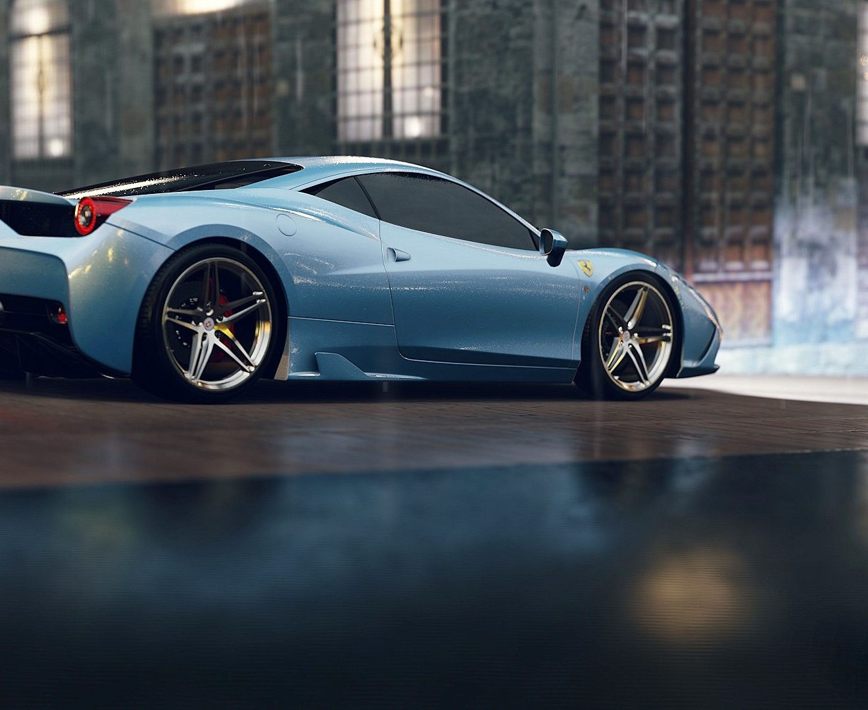
Add a Slide Title - 5

