Slide 1
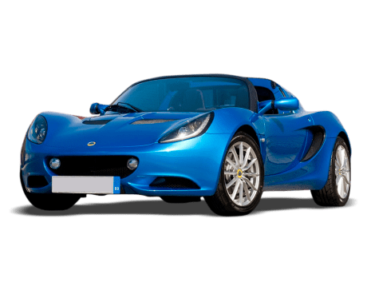
Used Car Analysis
Capstone Project
Author : Carla Kirby
This Photo by Unknown Author is licensed under CC BY-NC

Slide 2
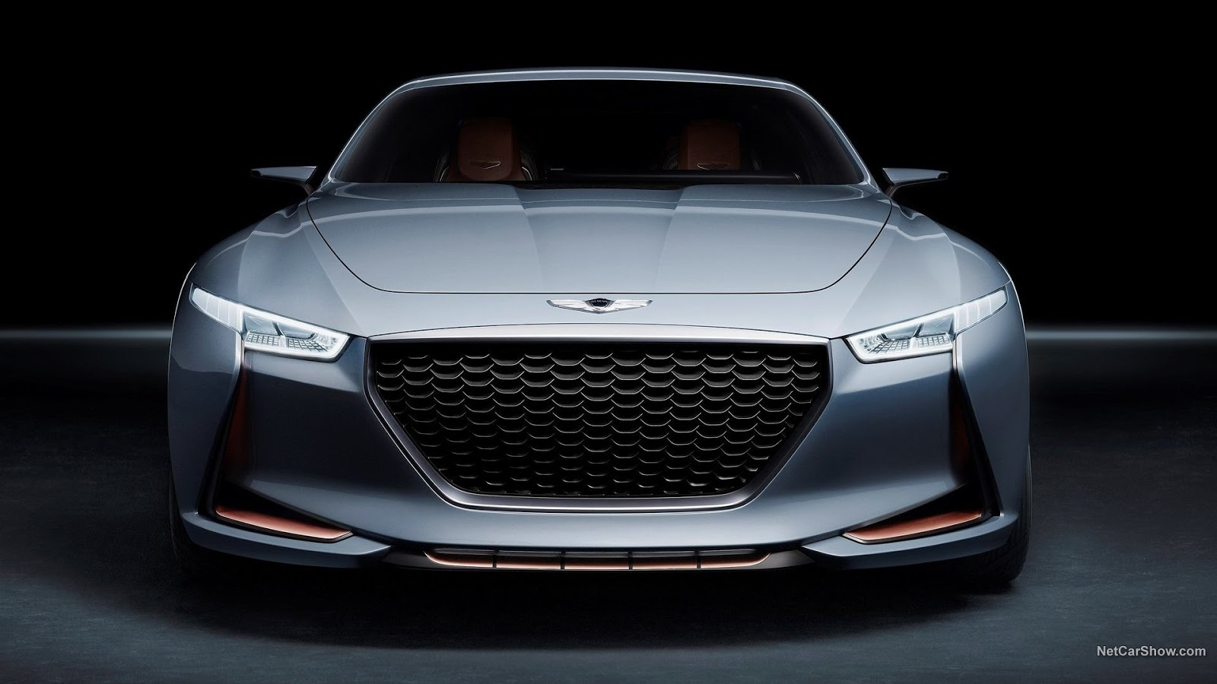
Discussion Points
Business Problems data aims to solve
Data
Process Methods Used
Visualizations
Results
Summarize Conclusions

Slide 3
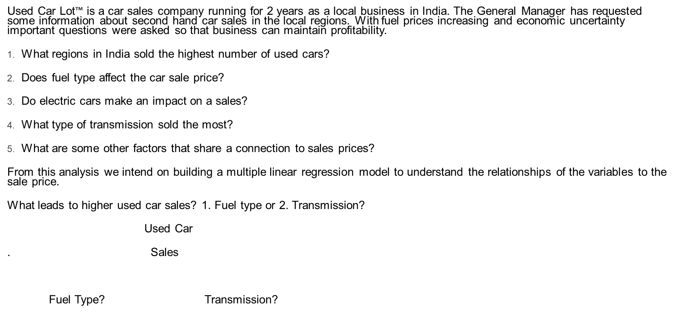
Business Problem
Used Car Lot$™$ is a car sales company running for 2 years as a local business in India. The General Manager has requested some information about second hand car sales in the local regions. With fuel prices increasing and economic uncertainty important questions were asked so that business can maintain profitability.
What regions in India sold the highest number of used cars?
Does fuel type affect the car sale price?
Do electric cars make an impact on a sales?
What type of transmission sold the most?
What are some other factors that share a connection to sales prices?
From this analysis we intend on building a multiple linear regression model to understand the relationships of the variables to the sale price.
What leads to higher used car sales? 1. Fuel type or 2. Transmission?
Used Car
. Sales
Fuel Type? Transmission?

Slide 4
Large Dataset size is over 7200 line - Source of used cars sold in India. The dataset is comprised of values such as mileage, year built, power, seats, engine type, kilometers driven and the price. Sourced from data.gov, a reliable data source online. Dataset required much categorical refinement in order to prepare for exploratory analysis. Data analysis packages consisted of matplot lib, numPy, pandas, statsmodels, and scikitlearn.
Data

Slide 5
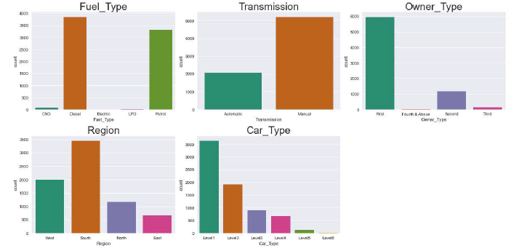
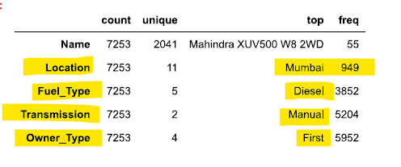
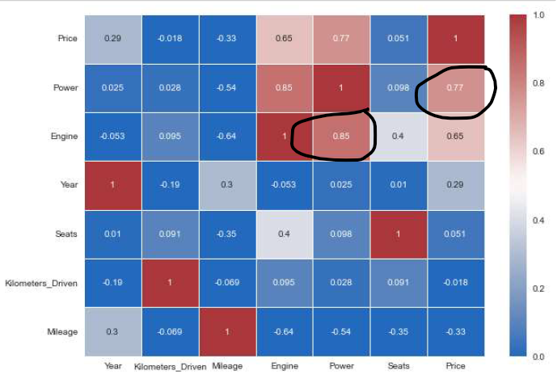
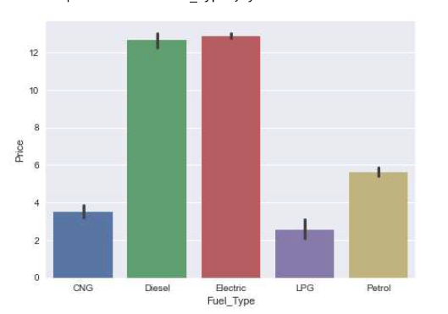
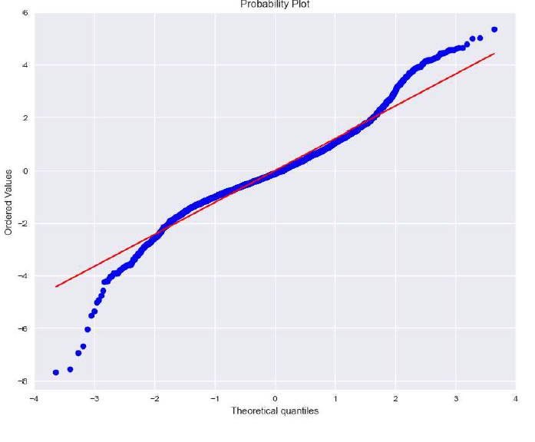
Models & Visualizations

Slide 6
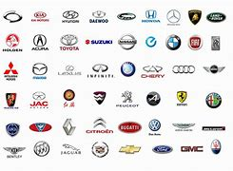
Results
1. Top Region in India that sold the most cars is Mumbai
8. Manual Cars sold for less than automatic
2. Diesel is the preferred fuel type
3. Electric vehicles sold are in similar price range of diesel fueled premium cars
7. Transmission & Owner type are negatively correlated
6. Price has a high correlation with Power
4.Year, mileage, number of seats and power have a positive correlation with sale price
5. Top 5 Used Cars sold in India were: Maruti, Hyundai, Honda, Toyota, Mercedes Benz
What regions in India sold the highest number of used cars? :
Does fuel type affect the car sale price?
Do electric cars make an impact on a sales
What are some other factors that share a connection to sales prices
Best Sellers Maruti, Hyundai, Honda, Toyota, Mercedes Benz
Price has a high correlation with Power
Transmission & Owner type are negatively correlated
Manual Cars sold for less than automatic

Slide 7
Conclusions
Electric Fuel Price & Diesel scored the highest based on the data set directly affecting the cost of the car. Petrol, LPG, and CNG vehicles were sold for less.
Transmission and owner type have a negative correlation to Price
Conclude that the OLS3 is a good model for inference and prediction with an adjusted R2 value of 95.1% - refer to Jupyter notebook
Electric car impact directly aligns with price with slight multicollinearity to fuel consumption biases.

Slide 8
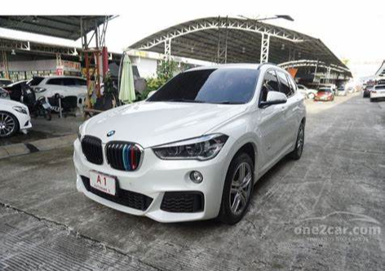
Questions?

