Slide 1
INFORMATION RETRIEVAL
CHAPTER 1:
INTRODUCTION

Slide 2


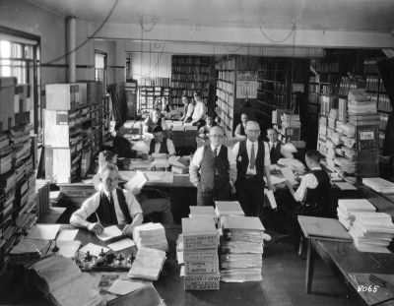
Information Retrieval
Concerned with the:
  Representation
  Storage
  Organization of, and
  Access to
Information items.

Slide 3
Motivation
Focus is on the user information need
Example user information need:
  Find all docs containing information on college tennis teams which: (1) are maintained by a USA university and (2) participate in the NCAA tournament.
Emphasis is on the retrieval of information (not data)

Slide 4
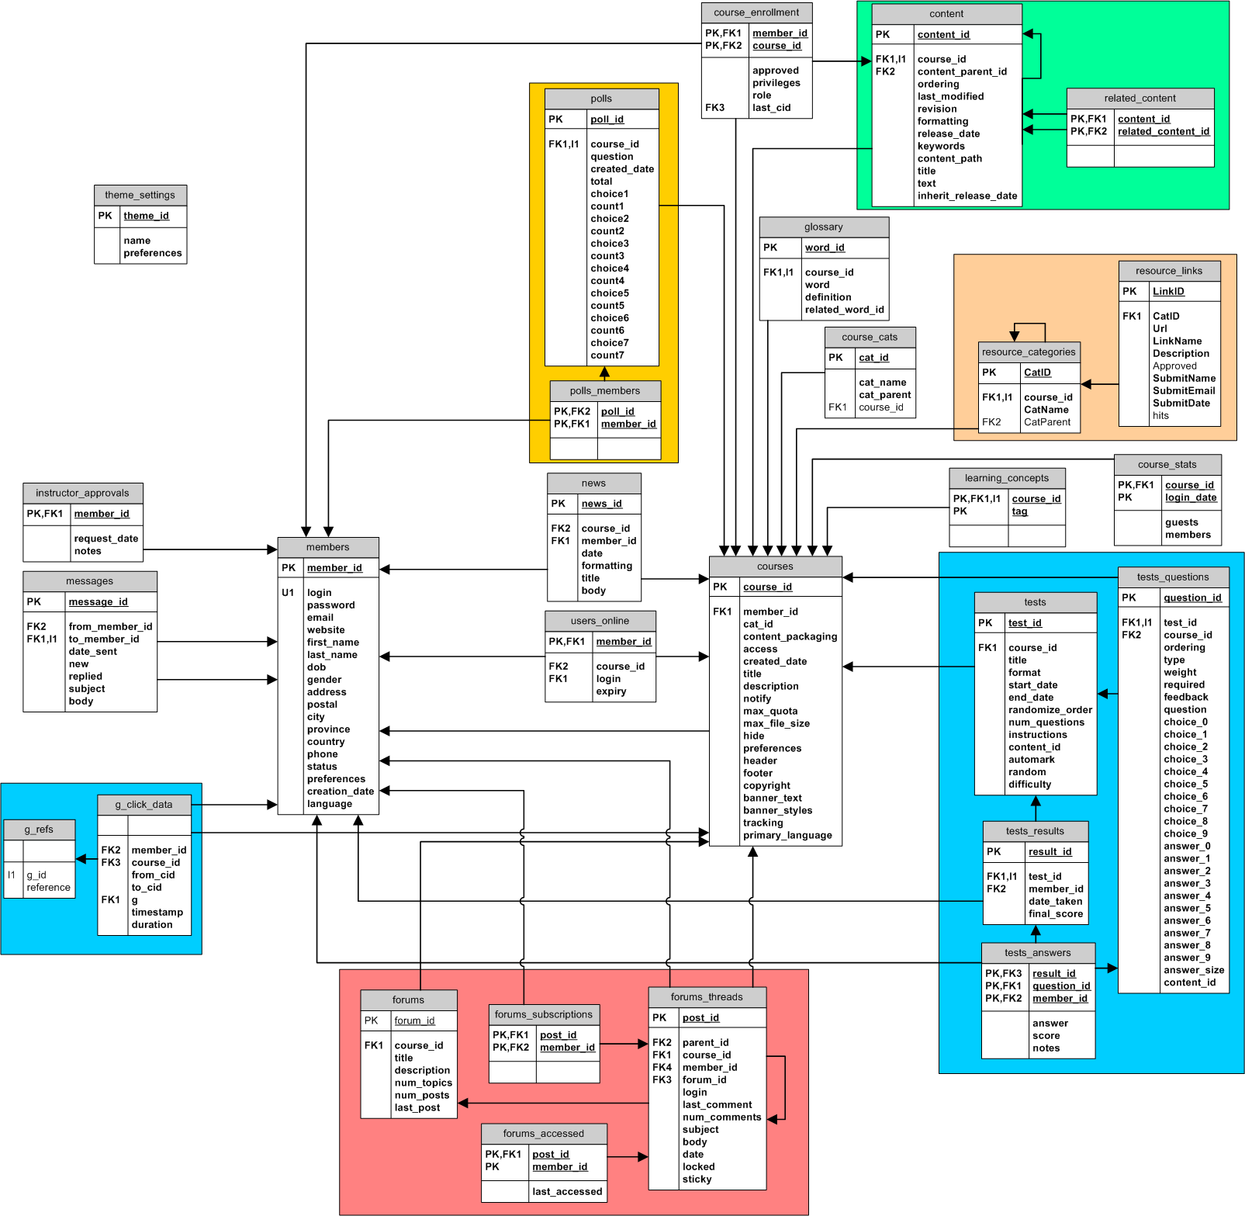
Data vs. Information Retrieval
Data retrieval
  Task: which docs contain a set of
  keywords? (think database)
  Well defined semantics
  A single erroneous object implies
  failure!
Information retrieval
  Task: get information about a subject
  or topic – task is user’s task rather than system’s task
  Semantics are frequently loose
  Errors are unavoidable and tolerated
IR system:
  Interpret contents of information items
  Generate a ranking which reflects relevance
  Notion of relevance is most important

Slide 5
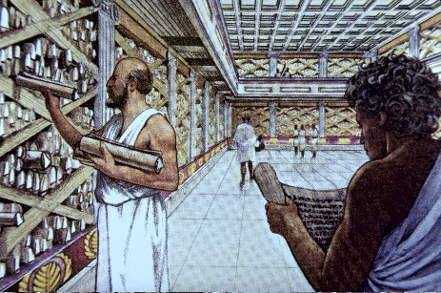
Brief History of IR
IR began with human systems
Information
Collections
  Indexed
  Searched
  Selected
by humans.

Slide 6
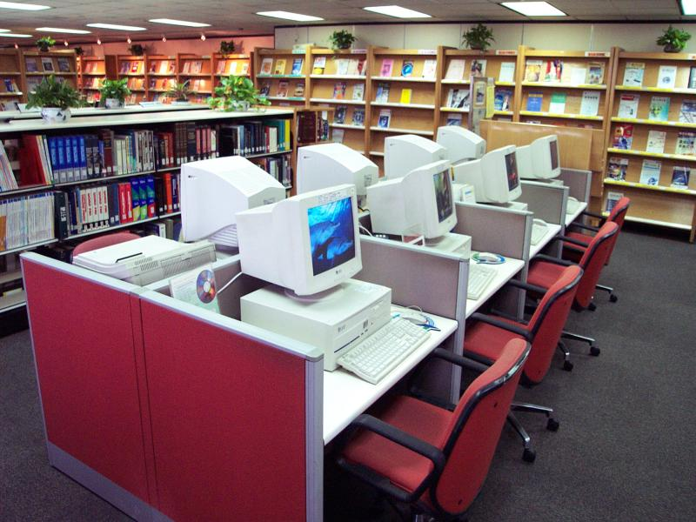
Brief History of IR
IR as a CS field (80s & early 90s):
  classification and
  categorization
  systems and
  languages
  user interfaces
  and visualization
Still, area was seen as of narrow interest

Slide 7
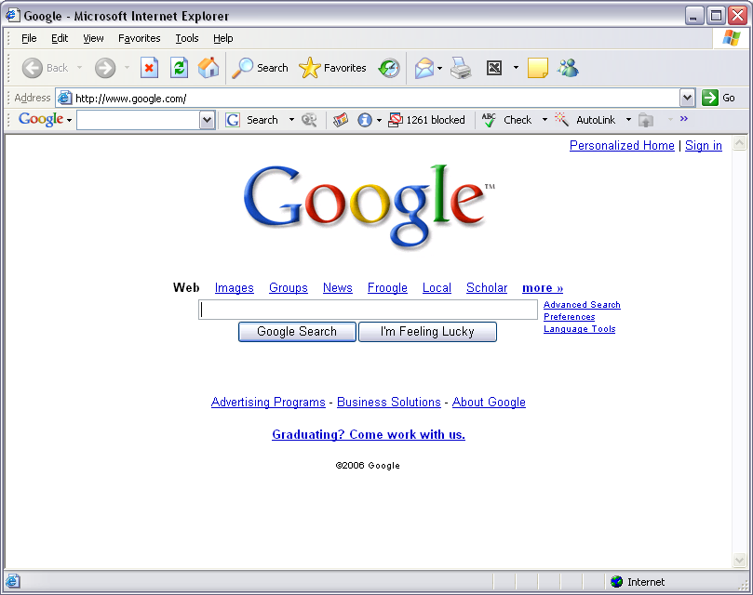
Recent History of IR
Advent of the Web changed this perception
  universal repository
  of knowledge
  free (low cost)
  universal access
  no editorial board
  many problems:
  IR seen as key to
  finding the solutions!
Increased capability for sharing personal collections of text and other media

Slide 8
Basic Concepts:
Effective retrieval of relevant information are directly affected by
1. The User Task
  Retrieval
    information or data
    precise request, purposeful
  Browsing
    glancing around
    navigation through associations
Retrieval
Database
Browsing

Slide 9

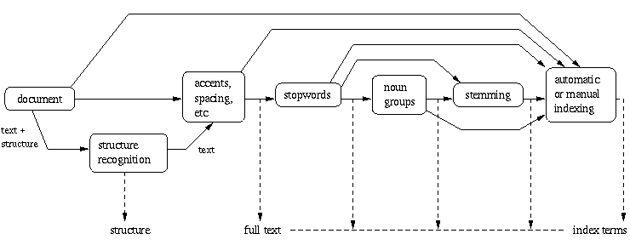
Logical View of Document : from full text to set of index terms.

Slide 10
Logical view of the documents
 Due to historical reasons, documents in a collection are frequently represented through a set of index terms or keywords.
 Such keywords might be extracted directly from the text of the document or might be specified by a human subject.
 No matter whether these representative keywords are derived automatically or generated by a specialist, they provide a logical view of the document.
 Modern computers are making it possible to represent a document by its full set of words. In this case, we say that the retrieval system adopts a full text logical view of the documents.

Slide 11
With very large collections, however, even modern computers might have to reduce the set of representative keywords.
This can be accomplished through the elimination of stopwords (such as articles and connectives), the use of stemming (which reduces distinct words to their common grammatical root), and the identification of noun groups (which eliminates adjectives, adverbs, and verbs).
These operations are called text operations (or transformations).
Text operations reduce the complexity of the document representation and allow moving the logical view from that of a full text to that of a set of index terms.

Slide 12
The Retrieval Process
User
Interface
Content
user need
Content
Content Processing & Operations
logical view
logical view
Query
Operations
DB Manager
Module
Indexing
user feedback
query
inverted file
Searching
Index
retrieved docs
Content
Database
Ranking
ranked docs

Slide 13
The Retrieval Process
We use a simple and generic software architecture .
First, before the retrieval process can even be initiated, it is necessary to define the text database.
This is usually done by the manager of the database, which specifies the following:
(a) The documents to be used
(b) The operations to be performed on the text
(c) The text model (i.e., the text structure and what elements can be retrieved).
The text operations transform the original documents and generate a logical view of them.

Slide 14
Once the logical view of the documents is defined, the database manager (using the DB Manager Module) builds an index of the text.
An index is a critical data structure because it allows fast searching over large volumes of data.
The most popular index structure is the inverted file.

Slide 15
Given that the document database is indexed, the retrieval process can be initiated.
The user first specifies a user need which is then parsed and transformed by the same text operations applied to the text.
Then, query operations might be applied before the actual query, which provides a system representation for the user need, is generated.
The query is then processed to obtain the retrieved documents.
Fast query processing is made possible by the index structure previously built.
Before been sent to the user, the retrieved documents are ranked according to a likelihood of relevance.

