Slide 1

ADIDAS Sales Report

Slide 2
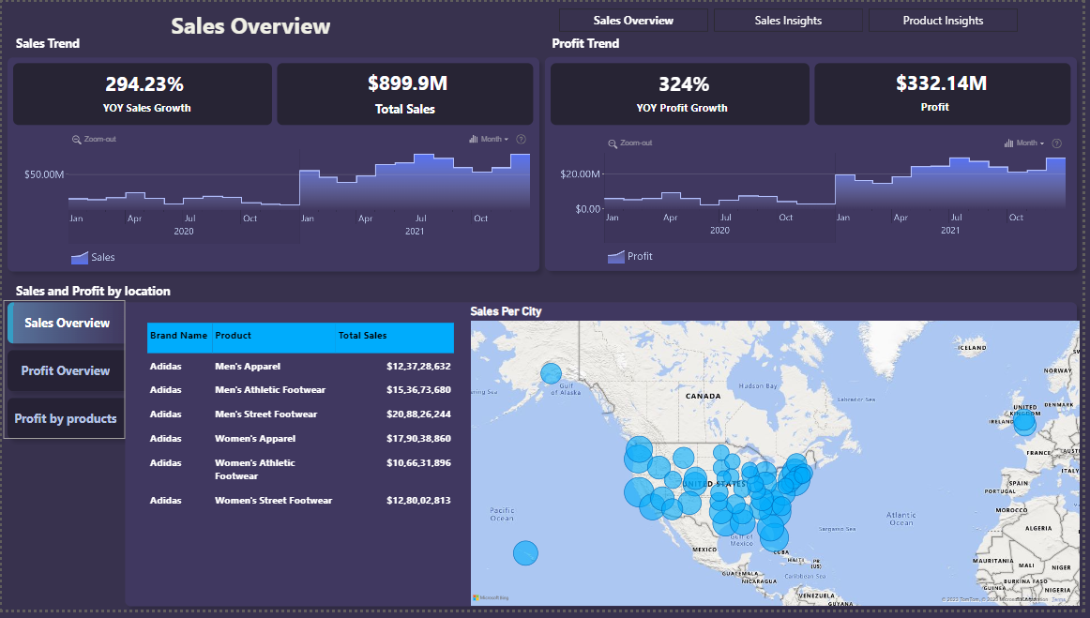
Sales Overview Report

Slide 3
Sales Overview KPI’S
YoY% Profit growth
$899.9 M
Total Profit
294.23%
324 %
Total Sales
$332.14 M
YoY% Sales growth

Slide 4
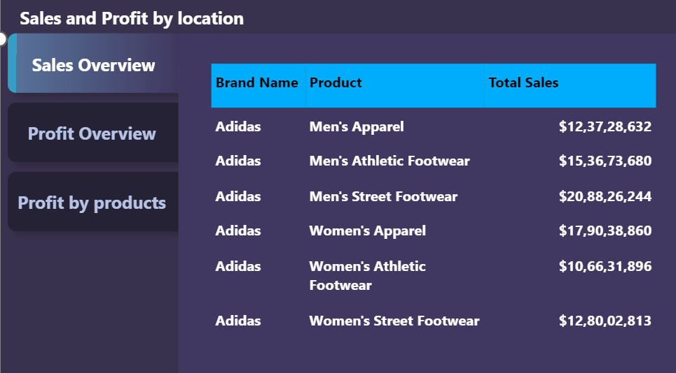
"The product-wise sales report” out of Six products The highest-selling product is Men's Street Footwear with total sales of "$208.83 million.", and the last product in terms of sales is Women's Athletic Footwear with total sales of "$106.63 million."

Slide 5
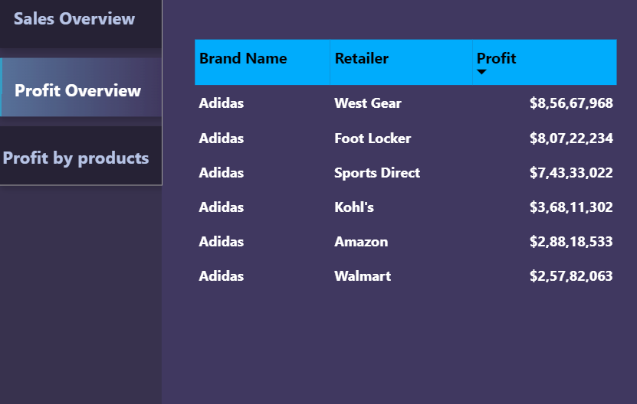
"The Retailer - wise Profit report” out of Six products The highest-profit retailer is West Gear with total Profit of "$85.67 million“ and the last Retailer in terms of profit is Walmart of “$25.78 million”

Slide 6
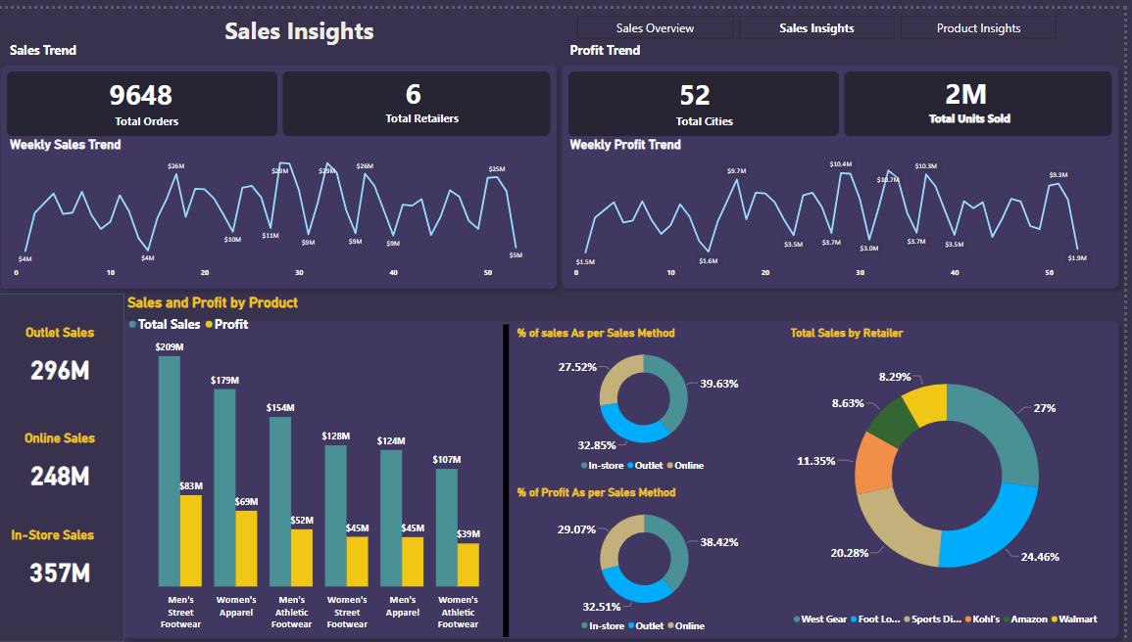
Sales Insights Report

Slide 7
Product wise sales and Profit
$ 209 M
$ 83 M
$ 179 M
$ 154 M
$ 128 M
Sales
Profit
Men Street Foot Ware
01
02
Women Appareal
$ 69 M
Men Atheltic footware
03
$ 52 M
Women street Foot ware
04
$ 45 M
men Apparel
05
$ 45 M
$ 124 M
Women Atheltic footware
06
$ 107K
$ 39 M

Slide 8
% of Sales
39.63%
32.85%
27.52%
% of Sales and Profit by Sales Methods
% of Profit
Instore
38.42%
Outlet
32.51%
Online
29.02%

Slide 9
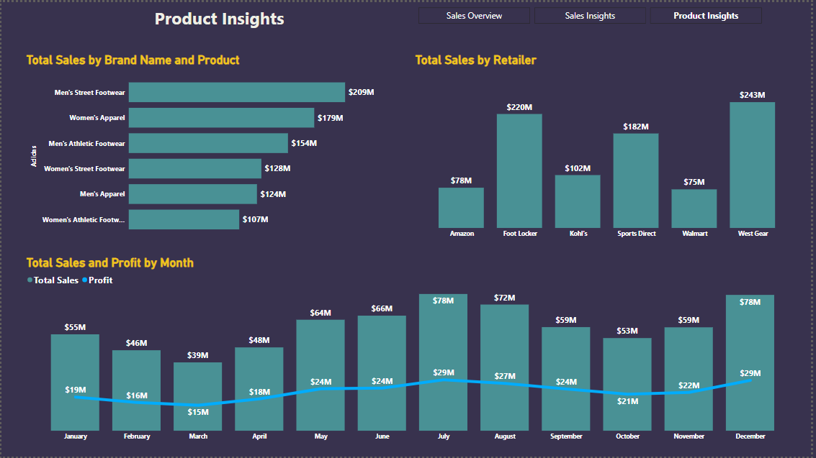
Product Insights Report

Slide 10
Retailer wise Sales
Amazon
$78 M
$182 M
Sports Direct
Foot Walker
$220 M
$ 75 M
Walmart
Kohl’s
$ 102 M
West Gear
$243 M

Slide 11
Thank You

