Slide 1

Hospitality Analysis

Slide 2
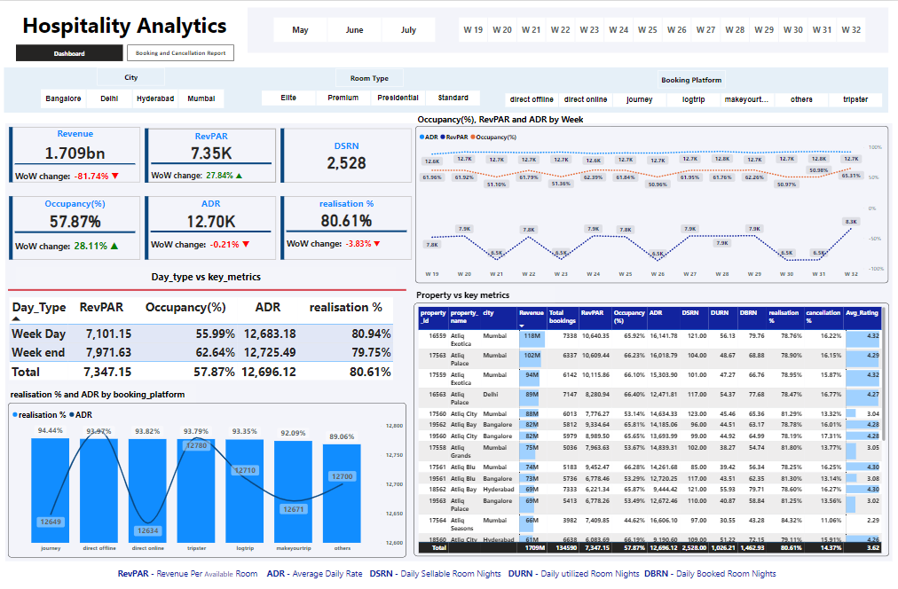

Slide 3
Key Metrics
1.709B
12.70 K
Revenue
ADR
7.25 K
57.87 %
RevPAR
Occupancy %
2528
80.61%
Realisation
DSRN

Slide 4
Day type Breakdown
ADR
RevPAR
Occupancy %
Week Day
12.6 K
7.1K
55.99 %
Week End
12.7 K
7.9 K
62.64 %

Slide 5
Booking Platform wise ADR and Realisation
94.44 %
12.79 K
Journey
Direct Offline
Realisation
ADR
89.06 %
12.63 K
Direct Online
Others

Slide 6
Month wise ADR,occupancy,RevPAR
Month-wise analysis reveals slight fluctuations in ADR, occupancy rates, and RevPAR over the entire three-month period. These metrics exhibit minor variations across different months, suggesting relatively stable performance trends throughout the analyzed timeframe. occupancy

Slide 7
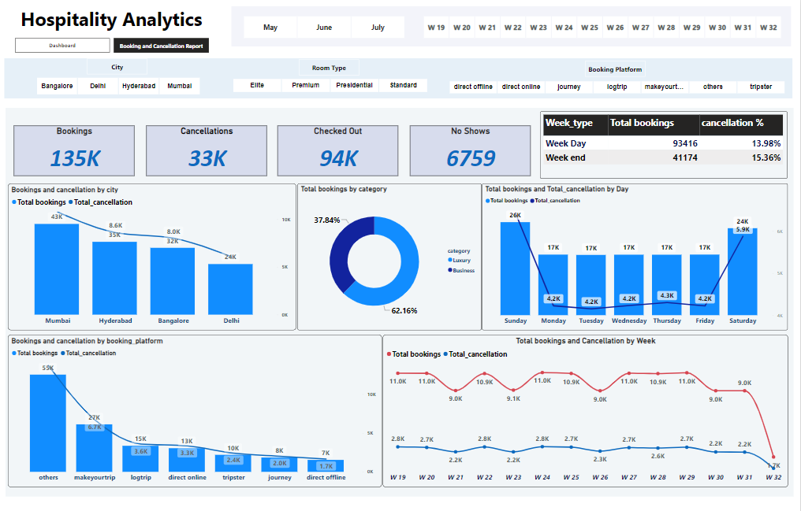

Slide 8
Metrics
135 K
33 K
Total Bookings
Cancellations
94 K
6759
Checked Out
No Shows

Slide 9
Day Type Breakdown
Bookings
Cancellations %
Week Day
93.41 K
13.98%
Week End
41.17 K
15.36%

Slide 10
Category wise Bookings
Luxury
62.16 %
Business
37.84 %

Slide 11
City wise Breakdown
Delhi
Mumbai
Bookings
Bookings
43 K
24 K
Cancellation
Cancellation
10.7 K
6.02 K

Slide 12
Day Wise Break Down
Sunday
Bookings | 26 K
Cancellations | 6.4 K
Saturday
24 K
5.9 K
Remaining Days
17 K
4.2 K

Slide 13
Booking Platform wise Bookings & Cancellation
Bookings through the Others platform total 55K, but it also experiences the highest number of cancellations at 13.69K.
Conversely, bookings via the Direct offline platform are lower at 7K, but cancellations are also fewer, with only 1.7K.

Slide 14
Week wise wise Bookings & Cancellation
Week 19 demonstrates higher bookings and cancellations, with 11K bookings and 2.8K cancellations
Conversely, in Week 32, bookings are lower at 1.7K, with cancellations also reduced to 396.

Slide 15
Thank You

